Slide 1
Restaurant Analysis of swiggy Food Delivery Services
Harish Kumar . S
MBE-12

Slide 2
Description
Top 10 Areas with Most Restaurants.
Most Popular Food Types Served by Swiggy Restaurants in Each City.
Top Rated Swiggy Restaurants (In Percentage).
Correlation of Factors Affecting Average Rating.
Correlation Between Restaurant Price and Average Rating.
City-wise Restaurant Count.
Price Analysis.
Delivery Time Analysis.
Cuisine Analysis.
Area-wise Restaurant Analysis.
Correlation Analysis.
Customer Feedback Analysis.
Geographical Mapping.
Business Recommendations for swiggy.
Conclusion.

Slide 3
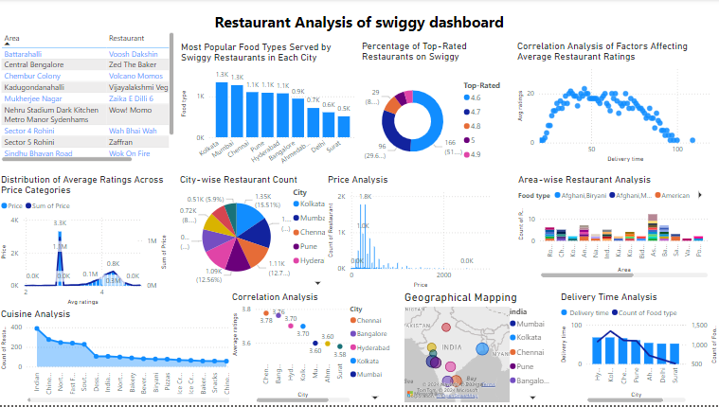

Slide 4
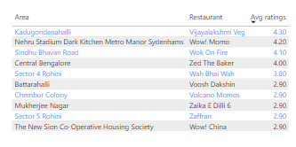
Top 10 Areas with Most Restaurants
From this chart, I understand that:
The top 10 areas with the most restaurants are clearly identified with the areas and ratings
Areas with the highest number of restaurants likely have higher competition for businesses.
Some areas may be more restaurant-dense, showing strong demand for dining options.
Top-ranking areas may also indicate popular or central neighborhoods, such as near business districts or tourist spots.
Areas with fewer restaurants might represent growth opportunities for new restaurants or less competition.

Slide 5
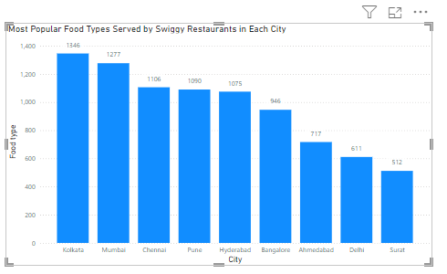
Most Popular Food Types Served by Swiggy Restaurants in Each City
From this chart, I understand that:
Clustered Column Chart" titled "Most Popular Food Types Served by Swiggy Restaurants in Each City." It presents data on the popularity of different food types by city. The y-axis represents the count of food types, while the x-axis lists various cities.
Key Insights from the Clustered Column Chart
The clustered column chart provides a comparative view of the number of popular food types served across major cities in India, based on Swiggy's restaurant data. Below are the key observations:
Kolkata leads with the highest number of popular food types, offering a total of 1,346 different food types.
Mumbai follows closely behind, with 1,277 food types, ranking second.
Chennai, Pune, and Hyderabad also show strong representation, each offering over 1,000 food types, showcasing their significant food diversity.
Bangalore and Ahmedabad exhibit moderate popularity, with 946 and 717 food types, respectively.
On the lower end, Delhi and Surat have fewer food types, with 611 and 512 food types, respectively.

Slide 6
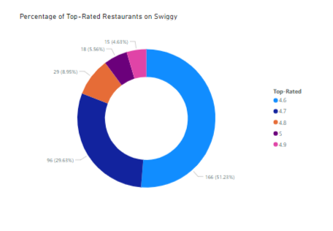
Top Rated Swiggy Restaurants (In Percentage)
From this chart, I understand that:
those with an average rating above 4.5).
Most common ratings are 4.6 (51.23%) and 4.7 (29.63%), showing that most top-rated restaurants fall in these ranges.
Higher competition exists in these rating categories, as many restaurants share similar ratings, making it harder to stand out.
Customers prefer consistent quality, as most restaurants fall in the 4.6–4.7 range, indicating demand for reliable, good quality food.
Mid-range ratings (4.6–4.7) likely represent popular restaurants that are good but not exceptional, attracting a broad customer base.
Fewer restaurants have ratings of 4.8 and above, suggesting growth opportunities for those aiming for top-tier quality and service.
The chart suggests market saturation in the 4.6–4.7 range but growth potential in the 4.8+ range for restaurants that can offer exceptional experiences.

Slide 7
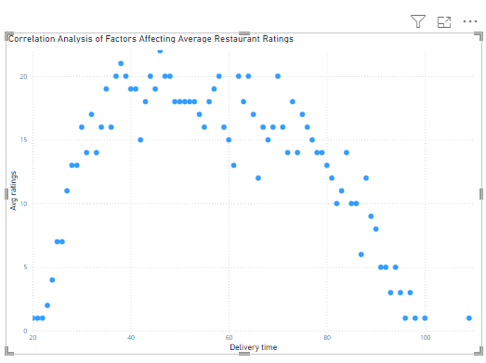
Correlation of Factors Affecting Average Rating
From this chart, I understand that:
Inverse Relationship: Ratings rise with delivery time up to a point, but then decrease as delivery time increases. Longer wait times may be acceptable to a certain extent, but not beyond that.
Peak Ratings: The best ratings are seen for delivery times around 40–60 minutes, suggesting that customers find this wait time reasonable.
Declining Ratings with Longer Waits: As delivery times exceed 60 minutes, ratings drop, indicating dissatisfaction due to longer waits or reduced food quality.
Low Ratings for Extremes: Very short or very long delivery times tend to have lower ratings, likely due to service limitations or inconvenience.
This chart shows that optimal delivery times (40–60 minutes) are key to higher customer satisfaction and better ratings.

Slide 8
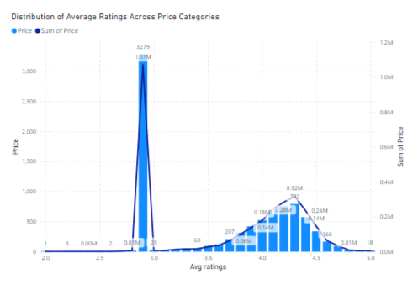
Correlation Between Restaurant Price and Average Rating
From this chart, I understand that:
Low-Rated, Low-Priced Restaurants: A lot of low-rated restaurants are in the lower price range, and they contribute significantly to the total price sum.
Higher Ratings with Higher Prices: As prices increase, there is a steady rise in average ratings, with most higher-rated restaurants falling in the mid-to-higher price range.
Decline in Ratings at Very High Prices: Extremely high-priced restaurants tend to have slightly lower ratings, showing that high prices don’t always guarantee better customer satisfaction.
Good Value in Mid-Range: Many restaurants with ratings between 4.0 and 4.5 are priced moderately, indicating customers see good value at these levels.
This chart shows that while higher-priced restaurants generally have better ratings, very high prices don't always lead to the highest ratings.

Slide 9
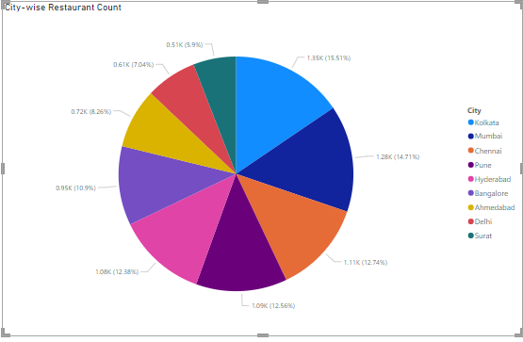
City-wise Restaurant Count
From this chart, I understand that:
City-Wise Restaurant Count Breakdown
This pie chart provides a visual distribution of the number of restaurants across different cities, with each slice representing a specific city. The size of the slice corresponds to the city's share of the total restaurant count.
Key Insights:
Kolkata: The largest share at 15.15% of total restaurants.
Chennai: A close second with 14.71%.
Mumbai: Contributes 12.74% of the total.
Bangalore: Has 12.56% of the total.
Hyderabad: Accounts for 12.38% of the total.
Cities with Smaller Shares:
Delhi: Represents 6.99%.
Ahmedabad: Makes up 7.04%.
Surat: Contributes 8.26%.
This chart visually highlights the distribution of restaurants, with Kolkata, Chennai, Mumbai, and Bangalore forming the largest segments.

Slide 10
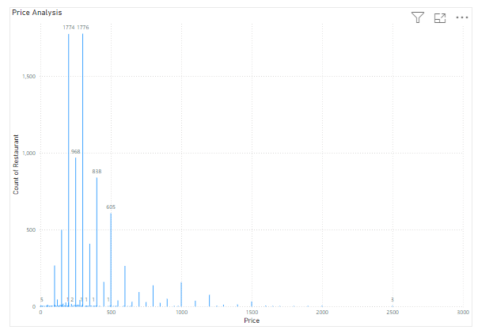
Price Analysis
From this chart, I understand that :
Concentration at Lower Price Points: Most restaurants are clustered in the low price range (around 100–200), with the highest number of restaurants in this range.
Right-Skewed Distribution: The chart is skewed to the right, meaning there are far fewer high-priced restaurants compared to low-priced ones.
Sharp Drop in Counts at Higher Prices: After the initial price peaks (100–200), the number of restaurants drops significantly, showing fewer options as prices increase.
Outliers at Very High Prices: There are a few restaurants with very high prices (1,500–3,000), but they are rare.
Price Strategy Insights: Most restaurants target lower price ranges, catering to price-sensitive customers. There may be opportunities to stand out in higher price segments if there’s customer demand.

Slide 11
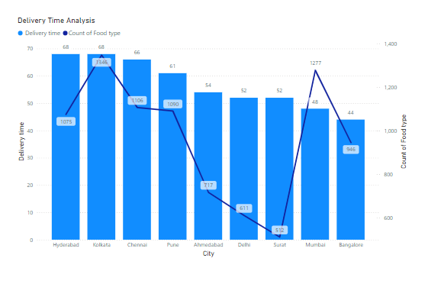
Delivery Time Analysis
From this chart, I understand that:
Cities Analyzed: The chart compares the average delivery time and food variety across Hyderabad, Kolkata, Chennai, Pune, Ahmedabad, Delhi, Surat, Mumbai, and Bangalore.
Delivery Time:Kolkata has a high average delivery time of 68 minutes, while Surat has one of the lowest delivery times at 52 minutes.Cities like Mumbai have a lower delivery time (48 minutes) compared to others with a larger variety of food options.
Food Variety:Mumbai offers the largest variety of food types (1277), whereas Surat has the least variety (592).There is no direct correlation between the number of food types and delivery time, as cities with high food variety, like Mumbai, often have shorter delivery times, while cities with fewer options, like Ahmedabad, may have longer delivery times.
Key Insights:Kolkata has a high delivery time but offers a relatively large food variety (1346).Mumbai manages both a high variety of food (1277) and efficient delivery (48 minutes).Surat provides a lower food variety (592) but still maintains a short delivery time.
From this analysis, I understand that cities with a larger variety of food (like Mumbai) tend to have better delivery efficiency, though the number of food types does not always predict delivery times. Factors such as logistics, infrastructure, and demand could be influencing these outcomes.

Slide 12
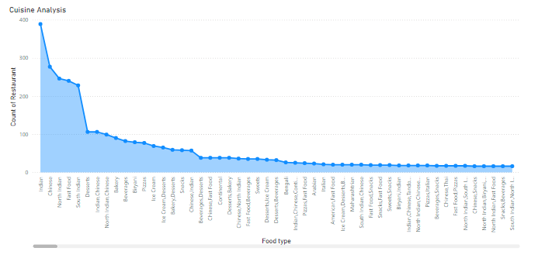
Cuisine Analysis
From this chart, I understand that:
Dominant Cuisines: Indian cuisine is the most common, with significantly more restaurants offering it compared to other cuisines. This indicates that Indian food is highly preferred in the area or dataset.
Gradual Decline in Variety: After the most popular cuisines, such as Indian, North Indian, and Chinese, the number of restaurants offering these cuisines gradually decreases, suggesting broad popularity for some types but a wider range of less common options.
Long Tail of Niche Cuisines: The chart shows a long tail, representing many niche or specialized cuisines with fewer restaurant offerings. This indicates that while diverse food options exist, they are not as widely available.
Emerging or Specialized Cuisines: At the far right, there are some cuisines with minimal representation, which could indicate emerging trends or very specialized food options.
Overall, from this chart, I understand that the food market is dominated by a few widely popular cuisines but also has a rich variety of niche options, which may present opportunities for growth or highlight consumer preferences for more specialized offerings.

Slide 13
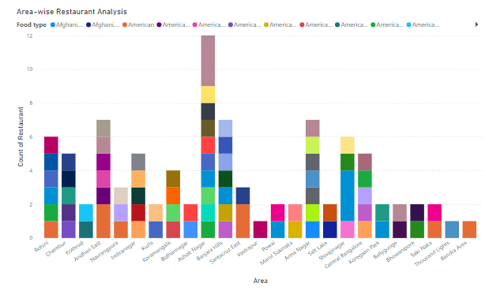
Area-wise Restaurant Analysis
From this chart, I understand that the objective is to analyze the distribution of restaurants by area, categorized by food types, using a stacked column chart. Here are the key insights:
Visualization Details:
The x-axis represents various areas within the city.
The y-axis displays the count of restaurants.
Different food types are represented by distinct colors in the stacked columns.
Notable Observations:
High Restaurant Concentration: Some areas (e.g., "Shaikh Zayed") show significantly more restaurants compared to others.
Food Type Diversity: The distribution of food types varies between areas. Some areas have a diverse range of food types, while others may have only a few predominant ones
Comparative Analysis: Certain areas (e.g., "Barsha" or "Jumeirah") also have a noticeable variety and quantity of restaurants, but not as high as the peak areas.

Slide 14
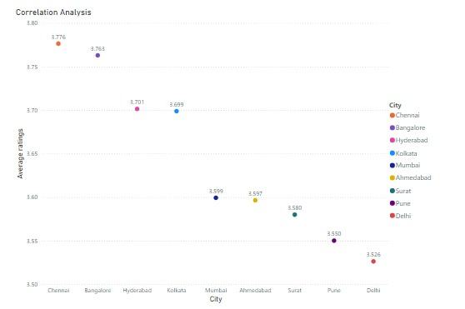
Correlation Analysis
From this chart titled "Correlation Analysis," I understand that the analysis investigates the correlation between average ratings and different cities. The line chart uses the cities on the x-axis and the average ratings on the y-axis. Here are the key insights:
Highest Ratings: Chennai and Bangalore have the highest average ratings, with values of 3.776 and 3.763, respectively. These cities might indicate a higher customer satisfaction in terms of service or product quality.
Moderate Ratings: Hyderabad, Kolkata, and Mumbai have average ratings close to each other, in the range of 3.701 to 3.599.
Lower Ratings: Cities like Pune and Delhi have lower average ratings, with Delhi having the lowest at 3.526. This could reflect room for improvement in areas like service quality or other related factors.
Distribution Overview: The ratings decrease gradually as we move from Chennai to Delhi, suggesting some possible patterns or variations in customer satisfaction across cities.
This analysis could prompt further investigation into factors affecting these ratings, such as pricing, delivery time, or other variables that might contribute to these differences.

Slide 15
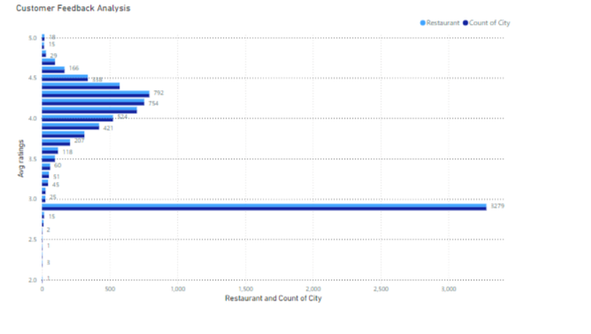
Customer Feedback Analysis
From the "Customer Feedback Analysis" chart, I understand the following key insights:
Average Rating Distribution: Most restaurants have ratings around 3.0, suggesting moderate customer satisfaction.
Rating Frequency: The 3.0 rating is the most common, with 1,279 instances, showing that many restaurants receive average ratings.
High Ratings: Ratings above 4.0 are less common but still significant, indicating some restaurants perform very well.
Low Ratings: Very few restaurants have ratings below 3.0, indicating generally positive customer feedback.
Customer Satisfaction: Most customers are moderately satisfied.
Quality Distribution: While many restaurants are rated averagely, some standout restaurants have high ratings.
Improvement Areas: Low ratings are rare but may indicate areas for improvement.
The clustered bar chart clearly shows rating distribution and trends. For deeper insights, additional charts like histograms could be useful.
Overall, the chart highlights both areas of strength and potential improvement for restaurants.

Slide 16
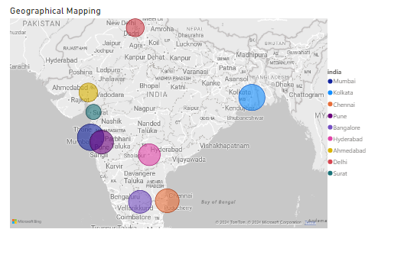
Geographical Mapping
From this chat, I understand that the geographical map visualization of restaurant locations in India provides insights into the financial impact of the restaurant market in different cities. Here are the key points:
Bubble Size and Price Sum:Larger bubbles in cities like Mumbai and Bangalore indicate either more restaurants or higher-priced dining options, while smaller bubbles in cities like Surat and Ahmedabad suggest fewer or more budget-friendly restaurants.
Restaurant Density:Cities with high-density areas like Pune and Chennai show a strong restaurant market, while cities like Ahmedabad may have potential for growth in the restaurant industry.
Regional Differences:Western and Southern regions have larger bubbles, reflecting a thriving restaurant culture, likely driven by urbanization and economic growth. High-density areas are ideal for niche dining, while emerging cities could benefit from well-established restaurant chains.
Legend and Data Clarity:The color-coded legend helps quickly compare cities and understand regional differences.
Accuracy:Latitude data ensures accurate representation of restaurant locations, which aids in geographic market research.
The bubble size reflects the financial weight of the restaurant market in each city, helping to identify cities with strong restaurant markets and those with growth opportunities.

Slide 17
Business Recommendations for swiggy
Focus on High-Density Markets: Invest in targeted marketing and premium services in cities with high restaurant density like Pune, Chennai, Mumbai, and Bangalore to stand out in competitive areas.
Expand in Emerging Markets: Increase presence in lower-density cities like Ahmedabad, Surat, and Delhi by partnering with more restaurants, offering exclusive promotions, and improving delivery efficiency.
Capitalize on Popular and Niche Cuisines: Focus on popular cuisines like Indian, North Indian, and Chinese, while also exploring niche offerings to create a unique brand identity in the market.
Optimize Delivery Times: Focus on improving delivery efficiency, particularly in cities with long delivery times like Kolkata, by investing in logistics and real-time tracking systems.
Enhance Restaurant Ratings through Quality: Create initiatives to encourage restaurants to maintain consistency in food quality and service, while incentivizing top-rated restaurants for greater visibility
Target Price Segmentation: Develop pricing strategies that cater to both budget-conscious customers and those seeking premium experiences by offering a mix of affordable and higher-priced options.

Slide 18
Expand in Western and Southern Regions: Target high-saturation regions like Mumbai and Bangalore for premium offerings and capitalize on emerging cities with growth potential, such as Ahmedabad and Surat.
Leverage Customer Feedback: Use customer feedback to help restaurant partners improve service, food quality, and delivery times, ensuring higher customer satisfaction.
Tailor Marketing to City-Specific Preferences: Implement city-specific marketing strategies based on local food preferences, delivery time needs, and customer behavior trends.
Create a Loyalty Program: Launch loyalty programs to encourage repeat business, offering discounts, exclusive promotions, and priority services, particularly in high-density areas.
Data-Driven Marketing: Utilize customer, restaurant, and city data to personalize promotions, targeting specific segments based on price sensitivity, food preferences, and location.

Slide 19
Conclusion
Market Expansion:Focus on high-density cities (Mumbai, Bangalore, Pune, Chennai) for growth while exploring emerging markets (Ahmedabad, Surat) with less competition.
Cuisine Strategy:Prioritize popular cuisines (Indian, Chinese) but also explore niche or specialized food options to cater to diverse tastes.
Delivery Efficiency:Optimize delivery times (40–60 minutes) for higher customer satisfaction, especially in cities with longer wait times like Kolkata.
Customer Satisfaction:Maintain high-quality standards to ensure consistency, especially in the 4.6–4.7 rating range. Address low ratings in cities like Delhi and Pune.
Pricing Strategy:Target budget-conscious customers in cities like Surat while offering premium options in higher-income cities like Mumbai and Bangalore.
Data-Driven Decisions:Leverage customer feedback, delivery insights, and pricing data to drive continuous improvement and strategic partnerships.

Slide 20
Thankyou!

