Slide 1
A SYSTEMATIC APPROACH FOR ANALYZING CYBERCRIME OCCURENCES USING BIG DATA
Under the guidance of
Prof.Kavitha B. R
Submitted By
Harish Kumar S(13MSE0029)

Slide 2
INTRODUCTION
Big data is the voluminous and complex collection of data that comes from different sources such as sensors, content posted on social media website, sale purchase transaction etc. Such voluminous data becomes tough to process using ancient processing application. There are various tools and techniques in the market for big data analytics. With continually increasing population, crimes and crime rate analyzing related data is a huge issue for governments to make strategic decisions so as to maintain law and order. This is really necessary to keep the citizens of the country safe from crimes. The best place to look up to find room for improvement is the voluminous raw data that is generated on a regular basis from various sources by applying Big Data Analytics (BDA) which helps to analyze certain trends that must be discovered, so that law and order can be maintained properly and there is a sense of safety and well-being among the citizens of the country.

Slide 3
EXISTING SYSTEM
Many of the existing cyber crime investigation models are abstract in the context of law enforcement investigation and are largely restricted to the examination of a definitive technical crime scene
Existing concept deals with providing backend by using MySQL which contains lot of drawbacks i.e. data limitation, processing time is high when the data is huge and once data is lost we cannot recover
PROPOSED SYSTEM
Proposed concept deals with providing database by using Hadoop with Spark we can analyse unlimited data’s and simply add number of machines to the cluster so the results are produced in less time.
Proposed concept deals with providing database by using Hadoop tool so we can analyse unlimited data and simply add number of machines to the cluster(based on the requirements) and results are generated with less time, high throughput and cost of maintenance is also very less.

Slide 4
SYSTEM REQUIREMENTS
HARDWARE
PROCESSOR : PENTIUM IV 2.6 GHz,Intel Core 2 Duo.
RAM : 4GB DD RAM
MONITOR : 15” COLOR
HARD DISK : 40 GB
SOFTWARE
Framework : Hadoop
Operating System : cent OS
IDE : Eclipse
Database : MySQL

Slide 5
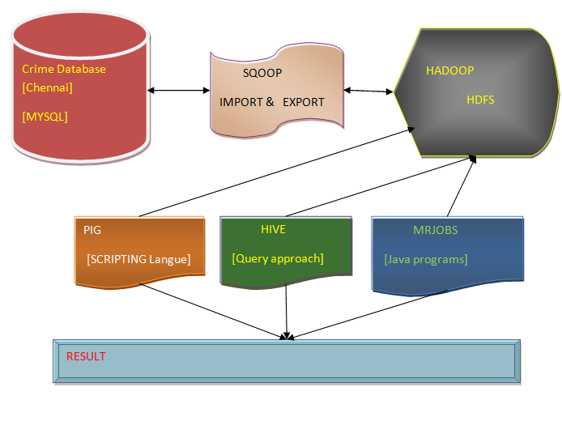
SYSTEM ARCHITECTURE DIAGRAM

Slide 6
MODULE DESCRIPTION
Data Pre-processing Model
Data Migration Model with Sqoop
Data Analytic Module with HIVE
Data Analytic Module with PIG
Data Analytic Module with MapReduce

Slide 7
THANK YOU

