Slide 1
A SYSTEMATIC APPROACH FOR ANALYZING CYBERCRIME OCCURENCES USING BIG DATA
GUIDE:
PROF.KAVITHA B R
HARISH KUMAR S
13MSE0029
Notes:
We designed this template so that each member of the project team has a set of slides with its own theme where he/she can present their research. Members, here’s how you add a new slide to just your set:
Mark where you want to add the slide: Select an existing one in the Thumbnails pane, click the New Slide button, then choose a layout.
The new slide gets the same theme as the previous one you selected.
Careful! Don’t annoy your fellow presenters by accidentally changing their themes. That can happen if you choose a theme Variant from the Design tab, which changes all of the slides in your presentation to that look.

Slide 2
Agenda / Topics
Project Description
Existing System/Proposed System
System Requirements
System Architecture Diagram
Use Case Diagram
Module Description
Dataset Description
Conclusion
Reference

Slide 3
Project Description
Big data is the voluminous and complex collection of data that comes from different sources such as sensors, content posted on social media website, sale purchase transaction etc. With continually increasing population, crimes and crime rate analyzing related data(crime data) is a huge issue for governments to make strategic decisions so as to maintain law and order.
Applying Big Data Analytics (BDA) on crime data's helps to analyze certain trends that must be discovered, so that law and order can be maintained properly and there is a sense of safety and well-being among the citizens of the country.

Slide 4
Existing System
Many of the existing cyber crime investigation models are abstract in the context of law enforcement investigation and are largely restricted to the examination of a definitive technical crime scene
Existing concept deals with providing backend by using MySQL which contains lot of drawbacks i.e. data limitation, processing time is high when the data is huge and once data is lost we cannot recover
Proposed System
Proposed concept deals with providing database by using Hadoop with Spark we can analyse unlimited data’s and simply add number of machines to the cluster so the results are produced in less time.
Proposed concept deals with providing database by using Hadoop tool so we can analyse unlimited data and simply add number of machines to the cluster(based on the requirements) and results are generated with less time, high throughput and cost of maintenance is also very less.

Slide 5
SYSTEM REQUIREMENTS
HARDWARE
PROCESSOR : PENTIUM IV 2.6 GHz,Intel Core 2 Duo.
RAM : 4GB DD RAM
MONITOR : 15” COLOR
HARD DISK : 40 GB
SOFTWARE
Framework : Hadoop
Operating System : cent OS
IDE : Eclipse
Database : MySQL

Slide 6
SYSTEM ARCHITECTURE DIAGRAM
Crime Database [Chennai]
[MYSQL]
HADOOP
HDFS
SQOOP
IMPORT & EXPORT
PIG
[SCRIPTING Langue]
HIVE
[Query approach]
MRJOBS
[Java programs]
RESULT

Slide 7
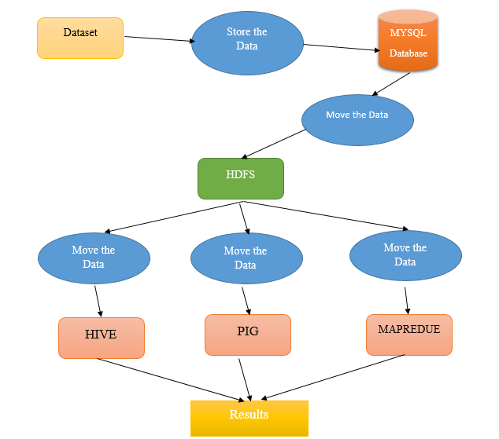
USE CASE DIAGRAM

Slide 8
Module Description
Data Pre-processing Model
Data Migration Model with Sqoop
Data Analytic Module with HIVE
Data Analytic Module with PIG
Data Analytic Module with MapReduce
Data Visualization Module with R

Slide 9
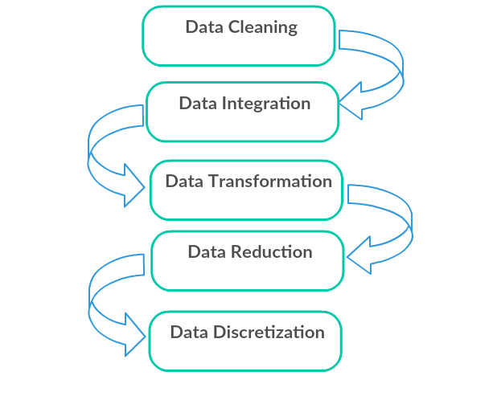
Data Pre-processing Model
In this module we have to create Data set for Crime dataset it contain set of information such that crime detail for different areas in particular Chennai city. This data set will be first provide into MySQL database with help of this dataset we analysis this project.
Datasets
Crime database(chennai)

Slide 10
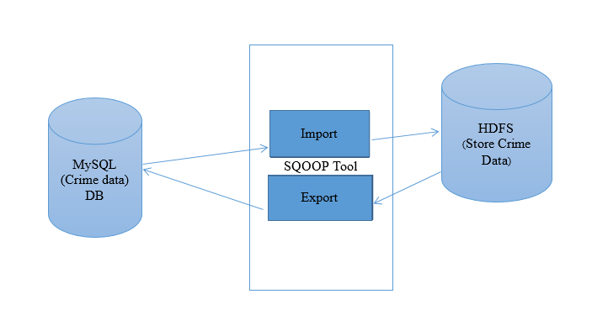
Data Migration Model with SQOOP
Transfer the dataset into hadoop(HDFS), that will be happen in this module.Sqoop is a command-line interface application for transferring data between relational databases and Hadoop
In this module we fetch the dataset into hadoop (HDFS) using sqoop Tool. Using sqoop we have to perform lot of the function, such that if we want to fetch the particular column or if we want to fetch the dataset with specific condition that will be support by Sqoop Tool and data will be stored in hadoop (HDFS).

Slide 11
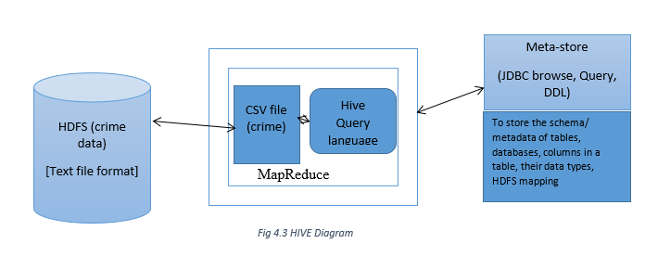
Data Analytic Module with HIVE
Hive is a data ware house system for Hadoop. It runs SQL like queries called HQL (Hive query language) which gets internally converted to map reduce jobs. Hive was developed by Facebook. Hive supports Data definition Language (DDL), Data Manipulation Language (DML) and user defined functions. IN this module we have to analysis the dataset using HIVE tool which will be stored in Hadoop (HDFS).For analysis dataset HIVE using HQL Language. Using hive we perform Tables creations, joins, Partition, Bucketing concept. Hive analysis the only Structure Language.

Slide 12
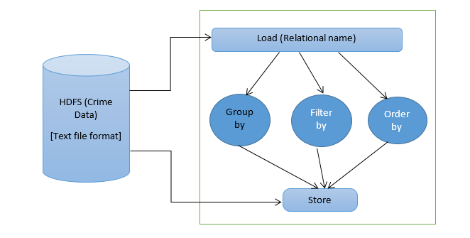
Data Analytic Module with PIG
Apache Pig is a high level data flow platform for execution Map Reduce programs of Hadoop. The language for Pig is pig Latin. Pig handles both structure and unstructured language. It is also top of the map reduce process running background. In this module also used for analyzing the Data set through Pig using Latin Script data flow language.in this also we are doing all operators, functions and joins applying on the data see the result.

Slide 13
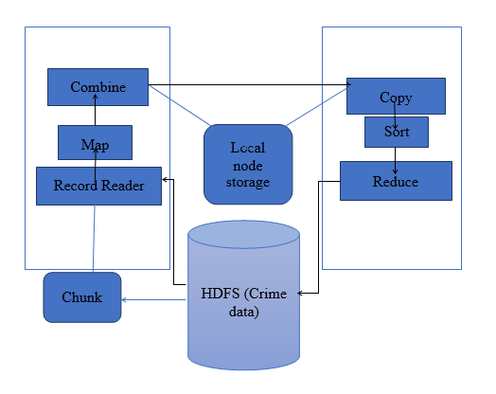
Data Analytic Module with MapReduce
MapReduce is a processing technique and a program model for distributed computing based on java. The MapReduce algorithm contains two important tasks, namely Map and Reduce.
In this module also used for analyzing the data set using MAP REDUCE. Map Reduce Run by Java Program.

Slide 14
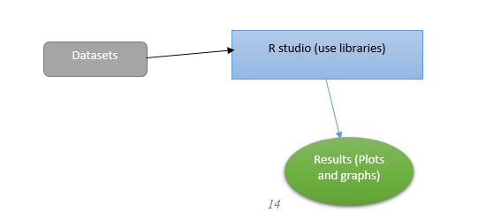
Data Visualization Module with R
Data visualization is the presentation of data in a pictorial or graphical format. It enables decision makers to see analytics presented visually, so they can grasp difficult concepts or identify new patterns. With interactive visualization, you can take the concept a step further by using technology to drill down into charts and graphs for more detail, interactively changing what data you see and how it’s processed.

Slide 15
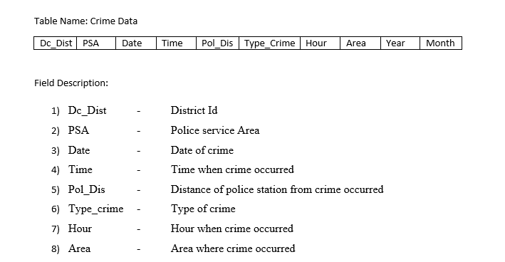
Dataset Description

Slide 16
Conclusion
Big Data Analytics refers to the tools and practices that can be used for transforming this raw data into meaningful and crucial information which helps in forming a decision support system for the judiciary and legislature to take steps towards keeping crimes in check. With the ever increasing population and crime rates, certain trends must be discovered, studied and discussed to take well informed decisions so that law and order can be maintained properly. Based on the information provided by the system the government should take necessary steps to reduce the crime in the particular area

Slide 17
Reference
[1] S. Sathyadevan, M. Devan, and S. Surya Gangadharan, “Crime analysisand prediction using data mining,” in Networks Soft Computing(ICNSC), 2014 First International Conference on, Aug 2014, pp. 406–412.
[2] T. Pang-Ning, S. Michael, and K. Vipin, Introduction to Data Mining,1st ed. Pearson, 5 2005.
[3] S. Kaza, Y. Wang, and H. Chen, “Suspect vehicle identification forborder safety with modified mutual information,” in Proceedings ofthe 4th IEEE International Conference onIntelligence and SecurityInformatics, ser. ISI’06. Berlin, Heidelberg: Springer-Verlag, 2006,pp. 308–318.
[4] V. Vaithiyanathan, K. Rajeswari, R. Phalnikar, and S. Tonge, “Improvedapriori algorithm based on selection criterion,” in ComputationalIntelligence Computing Research (ICCIC), 2012 IEEE InternationalConference on, Dec 2012, pp. 1–4.
[5] C. Chu-xiang, S. Jian-jing, C. Bing, S. Chang-xing, and W. Yun-cheng,“An improvement apriori arithmetic based on rough set theory,” inCircuits, Communications and System (PACCS), 2011 Third Pacific-Asia Conference on, July 2011, pp. 1–3.
[6] S. Kaza, T.Wang, H. Gowda, and H. Chen, “Target vehicle identificationfor border safety using mutual information,” in Intelligent TransportationSystems, 2005. Proceedings. 2005 IEEE, Sept 2005, pp. 1141–1146.

Slide 18
THANK YOU

