Slide 1
Topic modeling

Slide 2

Importance of textual data
Information extraction
Knowledge discovery
Customer understanding
Online reviews
Newspaper article

Slide 3

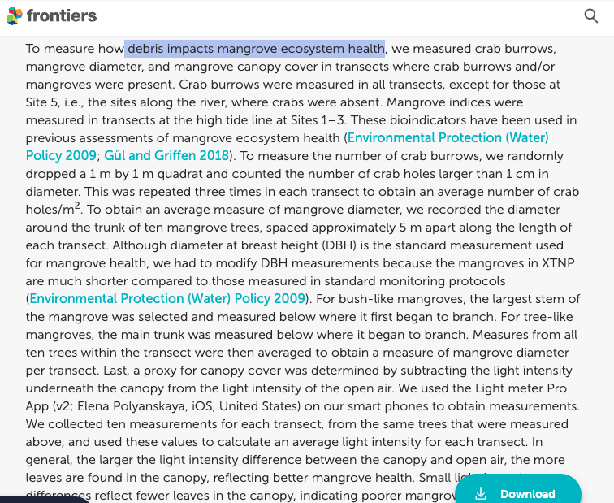
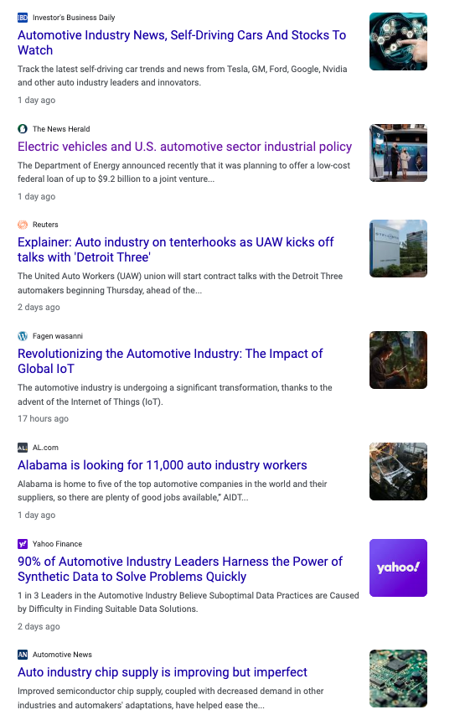
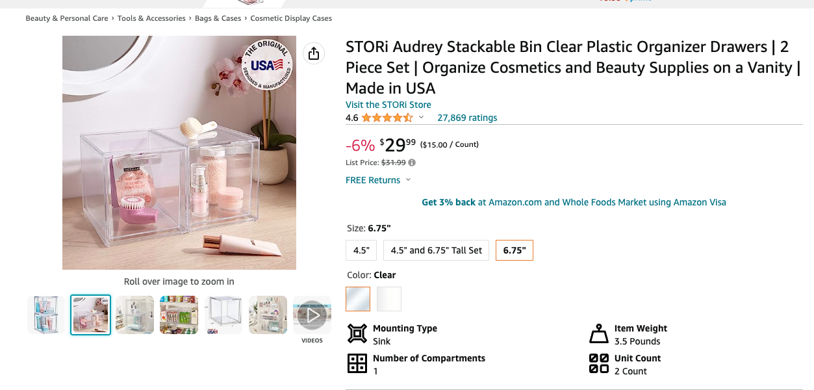
Why topic modeling?
Challenges in analyzing large volumes of textual data
Extracting meaningful insights and patterns
Introduction to topic modeling as a solution
Example
Utilizing Natural Language Processing for Review Analysis and Decision-Making.
Analyzing news articles on Automotive Industry
Analyzing to understand the impact of marine debris

Slide 4
How does topic modeling work?
Text data preprocessing
Topic modeling using BERTopic
Extract Topics from topic modeling
Topic similarities
Visualizations

Slide 5
Text Data Preprocessing
Removing stop words
Stemming
Lemmatization
Handling noisy data and special characters

Slide 6
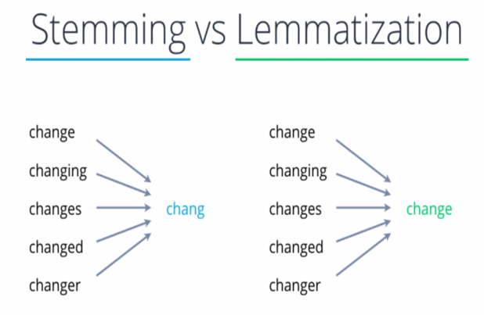

Slide 7
Topic Modeling Output
Topic | Count | Name
0 | 892 | 0_beverage bottle_beverage bottle container_bottle container_cigarette tobacco
1 | 269 | 1_cup cup_styrofoam cup_cup lid_cup cup lid
2 | 181 | 2_styrofoam piece_piece styrofoam piece_piece styrofoam_styrofoam piece styrofoam
3 | 162 | 3_water bottle_bottle water_water bottle water_bottle water bottle
4 | 132 | 4_plastic plastic_plastic plastic plastic_fishing gear_fishing gear rope
5 | 120 | 5_bag film_film bag film_film bag_bag film bag
6 | 114 | 6_bottle cap_cap bottle cap_bottle cap bottle_cap bottle
7 | 97 | 7_straw stirrer_straw stirrer straw_stirrer straw stirrer_stirrer straw
8 | 77 | 8_hard fragment_hard fragment hard_fragment hard fragment_fragment hard
9 | 59 | 9_food drink pouch_food drink_drink pouch_pouch food drink
10 | 58 | 10_chip bag_bag chip bag_bag chip_chip bag chip
11 | 58 | 11_sport equipment_sport equipment sport_equipment sport equipment_equipment sport
12 | 53 | 12_textile shoe_shoe textile shoe_shoe textile_textile shoe textile
13 | 40 | 13_medical waste_waste medical waste_waste medical_medical waste medical
14 | 27 | 14_paper paper_paper paper paper_junk mail_junk mail office
15 | 17 | 15_vehicle related_vehicle related vehicle_related vehicle related_related vehicle

Slide 8
Theme Analysis
Plastic Pollution and Single-Use Items
Medical and Hazardous Waste
Miscellaneous Debris and Small Items
Specific Waste Types
Notes:
1. Plastic Pollution and Single-Use Items:
This label includes topics that primarily focus on various forms of plastic pollution, single-use items, and their detrimental impact on marine ecosystems. These topics cover a wide range of plastic waste, including beverage bottles, packaging, cups, lids, straws, and other disposable items commonly found in marine debris. Additionally, it addresses the issue of plastic fishing gear, which poses significant threats to marine life. By grouping these topics together, we highlight the pervasive problem of plastic pollution in marine environments and the urgent need to address single-use plastic waste and its harmful consequences.
2. Miscellaneous Debris and Small Items:
This label encompasses topics that revolve around miscellaneous debris and smaller plastic items commonly found in marine debris. It includes items like medical waste, junk mail, vehicle-related debris, and other small debris fragments. While these items may not be as prominent as plastic pollution, they still contribute to litter and environmental hazards in marine ecosystems. By grouping these topics together, we recognize the importance of addressing the wide variety of debris, no matter how small, to maintain the cleanliness and health of marine environments.
3. Specific Waste Types:
This label represents topics that are focused on specific types of waste items, such as food and drink pouches, sports equipment, and textiles/metal waste. While they may not be as prevalent in the dataset compared to plastic items, they are still essential to address as they present unique challenges in waste management and recycling efforts. By grouping these topics separately, we acknowledge the significance of specific waste types and their potential environmental impact in marine environments.

Slide 9

Challenges and Limitations
Challenges in topic modeling (e.g., selecting optimal number of topics, domain-specific variations)

Slide 10
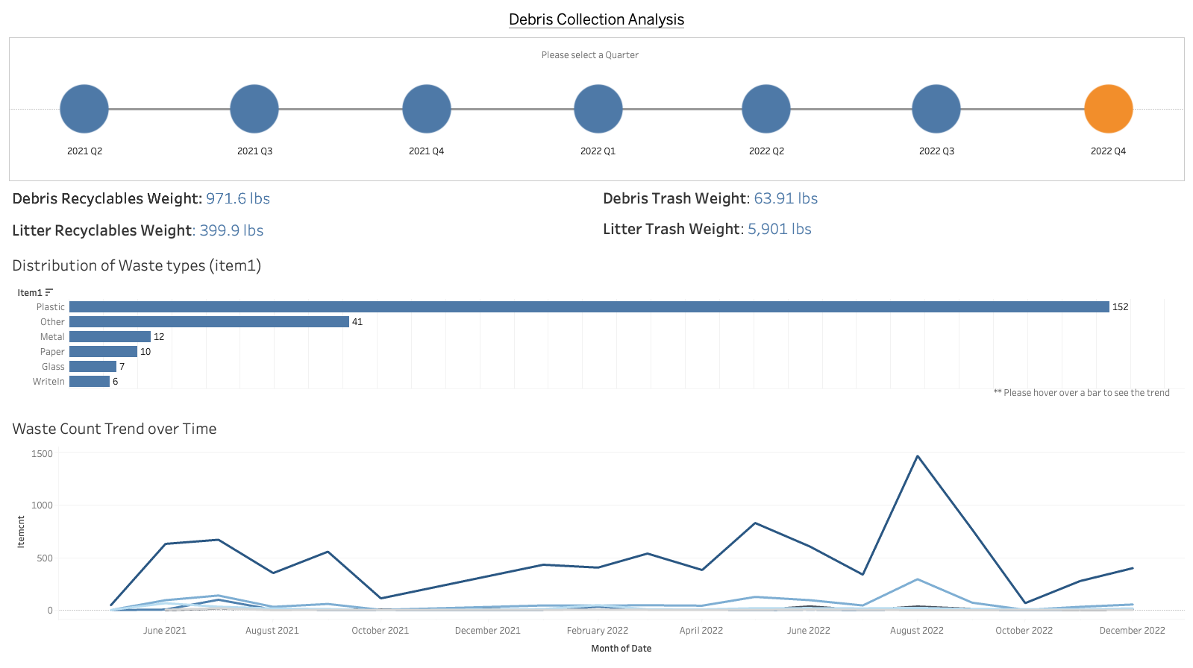

Slide 11
