Slide 1
Topic modeling

Slide 2

Importance of textual data
Information extraction
Knowledge discovery
Customer understanding
Online reviews
Newspaper article
Notes:
Information Extraction: Textual data contains a vast amount of information, ranging from articles, books, reports, emails, social media posts, customer reviews, and more. Analyzing and extracting insights from this data can provide valuable information about customer sentiments, market trends, emerging topics, and potential business opportunities.
Knowledge Discovery: Textual data analysis can uncover hidden patterns, relationships, and knowledge within the text. By applying techniques like text mining and topic modeling, organizations can extract meaningful insights, discover trends, and make data-driven decisions.
Customer Understanding: Textual data, such as customer feedback, reviews, and support tickets, provides valuable insights into customer preferences, satisfaction levels, and pain points. Analyzing this data helps businesses understand their customers better, improve products or services, and enhance customer experiences.
Online Reviews: Online reviews play a crucial role in shaping consumers' purchasing decisions. Analyzing textual reviews from platforms like e-commerce websites, social media, and review aggregators provides valuable insights into product or service performance, customer satisfaction, and areas for improvement. Sentiment analysis and opinion mining techniques help in understanding the sentiment expressed in the reviews, identifying key features or aspects being discussed, and assessing overall customer satisfaction. This information aids businesses in monitoring their online reputation, addressing customer concerns, and making informed business decisions.
Newspaper Article: Newspaper articles are a rich source of information about current events, news, opinions, and trends. Textual analysis of newspaper articles enables researchers, journalists, and organizations to understand public sentiment, track evolving topics, and gain insights into societal, economic, and political trends. Natural language processing techniques can be employed to extract key entities, detect named entities like people, organizations, and locations, and identify relationships and trends discussed in the articles. Analyzing newspaper articles helps in media monitoring, trend analysis, and obtaining a comprehensive view of current affairs.

Slide 3

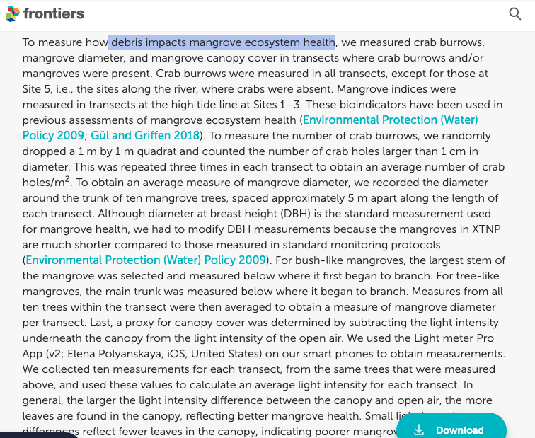


Why topic modeling?
Challenges in analyzing large volumes of textual data
Extracting meaningful insights and patterns
Introduction to topic modeling as a solution
Example
Utilizing Natural Language Processing for Review Analysis and Decision-Making.
Analyzing news articles on Automotive Industry
Analyzing to understand the impact of marine debris
Notes:
Let's consider a large collection of news articles related to the automotive industry. Manually reading and categorizing thousands of articles would be time-consuming and impractical. However, using topic modeling, we can automatically extract the main topics present in the dataset, such as "electric vehicles," "autonomous driving," "vehicle safety," "industry regulations," and so on. This allows us to quickly understand the content distribution, identify emerging trends, and gain insights into the industry without the need for manual effort.
And this is where natural language processing comes up trumps.
Analyzing to understand the impact of marine debris Certainly! Here's an example related to the Tampa Bay Estuary marine debris dataset:
- Challenges in Analyzing Large Volumes of Textual Data:
- The Tampa Bay Estuary marine debris dataset contains a vast amount of textual data, such as research papers, reports, and surveys, focused on studying and documenting marine debris in the estuary. Manually analyzing this extensive collection of text would be time-consuming and challenging.
- Extracting Meaningful Insights and Patterns:
- By applying topic modeling to the Tampa Bay Estuary marine debris dataset, we can extract meaningful insights and patterns:
- Identifying key topics: Topic modeling algorithms can uncover the main themes discussed in the textual data, such as "plastic pollution," "impact on marine life," "beach cleanup efforts," or "sources of marine debris."
- Understanding content distribution: Topic modeling reveals the prevalence and importance of each topic within the dataset, enabling us to identify which topics are most frequently discussed and potentially areas of concern.
- Document clustering and organization: Topic modeling allows us to group similar documents together based on their thematic content. For example, we can cluster research papers focusing on the impacts of marine debris on marine life or reports on cleanup initiatives.
Topic modelling is recognizing the words from the topics present in the document or the corpus of data. This is useful because extracting the words from a document takes more time and is much more complex than extracting them from topics present in the document. For example, there are 1000 documents and 500 words in each document. So to process this it requires 500*1000 = 500000 threads. So when you divide the document containing certain topics then if there are 5 topics present in it, the processing is just 5*500 words = 2500 threads.
This looks simple than processing the entire document and this is how topic modelling has come up to solve the problem and also visualizing things better.
Utilizing Natural Language Processing for Review Analysis and Decision-Making.
Unfortunately, it turned out to be a bad decision as the battery backup was well below par. I didn’t go through the reviews of the product and made a hasty decision to buy it based on its ratings alone. And I know I’m not the only one out there who made this mistake!
Ratings alone do not give a complete picture of the products we wish to purchase, as I found to my detriment. So, as a precautionary measure, I always advise people to read a product’s reviews before deciding whether to buy it or not.
But then an interesting problem comes up. What if the number of reviews is in the hundreds or thousands? It’s just not feasible to go through all those reviews, right? And this is where natural language processing comes up trumps.
Automotive industry: Imagine we have a massive collection of news articles about the automotive industry. It would be almost impossible to read and categorize each article individually. However, with topic modeling, we can automatically discover the main topics discussed in these articles, such as "electric vehicles," "autonomous driving," "vehicle safety," or "industry regulations." This gives us a quick understanding of what the articles are about and how important each topic is within the industry. It helps us navigate through the vast amount of information and extract valuable insights without having to read every single article.
- Introduction to Topic Modeling as a Solution:
- Given the challenges of analyzing the Tampa Bay Estuary marine debris dataset and the need to extract meaningful insights, topic modeling serves as a valuable solution:
- Instead of manually reading through numerous research papers and reports, topic modeling automates the process by identifying the main topics present in the dataset.
- Topic modeling provides a quantitative representation of the textual data, allowing for efficient analysis and exploration of the marine debris-related topics.
- By leveraging topic modeling, we can gain valuable insights into the patterns, trends, and areas of focus in the Tampa Bay Estuary marine debris dataset, contributing to informed decision-making and targeted mitigation efforts.

Slide 4
How does topic modeling work?
Text data preprocessing
Topic modeling using BERTopic
Extract Topics from topic modeling
Topic similarities
Visualizations

Slide 5
Text Data Preprocessing
Removing stop words
Stemming
Lemmatization
Handling noisy data and special characters

Slide 6
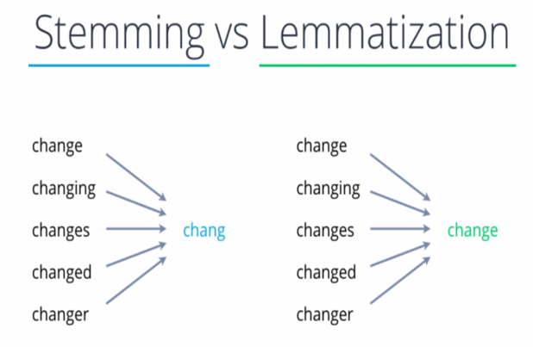
Notes:
The data transformation process involves three essential steps: removing punctuations, stemming, and lemmatization. Punctuation removal helps clean the text, while stemming reduces words to their root forms, and lemmatization converts words to their base or dictionary forms. These transformations are crucial for preparing the data for further analysis.

Slide 7
Topic Modeling Output
Topic | Count | Name
0 | 892 | 0_beverage bottle_beverage bottle container_bottle container_cigarette tobacco
1 | 269 | 1_cup cup_styrofoam cup_cup lid_cup cup lid
2 | 181 | 2_styrofoam piece_piece styrofoam piece_piece styrofoam_styrofoam piece styrofoam
3 | 162 | 3_water bottle_bottle water_water bottle water_bottle water bottle
4 | 132 | 4_plastic plastic_plastic plastic plastic_fishing gear_fishing gear rope
5 | 120 | 5_bag film_film bag film_film bag_bag film bag
6 | 114 | 6_bottle cap_cap bottle cap_bottle cap bottle_cap bottle
7 | 97 | 7_straw stirrer_straw stirrer straw_stirrer straw stirrer_stirrer straw
8 | 77 | 8_hard fragment_hard fragment hard_fragment hard fragment_fragment hard
9 | 59 | 9_food drink pouch_food drink_drink pouch_pouch food drink
10 | 58 | 10_chip bag_bag chip bag_bag chip_chip bag chip
11 | 58 | 11_sport equipment_sport equipment sport_equipment sport equipment_equipment sport
12 | 53 | 12_textile shoe_shoe textile shoe_shoe textile_textile shoe textile
13 | 40 | 13_medical waste_waste medical waste_waste medical_medical waste medical
14 | 27 | 14_paper paper_paper paper paper_junk mail_junk mail office
15 | 17 | 15_vehicle related_vehicle related vehicle_related vehicle related_related vehicle

Slide 8
Theme Analysis
Plastic Pollution and Single-Use Items
Medical and Hazardous Waste
Miscellaneous Debris and Small Items
Specific Waste Types
Notes:
1. Plastic Pollution and Single-Use Items:
This label includes topics that primarily focus on various forms of plastic pollution, single-use items, and their detrimental impact on marine ecosystems. These topics cover a wide range of plastic waste, including beverage bottles, packaging, cups, lids, straws, and other disposable items commonly found in marine debris. Additionally, it addresses the issue of plastic fishing gear, which poses significant threats to marine life. By grouping these topics together, we highlight the pervasive problem of plastic pollution in marine environments and the urgent need to address single-use plastic waste and its harmful consequences.
2. Miscellaneous Debris and Small Items:
This label encompasses topics that revolve around miscellaneous debris and smaller plastic items commonly found in marine debris. It includes items like medical waste, junk mail, vehicle-related debris, and other small debris fragments. While these items may not be as prominent as plastic pollution, they still contribute to litter and environmental hazards in marine ecosystems. By grouping these topics together, we recognize the importance of addressing the wide variety of debris, no matter how small, to maintain the cleanliness and health of marine environments.
3. Specific Waste Types:
This label represents topics that are focused on specific types of waste items, such as food and drink pouches, sports equipment, and textiles/metal waste. While they may not be as prevalent in the dataset compared to plastic items, they are still essential to address as they present unique challenges in waste management and recycling efforts. By grouping these topics separately, we acknowledge the significance of specific waste types and their potential environmental impact in marine environments.

Slide 9

Challenges and Limitations
Challenges in topic modeling (e.g., selecting optimal number of topics, domain-specific variations)

Slide 10
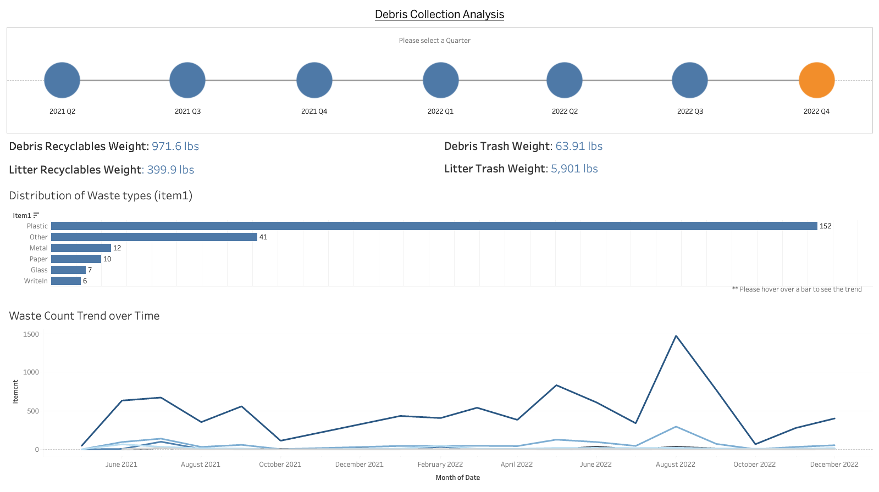

Slide 11
