Slide 1
Topic modeling

Slide 2

Importance of textual data
Information extraction
Knowledge discovery
Customer understanding
Online reviews
Newspaper article
Notes:
Information Extraction: Textual data contains a vast amount of information, ranging from articles, books, reports, emails, social media posts, customer reviews, and more. Analyzing and extracting insights from this data can provide valuable information about customer sentiments, market trends, emerging topics, and potential business opportunities.
Knowledge Discovery: Textual data analysis can uncover hidden patterns, relationships, and knowledge within the text. By applying techniques like text mining and topic modeling, organizations can extract meaningful insights, discover trends, and make data-driven decisions.
Customer Understanding: Textual data, such as customer feedback, reviews, and support tickets, provides valuable insights into customer preferences, satisfaction levels, and pain points. Analyzing this data helps businesses understand their customers better, improve products or services, and enhance customer experiences.
Online Reviews: Online reviews play a crucial role in shaping consumers' purchasing decisions. Analyzing textual reviews from platforms like e-commerce websites, social media, and review aggregators provides valuable insights into product or service performance, customer satisfaction, and areas for improvement. Sentiment analysis and opinion mining techniques help in understanding the sentiment expressed in the reviews, identifying key features or aspects being discussed, and assessing overall customer satisfaction. This information aids businesses in monitoring their online reputation, addressing customer concerns, and making informed business decisions.
Newspaper Article: Newspaper articles are a rich source of information about current events, news, opinions, and trends. Textual analysis of newspaper articles enables researchers, journalists, and organizations to understand public sentiment, track evolving topics, and gain insights into societal, economic, and political trends. Natural language processing techniques can be employed to extract key entities, detect named entities like people, organizations, and locations, and identify relationships and trends discussed in the articles. Analyzing newspaper articles helps in media monitoring, trend analysis, and obtaining a comprehensive view of current affairs.

Slide 3

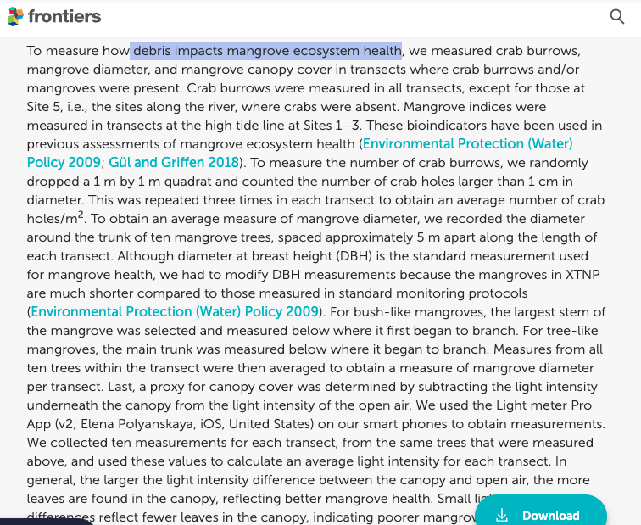


Why topic modeling?
Challenges in analyzing large volumes of textual data
Extracting meaningful insights and patterns
Introduction to topic modeling as a solution
Example
Utilizing Natural Language Processing for Review Analysis and Decision-Making.
Analyzing news articles on Automotive Industry
Analyzing to understand the impact of marine debris
Notes:
Let's consider a large collection of news articles related to the automotive industry. Manually reading and categorizing thousands of articles would be time-consuming and impractical. However, using topic modeling, we can automatically extract the main topics present in the dataset, such as "electric vehicles," "autonomous driving," "vehicle safety," "industry regulations," and so on. This allows us to quickly understand the content distribution, identify emerging trends, and gain insights into the industry without the need for manual effort.
And this is where natural language processing comes up trumps.
Analyzing to understand the impact of marine debris Certainly! Here's an example related to the Tampa Bay Estuary marine debris dataset:
- Challenges in Analyzing Large Volumes of Textual Data:
- The Tampa Bay Estuary marine debris dataset contains a vast amount of textual data, such as research papers, reports, and surveys, focused on studying and documenting marine debris in the estuary. Manually analyzing this extensive collection of text would be time-consuming and challenging.
- Extracting Meaningful Insights and Patterns:
- By applying topic modeling to the Tampa Bay Estuary marine debris dataset, we can extract meaningful insights and patterns:
- Identifying key topics: Topic modeling algorithms can uncover the main themes discussed in the textual data, such as "plastic pollution," "impact on marine life," "beach cleanup efforts," or "sources of marine debris."
- Understanding content distribution: Topic modeling reveals the prevalence and importance of each topic within the dataset, enabling us to identify which topics are most frequently discussed and potentially areas of concern.
- Document clustering and organization: Topic modeling allows us to group similar documents together based on their thematic content. For example, we can cluster research papers focusing on the impacts of marine debris on marine life or reports on cleanup initiatives.
- Introduction to Topic Modeling as a Solution:
- Given the challenges of analyzing the Tampa Bay Estuary marine debris dataset and the need to extract meaningful insights, topic modeling serves as a valuable solution:
- Instead of manually reading through numerous research papers and reports, topic modeling automates the process by identifying the main topics present in the dataset.
- Topic modeling provides a quantitative representation of the textual data, allowing for efficient analysis and exploration of the marine debris-related topics.
- By leveraging topic modeling, we can gain valuable insights into the patterns, trends, and areas of focus in the Tampa Bay Estuary marine debris dataset, contributing to informed decision-making and targeted mitigation efforts.
Automotive industry: Imagine we have a massive collection of news articles about the automotive industry. It would be almost impossible to read and categorize each article individually. However, with topic modeling, we can automatically discover the main topics discussed in these articles, such as "electric vehicles," "autonomous driving," "vehicle safety," or "industry regulations." This gives us a quick understanding of what the articles are about and how important each topic is within the industry. It helps us navigate through the vast amount of information and extract valuable insights without having to read every single article.
Utilizing Natural Language Processing for Review Analysis and Decision-Making.
Unfortunately, it turned out to be a bad decision as the battery backup was well below par. I didn’t go through the reviews of the product and made a hasty decision to buy it based on its ratings alone. And I know I’m not the only one out there who made this mistake!
Ratings alone do not give a complete picture of the products we wish to purchase, as I found to my detriment. So, as a precautionary measure, I always advise people to read a product’s reviews before deciding whether to buy it or not.
But then an interesting problem comes up. What if the number of reviews is in the hundreds or thousands? It’s just not feasible to go through all those reviews, right? And this is where natural language processing comes up trumps.

Slide 4
How does topic modeling work?
Text data preprocessing
Topic modeling using BERTopic
Extract Topics from topic modeling
Topic similarities
Visualizations

Slide 5
Text Data Preprocessing
Removing stop words
Stemming
Lemmatization
Handling noisy data and special characters

Slide 6
Building the Document-Term Matrix
Explaining the concept of a document-term matrix
Vector representation of text data
Term frequency-inverse document frequency (TF-IDF) weighting

Slide 7
Introduction to Latent Dirichlet Allocation (LDA)
Basic idea behind LDA
Generative process of LDA
Dirichlet distribution and its role in topic modeling

Slide 8
Training LDA Model
Selecting the number of topics
Training LDA on the document-term matrix
Tuning hyperparameters (e.g., alpha, beta)

Slide 9
Interpreting the Results
Extracting the most significant topics
Assigning topic labels
Analyzing topic-word distributions

Slide 10
Evaluation of Topic Models
Metrics for evaluating topic models (e.g., coherence, perplexity)
Interpreting evaluation results

Slide 11
Applications of Topic Modeling
Examples of real-world applications (e.g., document clustering, content recommendation, sentiment analysis)
Benefits and insights gained from topic modeling

Slide 12
Challenges and Limitations
Challenges in topic modeling (e.g., selecting optimal number of topics, domain-specific variations)
Limitations and potential pitfalls

Slide 13
Conclusion
Summary of key points covered
Reinforce the importance of topic modeling
Future directions and advancements in the field

Slide 14
Why topic modeling?
Topic modelling is recognizing the words from the topics present in the document or the corpus of data. This is useful because extracting the words from a document takes more time and is much more complex than extracting them from topics present in the document. For example, there are 1000 documents and 500 words in each document. So to process this it requires 500*1000 = 500000 threads. So when you divide the document containing certain topics then if there are 5 topics present in it, the processing is just 5*500 words = 2500 threads.
This looks simple than processing the entire document and this is how topic modelling has come up to solve the problem and also visualizing things better.
Topic modeling analysis can provide valuable insights into large text collections, enabling tasks such as document clustering, information retrieval, recommendation systems, and trend analysis. It helps researchers and organizations understand the main themes and trends present in their data and gain a deeper understanding of the underlying content.

Slide 15

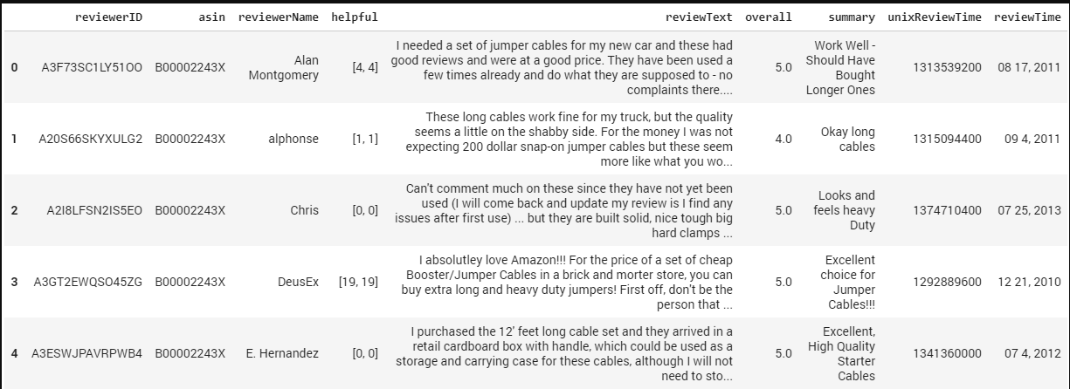
What is Topic modeling?
Topic modeling is a technique used to discover underlying themes or topics within a collection of documents. It can be applied to a variety of text data, including articles, papers, reviews, social media posts, and more. The goal is to identify patterns and extract meaningful insights from the text.

Slide 16
Algorithms used
To perform topic modeling analysis, several algorithms can be used, with Latent Dirichlet Allocation (LDA) being one of the most popular and widely used. LDA assumes that each document is a mixture of various topics, and each topic is a probability distribution over words. The algorithm iteratively assigns words to topics and topics to documents to find the best representation of topics.

Slide 17
Based on the output of the topic modeling, it appears that each topic is represented by a list of words or phrases that are associated with that topic. Here is a summary of the topics identified:
Topic 0: Bulky items
- Keywords: bulky item, item bulky item, item bulky
Topic 1: Beverage bottles and containers
- Keywords: bottle container, beverage bottle, beverage bottle
Topic 2: Styrofoam cups and lids
- Keywords: cup cup, styrofoam cup, cup lid
Topic 3: Styrofoam pieces
- Keywords: styrofoam piece, piece styrofoam piece, piece
Topic 4: Bags and films
- Keywords: bag film, film bag film, film bag
Topic 5: Bottle caps
- Keywords: bottle cap, cap bottle cap, bottle cap bottle
Topic 6: Straws and stirrers
- Keywords: straw stirrer, straw stirrer straw, stirrer straw
Topic 7: Hard fragments
- Keywords: hard fragment, hard fragment hard, fragment hard
Topic 8: Chip bags
- Keywords: chip bag, bag chip bag, bag chip
Topic 9: Medical waste
- Keywords: medical waste, waste medical waste, waste medical
Topic 10: Textiles and shoes
- Keywords: textile shoe, textile shoe textile, shoe textile
Topic 11: Paper and junk mail
- Keywords: paper paper, paper paper paper, junk mail
These topics represent different themes or categories of waste items that have been identified through the topic modeling process. Each topic consists of words or phrases that are frequently associated with that particular topic.

Slide 18
Topic Modeling Output
Topic | Count | Name
-1 | 10 | bulky item, item bulky item, item bulky
0 | 1161 | beverage bottle container, bottle container, beverage bottle
1 | 269 | cup cup, styrofoam cup, cup lid
2 | 181 | styrofoam piece, piece styrofoam piece, piece styrofoam
3 | 132 | food drink, food drink pouch, drink pouch
4 | 120 | bag film, film bag film, film bag
5 | 114 | bottle cap, cap bottle cap, bottle cap bottle
6 | 97 | straw stirrer, straw stirrer straw, stirrer straw stirrer
7 | 77 | hard fragment, hard fragment hard, fragment hard fragment
8 | 58 | sport equipment, sport equipment sport, equipment sport equipment
9 | 55 | medical waste, waste medical, waste medical waste
10 | 38 | textile shoe, textile shoe textile, shoe textile shoe
11 | 27 | paper paper, paper paper paper, junk mail
12 | 17 | vehicle related, vehicle related vehicle, related vehicle related

Slide 19
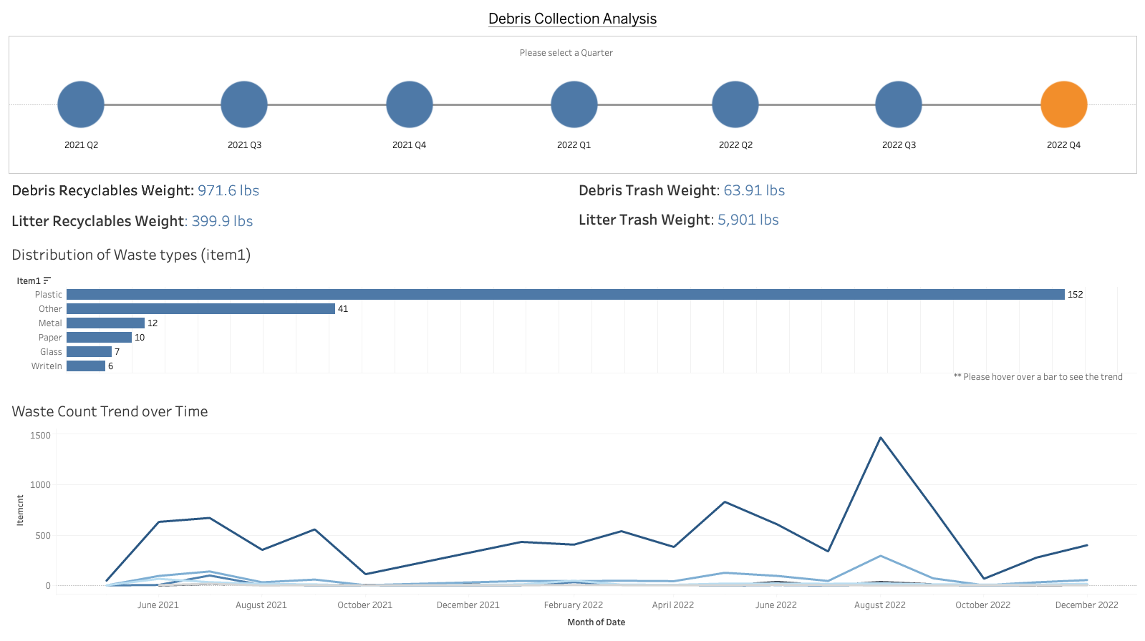

Slide 20
