Slide 1
Micro-internship: Extracting Insights from Data - FAMU DeLuca

Slide 2

Agenda
Exploratory Data Analysis
Questions answered through visualizations
Visualizations
Questions/Feedback

Slide 3
Metadata of the dataset
Date: The date when litter accumulation was recorded or measured.
DeviceID: A unique identifier for the litter collection device.
Org: The organization or entity responsible for the litter collection.
Site: The location or site where the litter collection device is installed.
LitterRecyclablesWeightLb: The weight of recyclable litter collected in pounds.
LitterTrashWeightLb: The weight of non-recyclable (trash) litter collected in pounds.
DebrisRecyclablesWeightLb: The weight of recyclable debris collected in pounds.
DebrisTrashWeightLb: The weight of non-recyclable (trash) debris collected in pounds.
dataCards: Possibly a count or identifier for data cards associated with the litter collection.
City: The city where the litter collection site is located.
County: The county where the litter collection site is located.
device: Possibly another identifier or category for the type of device used for litter collection.
lon: The longitude coordinate of the litter collection site.
lat: The latitude coordinate of the litter collection site.

Slide 4
Questions
Frequency of months

Slide 5
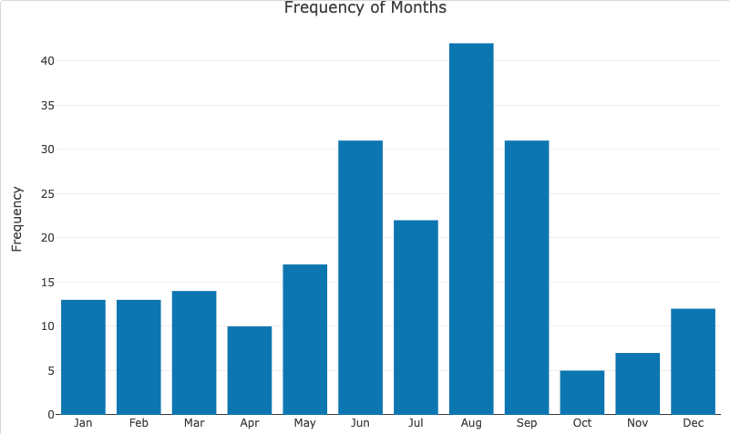
Waste Generation by Month
Notes:
The bar chart displays the amount of waste generated during the months of August, June, and September. Based on the chart, it can be observed that the highest amount of waste was generated in the month of September, followed by August and then June.
This information suggests that waste generation tends to be higher during the summer months, particularly in September. This could be attributed to various factors such as increased outdoor activities, tourism, or seasonal events that result in more waste production.
The higher waste generation in September highlights the need for effective waste management strategies and increased awareness during this period. It could serve as a valuable insight for planning and implementing targeted initiatives to address waste management challenges and promote responsible waste disposal practices during peak waste generation months.
By understanding the patterns of waste generation throughout the year, organizations and communities can allocate resources and develop tailored waste reduction campaigns to tackle the higher waste volumes observed in specific months, contributing to a more sustainable and cleaner environment.

Slide 6
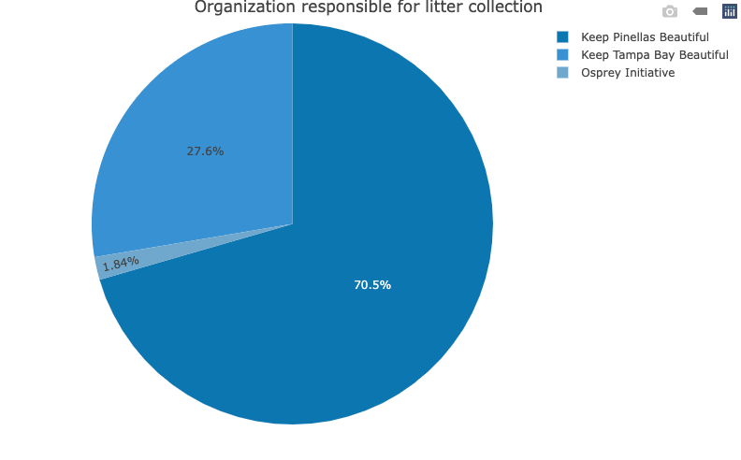
Organization responsible for litter collection
Notes:
The pie chart illustrates the distribution of litter collection organizations in the dataset. Out of the three organizations mentioned, Keep Pinellas Beautiful appears to have the highest representation in terms of litter collection. This suggests that Keep Pinellas Beautiful may have a more significant presence or involvement in litter cleanup efforts compared to Keep Tampa Bay Beautiful and Osprey Initiative.
The higher representation of Keep Pinellas Beautiful could indicate their proactive approach in addressing litter issues and their active participation in maintaining the cleanliness of the environment in the corresponding area. It highlights their dedication to promoting community engagement, raising awareness, and implementing effective litter collection initiatives.
This information could be valuable in recognizing the efforts of Keep Pinellas Beautiful and their positive impact on litter reduction and environmental preservation. It also emphasizes the importance of community organizations in combating litter and fostering a cleaner and more sustainable environment.

Slide 7
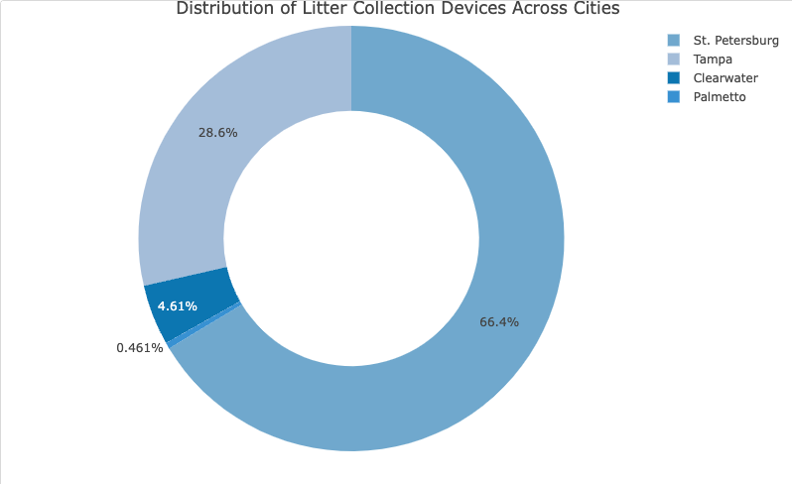
Distribution of Litter Collection Devices Across Cities
Notes:
The donut chart represents the distribution of litter collection devices across different cities. St. Petersburg has the highest number of devices, indicating a strong commitment to addressing litter and waste management. Tampa ranks second in terms of device installations, followed by Clearwater. Palmetto has the lowest number of devices among the listed cities. This distribution highlights the focus of these cities on implementing effective litter collection strategies to maintain cleanliness and preserve the environment.

Slide 8
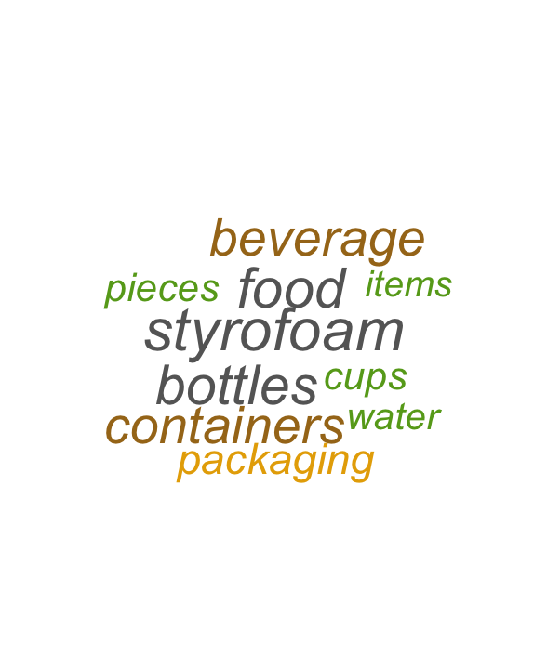
Top 10 items that are found in the marine debris
Notes:
Environmental Impact: The presence of words like "beverage," "food," and "packaging" underscores the significant impact of consumer-related waste on marine ecosystems. It highlights the urgent need for sustainable practices, recycling initiatives, and alternative packaging solutions to mitigate the environmental harm caused by these items.

Slide 9
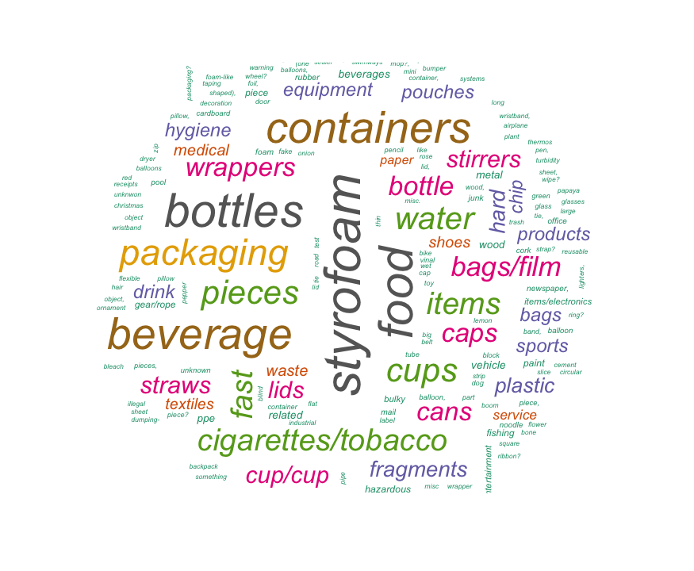
Items found in the marine debris
Notes:
Diversity of Debris: The word cloud showcases a diverse range of items found in marine debris, including plastics, bottles, packaging, styrofoam, and various other waste materials. This highlights the complexity and variety of items that contribute to marine pollution.
Common Waste Items: The larger and more prominent words in the word cloud indicate the prevalence of certain waste items, such as plastic bottles, food packaging, and single-use items like straws and caps. These common waste items emphasize the need for effective waste management strategies and increased awareness about responsible consumption and disposal.

Slide 10
Question: Are different devices better/ more effective at capturing certain categories (i.e maybe sea bins capture an abundance of cig butts)
Notes:
Yes, different devices can be more effective at capturing certain categories of litter or waste. The effectiveness of a device in capturing specific categories can depend on various factors such as design, functionality, location, and target waste type.
For example, in the case you mentioned, Sea Bins are specifically designed to capture floating debris and litter from marinas, harbors, and other water bodies. Due to their design and placement in water, they may be more effective at capturing items like cigarette butts, plastic bottles, or other floating waste commonly found in aquatic environments.
Similarly, other devices or waste management systems may be optimized for capturing specific types of litter or waste. For instance, litter traps or litter fences are designed to catch and collect larger debris or solid waste items before they enter water bodies or drainage systems.
It's important to consider the specific purpose and design of each device when assessing their effectiveness in capturing different categories of litter or waste. Factors such as location, maintenance, and operational procedures also play a role in determining the overall effectiveness of a device in waste capture.

Slide 11
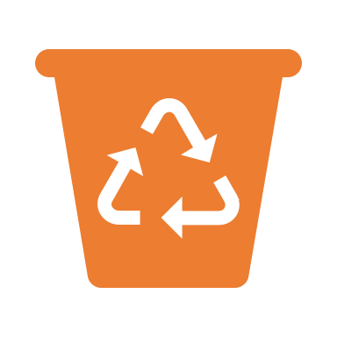

Solution
Waste analysis
Device analysis

Slide 12

Waste analysis

Slide 13
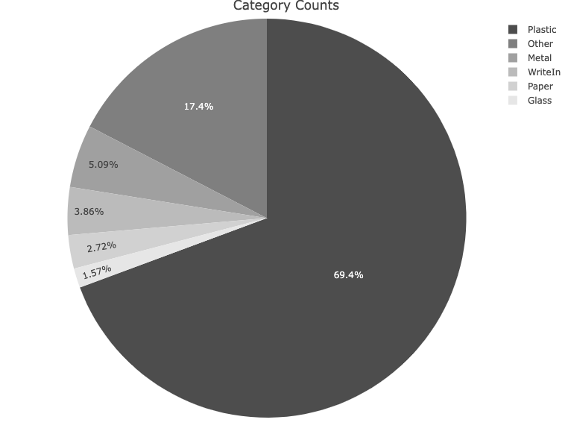
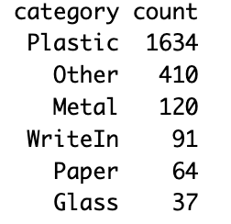
Category Counts: Distribution of Waste Categories
Notes:
The pie chart represents the counts of different waste categories present in the dataset. Each slice represents a category, and the size of the bar indicates the count or frequency of that category in the dataset.
By analyzing the pie chart, we can visually compare the counts of different categories and identify any variations or disparities in their frequencies. A larger slice of the pie chart indicates a higher proportion or percentage of the whole. Here, the larger slice is plastic which says the amount of plastic waste generated is high and the slice with smaller slice is glass, which represents that the number of glass waste is less.
In summary, the bar chart provides a visual representation of the distribution of categories and allows you to quickly grasp the relative frequencies or counts of each category in the dataset.

Slide 14
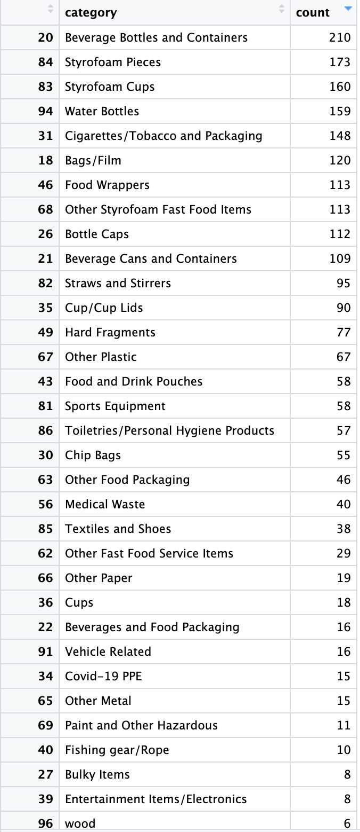
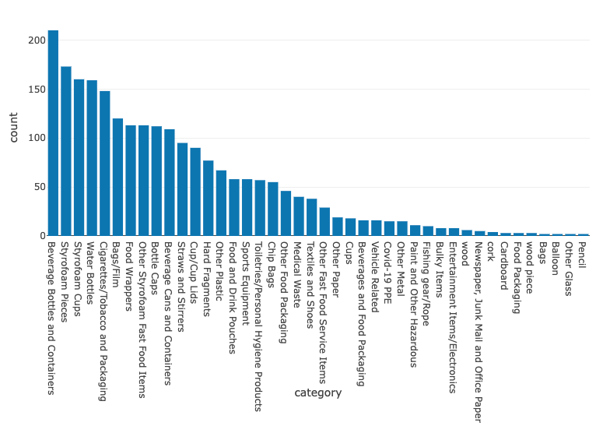
Sub-category Counts: Distribution of Waste Categories
Notes:
The longer the bar, the higher the count of that particular category. Here, the longer bar is beverage bottles and containers, which says the amount of beverage bottles and containers waste generated is high.
inorder to keep it more precise, i excluded the waste category which has count = 1

Slide 15
Questions: What are the various types of waste captured by the devices? Which devices are effective for different categories of waste?
Notes:
to add few more layers to the previous question

Slide 16
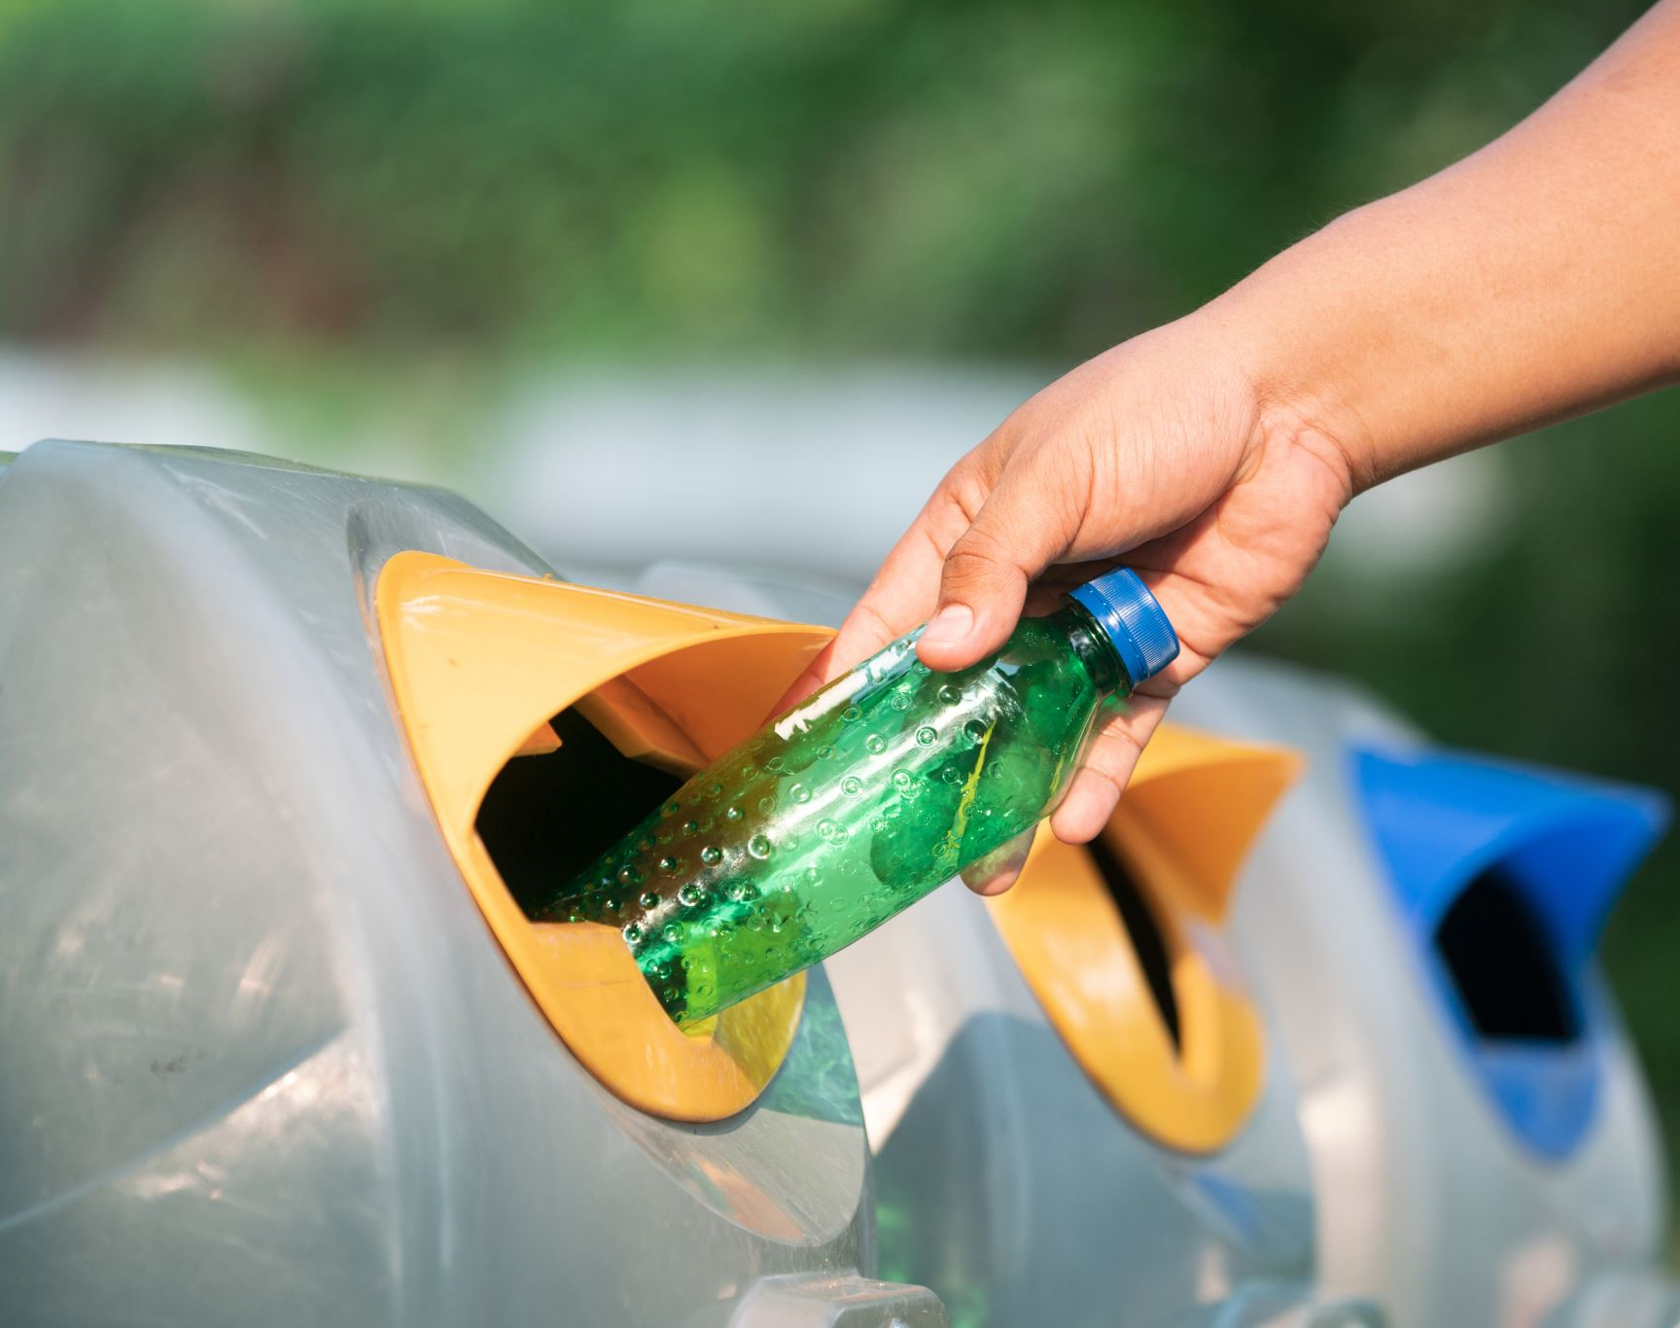
Device Analysis

Slide 17
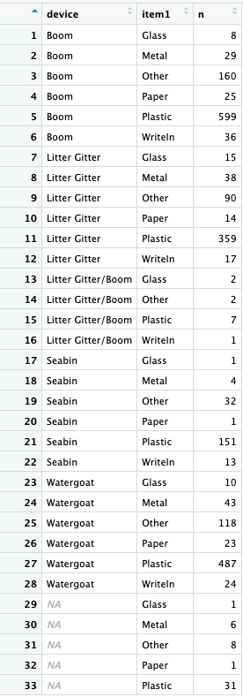
Type of wastes collected in every device

Slide 18
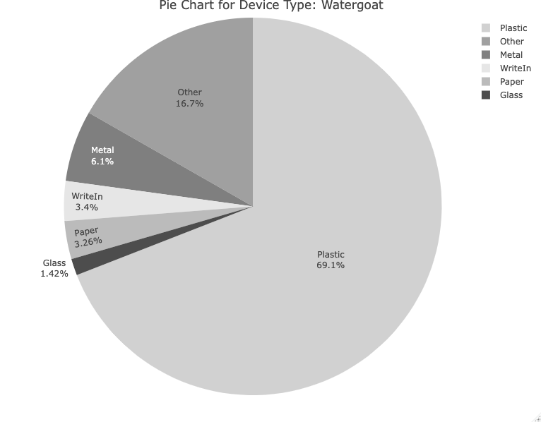
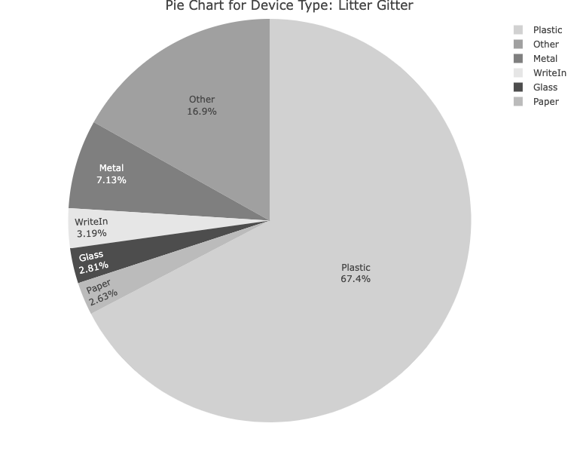
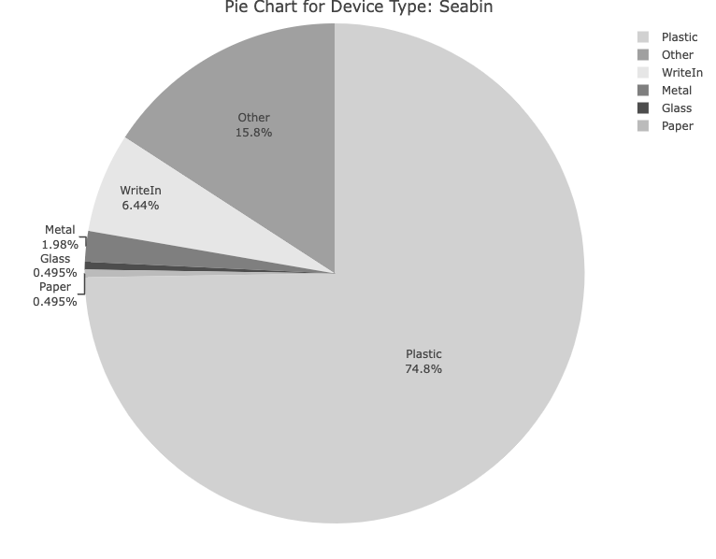
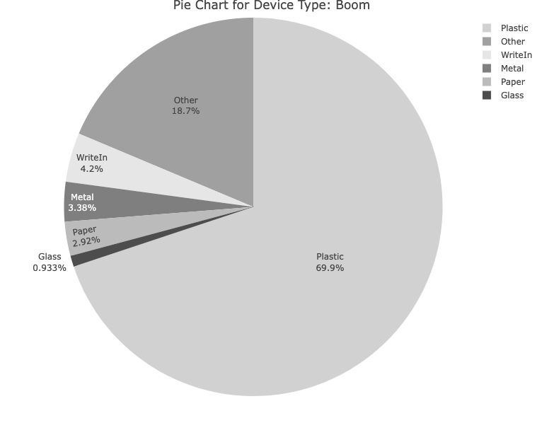

Slide 19
Table #1: Count of different categories for each device type
Device Type | Category | Plastic | Metal | WriteIn | Glass | Paper | Other
Boom | 599 | 29 | 36 | 8 | 25 | 160
Watergoat | 487 | 43 | 24 | 10 | 23 | 118
Seabin | 151 | 4 | 13 | 1 | 1 | 32
Litter Gitter | 359 | 38 | 17 | 15 | 14 | 90
Litter Gitter/Boom | 7 | 0 | 1 | 2 | 0 | 2
Table #2: Proportion of each category for each device type
Device Type | Category | Plastic | Metal | WriteIn | Glass | Paper | Other
Boom | 25.42 | 1.23 | 1.53 | 0.34 | 1.06 | 6.79
Watergoat | 20.67 | 1.83 | 1.02 | 0.42 | 0.98 | 5.01
Seabin | 6.41 | 0.17 | 0.55 | 0.04 | 0.04 | 1.36
Litter Gitter | 15.24 | 1.61 | 0.72 | 0.64 | 0.59 | 3.82
Litter Gitter/Boom | 0.3 | 0 | 0.04 | 0.08 | 0 | 0.08
Notes:
The table represents the count of different categories for each device type. Here's the breakdown of the information:
- Device Type: The different types of devices mentioned are Boom, Watergoat, Seabin, Litter Gitter, and Litter Gitter/Boom.
- Category: The categories represent different materials found during the analysis, such as Plastic, Metal, WriteIn (possibly miscellaneous or custom category), Glass, Paper, and Other (possibly miscellaneous or custom category).
- Counts: The numbers in the table represent the count of items belonging to each category for each device type. For example, for the device type Boom, there are 599 items categorized as Plastic, 29 items categorized as Metal, 36 items categorized as WriteIn, 8 items categorized as Glass, 25 items categorized as Paper, and 160 items categorized as Other.
The table provides an overview of the distribution of different material categories for each device type based on the count of items.
The updated table provides the proportion of each category for each device type. Here's what the information represents:
Device Type: The different types of devices mentioned are Boom, Watergoat, Seabin, Litter Gitter, and Litter Gitter/Boom.
Category: The categories represent different materials found during the analysis, such as Plastic, Metal, WriteIn (possibly miscellaneous or custom category), Glass, Paper, and Other (possibly miscellaneous or custom category).
Proportions: The numbers in the table represent the proportion or percentage of items belonging to each category for each device type. The values are presented as decimals.
For example, for the device type Boom, the proportion of Plastic items is approximately 25.42%, Metal items is approximately 1.23%, WriteIn items is approximately 1.53%, Glass items is approximately 0.34%, Paper items is approximately 1.06%, and Other items is approximately 6.79%.
The table provides an overview of the distribution and proportions of different material categories for each device type, giving a sense of the relative representation of each category within the device types.

Slide 20
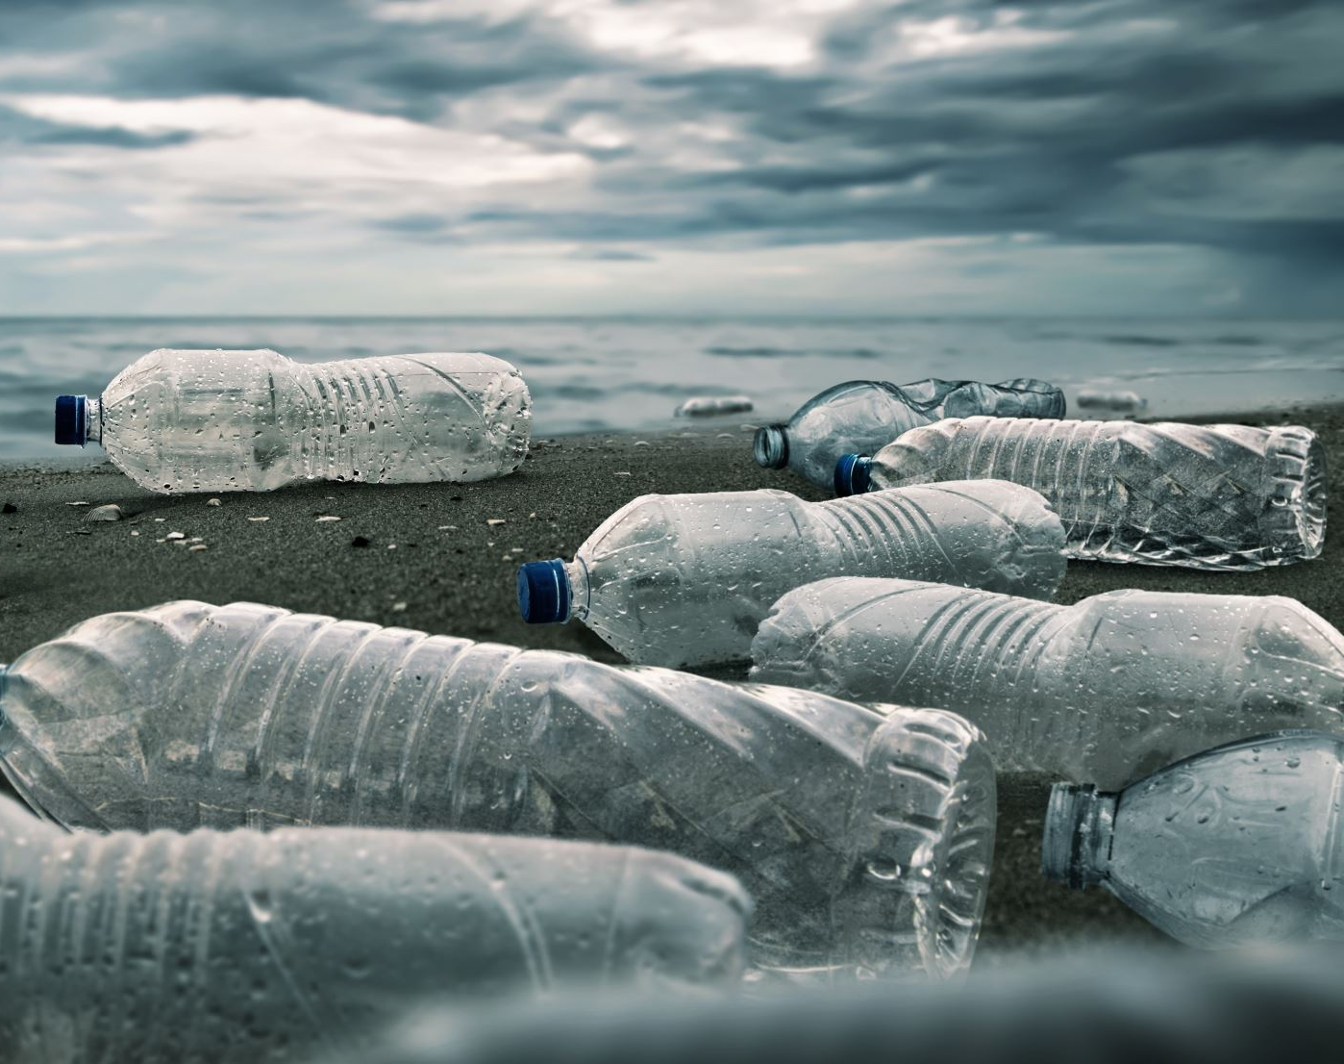
Insights from Topic Modeling
Notes:
Topic identification: Topic modeling helps identify key themes or topics present in the textual data. It automatically groups similar words and documents together, allowing us to understand the main areas of focus within the dataset.
Waste categorization: By applying topic modeling, we can categorize the marine debris items into different topics based on their textual descriptions. This categorization provides a structured way to analyze and understand the types of waste found, helping in waste management and decision-making processes.

Slide 21
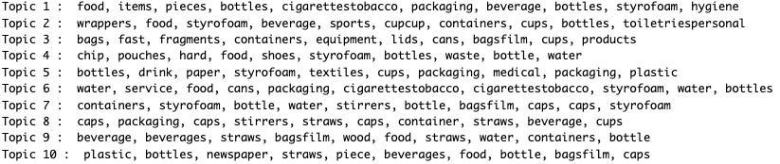
Tackling Waste and Promoting Sustainability
Notes:
In topic modeling, the words associated with each topic are created based on the statistical patterns observed in the text data. The process involves analyzing the co-occurrence patterns of words within documents and identifying groups of words that frequently appear together. These groups of words represent the topics.
Specifically, in the widely used topic modeling algorithm called Latent Dirichlet Allocation (LDA), the words for each topic are generated through a probabilistic process. Here's a simplified explanation of how it works:
1. Initialization: The algorithm randomly assigns each word in the corpus to a topic.
2. Iterative process: The algorithm iteratively updates the assignments of words to topics based on the observed word co-occurrence patterns.
3. Word-topic distribution: After several iterations, the algorithm calculates the probability of each word belonging to each topic. This results in a word-topic distribution for each topic, where the probabilities indicate the likelihood of a word appearing in that particular topic.
4. Top terms extraction: The top terms for each topic are selected based on their probabilities in the word-topic distribution. These top terms represent the most distinctive and representative words for each topic.
The words created for each topic are essentially the result of this iterative process, where the algorithm learns and assigns words to topics based on their co-occurrence patterns in the text data. The goal is to find the most coherent and meaningful topics that capture the underlying themes present in the documents.

Slide 22
Strategic Waste Management Solutions
Topic | Issues to be addressed | Solution
Topic 1 : Food, Items, Pieces, Bottles, Cigarettestobacco, Packaging, Beverage, Bottles, Styrofoam, Hygiene | Food packaging waste | Proper disposal of cigarette/tobacco packaging. Promoting hygiene practices and responsible waste management in public spaces
Topic 2 : Wrappers, Food, Styrofoam, Beverage, Sports, Cupcup, Containers, Cups, Bottles, Toiletriespersonal | Single-use wrappers alternatives to styrofoam waste | Recycling or sustainable disposal options for sports equipment
Topic 3 : Bags, Fast, Fragments, Containers, Equipment, Lids, Cans, Bagsfilm, Cups, Products | Reducing plastic bag usage fast food waste | Promoting reusable alternatives initiatives for better waste management in the industry
Topic 4 : Chip, Pouches, Hard, Food, Shoes, Styrofoam, Bottles, Waste, Bottle, Water | Non-recyclable chip packets hard food waste | Composting to reduce environmental impact
Topic 5 : Bottles, Drink, Paper, Styrofoam, Textiles, Cups, Packaging, Medical, Packaging, Plastic | Improper disposal of beverage bottles, recycling paper, textile waste, medical waste | Strategies to improve proper disposal methods
Topic 6 : Water, Service, Food, Cans, Packaging, Cigarettestobacco, Cigarettestobacco, Styrofoam, Water, Bottles | Plastic bottles service waste such as disposable cutlery and packaging | Reusable bottles
Topic 7 : Containers, Styrofoam, Bottle, Water, Stirrers, Bottle, Bagsfilm, Caps, Caps, Styrofoam | Single-use containers | Resusable containers proper recycling
Topic 8 : Caps, Packaging, Caps, Stirrers, Straws, Caps, Container, Straws, Beverage, Cups | Plastic caps, single-use stirrers, straws | Resusable containers proper recycling
Topic 9 : Beverage, Beverages, Straws, Bagsfilm, Wood, Food, Straws, Water, Containers, Bottle | Wooden disposable products plastic bags/film waste | Reusable bags
Topic 10 : Plastic, Bottles, Newspaper, Straws, Piece, Beverages, Food, Bottle, Bagsfilm, Caps | Plastic straw waste | Bottle deposit schemes
By addressing these specific waste management issues identified through the topic modeling analysis, organizations like Keep Pinellas Beautiful can develop targeted solutions, awareness campaigns, recycling initiatives, and collaborations to tackle the most significant waste challenges in their community.
Notes:
The output of the topic modeling provides valuable insights into the main topics or themes present in our dataset. Here's how this output can be helpful:
1. **Identifying common items and materials**: The topics extracted from the text data highlight common items and materials found in the dataset, such as food, bottles, cups, packaging, styrofoam, and more. This information can help you understand the types of items that are frequently mentioned or present in the dataset.
2. **Understanding problem areas**: By examining the topics and their associated terms, you can identify problem areas related to waste and pollution. For example, topics like plastic bottles, styrofoam, packaging, and cigarette/tobacco packaging may indicate specific areas of concern that require attention and potential intervention.
3. **Uncovering related categories**: The topics also reveal related categories or themes that may not be immediately obvious. For instance, Topic 2 includes terms like wrappers, sports equipment, and toiletries/personal hygiene products, suggesting a category related to packaging and personal care items.
4. **Identifying potential interventions**: With the knowledge of the dominant topics, you can brainstorm and discuss potential interventions or strategies to address the issues identified. For example, if Topic 3 highlights bags, fast food fragments, and containers, you can explore initiatives focused on reducing single-use plastic bags or improving waste management at fast food establishments.
5. **Targeting awareness campaigns**: The identified topics can guide the development of targeted awareness campaigns or educational initiatives. For instance, if Topic 6 emphasizes water bottles, beverage cans, and cigarette/tobacco packaging, you can design campaigns to promote responsible disposal of these items and raise awareness about their environmental impact.
6. **Informing resource allocation**: Understanding the prevalence of different topics can help allocate resources effectively. By knowing the dominant topics, you can prioritize efforts and allocate resources towards addressing the most significant and frequently occurring issues.
7. **Monitoring progress**: Topic modeling can be used as a baseline for monitoring progress over time. By periodically re-analyzing the dataset, you can track changes in topic proportions and assess the effectiveness of interventions or policies implemented.
Overall, the output of the topic modeling provides a comprehensive overview of the main topics within your dataset, enabling you to gain insights, identify areas of focus, and develop targeted strategies to address waste and pollution issues effectively.
Certainly! Here are some interesting talking points for each topic based on the output you provided:
Topic 1: Food, items, pieces, bottles, cigarette/tobacco packaging, beverage, styrofoam, hygiene.
- Discuss the impact of food packaging waste and explore ways to reduce it.
- Talk about the importance of proper disposal of cigarette/tobacco packaging.
- Highlight the significance of promoting hygiene practices and responsible waste management in public spaces.
Topic 2: Wrappers, food, styrofoam, beverage, sports equipment, cups, containers.
- Address the issue of single-use wrappers and their impact on the environment.
- Discuss the challenges of styrofoam waste and explore alternatives.
- Explore the potential for recycling or sustainable disposal options for sports equipment.
Topic 3: Bags, fast food fragments, containers, equipment, lids, cans.
- Talk about reducing plastic bag usage and promoting reusable alternatives.
- Address the problem of fast food waste and explore initiatives for better waste management in the industry.
- Discuss the challenges of recycling containers and explore strategies for improving recycling rates.
Topic 4: Chip packets, hard food waste, shoes, styrofoam, bottles.
- Discuss the issue of non-recyclable chip packets and explore potential solutions.
- Highlight the environmental impact of hard food waste and the importance of composting.
- Address the challenges of styrofoam waste and explore alternatives or recycling options.
Topic 5: Bottles, drink, paper, styrofoam, textiles, packaging, medical.
- Discuss the importance of proper disposal and recycling of beverage bottles.
- Explore the challenges of recycling paper and textile waste.
- Address the issue of medical waste and the need for proper disposal methods.
Topic 6: Water, service, food, cans, cigarette/tobacco packaging, styrofoam.
- Discuss the impact of plastic water bottles and explore alternatives such as reusable bottles.
- Address the issue of service waste, such as disposable cutlery and packaging.
- Highlight the importance of proper disposal of cigarette/tobacco packaging and styrofoam.
Topic 7: Containers, styrofoam, bottle, stirrers, bags/film, caps.
- Talk about the challenges of styrofoam waste and explore alternatives or recycling options.
- Discuss the issue of single-use containers and explore sustainable alternatives.
- Address the problem of plastic bottle waste and the importance of proper recycling.
Topic 8: Caps, packaging, stirrers, straws, beverage cups.
- Discuss the impact of plastic caps and explore initiatives for their reduction or recycling.
- Highlight the issue of excessive packaging waste and explore strategies for minimizing it.
- Address the problem of single-use stirrers, straws, and cups, and promote reusable alternatives.
Topic 9: Beverage, straws, bags/film, wood, food, water bottles.
- Talk about the environmental impact of plastic straws and explore alternatives.
- Discuss the challenges of plastic bags/film waste and promote reusable bags.
- Address the issue of wooden disposable products and explore sustainable alternatives.
Topic 10: Plastic bottles, newspaper, straws, piece, beverages.
- Discuss the importance of recycling plastic bottles and explore bottle deposit schemes.
- Address the issue of newspaper waste and promote recycling or digital alternatives.
- Highlight the impact of plastic straw waste and encourage the use of reusable options.
These talking points can serve as a starting point for discussions related to each topic and can help raise awareness, promote sustainable practices, and identify potential interventions to address waste and pollution.

Slide 23
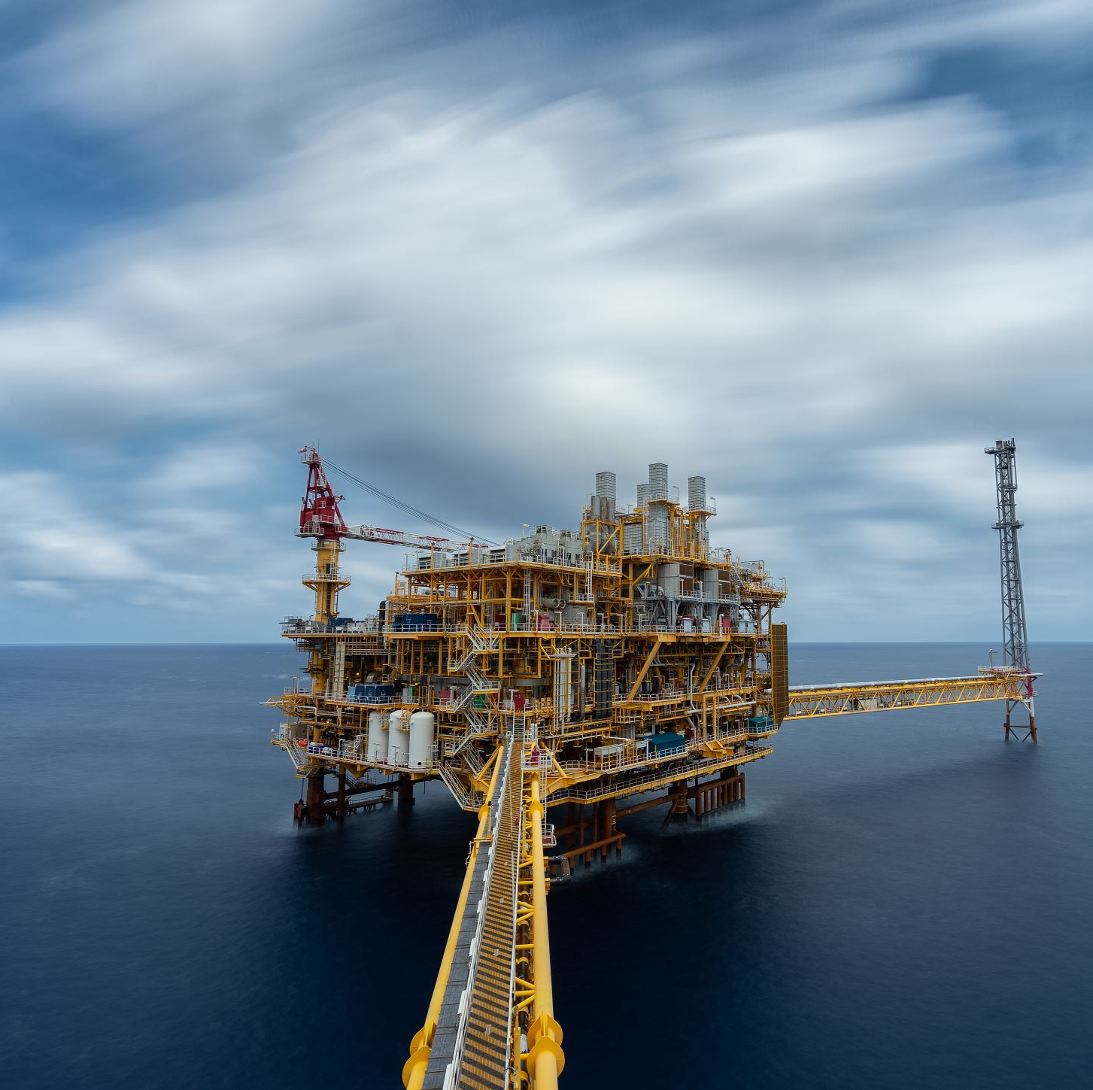
Future work
Is there a relationship between landuse around the location/watershed of the trash collection device and the category of trash collected?
Is there a relationship between the weather of the day and the amount waste generated?
Notes:
Yes, there can be a relationship between the land use around the location or watershed of a trash collection device and the category of trash collected. Land use refers to how the land is utilized, such as residential, commercial, industrial, agricultural, or natural areas. Different land use types can contribute to specific types of trash or waste.
Here's how land use can potentially influence the category of trash collected by a device:
1. Residential Areas: In residential areas, the collected trash may consist of household waste, packaging materials, food containers, and personal care products.
2. Commercial Areas: Trash collected near commercial areas might include items like packaging materials, single-use plastics, food containers, and office-related waste.
3. Industrial Areas: In industrial areas, there could be an accumulation of waste related to manufacturing processes, such as packaging materials, discarded machinery or equipment, and industrial byproducts.
4. Agricultural Areas: Trash collected in agricultural areas may include agricultural waste, such as plastic film used for crop protection, discarded farming equipment, or pesticide containers.
5. Natural Areas: Trash collected in natural areas or watersheds might consist of litter from recreational activities, such as beverage containers, food wrappers, and fishing gear.
The specific land use patterns around the trash collection device's location can provide insights into the potential sources of the collected trash. Analyzing the relationship between land use and the category of trash collected can help identify patterns, target specific areas for intervention or education campaigns, and develop strategies to address the identified waste sources effectively.

