Slide 1
Intelli-Drive System for Detecting Road Obstacles
PRESENTED
BY
R.BRINTHA(712219104007)
M.HARISHKUMAR(712219104011)
K.JAYAPRAKASH(712219104012)
V.N.LAKSHANAA PRIYA(712219104014)
R.VALLARASU(712219104028)
GUIDED
BY
Mr.PRABANCHAN G
AP/CSE

Slide 2
AGENDA
Introduction
Abstract
Kivy
Literature Survey
Existing System
Problem Statement
Proposed System
Workflow
Tools Used
Interface Design
Detections
Results and Discussions
Conclusion
Future work

Slide 3
INTRODUCTION
Intelli Drive System is a state-of-the-art app designed to improve the driving experience of car owners by utilizing the front and back cameras of their vehicles.
The system's advanced computer vision and machine learning algorithms enable it to detect various road features and obstacles, providing drivers with valuable information to avoid accidents and car damage.
Overall, the Intelli Drive System is an incredibly useful tool for any driver who wants to enhance their driving experience and stay safe on the road.
Its advanced technology and user-friendly interface make it easy to use and understand, providing drivers with an added layer of convenience and safety.

Slide 4
ABSTRACT
The Intelli-Drive System is designed to enhance road safety by detecting and identifying various obstacles on the road.
The Kivy app serves as a user interface, providing real-time feedback and visualizations of the detected road obstacles.
To evaluate the system's performance, a test file is used to simulate different driving scenarios. The test file contains recorded video footage or a sequence of images representing various road conditions.
By processing the test file, the Intelli-Drive System demonstrates its ability to detect and classify road lanes, potholes, objects, and parking spaces accurately.Furthermore, the system is optimized to convert the evaluated detections into real-time detections.
This capability is crucial for effective implementation in a real-world driving environment, where timely detection of obstacles is essential for driver awareness and safety.
In summary, the Intelli-Drive System combines the power of YOLO and OpenCV within a Kivy app to detect and classify road obstacles, such as road lanes, potholes, objects, and parking spaces.

Slide 5

KIVY
Kivy is an open-source Python framework for creating multi-touch applications that can run on various platforms, including Windows, macOS, Linux, Android, and iOS.
It was designed with user interface (UI) development in mind and provides tools for creating graphical user interfaces (GUIs) that are both easy to use and aesthetically pleasing.

Slide 6
LITERATURE SURVEY
S.NO | TITLE | METHOD USED
1 | Detecting Object Open Angle and Direction Using Machine Learning | Convolutional Neural Network
2 | Object Detection in Driving Datasets Using a High-Performance Computing Platform: A Benchmark Study | Driving Data Set, EVOLVE, Transfer Learning
3 | CNN-Based Classification for Point Cloud Object With Bearing Angle Image | Bearing angle-Convolutional Neural Network
4 | Hierarchical Classification of Very Small Objects: Application to the Detection of Arthropod Species | Convolutional Neural Network

Slide 7
EXISTING SYSTEM
The existing system for road lanes, potholes, obstacles, and parking space detection relies on image and video analysis technology.
However, this system is not able to detect these features in real time and provides low accuracy in detecting these features.
While this approach can provide valuable insights into road conditions and assist drivers in navigating challenging situations, it is not suitable for real-time detection.
Moreover, the accuracy of the system is limited, as it relies on the quality of the images and videos available for analysis.
If the images or video footage are blurry, poorly lit, or otherwise compromised, the system may not be able to accurately detect these features, leading to potential safety risks for drivers.

Slide 8
PROBLEM STATEMENT
The problem with the existing system for road lane, speed breaker, pothole, obstacle, and parking space detection is that it relies on image and video analysis technology that is not capable of real-time detection and provides low accuracy.
This approach can only analyze pre-recorded data from still images or recorded video footage, which is not suitable for detecting these features in real-time.
Additionally, the accuracy of the system is limited by the quality of the images and videos available for analysis, which may lead to potential safety risks for drivers if the system fails to accurately detect these features.
Therefore, there is a need for more advanced technology that can provide real-time detection and higher accuracy to improve road safety and enhance the driving experience.

Slide 9
PROPOSED SYSTEM
The proposed system aims to enhance image and video-based technology for road lane, pothole, obstacle, and parking space detection.
It utilizes a car's front and back cameras along with advanced computer vision and machine learning algorithms like YOLO and OpenCV.
The system analyzes the live video feed in real-time to accurately identify these features.
The front camera detects road lanes and potholes, displaying them on an augmented reality (AR) display.
The back camera identifies obstacles and available parking spaces, aiding drivers in navigating tight spaces and busy areas.
With deep learning techniques, the system achieves precise and fast detection, adapting to different road conditions. Overall, the proposed system aims to improve road safety and provide real-time and accurate detection of road features and parking spaces.

Slide 10
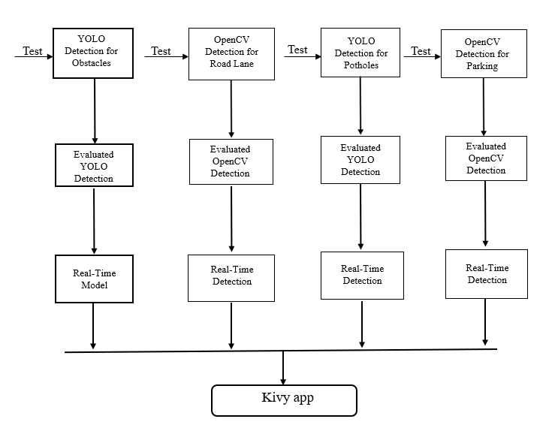
WORKFLOW
Fig1.1 Flow Chart

Slide 11
TOOLS USED
Environment : Visual Studio Code
Language : Python
Frameworks : KIVY
Libraries Used : OpenCV, YOLO

Slide 12

INTERFACE DESIGN
Fig 1.2 App Initial Screen

Slide 13
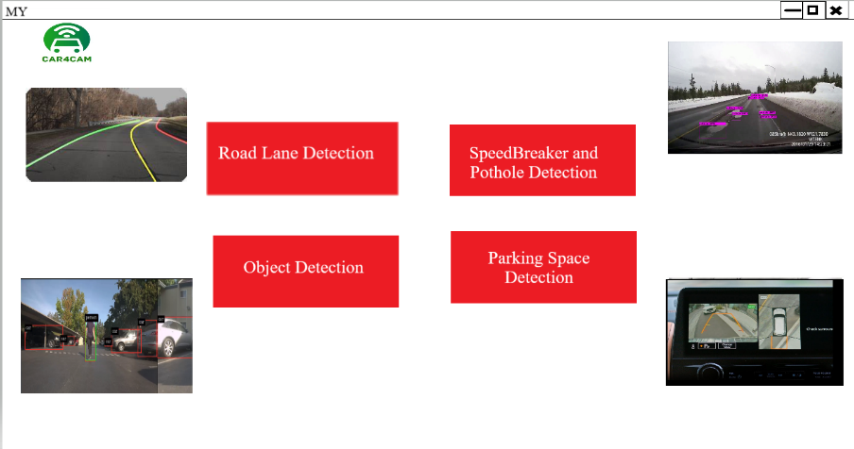
APP INTERFACE
Fig1.3 App Interface

Slide 14
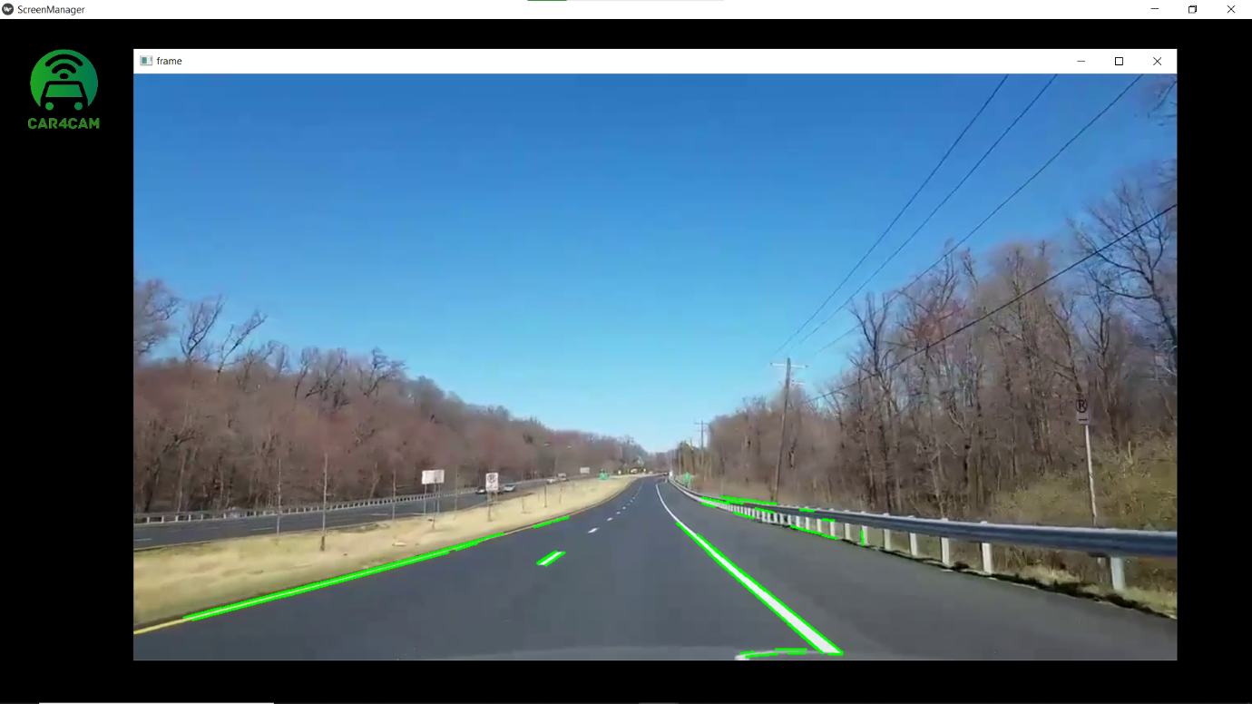
ROAD LANE DETECTION
Fig 1.4 Detection of Road Lane

Slide 15
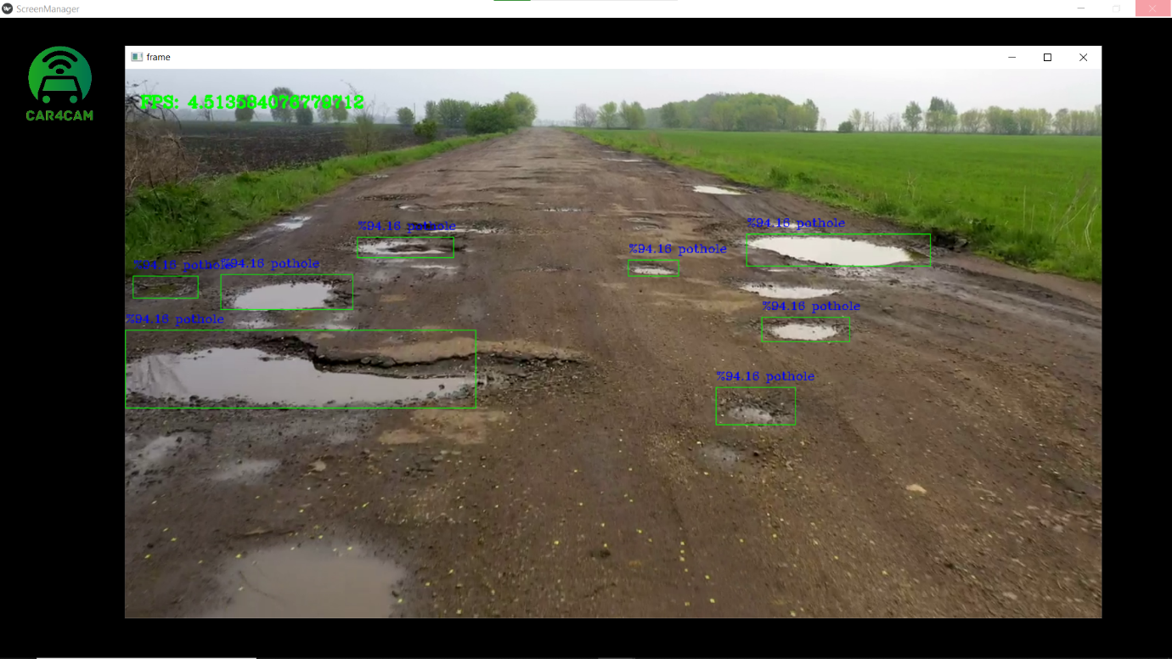
POTHOLE DETECTION
Fig 1.5 Detection of Potholes

Slide 16
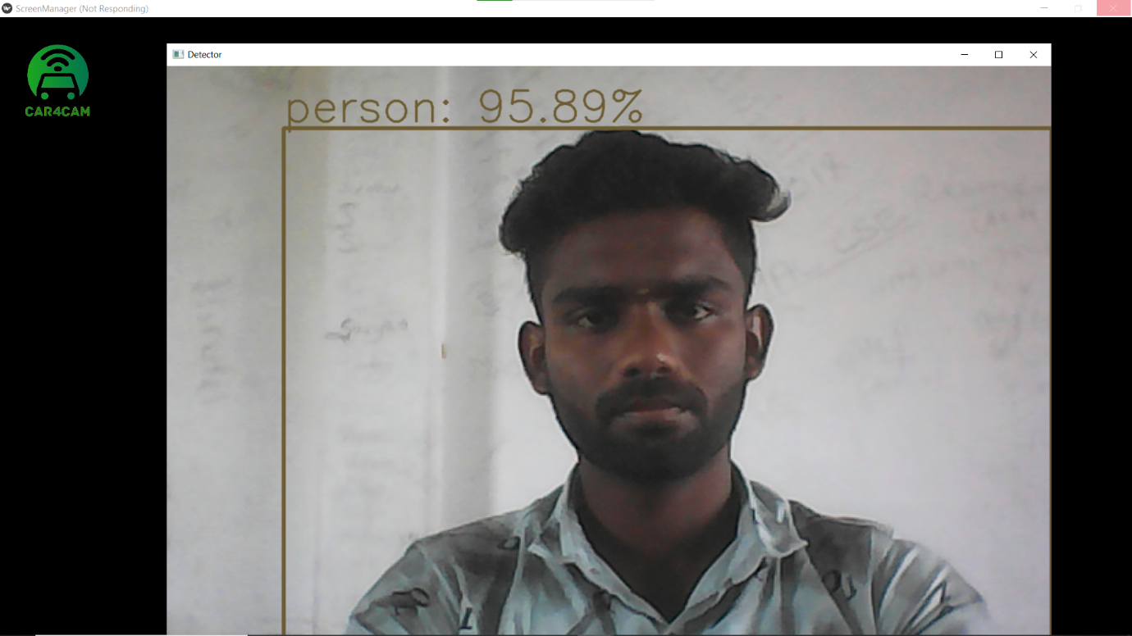
OBSTACLE DETECTION
Fig 1.6 Detection of Obstacles

Slide 17
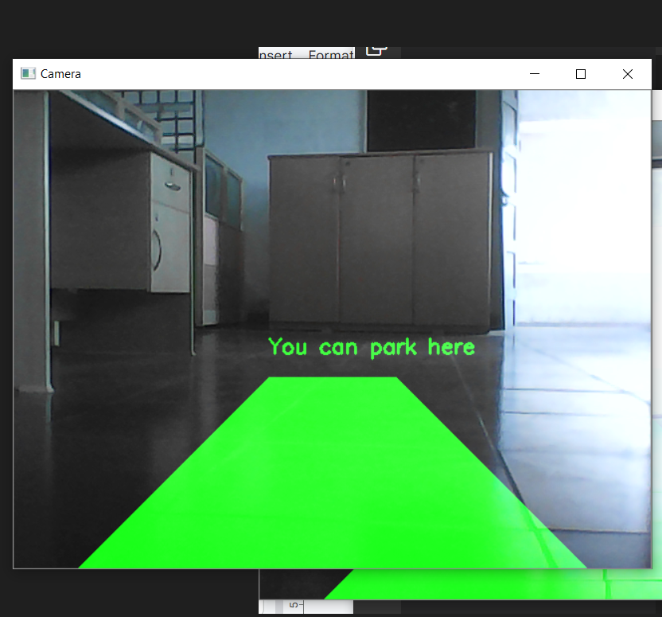
PARKING DETECTION
Fig 1.7 Detection of Parking Space

Slide 18
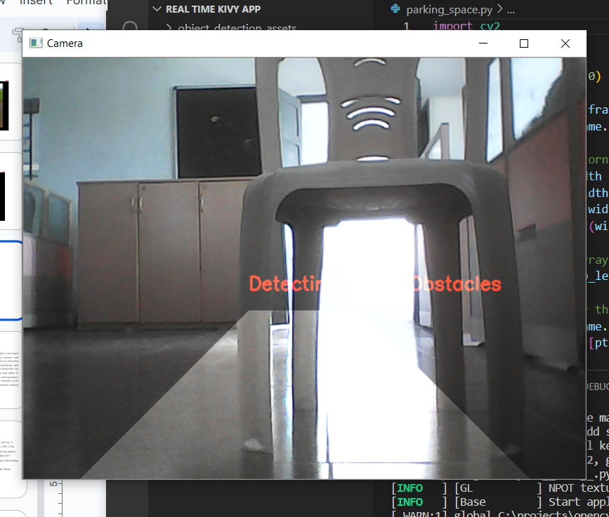
.
.
Fig 1.8 Detection of Obstacles while Parking

Slide 19
RESULTS AND DISCUSSIONS
In the Intelli-Drive System for detecting road obstacles, the performance can be evaluated based on the detection percentage in object and pothole detection, as well as the Frames Per Second (FPS) achieved during the detection process.
Detection Percentage
Detection Percentage = (Number of Correctly Detected Objects / Total Number of Objects) * 100
The system achieves a detection percentage above 85%, indicating a high level of accuracy in identifying and classifying road obstacles. This accuracy is crucial for ensuring the safety and reliability of the system's detections.

Slide 20
.
Frames Per Second
The formula for calculating FPS is as follows:
FPS = Number of Frames / Time Taken
where,
Number of Frames: This refers to the total count of frames processed by the system within a specific period. It can be obtained by tracking the number of frames as they are being processed during the detection phase.
Time Taken: This represents the duration of time it takes for the system to process the frames. It can be measured using a timer or by recording the start and end times of the detection process.
To calculate the FPS, divide the number of frames by the time taken. The resulting value represents the average number of frames processed per second.

Slide 21
CONCLUSION
In conclusion, the Intelli-Drive System for detecting road obstacles has been successfully developed with satisfactory performance. The system utilizes YOLO and OpenCV to detect various road obstacles, including objects, potholes, road lanes, and parking spaces. The system achieves a detection percentage above 80%, indicating a high level of accuracy in identifying and classifying road obstacles. This accuracy is crucial for ensuring the safety and reliability of the system's detections. By achieving these performance metrics, the System proves to be effective in enhancing road safety by providing real-time information about road obstacles. With its high detection accuracy and responsive processing speed, the system can assist drivers in navigating and avoiding potential hazards on the road. Overall, it has the potential to greatly improve driving safety and situational awareness, making it a valuable tool for drivers and contributing to safer roads.

Slide 22
FUTURE WORK
EfficientDet offers efficient inference performance, allowing real-time or near-real-time object detection on various platforms, including CPUs and GPUs.
By leveraging the power of deep learning and semantic segmentation, this approach can accurately identify the precise boundaries of potholes in an image, enabling effective detection and analysis.
By leveraging semantic segmentation with deep learning, road lane detection algorithms can accurately delineate the boundaries of road lanes, enabling tasks such as lane departure warning systems, autonomous driving, or advanced driver assistance systems (ADAS). The pixel-level information provided by semantic segmentation allows for precise lane positioning and assists in ensuring safe and reliable navigation on the road.

Slide 23
REFERENCES
Zhang, Y., Ren, Y., Xie, G., Wang, Z., Zhang, H., Xu, T., Xu, H., Huang, H., Bao, C., Pan, Z. and Yue, Y., 2020. Detecting object open angle and direction using machine learning. IEEE Access, 8, pp.12300-12306.
Kalayci, T.E., Ozegovic, G., Bricelj, B., Lah, M. and Stocker, A., 2022. Object detection in driving datasets using a high-performance computing platform: A benchmark study. IEEE Access, 10, pp.61666-61677.
Lin, C.C., Kuo, C.H. and Chiang, H.T., 2021. CNN-Based Classification for Point Cloud Object With Bearing Angle Image. IEEE Sensors journal, 22(1), pp.1003-1011.
Tresson, P., Carval, D., Tixier, P. and Puech, W., 2021. Hierarchical classification of very small objects: Application to the detection of arthropod species. IEEE Access, 9, pp.63925-63932.

Slide 24
.
[5] Kang, B., Jo, M. and Jeong, C.S., 2022. Clickable Object Detection Network for a Wide Range of Mobile
Screen Resolutions. IEEE Access, 10, pp.115051-115060.
[6] Li, X., Song, D. and Dong, Y., 2020. Hierarchical feature fusion network for salient object detection. IEEE
Transactions on Image Processing, 29, pp.9165-9175.
[7] Krišto, M., Ivasic-Kos, M. and Pobar, M., 2020. Thermal object detection in difficult weather conditions using
YOLO. IEEE access, 8, pp.125459-125476.
[8] Choi, J., Song, Y., Kim, Y., Yoo, J. and Kwak, N., 2022. MD3D: Mixture-Density-Based 3D Object Detection
in Point Clouds. IEEE Access, 10, pp.104011-104022.
[9] Cho, H., Lee, K., Choi, N., Kim, S., Lee, J. and Yang, S., 2022. Online Safety Zone Estimation and Violation
Detection for Nonstationary Objects in Workplaces. IEEE Access, 10, pp.39769-39781.

Slide 25
[10] Tao, Y., Zongyang, Z., Jun, Z., Xinghua, C. and Fuqiang, Z., 2021. Low-altitude small-sized object \
detection using lightweight feature-enhanced convolutional neural network. Journal of Systems Engineering
and Electronics, 32(4), pp.841-853.
[11] Sagues-Tanco, R., Benages-Pardo, L., Lopez-Nicolas, G. and Llorente, S., 2020. Fast synthetic dataset for
kitchen object segmentation in deep learning. IEEE Access, 8, pp.220496-220506.

Slide 26
.
THANK YOU

