Slide 1
XX Co. Market Entry Feasibility Study
US Vitamin Market

Slide 2



The Key Drivers of Success in the US Vitamin Market
Market size and growth potential
Competitive landscape
Consumer preferences
The global vitamin supplements market size was valued at USD 49.5 billion in 2020 and is expected to expand at a compound annual growth rate (CAGR) of 6.2% from 2021 to 2028
It is projected to reach $62.2 billion by 2027 and is expected to reach $70.3 billion by 2030(LRA)
The U.S. vitamin market is oligopolistic, with the top five companies accounting for just over 30% of the market share. This means that there are a small number of large companies that dominate the market, but there are also a number of smaller companies that compete in the market. This type of market structure is often characterized by high barriers to entry, which makes it difficult for new companies to enter the market.
Consumer preferences in the U.S. are shifting towards natural and organic products. According to a 2022 survey by the Natural Marketing Institute, 60% of U.S. consumers said they were willing to pay more for natural and organic products. This is a significant increase from the 52% of consumers who said the same in 2017.

Slide 3
The Key Drivers of Success in the US Vitamin Market
Consumer preferences
Regulatory environment
Distribution channels
The survey results suggest that the demand for natural and organic products is strong and growing. This is a trend that is likely to continue in the coming years. Companies that can offer high-quality natural and organic products at a competitive price are well-positioned to succeed in this market.
The FDA regulates dietary supplements in the United States. However, the regulations are less stringent than in other countries. For example, dietary supplements do not need to be approved by the FDA before they can be marketed. This makes it easier for new companies to enter the market and compete with established brands.
First, it allows new companies to enter the market more easily. Second, it allows companies to be more innovative with their products. Third, it allows companies to offer products at a lower price.
There are a number of well-established distribution channels for vitamins and supplements in the US. In 2022, 55% of vitamin and supplement sales were made through online retailers, 35% were made through brick-and-mortar stores, and 10% were made through direct mail.

Slide 4
The Size and Growth of the US Vitamin Market
Increasing awareness of the importance of vitamins and supplements
Growing demand for natural and organic products
Consumers are becoming more aware of the importance of taking vitamins and supplements to maintain their health. This is being driven by a number of factors, including the increasing prevalence of chronic diseases, the aging population, and the rising cost of healthcare.
Consumers are increasingly looking for natural and organic products, including vitamins and supplements. This is being driven by a number of factors, including the belief that natural products are safer and more effective than synthetic products, and the growing concern about the environmental impact of synthetic products.
Aging population
Rising disposable incomes
The aging population is a major driver of the vitamin and supplement market. As people age, they are more likely to experience nutrient deficiencies, which can lead to a number of health problems. Vitamins and supplements can help to prevent or manage these nutrient deficiencies.
As disposable incomes rise, more people are able to afford to buy vitamins and supplements. This is particularly true in developing countries, where the middle class is growing rapidly.
The vitamin and supplement market is a competitive market, with a number of well-established companies competing for market share. The key to success in this market is to offer high-quality products at a competitive price. Companies that can also differentiate their products from the competition will be well-positioned to succeed in this market.

Slide 5





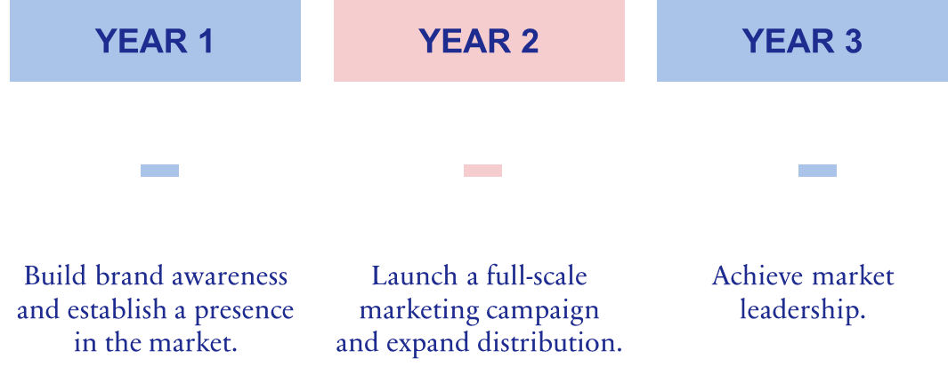
XX Co.'s Winning Formula for Success in the US Market
Build a strong brand identity in the US market
Partner with key retailers
Launch a comprehensive marketing campaign
Develop a strong distribution network
XX Co. can build a strong brand identity by investing in marketing and advertising. This could include creating a website, developing a social media presence, and running print and TV ads. XX Co. should also partner with key retailers to get its products on the shelves.
XX Co. can partner with key retailers by offering them exclusive deals or discounts. XX Co. should also work with retailers to create in-store displays and promotions.
XX Co. can launch a comprehensive marketing campaign by developing a creative and engaging message. XX Co. should also use a variety of marketing channels to reach its target audience.
XX Co. can develop a strong distribution network by partnering with distributors that have a wide network of retailers. XX Co. should also work with distributors to ensure that its products are always in stock.
XX Co. can build brand awareness by investing in marketing and advertising. This could include creating a website, developing a social media presence, and running print and TV ads. XX Co. should also partner with key retailers to get its products on the shelves.
XX Co. can launch a full-scale marketing campaign by developing a creative and engaging message. XX Co. should also use a variety of marketing channels to reach its target audience. XX Co. can expand distribution by partnering with new distributors and increasing its presence in existing channels.
XX Co. can achieve market leadership by continuing to invest in marketing and advertising. XX Co. should also focus on developing new products and services that meet the needs of its customers.
TIMELINE

Slide 6
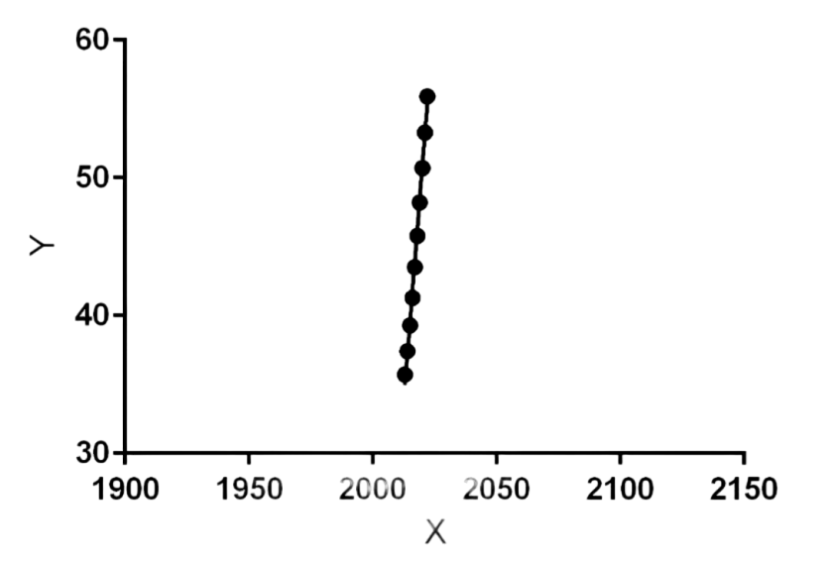
Success of XX Co.'s Market Expansion Plan
LINEAR REGRESSION GRAPH
Sales growth
Market share
CAC
CLV
ROI
XX Co. can track sales growth by comparing its sales figures from year to year.
XX Co. can track market share by comparing its sales figures to the sales figures of its competitors.
XX Co. can track customer acquisition cost by dividing its marketing and advertising costs by the number of new customers it acquires.
XX Co. can track customer lifetime value by multiplying the average customer lifetime by the average customer spend.
XX Co. can track return on investment by dividing its profits by its total investment.

Slide 7
APPENDIX
Abbreviations
CITATIONS
ROI – Return On Investment
CAC - Customer Acquisition Cost
CLV – Customer Lifetime Value
LRA – Linear regression Algorithm
KPI – Key performance indicator
CAGR - Compound annual growth rate
GTM - Go-to-market strategy
Source: Grand View Research, "Vitamin Market Size, Share & Trends Analysis Report by Product (Multivitamins, Multiminerals, Vitamin D, Vitamin B, Vitamin C), by Distribution Channel (Retail, Online), by Region, and Segment Forecasts, 2021-2028.
The US vitamin market is highly competitive.
The leading players in the market include:
GNC Holdings Inc. (market share: 12%)
Nature's Bounty (market share: 10%)
Amway (market share: 8%)
Herbalife Nutrition (market share: 7%)
The Vitamin Shoppe (market share: 6%)

Slide 8
BUSINESS OPPORTUNITIES ARE LIKE BUSES. THERE'S ALWAYS ANOTHER ONE COMING.
“
”
-Richard Branson
SUMMARY
XX Co. has a number of strengths that would make it successful in the US market. The company has a strong brand reputation, a wide range of products, and a strong distribution network. XX Co. also has a strong track record of innovation, which would help it to compete in the competitive US market.
The risks of expanding to the US market include the high cost of entry, the competitive landscape, and the regulatory environment. However, XX Co. can mitigate these risks by carefully planning its entry strategy and by partnering with experienced distributors and marketers.
Overall, the opportunities for XX Co. in the US vitamin market outweigh the risks. The company should expand its market to the US in order to capitalize on the growing demand for vitamins and minerals.

Slide 9
THANK YOU
Harish R
harish6717@gmail.com

