Slide 1
MACHINE LEARNING · CYBERSECURITY
ThreatShield
🛡️
Enterprise Insider Threat Detection Dashboard
An ML-based tool that automatically detects malicious insider threats
by analyzing employee behavioral data — with risk scoring & threat classification.
INSIDER THREAT
DETECTION
🤖
📊
🛡️
v1.0 | 2026
Random Forest
Classifier
Risk Score
Prediction
Threat Level
Classification
Made by: Harita Patil
Insider Threat Detection · ML · Cybersecurity

Slide 2
Introduction
What is ThreatShield?
🔍
What It Does
⚙️
Core Mechanism
ThreatShield is an ML-powered web application that automatically identifies malicious insider behavior within an organization by analyzing employee behavioral and activity-based data.
Employees' data — including department, campus, position, login patterns, file access, off-hours activity, and travel — is processed through a trained Random Forest model that returns binary predictions and probability-based risk scores.
🎯
Output Delivered
👥
Who It Serves
The system classifies each employee as Safe or Malicious, assigns a Risk Score (0–100%), and categorizes the threat as LOW, MEDIUM, or HIGH — displayed on an interactive Streamlit dashboard.
Security operations teams, HR departments, and enterprise IT administrators who need automated, data-driven threat intelligence without the need for manual log review.

Slide 3
Problem Statement & Solution
The Challenge — and How ThreatShield Solves It
⚠ THE PROBLEM
✔ OUR SOLUTION
Manual Process
Automated ML Detection
Security teams manually review thousands of access logs — a slow, error-prone, and unscalable approach.
Random Forest model trained on labeled employee data automatically flags malicious behavior with high accuracy.
Delayed Detection
Real-Time Risk Scoring
Insider threats often go undetected for months as subtle anomalies are hidden within large datasets.
Each employee receives a probability-based Risk Score (0–100%) enabling instant prioritization.
→
No Risk Prioritization
Threat Level Classification
Without automated scoring, analysts cannot prioritize which employees to investigate first.
Employees are classified as LOW, MEDIUM, or HIGH risk — color-coded for fast visual triage.
High False Negative Rate
Interactive Dashboard
Traditional rule-based systems miss evolving threat patterns that don't match predefined signatures.
Streamlit UI provides upload, preview, detection table, summary stats, and distribution charts in one place.
Resource Intensive
Scalable & Cost-Effective
Dedicated security analysts are expensive; smaller orgs have no viable insider-threat monitoring option.
Batch CSV prediction allows any organization to analyze hundreds of employees in seconds, no analyst needed.

Slide 4
Tech Stack Overview
Technologies & Tools Used in ThreatShield
🖥️ Frontend / UI
🧠 ML / Data Science
⚙️ Dev Environment
Streamlit
Scikit-learn
Python 3.x
Interactive Python web app framework for the dashboard UI
Random Forest model training, prediction, and evaluation
Primary programming language for all modules
Matplotlib
Pandas
Jupyter Notebook
Static chart generation for threat level distribution
Data loading, cleaning, preprocessing, and manipulation
Exploratory data analysis and model prototyping
Seaborn
NumPy
VS Code
Statistical visualization and data exploration plots
Numerical operations and array processing
Main IDE for development and debugging
End-to-End Pipeline: Upload CSV → Preprocess → Predict → Score → Visualize

Slide 5
Dataset & Model Used
Data Source, Features, and ML Algorithm
📂 DATASET
🤖 ML MODEL
Insider Threat Dataset for Corporate Environments
Algorithm :
Random Forest Classifier
Source: Kaggle | Target column: is_malicious
Task Type :
Binary Classification (Supervised)
Feature
Description
employee_department
Department / business unit
Label Values :
0 = Safe / 1 = Malicious
employee_campus
Physical campus location
Probability :
predict_proba() → Risk Score %
employee_position
Job designation / role
employee_seniority_years
Years of work experience
Threshold LOW :
< 50% probability of malicious
login_behavior
Off-hours / unusual login patterns
Threshold MED :
50 – 80% probability
file_access
Sensitive file access indicators
Threshold HIGH :
> 80% probability of malicious
travel_related
Business travel activity data
✦ Handles mixed/categorical features · Robust to noise · Probability output
is_malicious (target)
0 = Safe / 1 = Malicious
Serialization :
Pickle / joblib (.pkl)

Slide 6
Approach & Workflow
End-to-End ML Pipeline — How We Built It
01
Data Loading & EDA
02
Data Preprocessing
03
Feature Engineering
Load dataset from Kaggle CSV. Perform exploratory data analysis: check dtypes, value counts, class distribution, and visualize feature correlations.
Handle missing values and duplicate records. Apply one-hot encoding to categorical columns. Normalize/standardize numerical features where required.
Separate input features (X) from target variable (y = is_malicious). Identify high-importance features. Ensure consistent column ordering for inference.
04
Model Training
05
Prediction & Scoring
06
Dashboard Deployment
Split data 80/20 into train/test sets. Train a Random Forest Classifier. Tune hyperparameters. Evaluate with accuracy, precision, recall, and F1 score.
Run predict() for binary labels. Run predict_proba() to generate probability-based Risk Scores (0–100%). Map probabilities to LOW / MEDIUM / HIGH threat levels.
Build Streamlit frontend with CSV upload, data preview, detection table, summary metrics, and Matplotlib/Seaborn charts. Deploy locally with streamlit run.

Slide 7
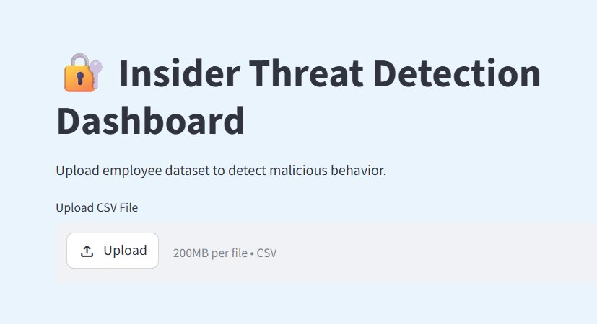
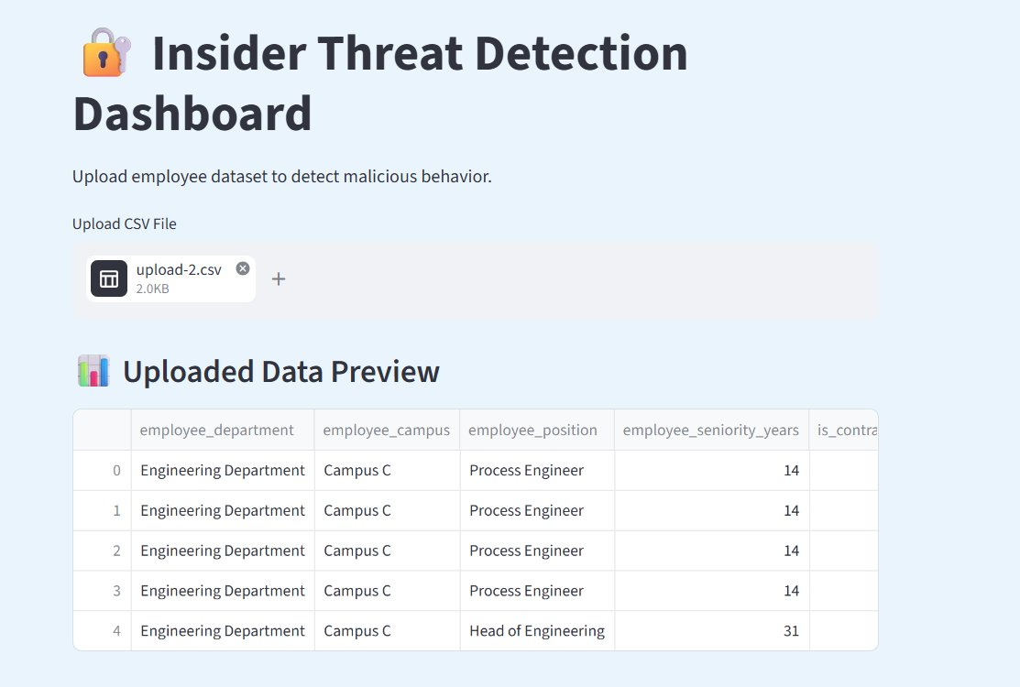
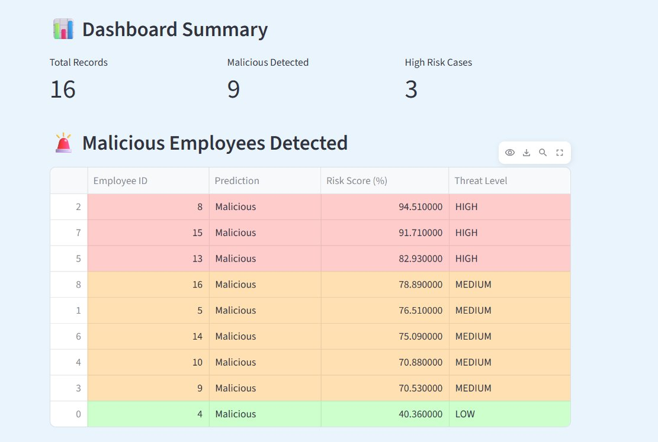
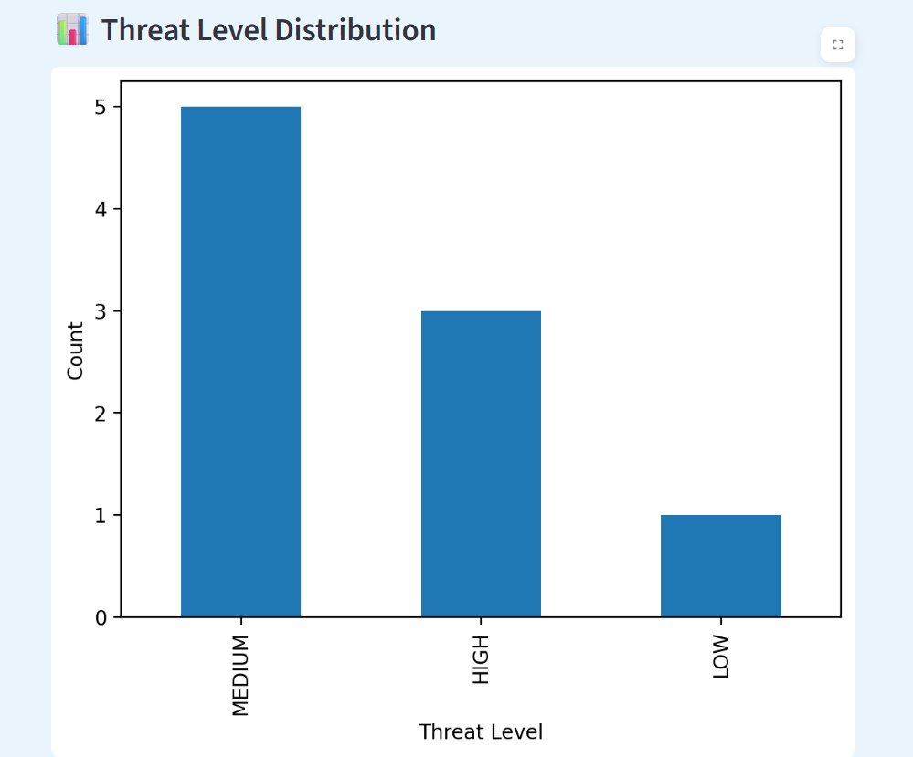
Frontend Demo
Streamlit Dashboard — User Interface Walkthrough
① CSV Upload Interface
② Uploaded Data Preview Table
③ Detection Results — Color-Coded Risk Table
④ Threat Level Distribution Chart

Slide 8
Backend Development
Python ML Pipeline — Architecture & Modules
📥
CSV Ingestion Module
Data Flow Pipeline
Reads uploaded file via Pandas. Validates column schema and strips invalid/empty rows before downstream processing begins.
Upload CSV File
▼
Validate & Read with Pandas
⚙️
Preprocessing Engine
▼
Applies one-hot encoding to all categorical variables. Aligns feature column order to match the training-time schema before inference.
One-Hot Encode Features
▼
Load RF Model (.pkl)
🧠
Prediction Engine
▼
predict() + predict_proba()
Loads serialized .pkl model. Runs predict() for binary output and predict_proba()[:,1] for per-employee malicious probability score.
▼
Compute Risk Score (%)
Risk Classifier
▼
🚨
Classify Threat Level
Maps probability to threat level: HIGH (>80%), MEDIUM (50–80%), LOW (<50%). Sorts results by risk score descending for triage.
▼
Render Dashboard Results

Slide 9
Results & Performance Metrics
ML Model Evaluation — Random Forest Classifier
97%
74%
69%
71%
Accuracy
Precision
Recall
F1 Score
Overall correct predictions
True malicious out of flagged
Actual threats identified
Harmonic mean of P & R
Classification Report
Threat Level Distribution — Live Demo
Class
Precision
Recall
F1-Score
Support
Safe (0)
0.98
0.99
0.98
—
Malicious (1)
0.74
0.69
0.71
—
Accuracy
0.97
—
Macro Avg
0.86
0.84
0.85
—
Weighted Avg
0.97
0.97
0.97
—

Slide 10
Future Scope
Planned Enhancements & Roadmap
01
🔄
Real-Time Log Monitoring
02
🚀
Advanced ML Models — XGBoost & Deep Learning
Integrate with enterprise SIEM platforms (Splunk, ELK Stack, Azure Sentinel) for continuous ingestion of live employee access logs, email activity, and network telemetry — replacing batch CSV uploads with streaming threat detection.
Replace Random Forest with XGBoost or LSTM-based models to capture temporal behavioral patterns. Ensemble methods will improve recall for edge-case insider threats that simple classifiers miss.
03
🔔
Automated Alert & Incident Response
04
🔍
Explainable AI (XAI) & Compliance Reporting
Add email / Slack / SMS notification triggers on HIGH-risk detection events. Integrate with ITSM platforms (Jira, ServiceNow) to auto-create incident tickets and escalation workflows for security analysts.
Integrate SHAP and LIME libraries to explain individual predictions — showing which employee features drove the risk score. Generate automated audit-ready PDF compliance reports for regulatory bodies.

Slide 11
🛡️
Thank You!
ThreatShield: Enterprise Insider Threat Detection Dashboard

