Slide 1
Credit Card Default Prediction Project Predicting Defaults Using Machine Learning Models
Team Members:
Hariteja Thallapelli
Noolkanti Manish Yadav

Slide 2
agenda
Introduction and Project Overview
Data and Preprocessing
Modelling and Techniques
Results and Comparison
Insights, Deployment, and Conclusion

Slide 3

Introduction
Objective: To predict whether a credit card holder will default on their payment next month.
Why It Matters: Helps financial institutions manage credit risk, minimize losses, and improve decision-making.
Dataset: Records of 30,000 clients from Taiwan, 23 features including demographics and payment history

Slide 4

Project Scope
Focus: Build and compare machine learning models to predict credit card defaults. Address challenges like class imbalance and feature selection.
Models Used: Logistic Regression and Random Forest.
Key Stages: Data preprocessing, feature engineering, model training, and performance evaluation.
Project Objectives
Exploratory Data Analysis (EDA)
Handle Class Imbalance
Model Optimization
Model Comparison
Insights & Recommendations

Slide 5
Dataset Overview
Dataset Overview
Dataset Source: Credit card client data from Taiwan.
Size: 30,000 records with 25 features.
Key Features
Demographic Information:
AGE, SEX, MARRIAGE, EDUCATION
Credit & Payment Details:
LIMIT_BAL: Credit limit.
BILL_AMT1-6: Bill amounts for the past 6 months.
PAY_AMT1-6: Payment amounts for the past 6 months.
PAY_0 to PAY_6: Repayment status (current month to 6 months ago).
Target Variable:
Y: Indicates if a customer defaulted (1 = Yes, 0 = No).
Distribution of Defaults
Non-Default (Y = 0): 78%
Default (Y = 1): 22%

Slide 6
Exploratory Data Analysis (EDA) Insights
Default by Gender:
Males have a higher default rate compared to females.
Females represent a larger proportion of non-defaulters.
Conclusion: Gender may influence default likelihood.
Default by Age:
Most defaulters fall within the 20-40 age range.
A peak in default rates is observed around age 30.
Conclusion: Younger individuals, particularly around 30, are at higher risk of default.
Default by Credit Limit:
Higher default rates seen in clients with lower credit limits.
Non-defaulters tend to have higher credit limits.
Conclusion: A correlation exists between credit limit and default risk.

Slide 7
Data Preprocessing Steps
Handling Missing Values:
No missing values in the dataset, so no imputation was required.
Feature Scaling:
Used StandardScaler to normalize numerical features like credit limit, bill amounts, and payment amounts for consistency.
Encoding Categorical Variables:
Applied One-Hot Encoding to transform categorical features (e.g., SEX, MARRIAGE, EDUCATION) into numerical format for machine learning models.
Feature Engineering:
Created new features to improve model performance:
Credit Utilization Ratio: Bill amount to credit limit ratio.
Payment Ratio: Payment amount to bill amount ratio.
Average Bill Amount: Mean of bill amounts over the past 6 months.
Payment Status Trend: Change in payment status over time.

Slide 8

Handling Class Imbalance
Problem
Class Imbalance: The dataset has a significant imbalance between classes, with only 22% of clients being defaulters. This imbalance can lead to biased model predictions, where the model may favor the majority class (non-defaulters).
Solution
SMOTE (Synthetic Minority Over-sampling Technique):
Description: SMOTE is a resampling technique that generates synthetic samples for the minority class (defaulters) by interpolating between existing samples.
Implementation: For each minority class instance, SMOTE identifies its nearest neighbors and creates new instances along the line segments connecting the minority class instance to its neighbors.
Benefit: This technique increases the number of minority class instances, helping the model learn more about the defaulting behavior and improving prediction performance.
Outcome: Using SMOTE helps the model to generalize better and reduces the likelihood of underfitting the minority class.

Slide 9

Models Used for Credit Card Default Prediction
Model | Type | Why? | Advantages | Limitations
Logistic Regression | Linear model | Provides a simple and interpretable baseline. Predicts the probability of default using a linear relationship between features. | Fast and easy to implement. Produces interpretable results. | Limited to linear relationships. Less effective with complex patterns in data.
Random Forest | Ensemble learning model (Decision Trees) | Handles non-linear relationships and interactions between features. Reduces overfitting by averaging multiple decision trees. | Better performance on complex datasets. Built-in feature importance ranking. | More computationally intensive. Less interpretable compared to Logistic Regression.

Slide 10
Model Evaluation Metrics
Metric | Definition | Importance
ROC-AUC | The proportion of true results (both true positives and true negatives) among the total number of cases examined. | Provides a general measure of model performance but can be misleading in imbalanced datasets.
Precision | The ratio of true positives to the sum of true positives and false positives. | Indicates the accuracy of positive predictions; important when the cost of false positives is high.
Recall | The ratio of true positives to the sum of true positives and false negatives. | Measures the ability of the model to identify all relevant instances; critical in cases where missing a positive case is costly (e.g., defaults).
F1-Score | The harmonic mean of precision and recall, providing a balance between the two. | Useful when the class distribution is imbalanced; a single metric that reflects both precision and recall.
ROC-AUC | The area under the Receiver Operating Characteristic curve, which plots true positive rate against false positive rate. | Represents the model’s ability to distinguish between classes; a higher AUC indicates better performance.

Slide 11
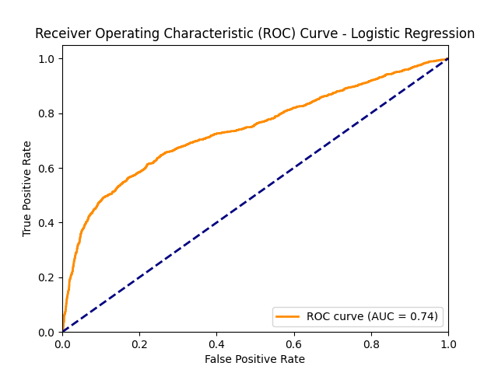
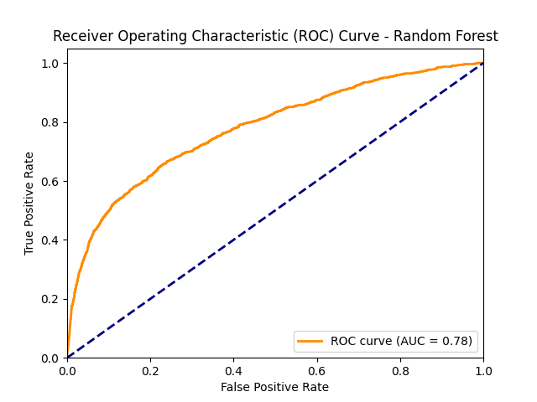
Performance Results
Logistic Regression
Performance:
AUC: 0.74 (Moderate performance)
Key insights: Effective for basic risk prediction, limited by linear assumptions
ROC Curve: Demonstrates initial steep rise, gradual plateau
Random Forest
Performance:
AUC: 0.78 (Better performance)
Key insights: Captures non-linear patterns, better prediction accuracy
ROC Curve: Steeper and more consistent rise compared to Logistic Regression

Slide 12
Model Comparison & Feature Importance
Model Comparison
Logistic Regression
AUC: 0.74
Performance: Moderate performance; effective for basic risk prediction but limited by linear assumptions.
Random Forest
AUC: 0.78
Performance: Better performance; captures non-linear patterns, leading to improved prediction accuracy.
Conclusion
Random Forest outperforms Logistic Regression, especially in handling complex relationships within the data.
Feature Importance (Random Forest)
Most Important Features:
Payment History: PAY_0 and PAY_2 are crucial indicators of default likelihood.
Credit Limit: LIMIT_BAL significantly impacts default risk.
Bill and Payment Amounts: Recent bill amounts and payments further contribute to risk assessment.
Insights
Recent payment history is identified as the strongest predictor of defaults, emphasizing the importance of monitoring repayment behaviors.

Slide 13
Conclusion
Summary:
Random Forest outperformed Logistic Regression (AUC 0.78 vs 0.74)
Key predictive features: payment history, credit limit
Recommendations:
Focus on monitoring recent payment behavior
Adjust credit limits based on behavior
Consider ensemble methods for credit risk assessment
Future Work
Explore advanced algorithms (e.g., Gradient Boosting)
Implement a real-time risk assessment system
Perform cost-benefit analysis of different thresholds

