Slide 1

IN Tryst with Testing
Presented by Brahma

Slide 2
What are we going to know
What is testing
Why testing exists
Types of testing
What I did in testing
What I learnt doing testing

Slide 3
What is Testing
Test
Activity in which a system or component is executed under specified conditions, the results are observed or recorded, and an evaluation is made of some aspect of the system or component [1]
- Do something and get something
Test Case
A set of preconditions, inputs and expected results, developed to drive the execution of a test item to meet test objectives [1]
- Do this thing and see if you get that thing
Basic terms and definitions
[1] "ISO/IEC/IEEE International Standard - Software and systems engineering --Software testing --Part 1:General concepts," in ISO/IEC/IEEE 29119-1:2022(E) ,27 Jan. 2022, doi: 10.1109/IEEESTD.2022.9698145.

Slide 4
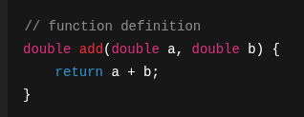

How do you "fully" test this
A double has 64 bits -> 2⁶⁴ combinations)
You have 2 inputs so 2⁶⁵ combinations
One test per millisecond
Takes 1,169,084,092 years
Nearly 1.17 billion years
Impractical
Pointless
How do we reduce the testing burden ?
Exhaustive Testing

Slide 5
Testing based on -Equivalence classes
Testing based on grouping different inputs (each group is an equivalence class)
Believing that every input in one group will be treated similarly
Testing one input in one group means the whole group can be considered tested
E.g., If input is a month, then the range will be 1-12
So, the grouping can be [-∞..0],[1..12],[13..∞] 3 groups one from each and 3 tests
But what if you have more inputs
You have 5 inputs ,and each has 5 groups ,that’s 25 classes to test
You should try the combinations for cross impact
Test the boundaries
Testing '0' values
And some random tests .. for good measure
Notes:
Some might not have equivlanet classes – like Boolean inputs .. Talk about them also

Slide 6
Testing based on -Coverage
Testing based on Different coverage criteria
Statement coverage [is every line in the code covered ??]
Condition coverage [is every condition in an expression was TRUE and FLASE ??]
Decision Coverage [all decisions are covered … like if/else ,switch, while etc.,]
Branch coverage[same as decision but with implicit conditions also]
Modified Condition Decision Coverage (MCDC)
[every input is toggled the output independently]
[important for safety critical systems]

Slide 7
WHY is testing required ?
Do we need testing !!!

Slide 8
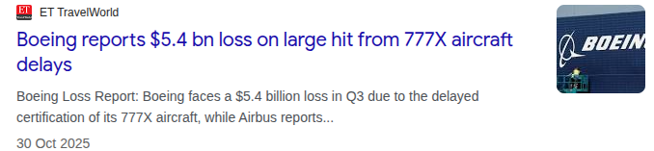

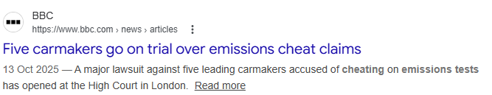
Testing takes 75% of development budget [1]
Testing is one of the boring job in Software lifecycle
- a bored tester
[1] https://ntrs.nasa.gov/api/citations/20190002301/downloads/20190002301.pdf

Slide 9
What we get form testing
Defects
Evidence for conformance to
Specifications
Standards
Regulations
Safe and unsafe scenarios to use a product
Asses the quality
Support for decision making
Some confidence that the product works
Sometimes it's mandatory to provide test results for certification.
Particularly for safety critical systems [defense, medical, aerospace, automotive, etc.,]

Slide 10
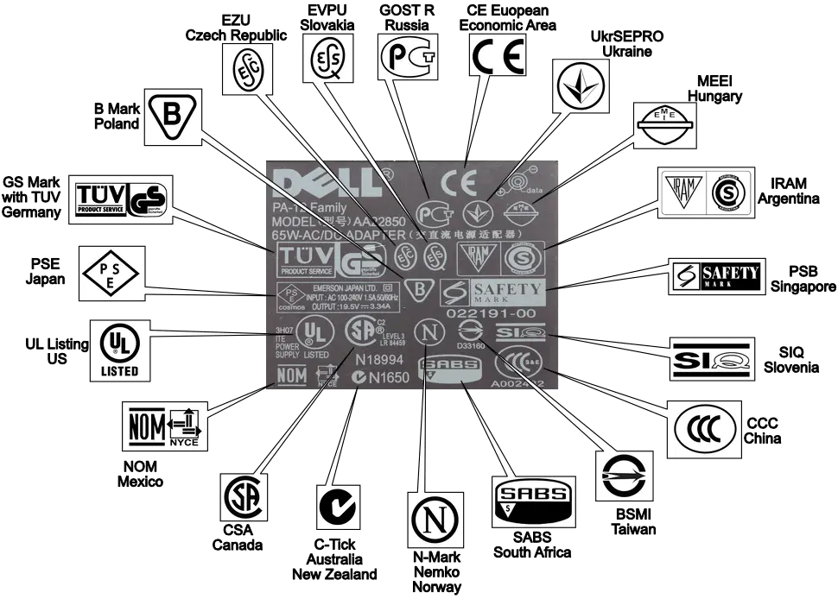
Laptop charger Compliance marking

Slide 11
Different Types of Testing
There are more than 1 for sure

Slide 12
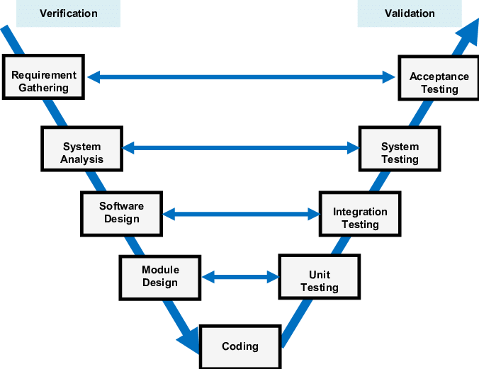
The v-Cycle of Software development
The 4 levels of testing identified are
Unit Testing
Integration testing
System Testing
Acceptance testing

Slide 13
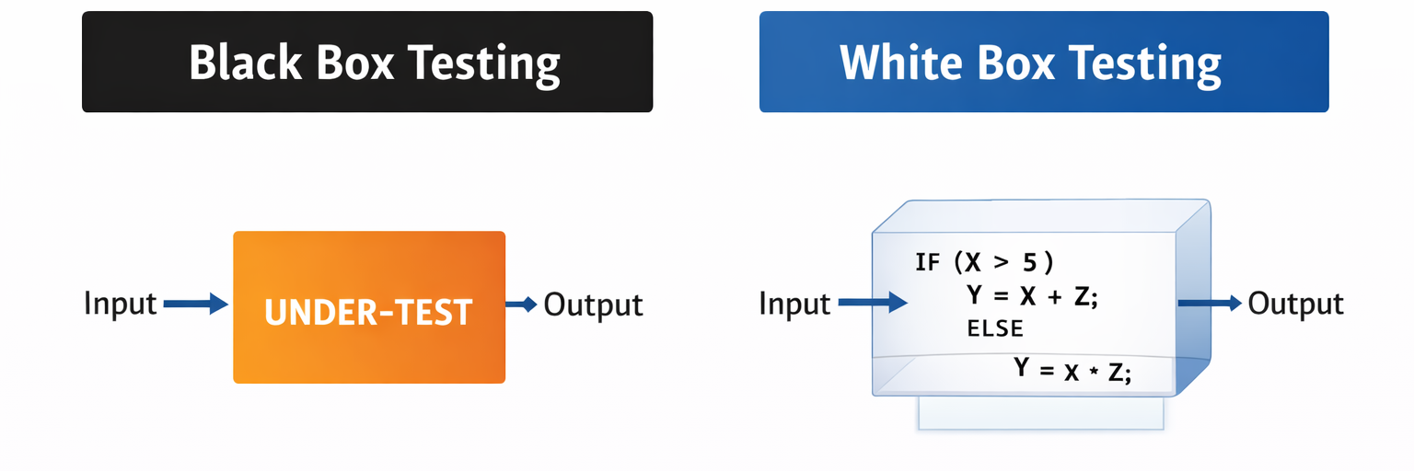
The internal structure in unknown | The internal structure in known
Best source is specification/requirement | Best source is code
Target for functional testing and conformity | Target for Coverage, dataflow testing, data & control coupling (DCCC)
Best suited for system level | Can be used at all levels

Slide 14
What I did in testing
Starting from the starting 🙄

Slide 15
doing first test
When I started my career as an engineer the fist task given to me was to run an existing test on a test setup.
Simple straight forward [ I did not need to know what it was or why … just how]
It passed … I was happy
After 1 month …. Not so happy doing the same thing again and again
The next task was to update a test case… finally some thing interesting
But I don’t know how to update it
My senior helped -> simple constant value change
Tested again … it passed … I was happy
Few more months passed …. Did small update to test cases … testing became boring
Then came a big update which needed a new test case
- But how to write it ??

Slide 16
Writing first test case
But how to write it ??
There will always be a format [may be different for each team or company]
A General template ^{[1]} will have
Unique identifier
Objective
Priority
Traceability
Preconditions
Inputs
Expected results
Not to be confused with Test procedure
- Test procedure is a collection of test cases which needs to be executed in a specific order to get expected results, necessary preconditions, and any cleanups post test.
[1] "IEEE/ISO/IEC International Standard for Software and systems engineering--Software testing--Part 3:Test documentation," in ISO/IEC/IEEE 29119-3:2021(E) ,28 Oct. 2021, doi: 10.1109/IEEESTD.2021.9591577.

Slide 17
Developing a test case
Writing a test case based on existing samples will be relatively straight forward
You have a reference
Make your new test case based on the reference
Now you know the
how to test
what are you testing
But what if you were not given a reference and you only have a low-level description

Slide 18
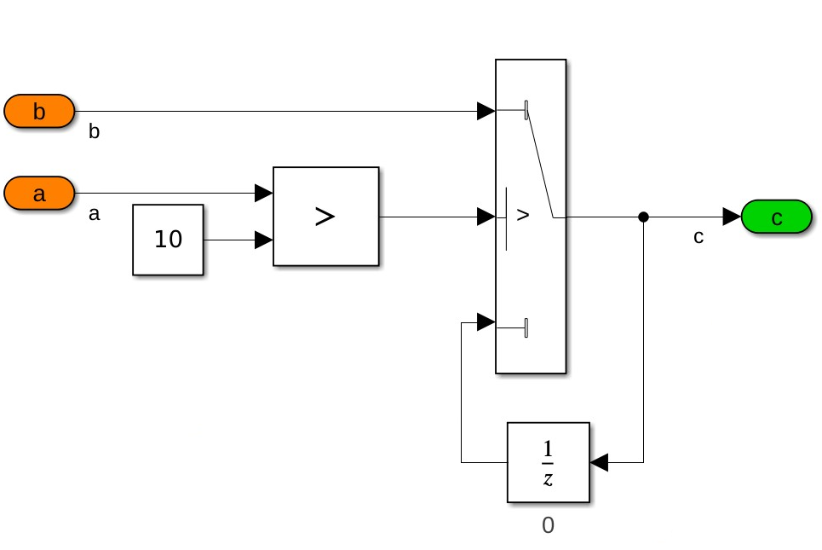
A sample low level requirement
If input a is more than 10 update output c with the value of input b, else hold to the previously updated output, the initial updated output value is 0.
How do you write a test case for this

Slide 19
What do you want to test for
Functionality
Coverage [for white box]
Data coupling
Control coupling
Bug identification ……. and many more
Based on your target; the type of test cases change
You can use multiple test approaches as well
Model-based testing
Mutation testing
Combinatorial testing
Path testing …………….. and many more
What test case needs to be written will always depend on what you want to achieve form the testing

Slide 20
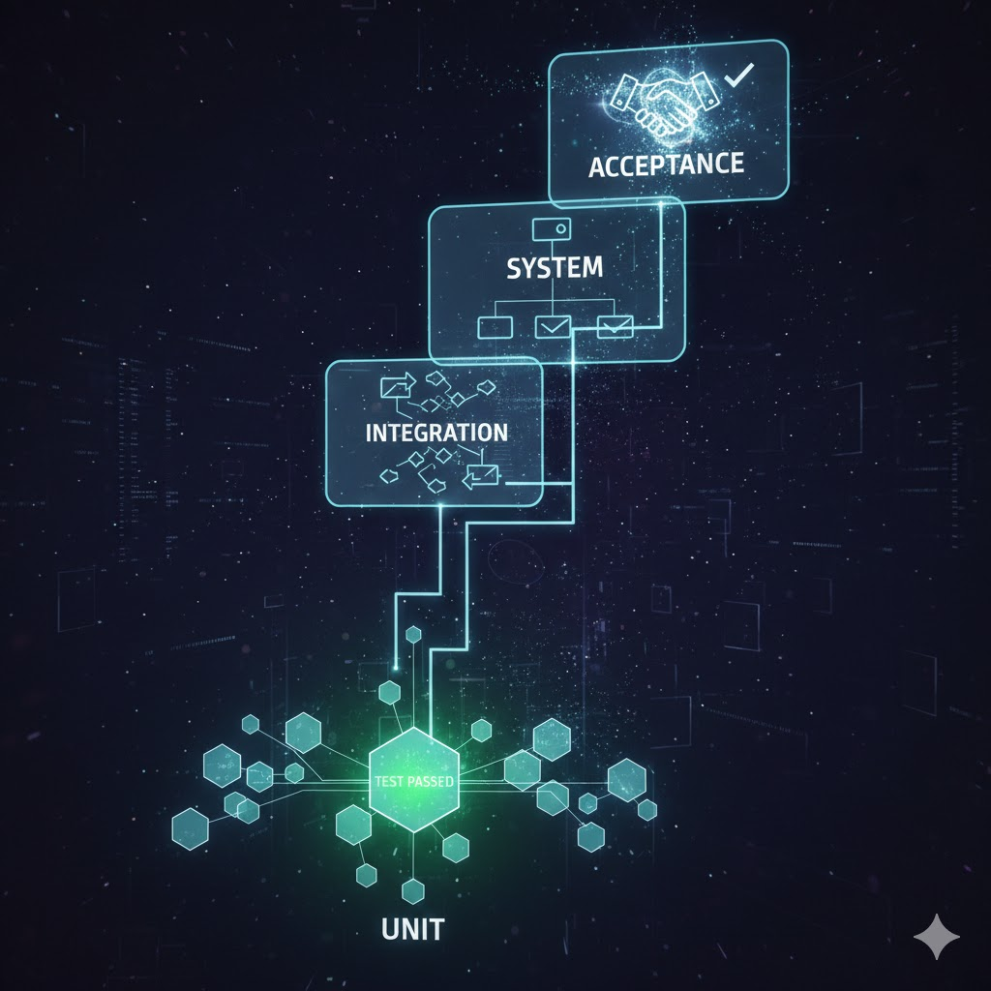
That was just Unit testing

Slide 21
Unit testing
involves
Benefits
Testing in isolation
Different test environment than the final one
Fast regression
Stubbing
Test cases only target the unit
Coverage is local
Changes become easy to handle
Integration becomes little simple
Documentation
Helps in clarifying specifications and any improvements

Slide 22
Writing effective unit tests involve
Understanding Requirements
Complex Logic
Dependencies (Mocking/Stubbing)
State Management
Test Maintainability
Performance Overhead
False Positives/Negatives
Test Coverage
Testing Edge Cases
Maintaining Test Independence

Slide 23
As the experience grows , testing level also increases
Integration testing
System testing
Acceptance testing

Slide 24
Integration testing
Where more than one individual components (units) are tested to verify if they are correctly interacting with each other
For a system like e-commerce consider
cart is implemented as one moule
Payments is implemented as one module
Now if you need to finish a purchase
cart value needs to be passed to the payment AND
payment confirmation need to be passed back cart
Integration testing is where these exchanges are tested
it is not required that the test verify
if the value form cart is correct
and the payment done for the expected value

Slide 25
Integration Testing Strategies
Big-bang
Top-down
Bottom-up
Critical-first
Function-at-a-time
As-delivered
Sandwich

Slide 26
System testing
Where the final system is tested if it is
Compliance with functional requirements
Compliance with non-functional requirements
System testing should
Use final real environment
Test functionality as a user and designer
Check on performance
Speed
Latency
Load
Test how failures are handled
System testing is the last place where failure could be accepted
System testing provides the confidence on the system as a whole
The environment is real and testcases are real world

Slide 27
Acceptance testing
Where the customer or end user tests the system
Beta testing
Crowd testing
Compliance testing
Field Testing
Acceptance testing validates
Business requirements
User workflows
Real-world usage
Contract conditions
Regulatory rules
Acceptance testing is where you decide to release or not to
Acceptance testing is executed in non developmental perspective
Non one cares how the system is inside
Only yard stick is how well it performs

Slide 28
What I learnt doing testing
Personal experiences

Slide 29

Rules of thumb
To conduct a successful test campaign
Decide an overall strategy
What level are you testing
What type are you testing (black box or white box)
What do you want to achieve
What is the minimum required
What is the maximum you want to do (when to stop)
What are must to do (for certifications , conformities etc.,)
Create a test plan [and document it properly]
Stick to the plan
Log all defects
Document all lessons learnt

Slide 30

Qualities of a tester
Independent of designing team
Think like a user
Have curiosity
Lots of patience
Good documentation skills
You need all the evidence to support you
A little bit courageous
Notes:
Discuss steering wheel issue .. And general test pilots

Slide 31
Any Queries ??
That’s all what I want to talk about Testing

Slide 32
Let’s put what we learnt to action
Class Activity

Slide 33

Class Activity 4 : Testing
4 questions
20 marks
NO MOBILES
NO COMPUTERS
NO CHEATING

Slide 34
Graded Activity 4 - Testing
ANNAPURNA the food delivery app shall calculate the final amount payable as follows.
The user provides the food order amount, the delivery distance in kilometers, whether they are a premium member, and an optional coupon code.
Delivery charges are based on distance. If the distance is up to 5 km, the delivery charge is ₹20. If the distance is more than 5 km, the delivery charge is ₹50. Premium members do not pay any delivery charge.
If the order amount is ₹500 or more, a discount of 10% is applied to the order amount. A coupon code SAVE50 provides an additional ₹50 discount, but only when the order amount is at least ₹300. The total discount applied cannot exceed ₹100.
Identify Equivalence classes with examples for at least two inputs – 2 marks
Identify 2 ‘units’ in the requirement and write at least 3 unit level testcases for each – 6 marks
Identify at least 4 end-to-end use case scenarios – 4 marks
Write testcases in generic template for the 4 use case scenarios – 8 marks

