Slide 1
Transformers
CV Jawahar
IIIT-H
17 April 2025

Slide 2
Overview
Embeddings
Self Attention
Transformer Block
Encoder and Decoder configuration
Self Supervised Learning for Language

Slide 3
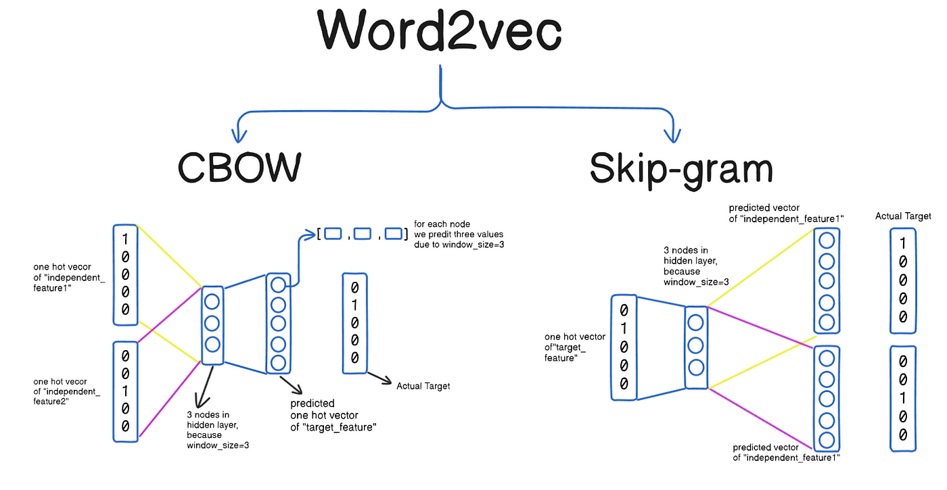
Word Embedding: Self Supervised Learning

Slide 4
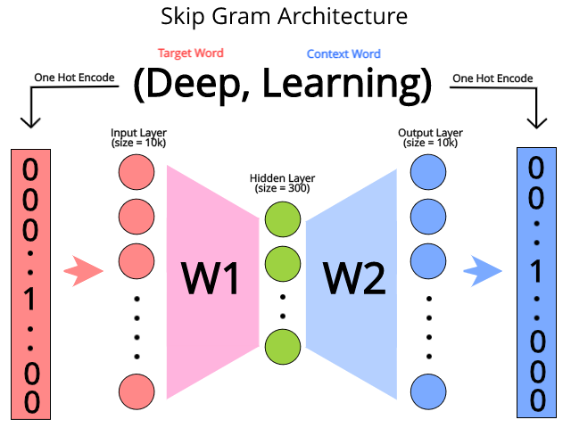
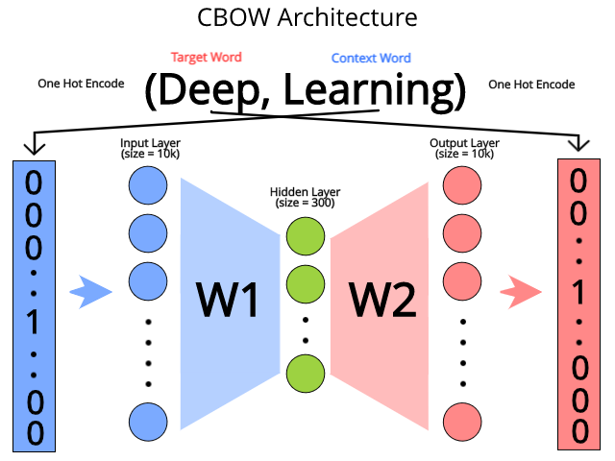
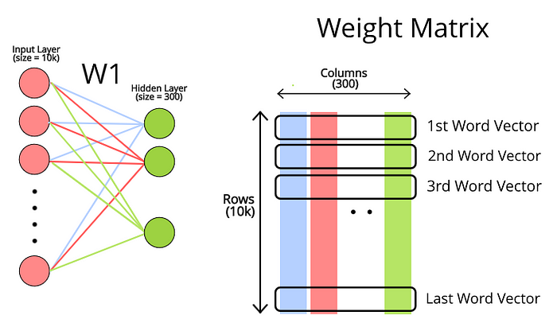
Words to Embeddings (Vector)

Slide 5
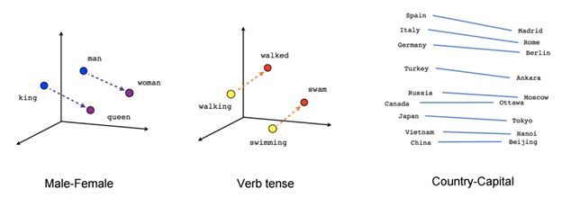
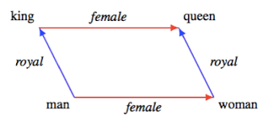
Word Arithmatic
King – Queen = Man – Women

Slide 6
Self Attention

Slide 7
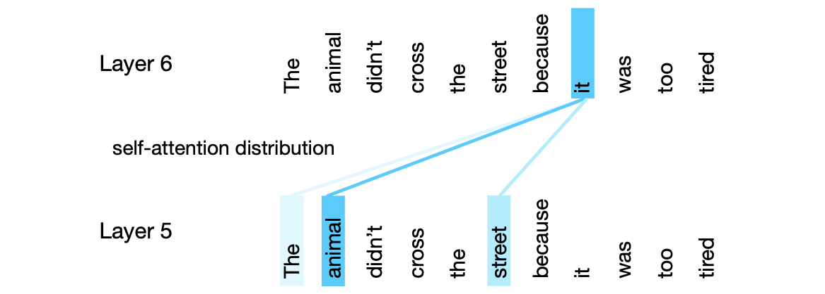
Self Attention

Slide 8
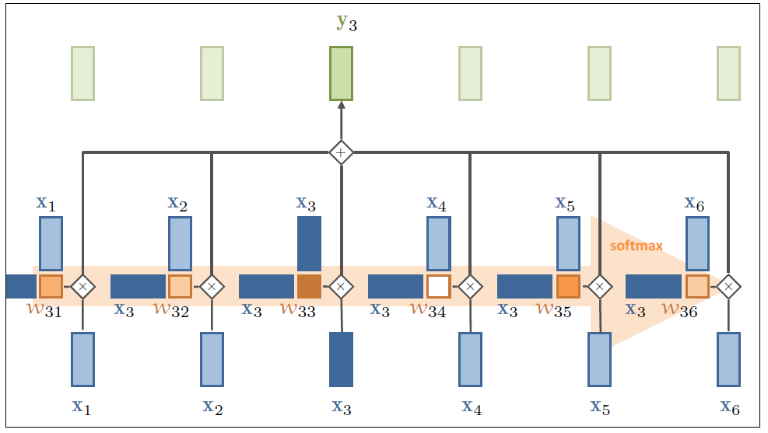
SA: Simple Self Attention

Slide 9
SA: Observations
Input and Output:
Vectors are of same in number and dimension
Set of vectors (in simple form). Add position, if required.
Every output vector is influenced by “all” input vectors.
“W” is not learned here. It is computed from the input/data.

Slide 10
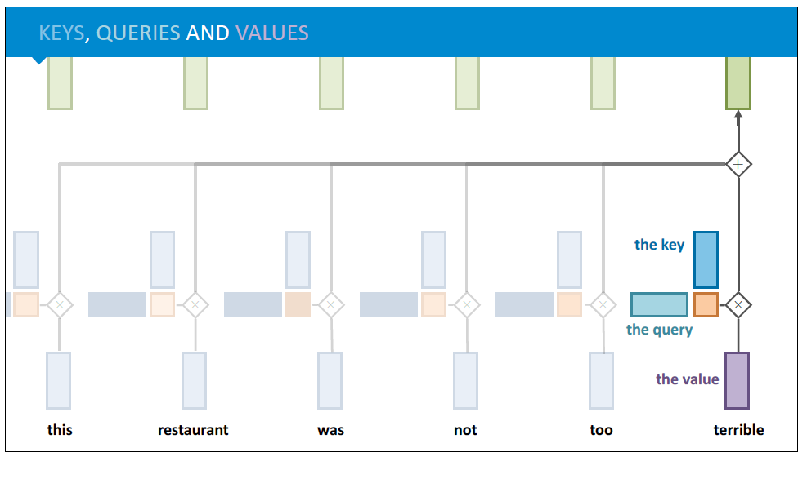
Query, Key and Value

Slide 11
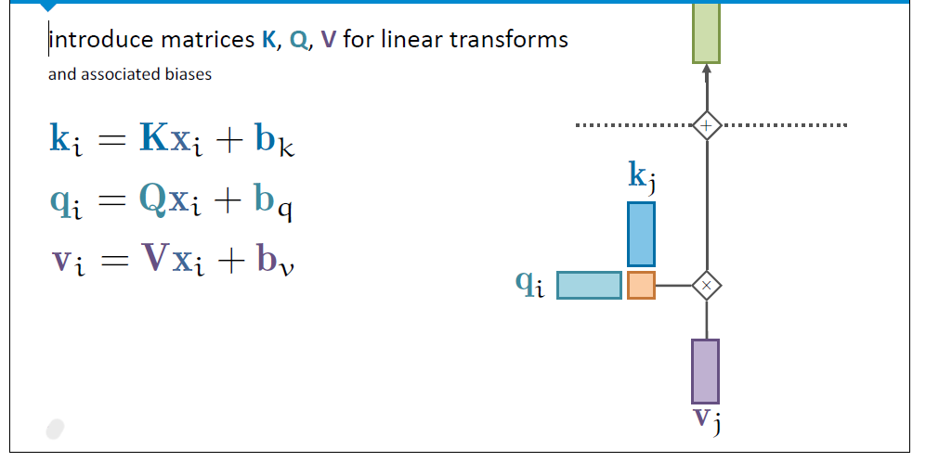
Learnable “Query”, “Key” and “Value”

Slide 12
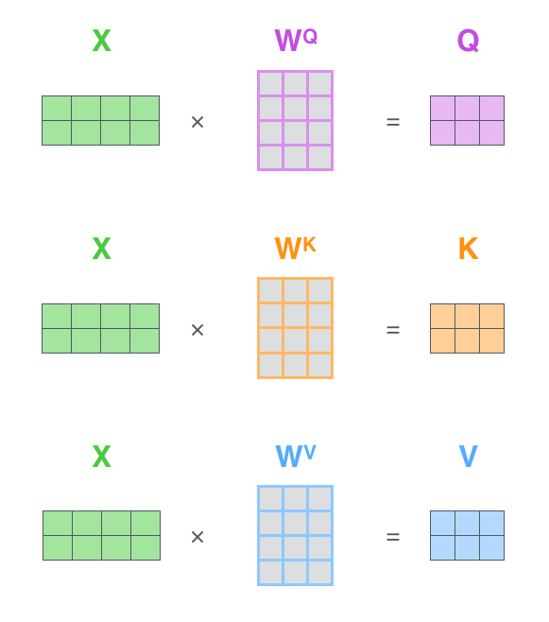
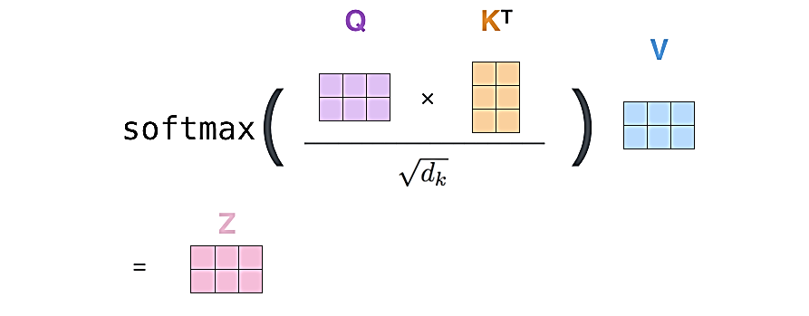
Matrix View

Slide 13
Parallelizable Computation

Slide 14
Multi Head Attention: Why?
Why are we limited to one query, key and value?
Multiple Feature Maps (like Convolution Layers)

Slide 15
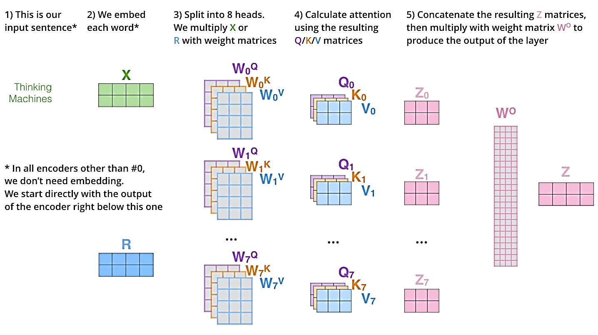
Multi-Head Attention

Slide 16
Summary Multi Head Attention

Slide 17
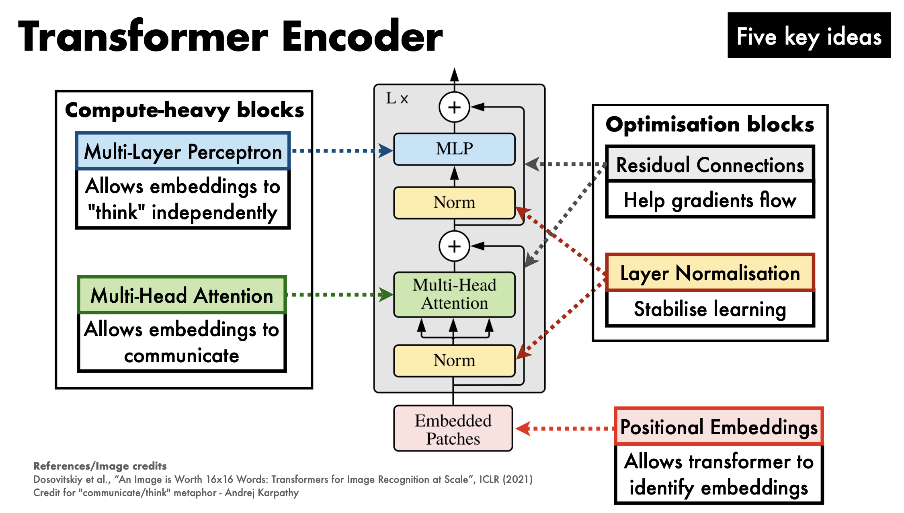
Transformers

Slide 18
Transformer Block
Both X and H are of N X d

Slide 19
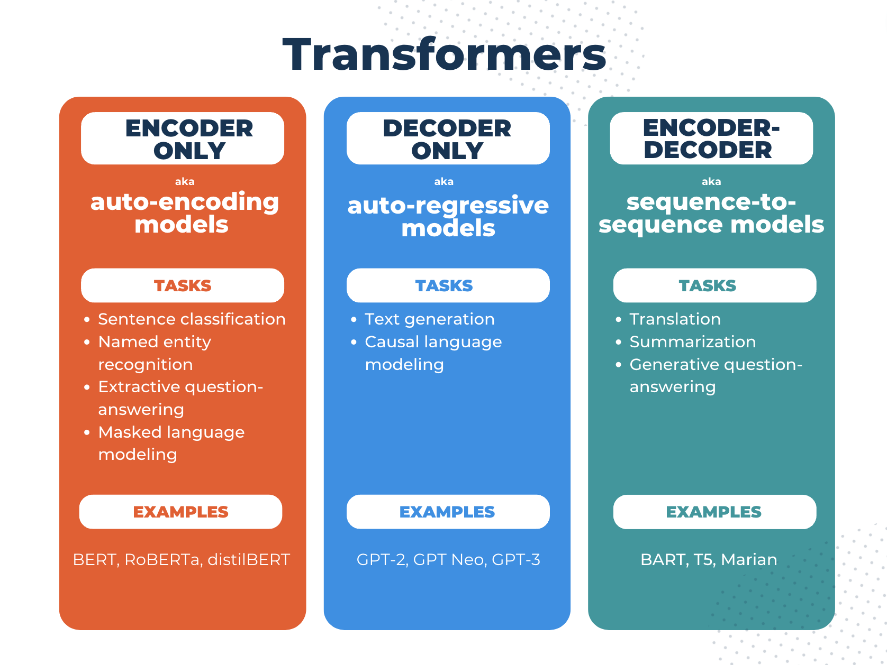
Configurations

Slide 20
Transformer

Slide 21
Sentence Completion

Slide 22
Eg. A Complete Decoder Model

Slide 23
Questions?

Slide 24
Query, Key and Value

Slide 25
