Slide 1
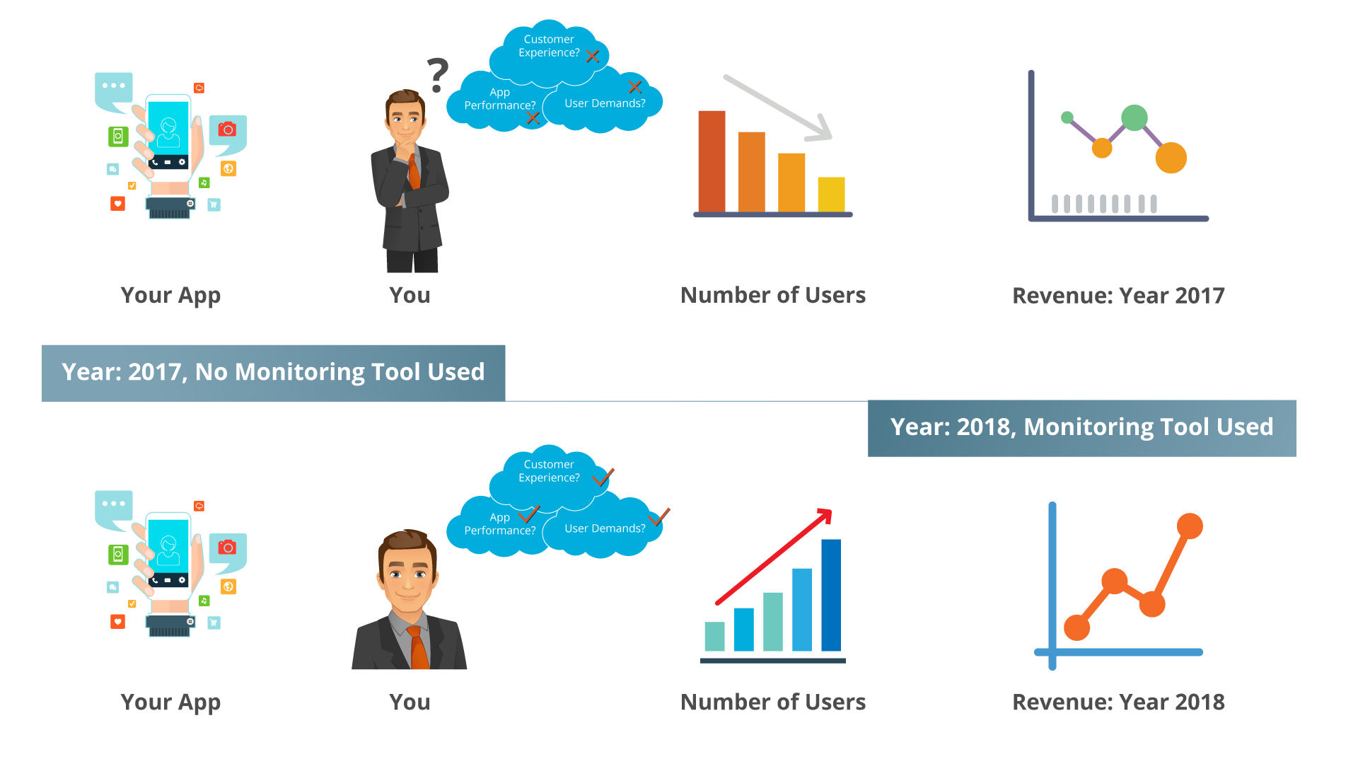
Need Cloud-Based Monitoring?
Cloud monitoring is a broad category that includes monitoring of web and cloud applications, infrastructure, networks, platform, application, and micro-services.
Monitoring is crucial to make sure that all the services which you are using on the cloud are running smoothly and efficiently.

Slide 2
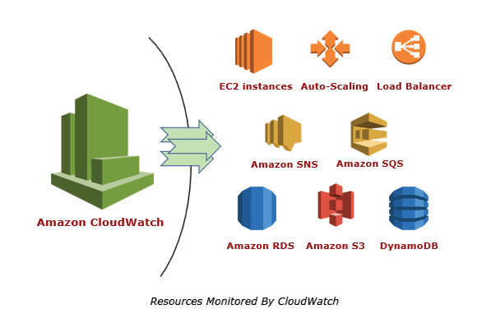
What Is Amazon CloudWatch?
Amazon CloudWatch is the component of Amazon Web Services that provides real-time monitoring of AWS resources and customer applications running on Amazon infrastructure.

Slide 3
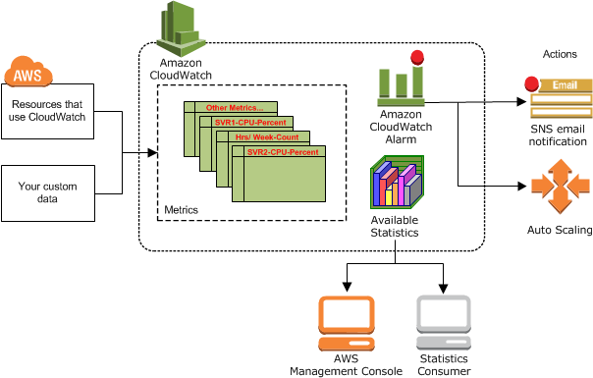
How Amazon CloudWatch works
Amazon CloudWatch is basically a metrics repository.
An AWS service—such as Amazon EC2—puts metrics into the repository, and you retrieve statistics based on those metrics.
If you put your own custom metrics into the repository, you can retrieve statistics on these metrics as well.
It will monitor your resource files and generate key metrics based on your application’s log files.
Key metrics include CPU usage, CPU latency, Network traffic, Disk storage etc.
Based on these metrics it provides a real-time summary of system activity and individual resources.

Slide 4
CloudWatch concepts:
Namespaces
A namespace is a container for CloudWatch metrics.
Metrics in different namespaces are isolated from each other, so that metrics from different applications are not mistakenly aggregated into the same statistics.
Metrics
A metric represents a time-ordered set of data points that are published to CloudWatch.
Think of a metric as a variable to monitor.
the data points as representing the values of that variable over time.
Metrics are uniquely defined by a name, a namespace, and zero or more dimensions.
Each data point in a metric has a time stamp.

Slide 5
Dimensions
A dimension is a name/value pair that is part of the identity of a metric.
Every metric has specific characteristics that describe it, and you can think of dimensions as categories for those characteristics.
Dimensions help you design a structure for your statistics plan. Because dimensions are part of the unique identifier for a metric, whenever you add a unique name/value pair to one of your metrics, you are creating a new variation of that metric.
Statistics
Statistics are metric data aggregations over specified periods of time.
CloudWatch provides statistics based on the metric data points provided by your custom data or provided by other AWS services to CloudWatch.
Aggregations are made using the namespace, metric name, dimensions, and the data point unit of measure, within the time period you specify.
Alarms
You can use an alarm to automatically initiate actions on your behalf.
An alarm watches a single metric over a specified time period, and performs one or more specified actions, based on the value of the metric relative to a threshold over time.
The action is a notification sent to an Amazon SNS topic .

Slide 6
Hands on:
Created an alarm to notify when CPU Utilization metric of the instance is lower than 15%
Monitored ec2 and s3 resources changes with amazon cloud watch event.
Created flow log for vpc (created log groups)

Slide 7
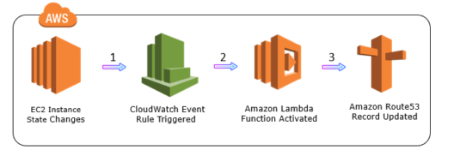
Amazon CloudWatch Events
Amazon CloudWatch Events deliver a real-time stream of system events from AWS resources to AWS Lambda functions, Amazon SNS Topics, Amazon SQS queues, and other target types.
Events
An event indicates a change in the AWS environment.
AWS resources generate events when their state changes.
Rules
Rules are nothing but constraints.
They evaluate every incoming event to determine if out-of-bounds scenario exists.
If yes the event is then routed to target for processing.
A single rule can route to multiple targets, all of which are processed in parallel.
Targets
A target processes events. Targets can include Amazon EC2 instances, AWS Lambda functions, Kinesis streams, Amazon ECS tasks, Amazon SNS topics, Amazon SQS queues, and built-in targets.
A target receives events in JSON format.

Slide 8
Amazon CloudWatch Logs
Amazon CloudWatch Logs is used to monitor, store and access log files from AWS resources like Amazon EC2 instances, Amazon CloudTrail, Route53, and others.
Log event:
Log event is a record of some activity recorded by application or resource being monitored.
Log streams:
Log stream is a sequence of log events that share the same source.
Log groups:
Log groups represent groups of log streams that share the same retention, monitoring, and access control settings. Each log stream has to belong to one log group.

Slide 9
CloudWatch monitoring types:
Basic monitoring : free --- threshold of 5 minutes
Detailed monitoring --- paid ---threshold based on user requirement

