Slide 1
Azure Capstone Project
BY HARITHA CHALUMURI
F09565/Haritha.Chalumuri@fractal.ai

Slide 2

PROBLEM STATEMENT
The dataset(Bank_Data.csv) consists of data from a Portuguese banking institution's direct marketing campaigns. These campaigns primarily involved phone calls, and multiple contacts were often made to the same client to determine their interest in subscribing to a bank term deposit.

Slide 3
Transformation by Reading from Silver layer and writing it to the Gold layer
We’re asked to do some transformations on the data which is given in the provided Data Set to get the desired Outcome. For that
Create a Storage Account.
Create 2 containers named “silver” and gold” under the Storage Account which we’ve created.
And upload the given dataset to silver layer in the storage account.
Did some transformations in Notebook under Azure Databricks on the given dataset which we’re reading from Silver layer.
And Writing that to Gold Layer.

Slide 4
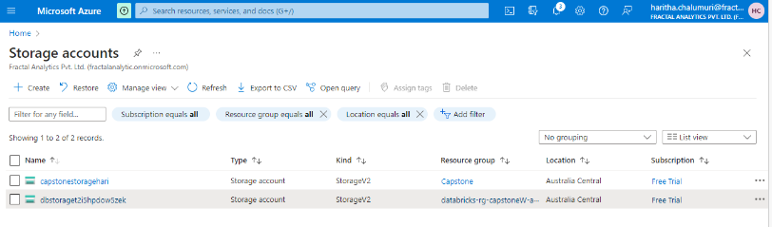
Creation of Storage Account:
->Select "Storage account" from the search results ->On the "Create storage account" page, you need to provide the information. ->After providing the necessary information, click on the "Next" button. ->Click on the "Review + create" button to review your configuration.

Slide 5
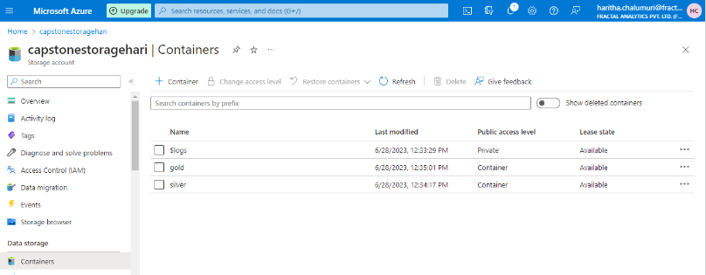
Creating Containers and Adding the dataset into that: -->Go to the "Containers" section. Create a new container. Provide a unique name for the container. Choose the desired level of public access. Click "OK" to create the container. Enter the container you just created. Click "+ Upload" to start the upload process. Select the CSV file from your local machine. Click "Upload" to begin the upload. Monitor the progress of the upload. Once complete, the CSV file will be listed in the container.

Slide 6
Creating Azure Data Bricks and Cluster: 1.Search for "Azure Databricks" and select it. 2.Click "Create" to start creating the Databricks workspace. 3.Provide necessary details like workspace name, subscription, resource group, region, and pricing tier. 4.Review the configuration and click "Create." 5.Once the workspace is created, launch it from the Azure portal. Here is the snapshot attached below to see how it looks like after the data bricks is created.

Slide 7
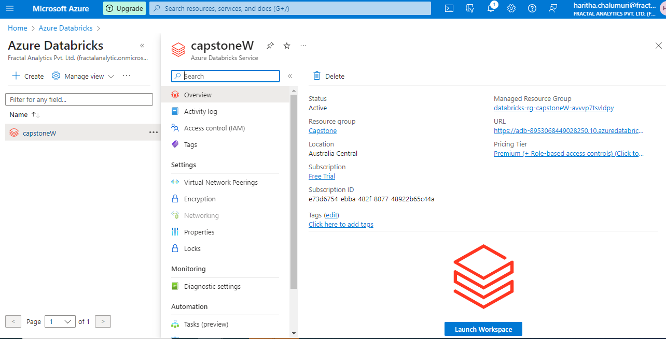

Slide 8
Creating the Cluster and Notebook to do the required transformations on Dataset:
Log in
Log in to the Databricks workspace.
Navigate
Navigate to the Clusters section.
Click
Click "Create Cluster."
Provide
Provide cluster details like type of node as “Single Node”.
Click
Click "Create Cluster" to set up the cluster.
Monitor
Monitor the cluster status in the Databricks workspace.

Slide 9
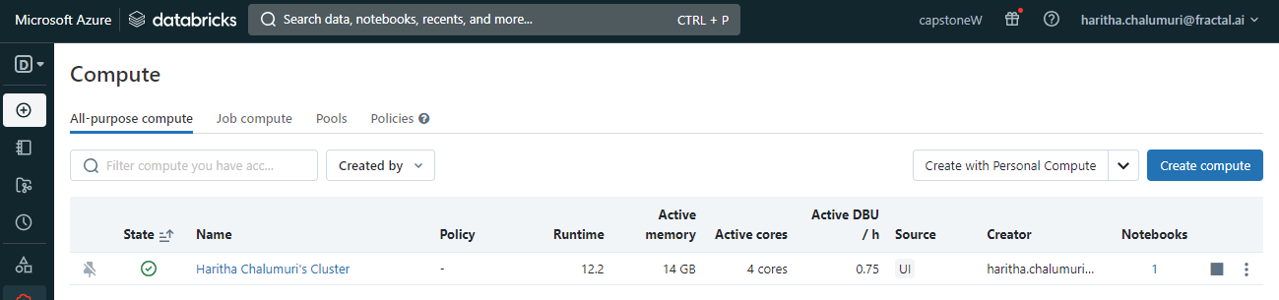
-> Now Open the Notebook and start Writing queries ->Before proceeding with the transformations on data that we load from the Dataset provided we’re importing the required library Functions and setting the configuration in next slide.

Slide 10
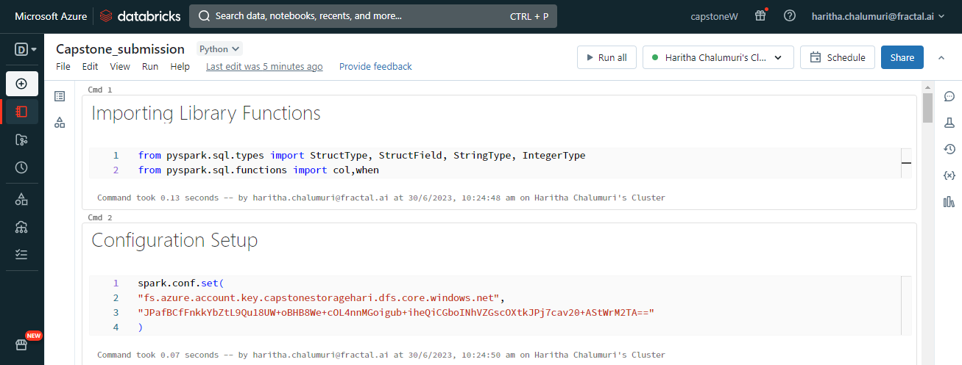
Writing the query for importing library functions and setting the configuration

Slide 11
Following are the some of the Transformations on the Data which is there in Dataset
Define Schema with storage account and account key obtained from the storage account's access keys.
Use the defined Schema to read the Dataset from the Container within the previously created Storage Account.

Slide 12
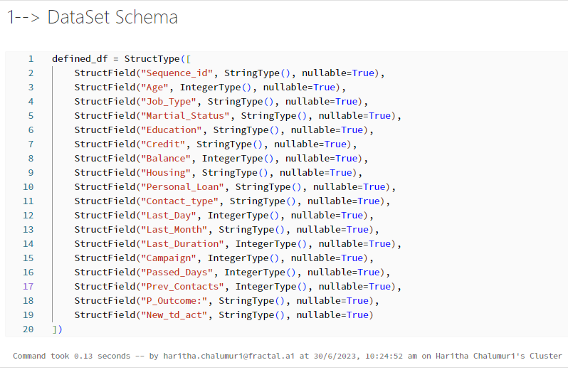
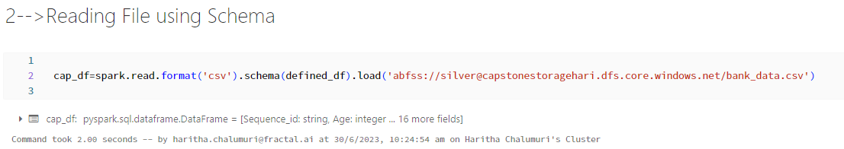

Slide 13
Here are some other queries for some more transformations on data --> Verify the Schema
cap_df.display()
-> Checking the Datatype
for columns,datatypes in cap_df.dtypes: print(f"column_name: {columns} and datatype :{datatypes}")
-> Cache the dataframe
cap_df.cache()
→ Verify the first few records
cap_df.show(10)
--> Verify the total number of rows and columns
Rows_No=cap_df.count() Cols_No=len(cap_df.columns) print(f"Rows_No: {Rows_No}\n Cols_No: {Cols_No} ")
→ Verify the summary statistics
cap_df.describe().display()

Slide 14

→ Find the maximum and minimum values in each column
Value_max_min=cap_df.describe().filter((col("summary")=="min") | (col("summary")=="max"))
Value_max_min.display()
→ Find if there are any negative balances in the columns
Neg_Values = cap_df.filter((col('Balance') < 0) | (col('Passed_Days') < 0))
Neg_Values.show()
→Replace the negative balances with zero.
T_df=cap_df.withColumn("Balance",when(col("Balance")<0,0).otherwise(col("Balance")))
T_df1=T_df.withColumn('Passed_Days',when(col('Passed_Days')<0,0).otherwise(col('Passed_Days')))
T_df1.display()

Slide 15
→Define a table/view on the spark dataframe created to run sql queries on the dataframe.
T_cap_df1.createOrReplaceTempView(“h_view")
→To check whether the query is working or not:
%sql
select * from h_view where Age>50;
After all these Transformations are done, We can proceed with creating ADF and creating Pipeline and the further Steps

Slide 16
Creating Azure Data Factory (ADF) and Configuring a Pipeline with Notebook Activities to Trigger Azure Databricks (ADB) Notebook
Search
Search for "Azure Data Factory" and select it.
Click on
Click on "Create a resource" (+) and choose "Azure Data Factory" from the options.
Provide
Provide necessary details like name, subscription, resource group.
Select
Select the desired region, desired pricing tier based on your requirements.
Review
Review the configuration and click on "Create" to create the ADF instance.
Navigate
Once the ADF instance is created, navigate to it from the Azure portal

Slide 17
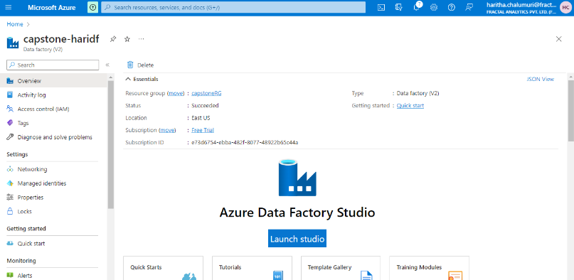

Slide 18
Steps to create a pipeline in Azure Data Factory (ADF) with notebook activities to trigger the Azure Databricks (ADB) notebook:
Open an Azure Data Factory (ADF) instance in the Azure portal.
In the ADF instance, create a new pipeline.
Within the pipeline, add a notebook activity.
Configure the notebook activity to reference the ADB notebook you created earlier.
Specify any necessary input parameters or parameters to pass to the notebook.
Configure the integration runtime to connect ADF with ADB.
Set up the desired execution settings, such as frequency and triggers for the pipeline.
Save and publish the pipeline in ADF.
Monitor and validate the pipeline's execution and output in ADF

Slide 19

After creating the pipeline, search for "Notebook" under activities.
Drag and drop the Notebook activity onto the work area and click on it.
Provide the required information in the prompted details section.
Under the Settings option, select the Azure notebook path or provide the path to the notebook created earlier in Azure Databricks.
In the Azure Databricks section, create the Linked Service by specifying Subscription, Workspace, and Cluster details

Slide 20
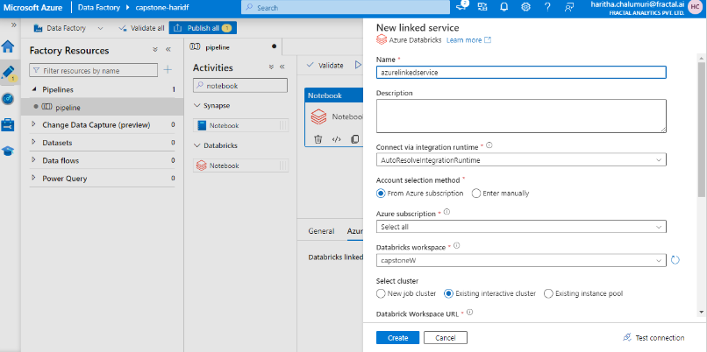
After done with all the creations of required services and given the details ,Create a trigger.

Slide 21
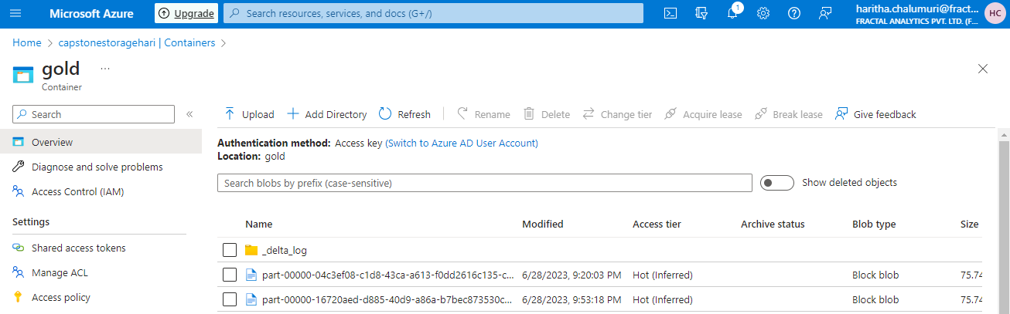
Test all the test connections
Debug and check whether the pipeline that you’ve created for the trigger the ADB notebook is working fine or not
Add the trigger for that to run the pipeline at multiple times automatically on its own.
Go to the gold layer container that you’ve created under the Storage account that we’ve created in the starting
And check whether it got loaded with data columns from both the files.

Slide 22
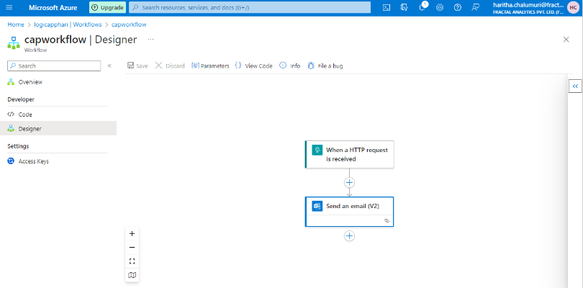
Once the processing in ADB notebooks is complete, use web activity and Logic apps to trigger an email to yourself with a success message.
Create a Logic App in the Azure portal.
Within the Logic App, add a trigger that suits your requirement, such as an HTTP trigger.
Add a Web Activity to the Logic App workflow.
Configure the Web Activity to make an HTTP request to the desired endpoint
Customize the request payload to include the necessary information for the email,
such as the recipient, subject, and message body.
Set up an action in the Logic App to send an email using an email service, such as Office 365 Outlook or SendGrid.
Provide the required email details, such as the recipient's email address, subject, and message body.
Save and test the Logic App to ensure that it triggers the email with the success message to your email address.

Slide 23
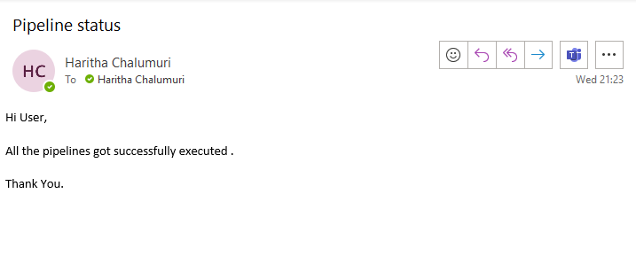
Here is the result for the activity: Use web activity and Logic apps to trigger an email to yourself with a success message.

Slide 24
Once this transformed data is written onto Gold layer, create views using serverless synapse and Read the data from synapse view.
For this, we need to create azure synapse analytics and process for that is:
Search for "Azure Synapse Analytics" and select it.
Click on "Create a resource" (+) and choose "Azure Synapse Analytics" from the options.
Provide necessary details like name, subscription, resource group, and workspace settings.
Choose the storage account and Azure Data Lake Storage Gen2 options.
Review the configuration and click on "Create" to create the Azure Synapse Analytics instance.
Once the deployment is complete, navigate to the Synapse Analytics workspace from the Azure portal.

Slide 25
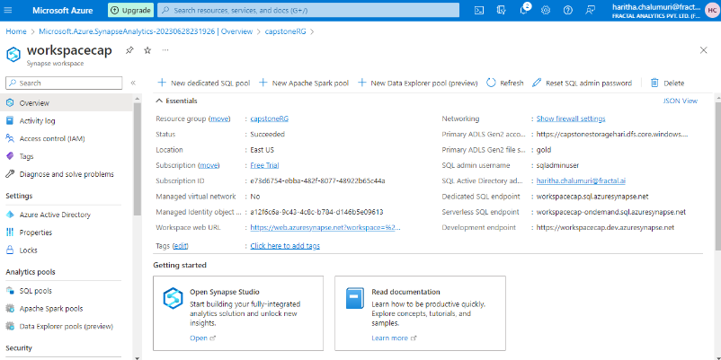

Slide 26
Creating views using serverless synapse and Reading the data from synapse view.
Navigate to the Azure Synapse Analytics workspace in the Azure portal.
Data->Linked -> Azure Data Lake Storage Gen2-> workspacecap( linked service that you created)-> gold (container that you created for storing the output)
On right side panel click on New SQL script ,choose create external table
Write a SQL query to define the view, including the desired columns and conditions.
Use the CREATE VIEW statement to create the view in the Serverless SQL pool.
Save and execute the SQL query to create the view.

Slide 27
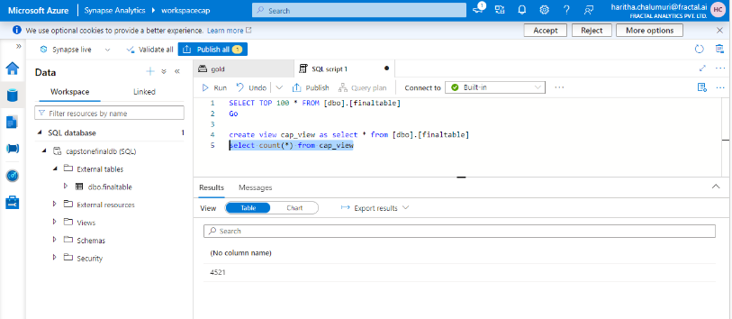
1.Create a view and read the data into that. 2.Write a query to check whether the data loaded into the view or not 3. Validate the numbers to make sure that the result we’re getting using view and table are same or not. 4.Here is the picture of the Final expected outcome of the project.

Slide 28
Conclusion
We successfully utilized various Azure services to read data from specific datasets, perform transformations, and write the transformed data to ADLS in delta format. Additionally, we created views using serverless synapse for easy data access from the ADLS location. This solution enables efficient data processing, storage, and retrieval for valuable insights and informed decision-making.

Slide 29

Thank you

