Slide 1
Module 3 — Adaptive Control
PI Control + Adaptive Conformal Inference + Oscillation-Conditioned Widening and the Actuator (proportional Kubernetes replica control)
A Multi-Signal, Co-Scheduling Autoscaling Framework with Adaptive Control
for SLA-Driven Kubernetes Workloads

Slide 2
1
Research Context
The problem, the objective, and what's already published

Slide 3
The Problem — Gap 3: Static Control Parameters
▸ Most autoscalers — including Kubernetes' own HPA — run on fixed, human-set control parameters:
– A fixed threshold — same danger line whether the system is calm or bursty
– A fixed step size — almost always exactly ±1 pod per action
– A fixed monitoring interval
▸ Consequence:
– Late reactions to sudden bursts (under-provisioning)
– Chronic waste during calm periods (over-provisioning)
– Control instability — oscillation between scale-up and scale-down
Module 3 — Adaptive Control
3

Slide 4
Objective — Sub-RQ 3 / Specific Objective 3
▸ Build a working ADAPTIVE control mechanism
– Threshold adjusts itself online — no manual re-tuning
– The actuator's step size adjusts itself too
▸ Test it against fixed-parameter control
▸ Measure whether it improves stability and SLA compliance
Module 3 — Adaptive Control
4

Slide 5
Related Work — What's Already Published
Source | Contribution
Gibbs & Càndès (2021)-style ACI | The general online-calibration mechanism this module's conformal layer implements
Liu, Li, Farkiani & Crowley (2026) BACC — arXiv:2606.20575 | A PI controller calibrated by ACI, already published and tested on Kubernetes — the design this module directly builds on
Module 3 — Adaptive Control
5

Slide 6
2
Where Module 3 Sits
Position in the overall pipeline

Slide 7
Pipeline Position
Module 1
Signal Fusion predicted_risk, violation_now
Module 3
Adaptive Control threshold, widening_multiplier
Actuator
Proportional replica stepping decision
Kubernetes
Replica count changed live
Module 3 — Adaptive Control
8

Slide 8
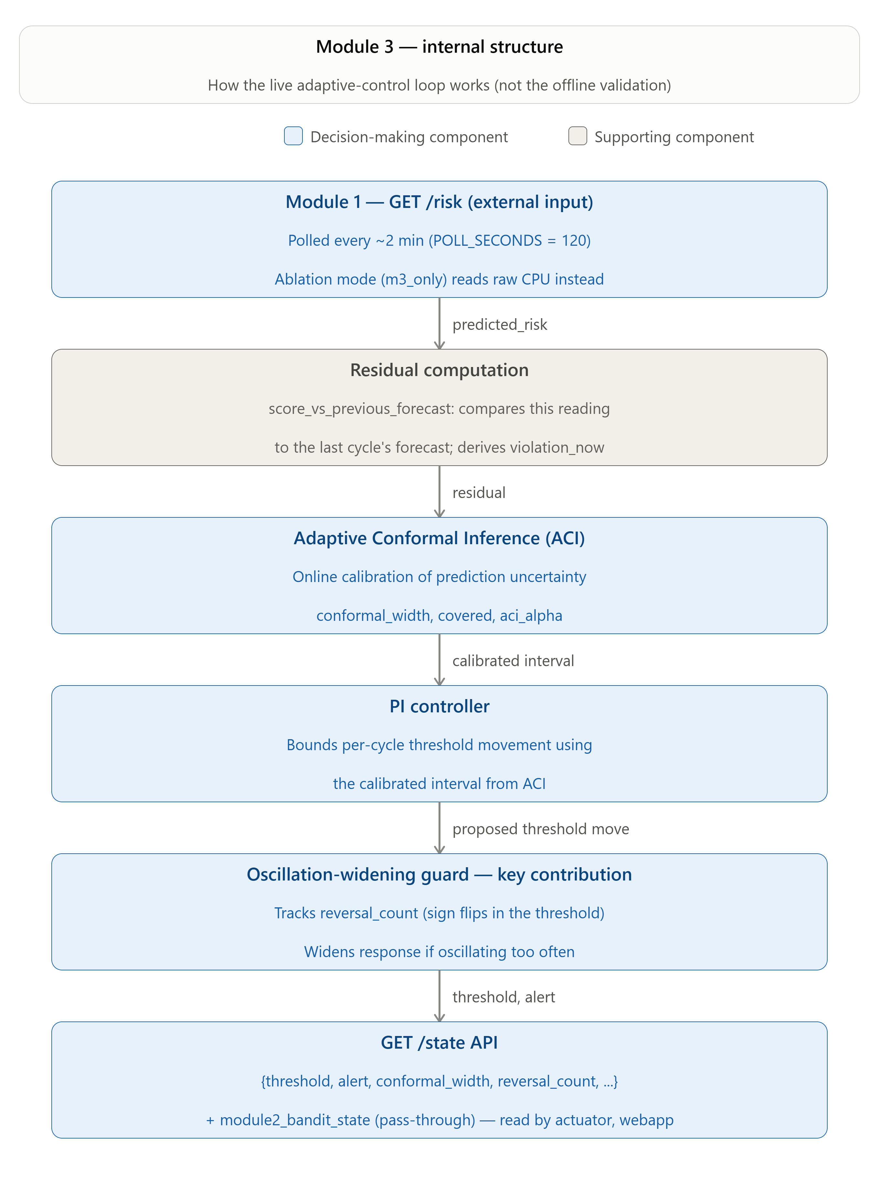
Module 3 — Internal Structure (Live Loop)
Every 120 seconds: Module 1 input → residual scoring → ACI → PI controller → oscillation-widening guard → /state output
Module 3 — Adaptive Control
9

Slide 9
3
Offline Validation
Phase 3B — formulas validated against data, not fitted to it

Slide 10
Important Reminder Before the Results
▸ No parameters are "learned" in this phase.
– This validates fixed formulas against real & synthetic data
– It does not fit any constant to the data the way Module 1's classifier does
▸ "Training/testing" here really means: does the design behave correctly?
– Bounded? Responsive? Stable? Statistically sound coverage?
Module 3 — Adaptive Control
11

Slide 11
Data Used for Validation
Dataset | Rows | Real violations | Purpose
True held-out test stream | 90 | 1 | Main conformal coverage check
Walk-forward out-of-sample series | 210 | 27 | Bursty stress-test segment
Synthetic quiet→busy transition | 55 | — | Step-response test
Synthetic multi-burst series | 15 × 50 repeats | — | ⭐ Individual contribution's statistical proof
Module 3 — Adaptive Control
12

Slide 12
Five Validation Tests — In Order
▸ Isolated PI controller test
▸ Conformal coverage check
▸ Full-design step-response test
▸ Three-way instability comparison
▸ Synthetic multi-burst addendum **
Module 3 — Adaptive Control
13

Slide 13
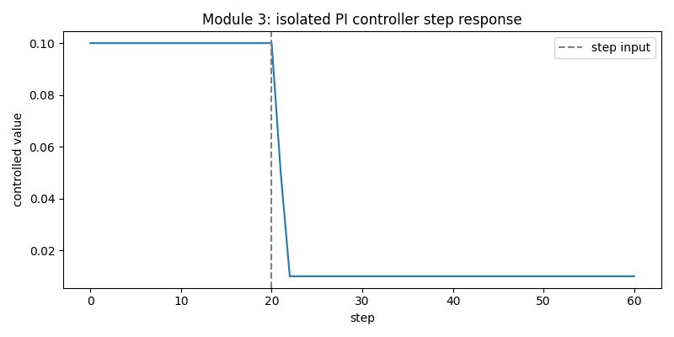
Test 1 — Isolated PI Controller
▸ Hand-built synthetic step input
– No conformal bounding — plain PI controller only
▸ Holds flat at 0.10 for the first 20 steps
– Step change drives it down sharply
– Settles at the lower bound (0.01) by step ~23
▸ Result: responds to step ✓ stays bounded ✓
Module 3 — Adaptive Control
14

Slide 14
Test 2 — Conformal Coverage Check
88.9%
empirical coverage, vs. a 90% target
▸ Ran on the true 90-row holdout stream
▸ Target: ~90% of real outcomes should fall inside the predicted interval
▸ Result: within tolerance — PASS
▸ Caveat: only 1 real violation in this split — read as “consistent with target,” not a tight statistical confirmation
Module 3 — Adaptive Control
15

Slide 15
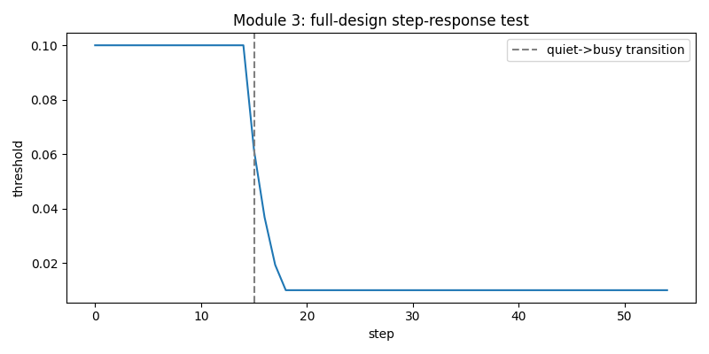
Test 3 — Full-Design Step-Response Test
▸ Same step test as Test 1
– But through the COMPLETE design: PI + ACI + oscillation widening together
▸ Overshoot: 0
▸ Settles in 2 steps
▸ Stays bounded throughout
▸ Confirms the added layers introduce no instability of their own
Module 3 — Adaptive Control
16

Slide 16
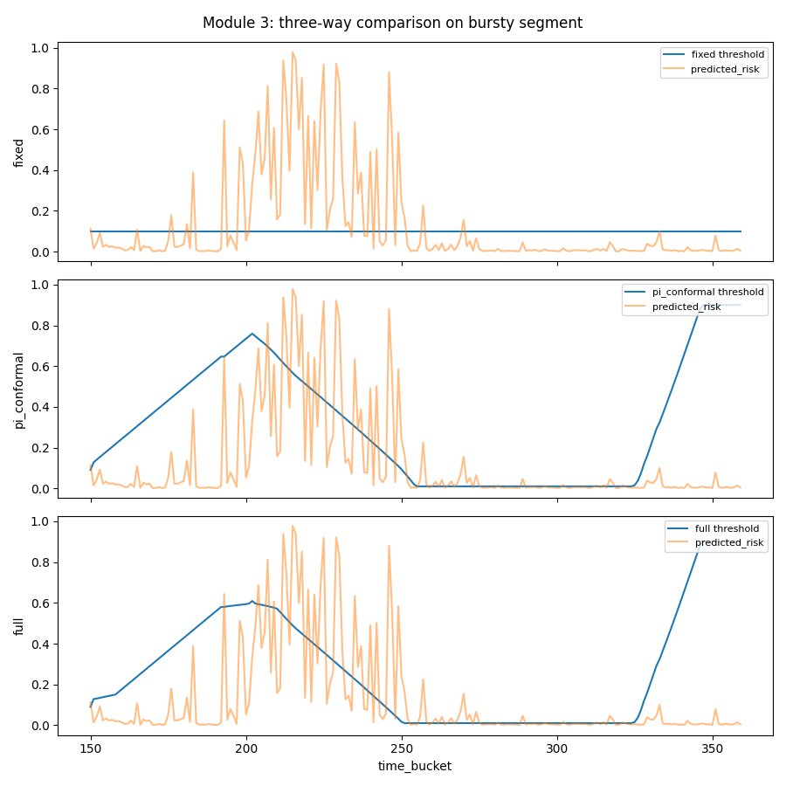
Test 4 — Three-Way Instability Comparison
▸ Real 210-row bursty segment
– Fixed vs. PI+Conformal (BACC-equivalent) vs. Full
▸ Reversals: 0 / 4 / 4 — an honest tie here
▸ Deviation std: 0.000 / 0.294 / 0.277
– Full's deviation is still lower — moves less erratically
▸ Too few real oscillation events to resolve statistically → see Test 5
Module 3 — Adaptive Control
17

Slide 17
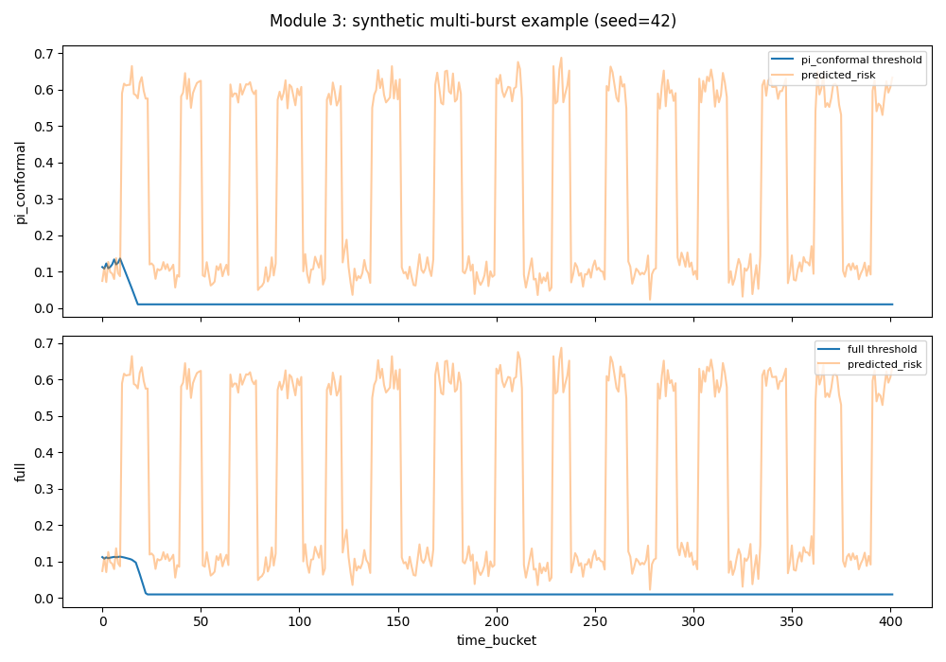
Test 5 — Synthetic Multi-Burst Addendum
▸ 50 repeats, 15 quiet↔busy transitions each
– Paired Wilcoxon significance test
▸ Reversal count: 14.04 → 7.64 (45% fewer)
– p = 9.8×10⁻⁶ — highly significant
▸ Full never worse in 96% of repeats
▸ This is where the individual contribution becomes statistically clear
Module 3 — Adaptive Control
18

Slide 18
Phase 4 — Combined Integration Test
▸ Ran Module 3 continuously over Module 1's full 12-hour trace
▸ All coherence checks passed
▸ A real bug was caught here — not by Module 3's own narrower tests:
– PI controller stuck at its lower bound for ~230 of 360 buckets
– Root cause: anti-windup checked a stale signal instead of the current error's sign
– Fixed by checking the current error's own sign directly
▸ Why this matters: proves integration testing catches what per-module testing can't
Module 3 — Adaptive Control
19

Slide 19
4
Processing
Full processing flow for every formula — in plain language

Slide 20
Overall Cycle — Every 120 Seconds
▸ Get predicted_risk (or cpu_utilization in ablated mode) from Module 1
▸ Get violation_now — ground truth for the bucket just finished
▸ Score the PREVIOUS cycle's forecast against THIS cycle's real outcome
▸ Feed the score into ACI → get width, covered, adjust alpha
▸ Check the threshold's own recent trajectory for reversals
▸ Convert reversal count into a widening multiplier
▸ Turn the widened width into a movement cap (max_step)
▸ Run the PI controller one step, capped at max_step → new threshold
▸ Compare signal to the new threshold → alert
▸ Publish everything on /state for the actuator to read
Module 3 — Adaptive Control
21

Slide 21
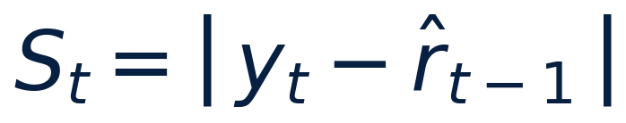
Residual (Nonconformity Score)
Processing Flow
Formula (plain language)
1. Take last cycle's forecast (predicted_risk / control_signal)
2. Wait one cycle for the real outcome to become known
3. Take this cycle's real outcome (violation_now)
4. Compute how far apart the forecast and reality were
5. Hand that single number to ACI as this cycle's score
• score = |actual_outcome − previous_forecast|
• Offline: score = |actual − risk|
• Live: score = |violation_now − prev_control_signal|
• Skipped on the very first cycle — no previous forecast exists yet
What It Means
▸ This is conformal prediction's “nonconformity score” — a plain absolute error
▸ ACI's width/alpha update (next slide) needs this one number as its only input
▸ Live scoring is necessarily one cycle behind: outcomes aren't known until the cycle finishes
Module 3 — Adaptive Control

Slide 22
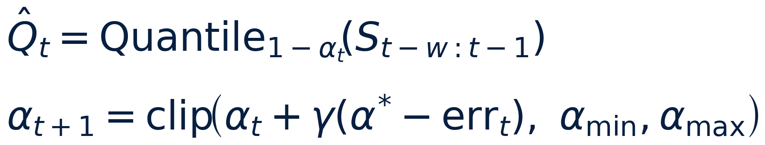
Adaptive Conformal Inference (ACI)
Processing Flow
Formula (plain language)
1. Compute the current width from the last 20 recent scores
2. Check: did that width actually cover this cycle's real score?
3. If missed → lower alpha (become more cautious)
4. If covered → raise alpha (can relax a little)
5. Store the new score for next cycle's calculation
• width = the (1 − alpha) percentile of the last 20 scores
• covered = was the real score within that width?
• if missed: alpha decreases → next width grows
• if covered: alpha increases → next width can shrink
What It Means
▸ “How wrong have recent forecasts typically been?” — self-adjusting caution
▸ This is the published mechanism (BACC / Gibbs & Càndès) — used as-is, not modified
▸ alpha is the one genuinely self-computed value in the whole module
Module 3 — Adaptive Control
23

Slide 23
ACI — Calibrated vs. Adjusted Live
Calibrated at Validation
Adjusts Live, Every Cycle
• alpha_target = 0.10 — target miscoverage (aims for ~90% coverage)
• alpha_bounds = [0.02, 0.5] — hard floor/ceiling on alpha
• aci_gamma = 0.05 — adaptation step size
• score_window = 20 — how many recent scores considered
• alpha — nudged up/down each cycle by whether the last forecast was covered
• scores — rolling list of nonconformity scores, appended each cycle
• width — recomputed fresh every cycle from the current alpha + scores
What It Means
▸ alpha is the one genuinely self-computed value in the whole module — everything else here is a fixed constant
▸ alpha_target = 0.10 was directly validated offline: measured coverage was 88.9% against this exact target
▸ None of these four constants came from a search/optimizer — set before validation ran, then checked against real and synthetic data
Module 3 — Adaptive Control

Slide 24
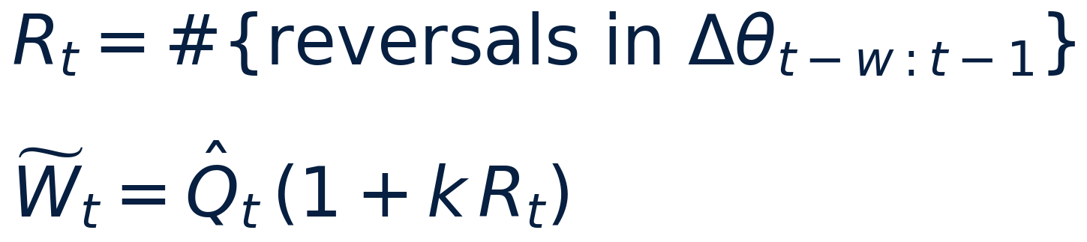
Oscillation-Conditioned Widening
Processing Flow
Formula (plain language)
1. Scan the threshold's own recent trajectory (last 8 cycles)
2. Count how many times it flipped direction (reversals)
3. Turn that count into a widening multiplier
4. Multiply ACI's width by that multiplier
• reversal_count = direction flips in the last 8 cycles (oscillation_window)
• widening_multiplier = 1 + (oscillation_k × reversal_count)
• widened_width = ACI's width × widening_multiplier
What It Means
▸ Even ONE recent wobble → multiplier = 5.0 — deliberately aggressive braking
▸ This is the piece BACC's published design does NOT have
▸ Self-tightens the safety envelope during instability, not only when the forecast is noisy
▸ This is the individual contribution — see Section 6 for full evidence
Module 3 — Adaptive Control
24

Slide 25
Oscillation Widening — Calibrated vs. Adjusted Live
Calibrated at Validation (Phase 3B)
Adjusts Live, Every Cycle
• oscillation_window = 8 — how many recent steps are checked for reversals
• oscillation_k = 4.0 — how aggressively a reversal inflates the width
• reversal_count — rescanned every cycle from the threshold's own recent trajectory
• widening_multiplier — recalculated every cycle: 1 + (oscillation_k × reversal_count)
• widened_width — recomputed every cycle: ACI's width × widening_multiplier
What It Means
▸ These are the only two constants in Module 3 with an actual robustness check — the real-data finding held across every (window, k) combination tested, not just this one
▸ Everything downstream recomputes from scratch every cycle — nothing here is a stored/carried value except the threshold trajectory itself
▸ This is the ⭐ individual contribution's own calibration — see Section 6 for the full evidence
Module 3 — Adaptive Control

Slide 26
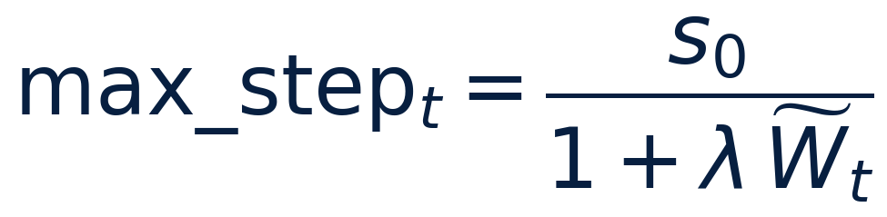
Width → Step Cap
Processing Flow
Formula (plain language)
1. Take the widened width from Formula 3
2. Shrink the maximum allowed movement proportionally
3. Hand the result to the PI controller as max_step
• max_step = base_max_step ÷ (1 + width_sensitivity × widened_width)
• base_max_step = 0.05 (the largest possible move, at zero uncertainty)
• width_sensitivity = 3.0 (how hard uncertainty throttles movement)
What It Means
▸ More uncertainty OR more oscillation → smaller allowed movement per cycle
▸ This is where Formulas 1–3 all converge into one number
▸ An uncertain or unstable system is automatically throttled to cautious, gradual moves
Module 3 — Adaptive Control
25

Slide 27
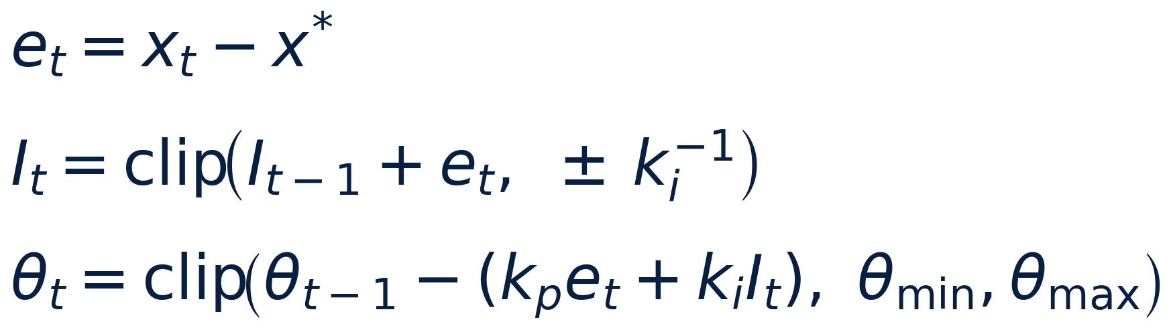
PI Controller
Processing Flow
Formula (plain language)
1. Compute error = current signal − setpoint
2. Check anti-windup: is the threshold already stuck at a bound?
3. If not blocked, build up the integral term (capped)
4. Combine proportional + integral terms into a step
5. Move the threshold by that step, capped at max_step, within bounds
• error = signal − setpoint
• integral builds up by the error (only if not blocked)
• output = (kp × error) + (ki × integral)
• threshold moves by −output, capped to ±max_step
• always kept inside [0.01, 0.9]
What It Means
▸ Risk running hot (above setpoint) → threshold drops — more sensitive, alerts sooner
▸ Risk calm (below setpoint) → threshold rises — fewer false alarms
▸ The anti-windup gate stops a long saturated run from leaving a backlog too large to unwind
Module 3 — Adaptive Control
22

Slide 28
PI Controller — Calibrated vs. Adjusted Live
Calibrated at Validation (Phase 3B)
Adjusts Live, Every Cycle
• kp = 0.6 — proportional gain
• ki = 0.15 — integral gain
• setpoint = 0.10 — the equilibrium risk level
• initial_threshold = 0.10 — cold-start value (matches setpoint)
• threshold_bounds = [0.01, 0.9] — hard floor/ceiling
• base_max_step / width_sensitivity — shared with the widening step (Formula 4)
• threshold — recalculated every cycle from the current error
• integral — accumulated every cycle (subject to the anti-windup gate)
What It Means
▸ None of these six constants came from a search/optimizer — fixed engineering defaults, validated (not derived) via the step-response and full-trace tests
▸ threshold and integral are the two values that actually carry state cycle to cycle — everything else stays fixed once set
▸ This is the published PI+ACI design (BACC) — used as published, not modified
Module 3 — Adaptive Control

Slide 29
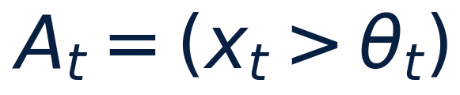
Alert
Processing Flow
Formula (plain language)
1. Compare the current control signal to the freshly-updated threshold
• alert = control_signal > threshold
What It Means
▸ The simple trigger the entire adaptive pipeline exists to get right
▸ Everything in Formulas 1–4 exists to make this one threshold trustworthy
Module 3 — Adaptive Control
26

Slide 30
5
Inputs, Outputs & Constants
Module 3

Slide 31
Module 3 — Inputs
Input | Source | Meaning
predicted_risk | Module 1 /risk | Forecast probability of a violation next cycle
violation_now | Module 1 last_bucket | Ground truth: did a violation just happen
cpu_utilization | Module 1 last_bucket | Used only in the ablated cpu_direct mode
control_signal | = risk OR cpu/100 | The single number Module 3 actually controls against
Module 3 — Adaptive Control
28

Slide 32
Module 3 — Outputs (published on /state)
Output | Meaning
threshold | The live danger line — read directly by the actuator
alert | control_signal > threshold
widening_multiplier | Reused by the actuator for proportional replica stepping
conformal_width | ACI's raw calibrated width, before oscillation widening
aci_alpha | The one value genuinely computed live (Formula 2)
reversal_count | Recent threshold zig-zags detected
mode | "risk" (full design) or "cpu_direct" (ablated)
Module 3 — Adaptive Control
29

Slide 33
Module 3 — Constants & Reasoning (1/2)
Constant | Value | Usage
setpoint | 0.10 | Matches the label's own rare-violation philosophy
kp | 0.6 | Validated via step-response test — responsive, no overshoot
ki | 0.15 | Same — validated through the test suite, not searched
initial_threshold | 0.10 | Starts the controller at its own equilibrium point
threshold_bounds | [0.01, 0.9] | Prevents a degenerate always/never-alert state
base_max_step | 0.05 | A full swing takes ~36 min — deliberately gradual
width_sensitivity | 3.0 | Checked via tests to stay bounded and non-oscillatory
Module 3 — Adaptive Control
30

Slide 34
Module 3 — Constants & Reasoning (2/2)
Constant | Value | Usage
alpha_target | 0.10 | Directly validated — measured 88.9% vs. this exact target
alpha_bounds | [0.02, 0.5] | Keeps the coverage target from collapsing to an extreme
aci_gamma | 0.05 | Standard small-step update size for this algorithm family
score_window | 20 | Balances responsiveness against a stable quantile estimate
oscillation_window | 8 | ~one full up/down cycle length observed in real data
oscillation_k | 4.0 | Checked for robustness across every (window, k) combo tested
POLL_SECONDS (live) | 120 | Matches the offline bucket size — live = validated design
Honest note: none of these were produced by a search/optimization procedure — fixed engineering defaults, validated (not derived) against real & synthetic data.
Module 3 — Adaptive Control
31

Slide 35
Why 120 Seconds? (The Shared Cycle Length)
▸ Dataset's native rates differ: Node=30s, MSResource=60s, MSCallGraph=per-event
▸ Bucket size must be no finer than the coarsest source (MSResource, 60s)
– Otherwise the pipeline fabricates resolution that source doesn't actually have
▸ 120s = 2× that floor — a safety margin against jitter/missed readings
▸ Over the fixed 12h trace: 360 rows (270 train / 90 test) — a workable sample size
▸ Live cycle reuses the same 120s — live behavior matches the validated offline design
Module 3 — Adaptive Control
32

Slide 36
6
Individual Contribution
Oscillation-Conditioned Widening

Slide 37
What BACC Published — Precisely (Verified Against the Paper)
▸ BACC's PI controller regulates SLA-violation BUDGET BURN RATE
– Not a risk-vs-setpoint error the way this project's Module 3 does
▸ BACC's PI output adjusts a CPU-utilization threshold
– A separate capacity-planning optimizer converts it to a replica count
▸ BACC's conformal calibration widens the WORKLOAD FORECAST itself
– Not the controller's own step size — a different point in the pipeline
▸ BACC has a FIXED, non-adaptive per-cycle replica-change cap
– No mechanism reacts to the controller's own output oscillating
Module 3 — Adaptive Control
34

Slide 38
What This Project Adds On Top
▸ A second input: rolling reversal count of the threshold's OWN trajectory
▸ Multiplies the calibrated width before it caps controller movement
▸ Safety envelope self-tightens during oscillation — not only when the forecast is noisy
▸ New elements introduced: reversal_count, oscillation_window, oscillation_k, widening_multiplier
▸ Honest caveat (disclosed proactively):
– Relaxes strict conformal guarantees into a practical safety heuristic
– BACC's own ACI already relaxes strict exchangeability for a similar reason — a normal move in this space
Module 3 — Adaptive Control
35

Slide 39
Evidence — Offline
Test | Result
Three-way, real 210-row segment | Exact tie on reversal count (4 vs 4) — disclosed honestly; deviation std still lower for Full (0.277 vs 0.294)
Synthetic multi-burst, 50 repeats | 14.04 → 7.64 reversals (45% fewer), p = 9.8×10⁻⁶ — highly significant
Module 3 — Adaptive Control
36

Slide 40
Evidence — Live (Ablation)
0.20 vs. 0.80
mean reversals per trial — full arm vs. m3_only arm (omnibus p = 0.0202)
▸ full = Module 1's fused risk signal, run through the full adaptive design
▸ m3_only = raw CPU, same PI+ACI+widening machinery (the ablation isolate)
▸ Confirms the offline synthetic finding holds in a real, live Kubernetes ablation study
▸ Three independent lines of evidence now support this contribution: real-data, synthetic, and live
Module 3 — Adaptive Control
37

Slide 41
7
Live Ablation Testing
Phase 6 — two independent 25-trial studies

Slide 42
The Live Port — How It Runs on Kubernetes
▸ Runs the EXACT SAME formulas as offline validate.py's “full” design
▸ risk mode = the “full” ablation arm (Module 1's fused signal)
▸ cpu_direct mode = the “m3_only” ablation arm (raw CPU, no fusion)
▸ Live scoring is one cycle behind, by necessity:
– Grades the PREVIOUS cycle's forecast against the outcome that's only just become known
– score = |violation_now − previous cycle's control_signal|
Module 3 — Adaptive Control
39

Slide 43
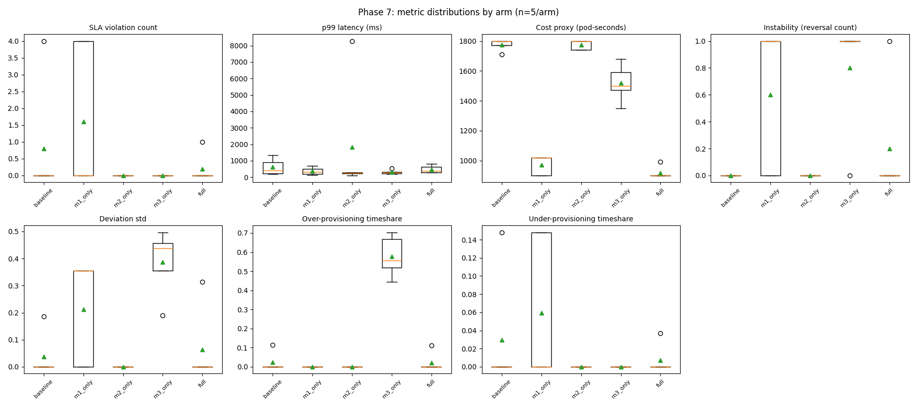
Live Study 1 — Replica Ceiling = 2 (25 trials)
▸ m3_only: ~58% over-provisioning, every single trial
▸ full: drops to 2.2% over-provisioning
▸ full: cheapest of all 5 arms (918 pod-seconds)
▸ Both differences statistically significant (p_adj = 0.024, 0.014)
Module 3 — Adaptive Control
41

Slide 44
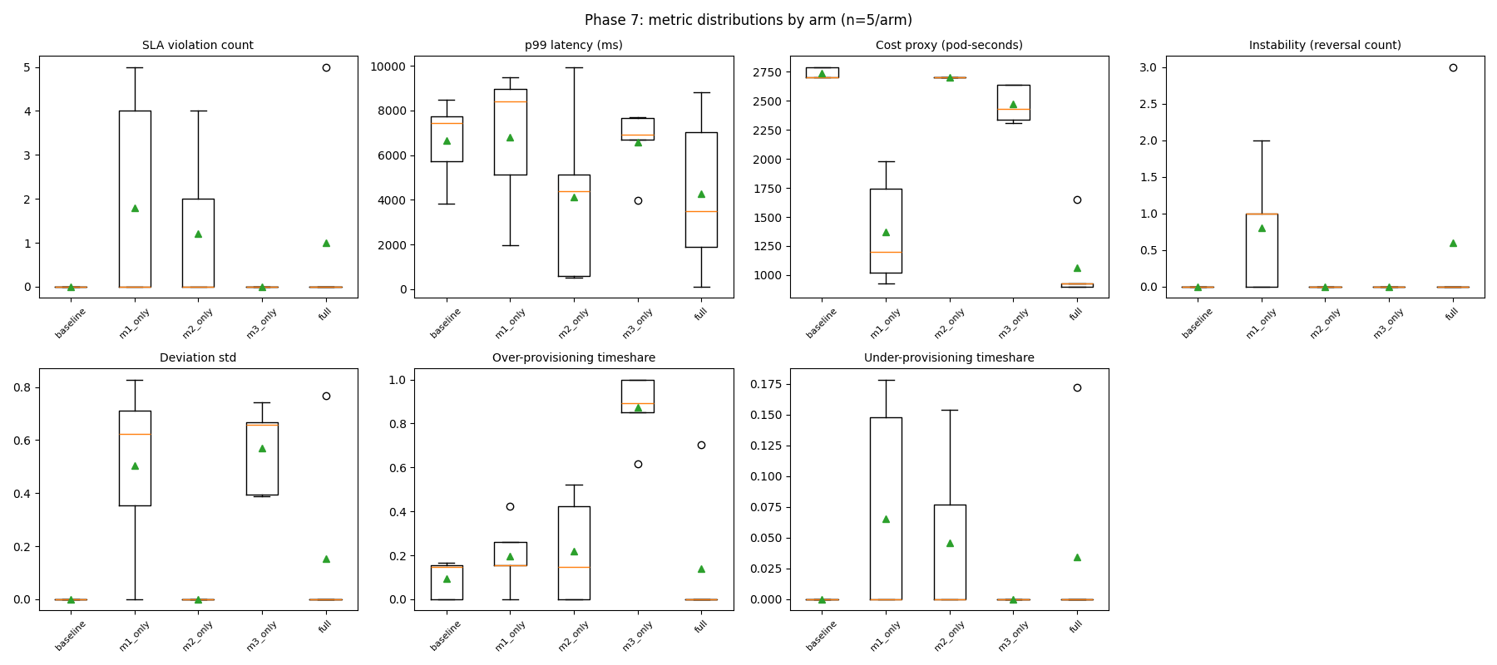
Live Study 2 — Replica Ceiling = 3, Wider Load (25 trials)
▸ m3_only over-provisioning JUMPS to 87.2%
▸ full remains cheapest (1060 pod-seconds)
▸ The gap between m3_only and full WIDENS at the higher ceiling
▸ Independent dedicated cloud VM, different load range — same core pattern
Module 3 — Adaptive Control
42

Slide 45
Combined Conclusion — Both Studies
▸ Module 3 alone (raw CPU) consistently over-provisions across two independent studies
▸ Combined with Module 1 (“full”), it becomes the cheapest AND one of the safest arms
▸ This result replicates and strengthens across two different replica ceilings and load ranges
▸ This is the central, statistically supported result for the adaptive control component
Module 3 — Adaptive Control
43

Slide 46
8
The Actuator
Turning Module 3's threshold into a real Kubernetes action

Slide 47
Why the Actuator Exists
▸ Modules 1 / 2 / 3 only COMPUTE and expose a signal — none takes a scaling action itself
▸ The actuator closes that gap:
– Reads the relevant signal + threshold for its arm
– PATCHes a freshly-calculated replica count directly on Kubernetes
▸ Bypasses HPA/KEDA for the ablation study's non-baseline arms (removed for a fair comparison)
Module 3 — Adaptive Control
45

Slide 48
Actuator — Processing Flow
1. Read
signal, threshold, widening_multiplier
2. Check
replicas + cooldown (90s minimum)
3. Decide
how many replicas to move, or hold
4. Act
PATCH Kubernetes + publish /state
Module 3 — Adaptive Control
46

Slide 49
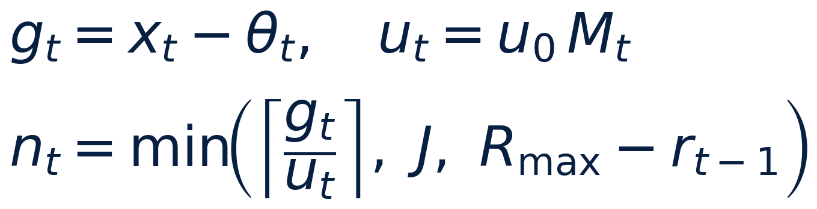
Actuator Formula — Calculating the Replica Count
Processing Flow
Formula (plain language)
1. Measure how far past the danger line the signal sits
2. Shrink the “unit” if Module 3 has detected recent oscillation
3. Divide the gap by that unit — this is where the replica count is calculated
4. Round up, then cap the result at a safe maximum jump
• effective_unit = STEP_UNIT × widening_multiplier
• gap = signal − threshold (or threshold×0.5 − signal, scaling down)
• replicas to move = ceil(gap ÷ effective_unit), capped at MAX_JUMP
What It Means
▸ The number of replicas is CALCULATED fresh every cycle — never a fixed amount; a bigger gap or a calmer recent history moves more replicas at once
▸ Directly addresses the fixed-step limitation (Gap 3) that most autoscalers, including plain HPA, still have
▸ Reuses Module 3's own oscillation output — an engineering extension of that individual contribution, not a second separate claim
Module 3 — Adaptive Control
47

Slide 50
Actuator — Inputs & Outputs
Type | Field | Meaning
Input | signal | Module 1's risk, or cpu_utilization/100 (m3_only)
Input | threshold | Fixed 0.08 (m1_only) or Module 3's live threshold
Input | widening_multiplier | From Module 3 /state — feeds effective_unit
Input | replicas | Read live from the Kubernetes API each cycle
Output | decision | hold / scale_up(+n) / scale_down(−n)
Output | step | Calculated number of replicas moved this cycle (0 if holding)
Output | replicas | Replica count after this cycle's decision
Module 3 — Adaptive Control
49

Slide 51
Actuator — Constants & Reasoning
Constant | Value | Usage
ACT_INTERVAL_SECONDS | 30 | Finer than Module 3's 120s cycle — reacts to a held signal quickly
COOLDOWN_SECONDS | 90 | Mirrors HPA's own default stabilization window — fairness across arms
MIN / MAX_REPLICAS | 1 / 3 (study) | Ceiling must match HPA/KEDA baselines exactly — arms stay comparable
FIXED_THRESHOLD | 0.08 (m1_only) | Recalibrated from real observed risk range (0.003–0.3), not guessed
STEP_UNIT | 0.05 | Matches Module 3's own base_max_step — same scale of “urgency unit”
MAX_JUMP | 2 | Safety cap — one noisy reading can't jump straight to the ceiling
Module 3 — Adaptive Control
50

Slide 52
9
Summary
Published vs. individual contribution, end to end

Slide 53
Published vs. This Project's Addition
Layer | Published / Standard Technique | This Project's Addition
Interval calibration | Adaptive Conformal Inference (Gibbs & Càndès-style) | — used as-is
Threshold control | PI controller calibrated by ACI (BACC, Liu et al. 2026) | — used as published
Interval widening | Reacts only to forecast/ nonconformity noise | ** Oscillation-conditioned widening — self-tightens during instability
Replica stepping | Fixed step (commonly ±1 pod) | ** Proportional stepping — calculates how many replicas to move each cycle, reusing the contribution's own output
Module 3 — Adaptive Control
52

Slide 54
Bottom Line
▸ Oscillation-conditioned widening IS genuinely new relative to BACC
– Proven via three independent lines of evidence:
– Real-data deviation-std reduction
– Synthetic multi-burst significance — p = 9.8×10⁻⁶
– Live ablation reversal-count separation — p = 0.0202
▸ The actuator's proportional stepping is an honestly-scoped engineering extension of that same contribution
Module 3 — Adaptive Control
53

Slide 55
Thank you
Questions?

