Slide 1


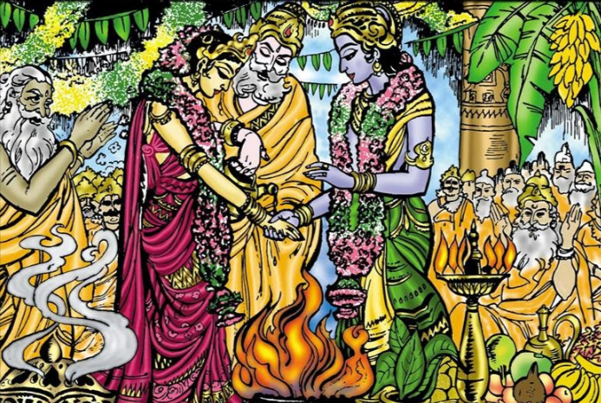
||Sreerasthu|| ||JaiSreeRam|| ||Subhamasthu||
||ASHTOTHARA DIVYA DESA SANDARSHITHA BHADRACHALA SRI SITARAMA KALYANA MAHOTSAVA INVITATION||
||Slokam: || ||Raamaaya Raama Bhadraaya, Raama Chandraaya Vedase||
||Raghunaadhaaya Nadhaaya, Seethaaya Pathaye Namaha||
Sri Rama Sevakas:
< & > along with their family
humbly invites your presence with family and friends on the auspicious event of
Sri Sita Rama Kalyanam
||To the Divine Idols empowered by the 108 Divya Desa Yatra||
Performed on:
Dated: <mm/dd/yyyy> (Day of the week), 11:00am to 1:00pm Abhijith Muhurtham
(Swasthisree Hevilambi naama Samvatsara Dakshinaayanam, <Ruthuvu>,
< >Maasam <> Paksha <Thidhi>)
Bride:
Ayonija & Mahalakshmi Swaroopini
||Chi|| ||Sow|| Seetha Mahalakshmi
(Daughter of Nimivamsa Descendents, King of Midhila: Sri Sri Sri Janaka Maharaja)
Groom:
Sriman Naarayana Swaroopaaya
||Chi|| ||Ra|| Sri Rama Chandra Swamy
(Son of Raghuvamsa Descendents, King of Ayodhya: Sri Sri Sri Dasaradha Maharaja).
||SHUBHAM||
Blessings from
Sri SaiRam Temple
(A non-profit 501(3)© corporation)
585 Franklin Rd, #135, Marietta, GA 30067
Phone: (615) 584.8338/(678) 929.7482

