Slide 1
FINAL PROJECT
HARITHUS AVGS

Slide 2
KEYLOGGER AND SECURITY
Understanding and Mitigating Keylogging Threats

Slide 3
agenda
Introduction
Problem Statement
Project Overview
Solution and Value Proposition
Modelling
Results
Conclusion

Slide 4
Problem statement
Problem:
Keyloggers pose a serious cybersecurity threat, resulting in unauthorized access to sensitive information, identity theft, and financial fraud.
Impact:
They compromise data privacy and security, affecting individuals, businesses, and organizations

Slide 5
Project overview
Objective:
Develop a comprehensive understanding of keyloggers, their types, how they work, and effective security measures to prevent keylogging attacks
Scope:
Includes an analysis of hardware and software keyloggers, legal and ethical implications, security measures, and best practices.

Slide 6
Solution and its value propositions
Solution: Implement a multi-layered security strategy that includes
anti-keylogging software, regular system scans, software updates,
and user education.
Value Proposition:
Enhanced Security: Reduces the risk of data breaches and
identity theft.
User Awareness: Educates users about keylogging threats and
protection methods.
Compliance: Helps businesses and organizations comply with
data protection regulations.

Slide 7
modelling
Architecture Overview:
Modular Design: The keylogger code is structured into modular functions for better readability and maintenance.
Event Handling: Utilizes the pynput library to capture and handle keyboard events.
Data Logging: Implements functions to log captured data into text and JSON files.

Slide 8
modelling
Components:
Key Press Handling: Function: on_press(key)
Description: Captures and logs the pressed keys.
Details: Appends key press events to a list and updates the JSON log file.
Key Release Handling: Function: on_release(key)
Description: Captures and logs the released keys.
Details: Appends key release events to a list, updates the JSON log file, and accumulates keys for the text log.
Logging Functions:
Text Logging: generate_text_log(key)
Description: Writes the recorded keys to key_log.txt.
JSON Logging: generate_json_file(keys_used)
Description: Dumps the list of key events to key_log.json.

Slide 9
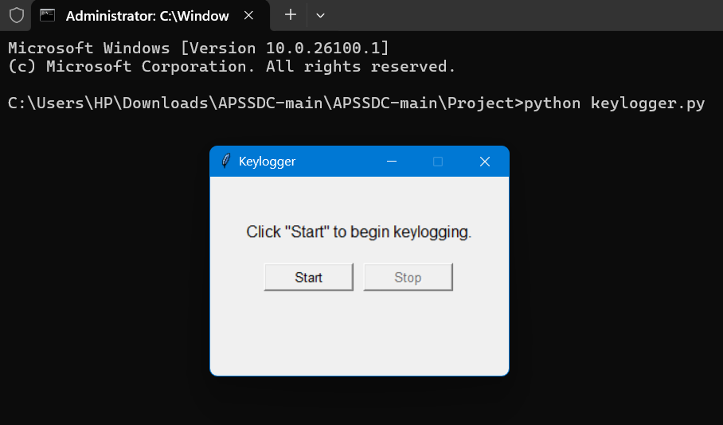
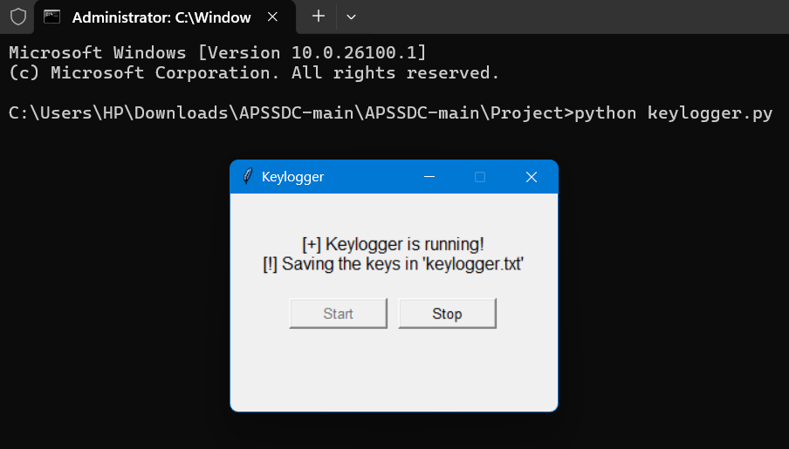
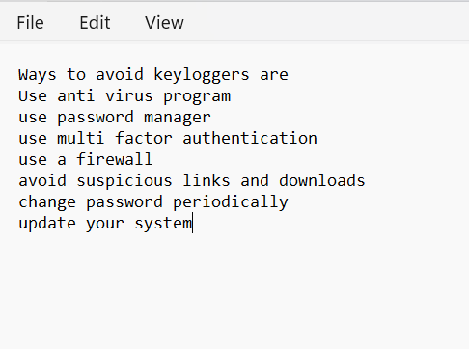
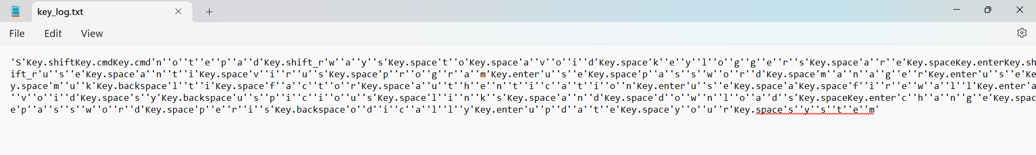
Results

Slide 10
Results
Successfully implemented a keylogger that captures keystrokes and records them into both text and JSON files.
Real-time keylogging with start and stop functionality controlled via a simple GUI.
Demonstrated the capability to effectively capture and log keystrokes in real-time.
Provided a user-friendly GUI to control the keylogger, making it accessible and easy to use.

Slide 11
Thank you
By Harithus Avgs

