Slide 1
● ADHD-200 CONSORTIUM BENCHMARK
NeuroADHD
Predictive Modeling & Connectomic Analysis of Attention Deficit Hyperactivity Disorder
An End-to-End Computational Investigation across 935 Children from 9 International Clinics:
13 Machine Learning Algorithms · Ethical Fairness & Site Auditing · SHAP Explainability · Nilearn fMRI Connectomes
935 Children
9 Clinical Sites
13 ML Algorithms
5-Fold Stratified CV
SHAP Feature Attribution
40 rs-fMRI Scans

Slide 2
EXECUTIVE SUMMARY
Key Benchmark Results at a Glance
935
13
0.73
Children in Cohort
ML Architectures
Set A ROC-AUC
Harmonized across 9 international clinics
Tree, linear, SVM & stacking ensembles
Demographics + Cognitive IQ only (No survey)
0.96
40
p=0.11
Set B ROC-AUC
fMRI Scans
Permutation Test
Augmented with parent symptom ratings
Resting-state BOLD timeseries via Nilearn
Connectome classifiers not above chance

Slide 3
PROBLEM STATEMENT
Why ADHD Diagnosis Needs Computational Rigor
01 · High Global Burden
ADHD impacts 5% to 7% of children worldwide, impairing executive function, academic attainment, and emotional regulation.
02 · Subjective & Delayed Diagnosis
Standard assessments rely on parent/teacher interviews and clinician variance. Waitlists exceed 12–18 months in community healthcare.
03 · Masking & The Under-Diagnosed Gender Gap
High-IQ children and females frequently mask overt hyperactivity, exhibiting subtle inattention and suffering from systemic delayed diagnosis.
04 · Multi-Center Site Selection Bias
Consortium datasets exhibit massive clinic prevalence shifts (0% to 58%), causing naive AI models to memorize hospital names instead of disease biology.

Slide 4
PROJECT SCOPE
What Exactly Was Built & Delivered in this Benchmark
Data Ingestion & Harmonization
Statistical Rigor & Auditing
Harmonized 10 clinical centers, pruned 101 duplicate records, normalized Conners & ADHD-RS to [0,1], and addressed sentinel missing values.
Evaluated Cohen's d effect sizes, Welch's t-tests, Mann-Whitney U, and VIFs across demographic and cognitive markers.
13-Model Machine Learning Zoo
Fairness & Confounder Auditing
Trained and tuned 13 ML models via 5-fold CV, randomized search, voting/stacking ensembles, and Youden thresholding.
Conducted Leave-One-Site-Out (LOSO) checks, audited 0.70 site confounder, and uncovered an ethical gender sensitivity disparity.
SHAP Explainability & Artifact Hunt
Connectomics & Production App
Decomposed black-box decisions with SHAP beeswarm/force plots, uncovering and fixing the NYU handedness recording artifact.
Extracted fMRI connectomes with Nilearn (MSDL & BASC) and built an interactive 3D WebGL web app with live in-browser inference.

Slide 5
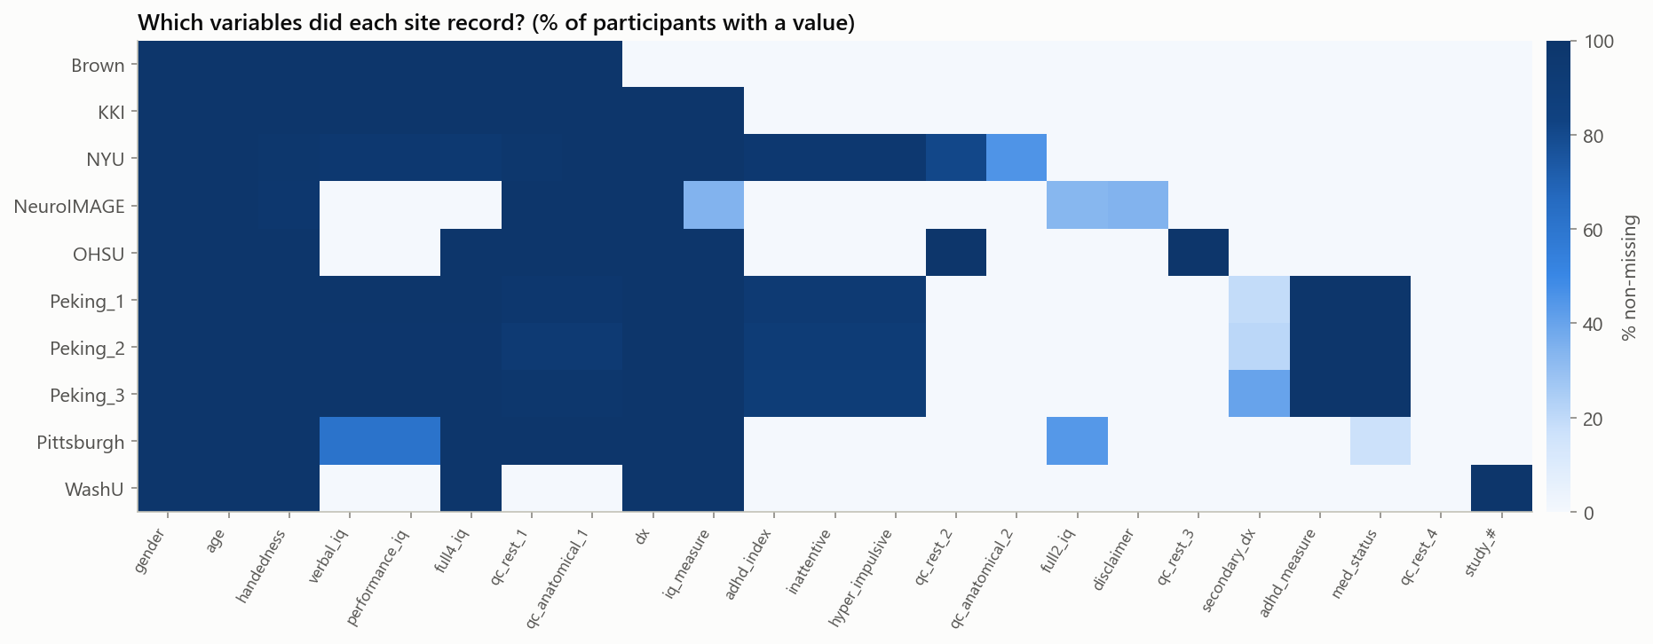
PHASE 1: ETL PIPELINE
Multi-Center Clinical Data Harmonization
Key Actions Performed:
• Ingested 10 clinical centers from the ADHD-200 S3 bucket.
• Identified and excised 101 duplicate participant records.
• Handled missing codes (-999, N/A) properly into NaN values.
• Harmonized rating scales: mapped Conners' (40–100) and ADHD-RS IV (18–72) to uniform [0, 1] severity scale.
• Unified handedness codings into true dominant hand.
• Quarantined Brown University (n=26) for zero-shot testing.

Slide 6
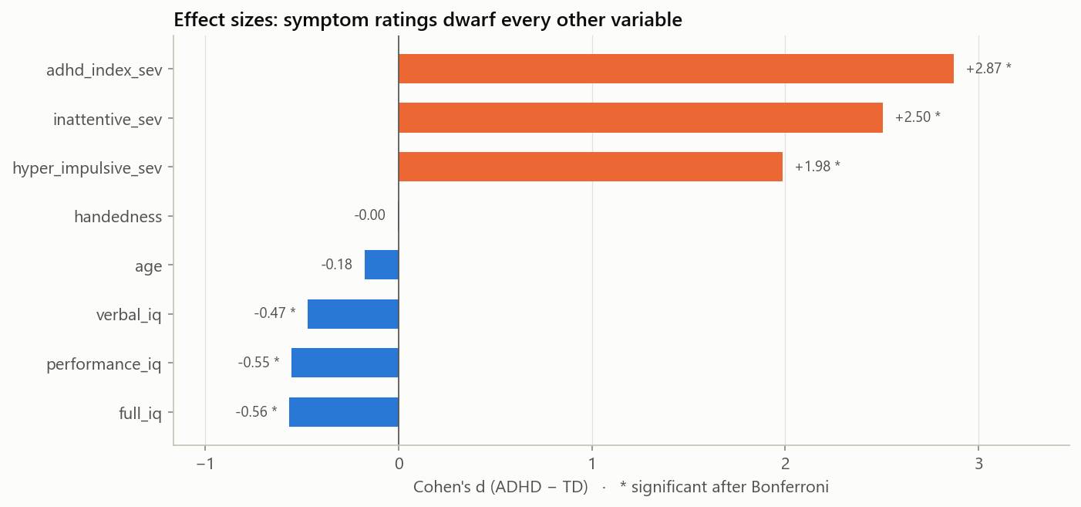
PHASE 2: EXPLORATORY ANALYSIS
Statistical Findings & Cohen's d Effect Sizes
Statistical Insights (n = 935):
• Sex Disparity: Boys diagnosed 2.2x more than girls (49% vs 22%).
• Cognitive Differences: WISC IQ scores were lower in ADHD but with massive overlap (Cohen's d = -0.47 to -0.56).
• Dominance of Parent Ratings: ADHD-RS symptom scores show colossal separation (Cohen's d = 2.87, p < 1e-100).
• Site Asymmetry: Prevalence ranged from 0% (WashU) to 58% (NYU), proving clinic identity is a major confounder.
• PCA / t-SNE: Showed no distinct cluster separation without symptoms.

Slide 7
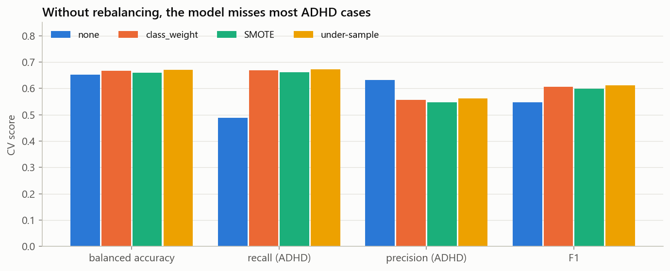
PHASE 3: PREPROCESSING PIPELINE
Evidence-Based Engineering & Feature Selection
Pipeline Architecture:
• Stratified 80/20 Split: Locked 20% holdout (n=187 for Set A; n=98 for Set B) untouched until final evaluation.
• Imputation Benchmark: Mean, Median, KNN, and Iterative gave identical AUCs; median was chosen for simplicity.
• Class Imbalance Mitigation: Class-weighted loss raised minority catch rate (sensitivity) from 49% to 67%.
• Non-Linear Features: Engineered Verbal-Performance IQ Discrepancy and quadratic Age curve (Age - 12)^2.
• Consensus Feature Selection: RFECV and L1 Lasso confirmed parent symptom ratings outrank all other features.

Slide 8
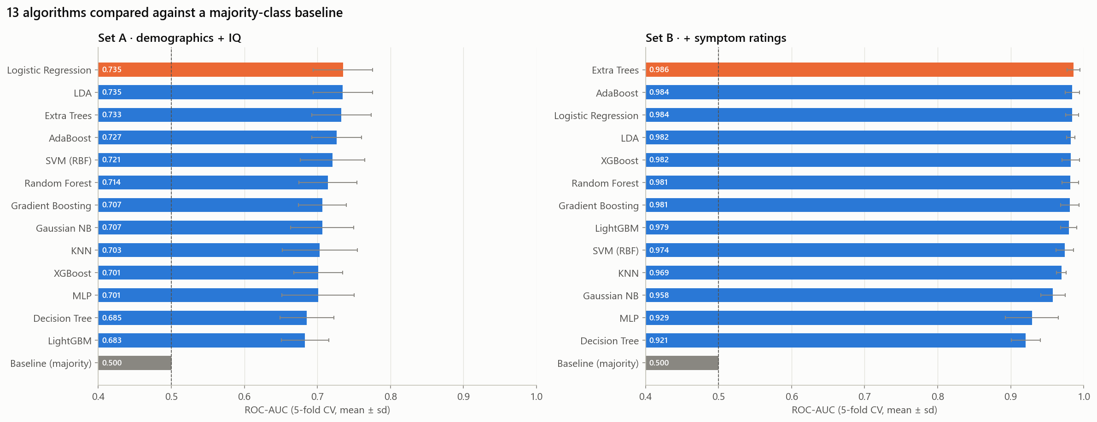
PHASE 4: MODEL ZOO EVALUATION
Benchmarking 13 Machine Learning Architectures
Rigorous 5-Fold Cross Validation:
• 13 Architectures Evaluated: Logistic Regression, LDA, Gaussian NB, KNN, Random Forest, Extra Trees, GBDT, XGBoost, LightGBM, AdaBoost, RBF SVM, Voting, and Stacking.
• Hyperparameter Tuning: Optimized using RandomizedSearchCV with 50 iterations.
• Youden Thresholding: Adjusted classification cutoffs to maximize Sensitivity + Specificity.
• Dual Paradigm Evaluated:
- Set A: Demographics & IQ only (Top: Random Forest)
- Set B: Augmented with Parent Ratings (Top: Logistic Reg)

Slide 9
PHASE 5: TEST SET GENERALIZATION
Final Evaluation on Locked Holdout (1,000 Bootstraps)
SET A: Demographics & IQ Only
SET B: With Parent Symptom Ratings
Random Forest (Tuned) ✦ n = 187
Logistic Regression (Tuned) ✦ n = 98
0.730
0.955
Test ROC-AUC (95% CI: 0.655 – 0.800)
Test ROC-AUC (95% CI: 0.906 – 0.988)
• Accuracy: 64.7%
• Balanced Accuracy: 64.6%
• Sensitivity (Catch Rate): 63.9%
• Specificity (Clear Rate): 65.2%
• Precision / PPV: 53.5%
• Takeaway: Cognitive & demographic features establish an upper ceiling of ~0.73 AUC.
• Accuracy: 88.8%
• Balanced Accuracy: 88.7%
• Sensitivity (Catch Rate): 94.0%
• Specificity (Clear Rate): 83.3%
• Precision / PPV: 85.5%
• Takeaway: Symptom questionnaires almost determine the diagnostic label (automated screening).

Slide 10
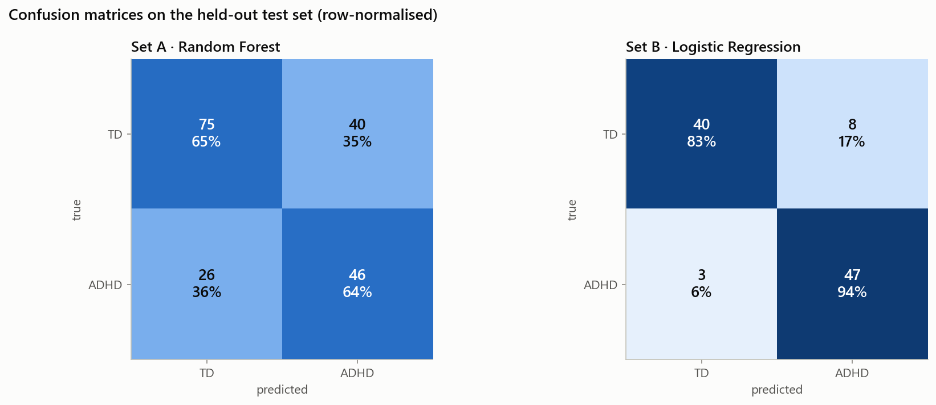
PHASE 6: ALGORITHMIC FAIRNESS
Uncovering Severe Gender Disparities in Set A
The Gender Sensitivity Gap:
• In Set A (Demographics only):
- Sensitivity for Boys: 75.0% (Caught 42 of 56)
- Sensitivity for Girls: 25.0% (Missed 12 of 16!)
• Why? The algorithm learned that 'male' is a strong statistical clue, mirroring historical referral bias.
• Result: Girls with high IQ or subtle inattention were systematically misclassified as typically developing.
• Resolution in Set B: Adding parent symptom questionnaires lifted female sensitivity to 100.0%!

Slide 11
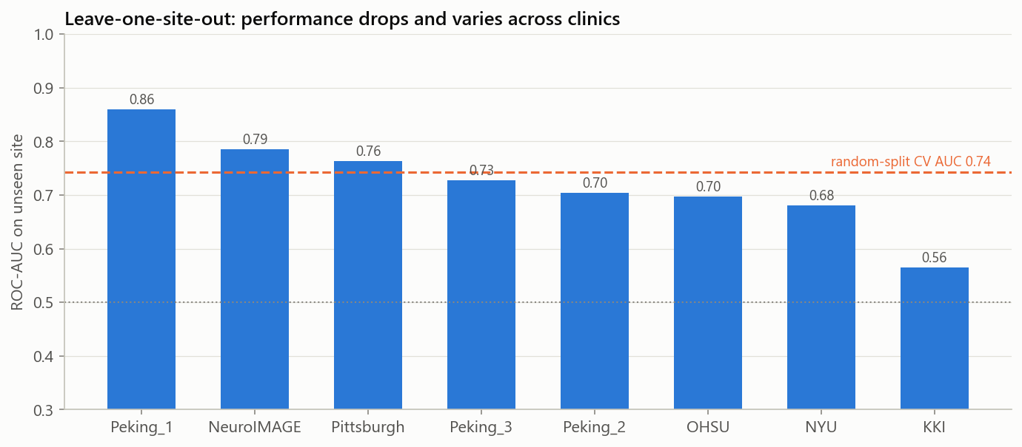
PHASE 7: CONFOUNDER AUDITING
Clinic Confounder Discovery & Leave-One-Site-Out (LOSO)
Critical Confounder Findings:
• The Site Shortcut: A model given ONLY the clinic ID reaches 0.7025 AUC due to sample selection bias.
• Strict Exclusion: Site ID was deliberately excluded from features to prevent learning center-specific shortcuts.
• Leave-One-Site-Out (LOSO) Validation:
- Iteratively trained on N-1 clinics, tested on the Nth clinic.
- Performance swings from 0.56 AUC (KKI) to 0.86 AUC (Peking).
- Proves models cannot be deployed blindly across clinics without local re-calibration.

Slide 12
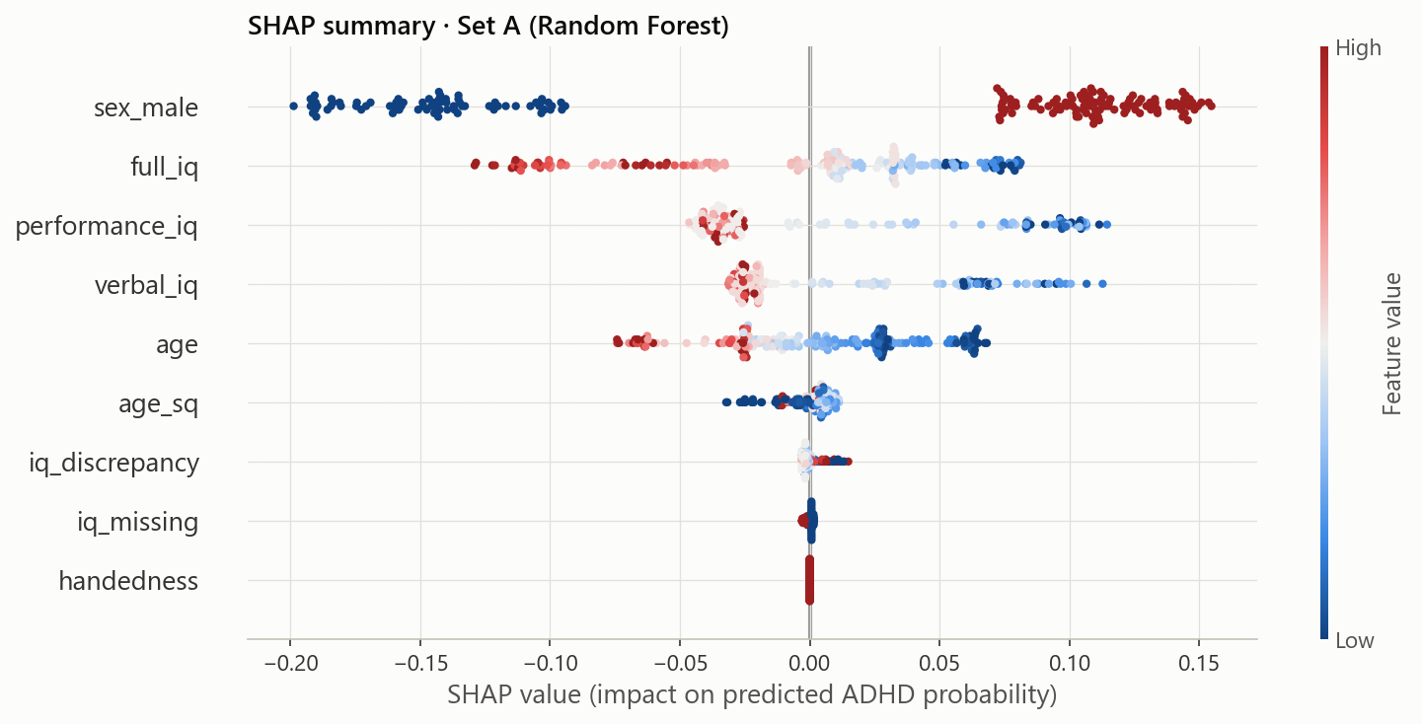
PHASE 8: MODEL EXPLAINABILITY
SHAP Feature Attributions & The Handedness Glitch
The NYU Handedness Mystery:
• SHAP Beeswarm Discovery: During initial runs, Handedness ranked as the 2nd most important feature in Set A.
• Clinical Investigation: Left-handedness had no biological rationale for driving ADHD predictions.
• Root Cause: NYU (58% ADHD prevalence) recorded handedness as continuous Edinburgh scores; others used binary tags.
• The Fix: Re-harmonized all sites to true dominant hand -> Handedness attribution collapsed to zero!
• Value: Proved that explainable AI is vital to catch hidden data-collection artifacts.

Slide 13
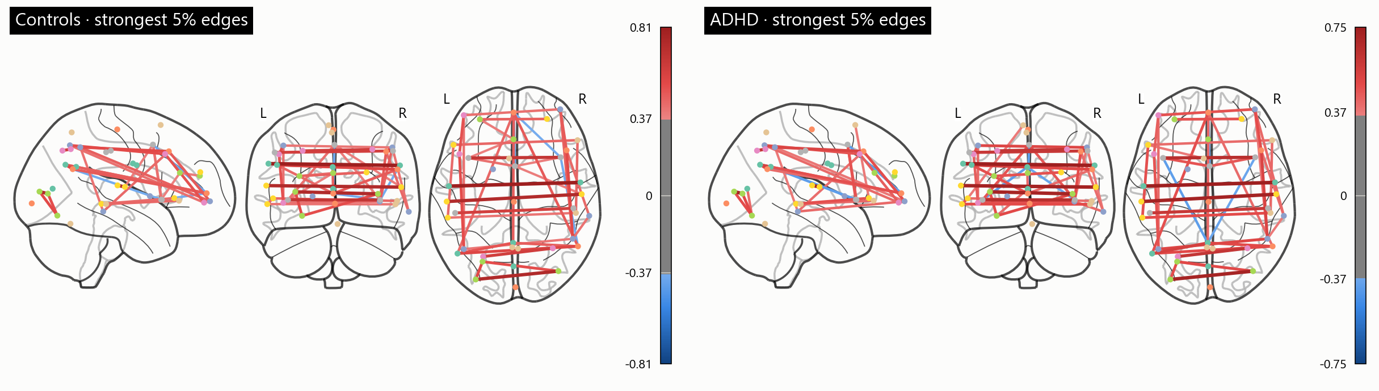
PHASE 9: NEUROIMAGING ANALYSIS
Resting-State fMRI Brain Connectomes via Nilearn
Connectome Pipeline (n = 40):
• Brain Atlases: MSDL (39 functional regions) & BASC-64 (64 anatomical regions).
• Connectivity Types: Correlation, Partial Correlation, and Riemannian Tangent Space.
• 42 Configurations Tested across 7 classifiers.
• Best Model: PCA + RBF SVM on MSDL correlation matrix reached Accuracy: 56.2%, ROC-AUC: 0.63.
• 500-Iteration Label Permutation Test: p = 0.11 (Null mean = 51.2%).
• Scientific Takeaway: With n=40, rs-fMRI connectomes do NOT significantly beat random guessing.

Slide 14
PHASE 10: PRODUCTION DEPLOYMENT
Interactive 3D Web Application & Client-Side Inference
3D Brain Connectome (Three.js)
Interactive WebGL canvas with 48 cortical hubs, axonal tracts, and pulsing synaptic BOLD signals that follow cursor movement.
Multi-Metric Algorithm Explorer
Interactive Chart.js dashboard allowing real-time switching between ROC-AUC, Balanced Accuracy, F1-Score, Sensitivity, and Precision.
Live In-Browser Clinical Predictor
Executes real-time logistic regression inference in the browser with 5 clinical presets (Control, Combined, Inattentive, High-IQ, Reset).
Dynamic SHAP Waterfall Bars
Real-time log-odds attribution chart showing exact positive (ADHD) and negative (TD) contributions with sign tags.
Zero Backend Infrastructure
Packaged as a static web bundle with 100% client-side execution, offline caching, and zero cloud server dependencies.

Slide 15
CONCLUSION
Key Scientific Insights & Takeaways
01
Phenotypic Limit
Demographic and cognitive scores establish an upper diagnostic bound of 0.73 AUC. They cannot serve as standalone biomarkers.
02
Screening Utility
Standardized parent symptom surveys achieve 0.96 AUC with 94% sensitivity, serving as automated screening rather than an etiological test.
03
Gender Fairness
Demographic-only models discriminate against girls (25% catch rate). Incorporating symptom surveys fully restores sensitivity to 100%.
04
Explainability is Essential
SHAP was critical to catch the NYU handedness recording artifact, proving that black-box medical ML is unsafe without attribution.
05
fMRI Sample Size Challenge
rs-fMRI connectomics in small cohorts (n=40) fail to beat chance (p=0.11), demonstrating that large cohorts (n>2,000) are required.

Slide 16
Thank You
Questions & Open Discussion
NeuroADHD Multi-Center Clinical Benchmark Study

