Slide 1


K.RAMAKRISHNAN COLLEGE OF TECHNOLOGY
(AUTONOMOUS), TRICHY.
AIRLINE RESERVATION SYSTEM
PRESENTED
HARIVARSHAN M
2303811710421058
SUPERVISOR
Mr. M. Saravanan, M.E.,
AP/CSE.

Slide 2
PRESENTATION OVERVIEW
Objective
Project Introduction
Problem Statement
Methodologies (Programming concepts relevant to problem statement)
Architecture of the proposed system
List of Modules
Merits
Results and Discussion
Queries

Slide 3
OBJECTIVE
The objective of our airline reservation system (ARS) is to facilitate the efficient management of flight bookings while enhancing the customer experience during the ticket purchasing process. At its core, the ARS aims to provide a streamlined and user-friendly platform for passengers to search for flights, check availability, and make reservations with ease. By centralizing critical data such as flight schedules, fare tariffs, and passenger name records (PNRs), the system enables airlines to manage their inventory effectively across various distribution channels, including direct sales and global distribution systems (GDS) used by travel agencies. Additionally, the automation of the reservation process minimizes human errors associated with manual systems, ensuring accuracy in data entry and retrieval. The ARS also focuses on improving customer service by offering timely information about flights and allowing passengers to manage their bookings independently, with features like seat selection and real-time updates.

Slide 4
PROJECT INTRODUCTION
The program is designed to simulate an airline reservation system, enabling users to manage seat bookings. It showcases how basic Java programming can address real-world problems effectively.

Slide 5
PROBLEM STATEMENT
Airlines and passengers in the current manual booking processes. Existing systems often require customers to physically visit ticket counters, which can be time-consuming and inconvenient, leading to frustration and inefficiencies.
This traditional approach limits booking availability to specific hours, restricting customer access and resulting in lost sales opportunities.
Manual systems are prone to errors, such as incorrect data entry, which can lead to inconsistencies and inaccuracies in reservations.
The lack of an online platform prevents customers from easily comparing ticket prices across different airlines, thereby limiting their options.

Slide 6
METHODOLOGIES
Object-Oriented Programming (OOP)
Event-Driven Programming
Data Management with Collections
User-Centered Design
Error Handling and Validation
Notes:
Error Handling and Validation
The program includes validation c

Slide 7
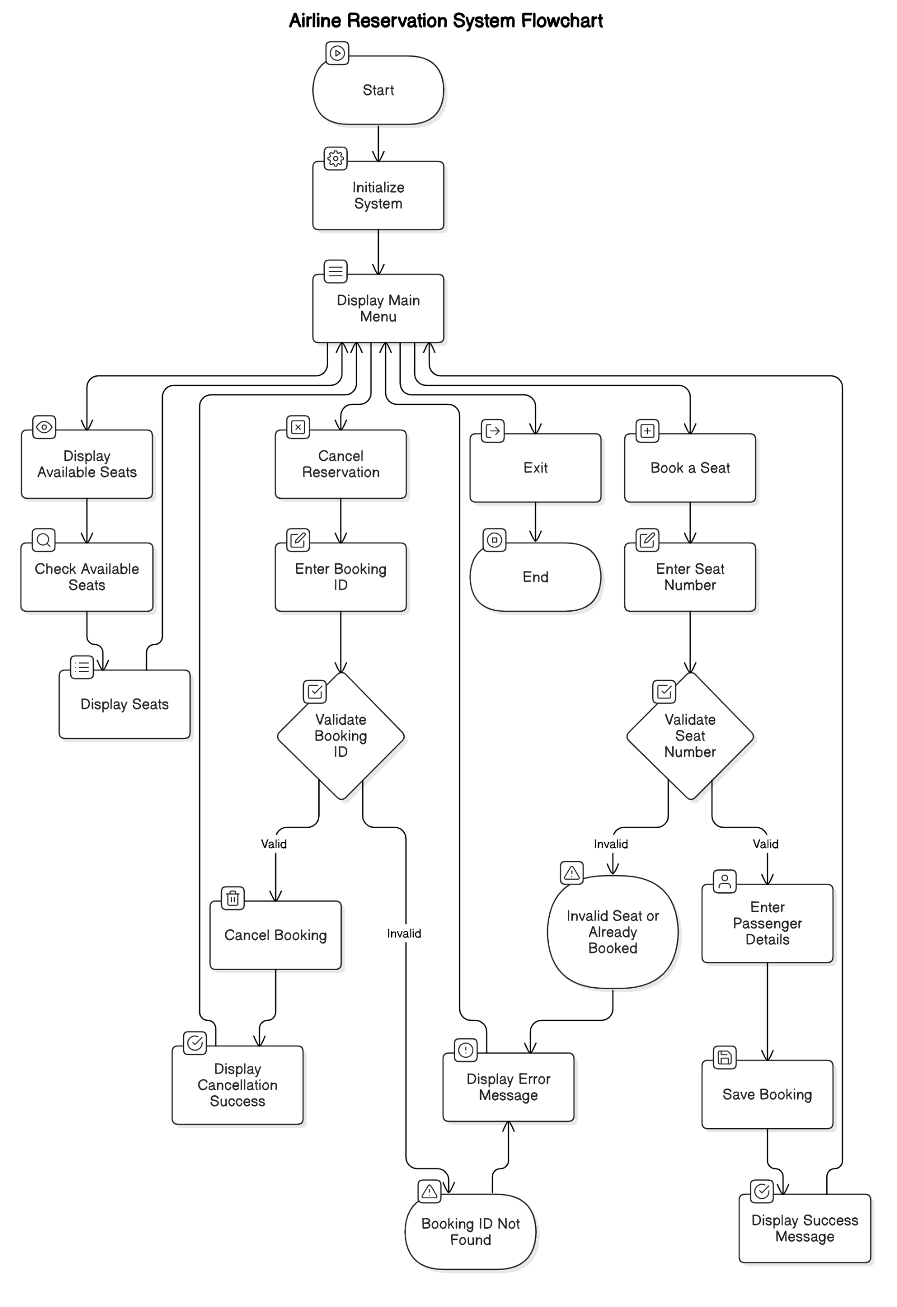
ARCHITECTURE OF THE PROPOSED SYSTEM

Slide 8
LIST OF MODULES
Booking Module: Allows users to book available seats by entering details, validates input, and assigns a unique booking ID.
Display Module: Shows available seats to the user, making it easy to view which seats are free for booking.
Cancelling Module: Enables users to cancel bookings by entering a Booking ID, confirming cancellation, and freeing the seat.
Exit Module: Ends the program, displaying a thank-you message and ensuring a clean exit.

Slide 9
MERITS
Convenience: Allows users to book flights anytime and from anywhere, eliminating the need for physical visits to ticket counters.
Real-Time Availability:Provides up-to-date information on flight availability and pricing, enabling informed decision-making.
Time-Saving:Facilitates quick comparisons of multiple flight options and allows for fast booking, reducing the time spent on reservations.
Online Management:Enables easy cancellations or modifications of bookings without lengthy procedures, enhancing user experience.
Dynamic Pricing:Supports fare adjustments based on demand, helping airlines maximize revenue while offering competitive prices.

Slide 10
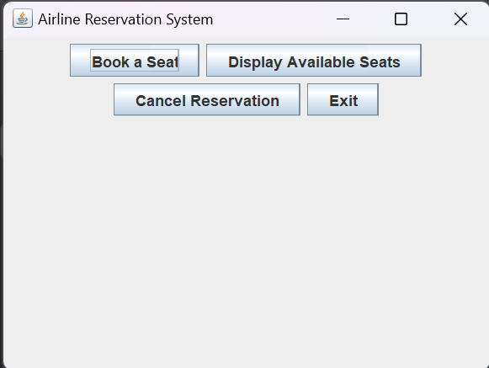
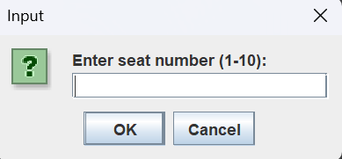
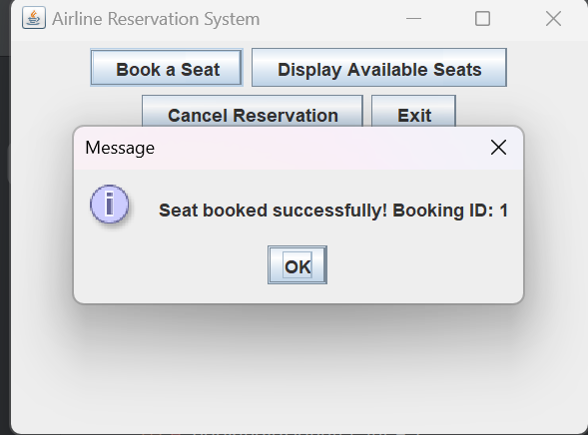
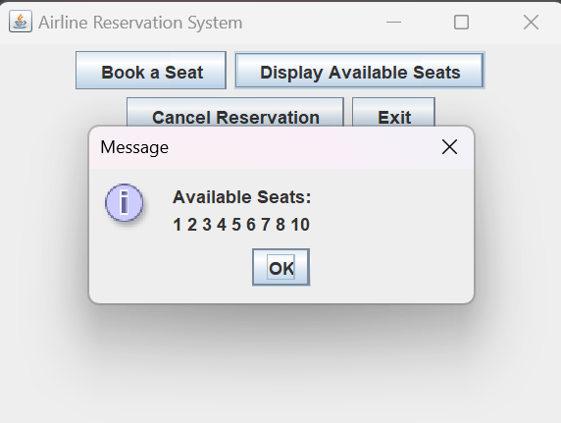
RESULTS AND DISCUSSION

Slide 11
QUERIES ?

