Slide 1




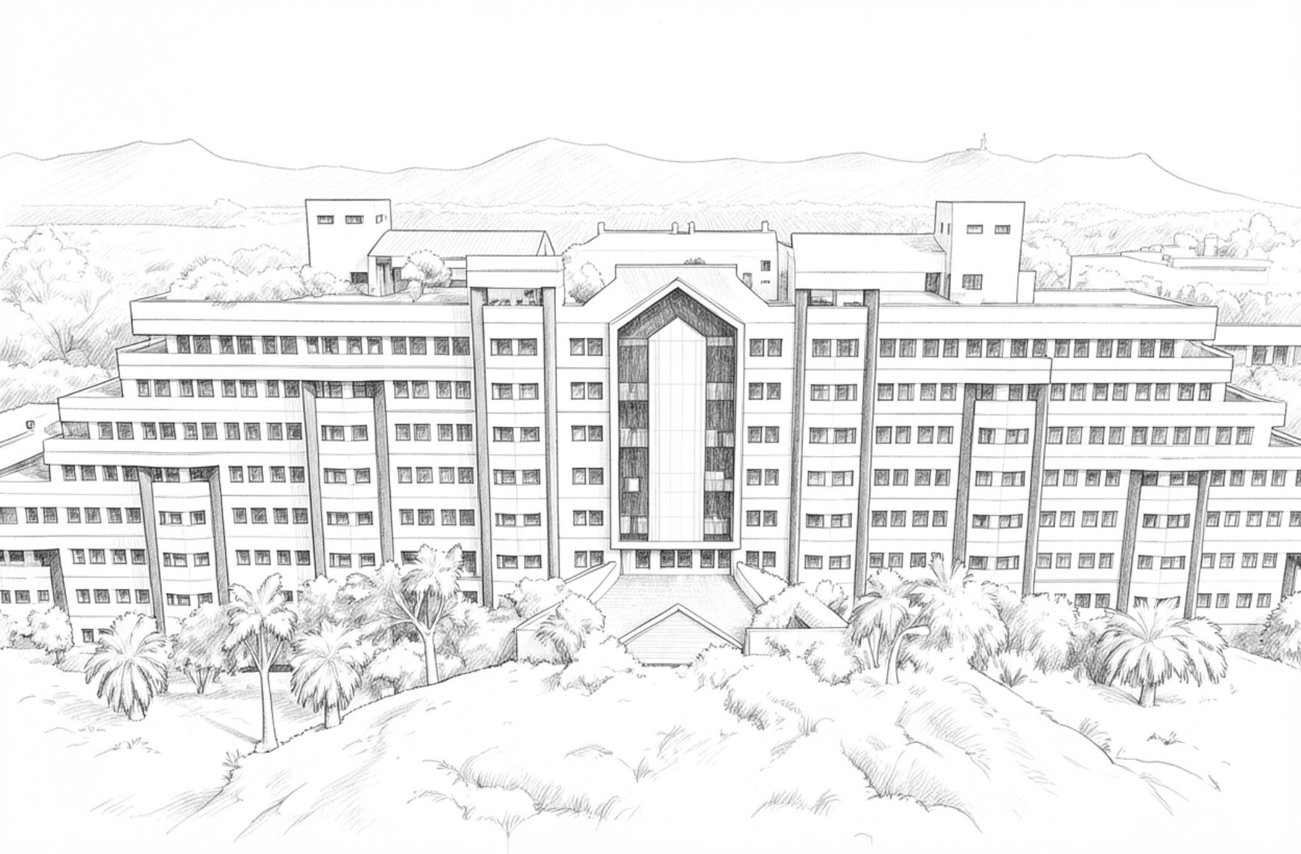
INNOHACK 2.0
RESILI-MESH : DISASTER INFO AGGREGATION AND MANAGEMENT SYSTEM
TRACK: IOT
PROBLEM STATEMENT :
Real-Time Disaster aggregation using IoT Sensors
TEAM FLUXION
HARI VISHVA S - 25MIS0522
YUVARAJ H - 25MIS160
JOSHUA IMMANUEL E - 25MIS0172
AHILESH GURU S - 25MID0073

Slide 2
INNOHACK 2.0
PROBLEM STATEMENT
Rural and hilly regions prone to floods and landslides often lack real-time monitoring, and when disaster strikes, poor or absent network connectivity delays critical data from reaching rescue teams — costing precious response time exactly where it's needed most.
IMPORTANCE / RELEVANCE:
85% of Indian land is vulnerable to one or more natural hazards, with floods and landslides disproportionately affecting rural, hard-to-reach populations
Rural areas typically have the poorest network/cellular infrastructure, so exactly the places most at risk are the ones least likely to get a warning out in time
SUPPORTING STATISTIC EXAMPLE:
Floods alone kill an average of 1,700 people and affect 3.9 million people every year in India, with rural populations disproportionately affected since most live close to rivers, compounded by poor infrastructure and remote locations

Slide 3
INNOHACK 2.0
PROPOSED SOLUTION
A hybrid hardware + software disaster monitoring system built on a LoRa mesh network of sensor nodes:
Node A (River Zone): ESP32 + LoRa, fitted with an ultrasonic sensor (water level) and a barometer (temperature/pressure) — monitors flood risk
Node B (Hilly/Landslide Zone): ESP32 + LoRa, fitted with rain, soil moisture, and vibration sensors — monitors landslide risk
Node C (Rescue Department): ESP32 + LoRa receiver, collecting data relayed from A and B, hosting a local WiFi webpage that displays live sensor readings and a predicted disaster status per zone — no internet required at any stage
Data hops node-to-node like a mesh (A → B → C), so even nodes physically out of range of the rescue station can still get their data through

Slide 4
HOW DOES IT SOLVE THE PROBLEM?
Removes dependency on cellular network/internet — the exact infrastructure that's weakest in rural and disaster-affected areas — by using long-range LoRa RF communication instead
Places sensing directly at the hazard source (riverbanks, slide-prone slopes), so risk is detected at the point of origin rather than relying on manual reports after the fact
Mesh relay design means coverage can extend across a village even where no single node has direct line-of-sight/range to the rescue station
WHAT MAKES IT INNOVATIVE?
Fully offline, end-to-end: sensing, relaying, and viewing all work with zero internet or cellular dependency
Fully offline, end-to-end: sensing, relaying, and viewing all work with zero internet or cellular dependency
Combines multiple hazard types (flood + landslide) in one unified network and one unified rescue-facing dashboard, rather than siloed single-sensor systems
Low-cost, low-power hardware (ESP32 + LoRa) makes it realistic to deploy at scale in resource-constrained rural regions, unlike expensive centralized monitoring stations

Slide 5
INNOHACK 2.0
TECHNICAL APPROACH
TOOLS, TECHNOLOGIES OR COMPONENTS USED
HARDWARE:
ESP32 microcontroller (×3) — WiFi + processing for each node
SX1278/LoRa module (×3) — long-range wireless communication (433 MHz)
Ultrasonic sensor — water level (Node A)
Barometer (BMP280/BME280) — temperature & pressure (Node A)
Rain sensor, soil moisture sensor, vibration sensor — landslide indicators (Node B)
SOFTWARE:
Arduino IDE / C++ for ESP32 firmware
LoRa library (Sandeep Mistry) for SPI-based LoRa communication
ESP32 WebServer library — hosts local webpage at Node C
HTML/CSS/JS — dashboard frontend served locally, no internet dependency
Hardcoded threshold logic — computes disaster probability/state from sensor values

Slide 6
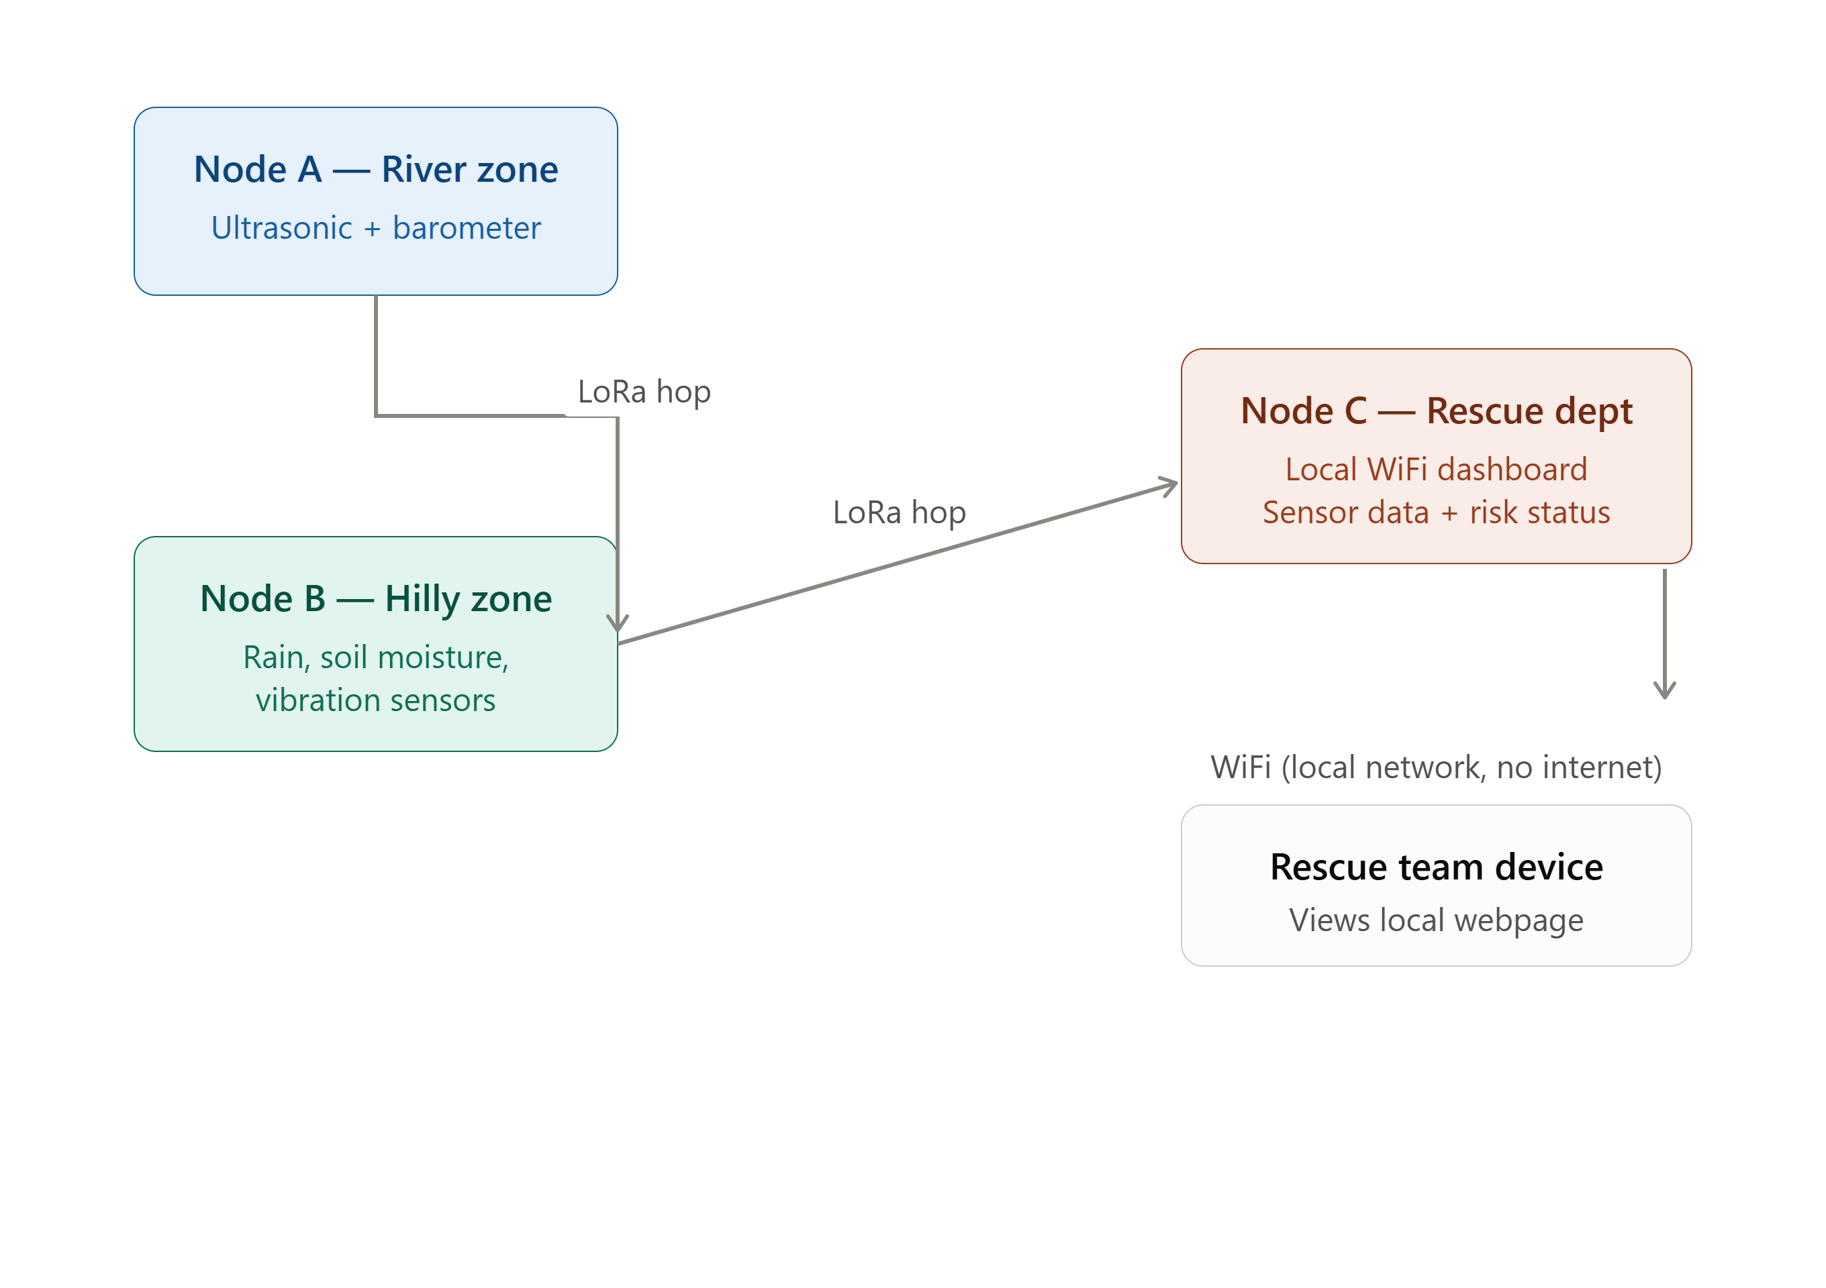
WORKFLOW / ARCHITECTURE DIAGRAM

Slide 7
IMPLEMENTATION DETAILS
Node A continuously reads ultrasonic + barometer values, packages them, and transmits via LoRa at fixed intervals (e.g., every 5–10 seconds)
Node B listens for incoming LoRa packets from A, combines them with its own rain/soil/vibration readings, and forwards the merged payload via LoRa to Node C
Node C receives all data, runs hardcoded threshold logic per sensor type (e.g., water level > threshold + falling pressure → "high flood risk"; soil moisture + vibration + rain above thresholds → "landslide risk") to generate a disaster probability/status
Node C's ESP32 runs a local WebServer, rendering an HTML page showing each node's live readings and computed risk status — accessible by any device connected to Node C's WiFi, no internet required
All three nodes are self-contained, battery/solar-powerable, and physically deployable at the actual hazard zones

Slide 8
INNOHACK 2.0
DEMO / PROTOTYPE
WORKING PROTOTYPE
NIL
KEY FEATURES:
Real-time sensor data display, separated by node and hazard type
Hardcoded disaster-risk logic showing live status (e.g., "Normal" / "Warning" / "High risk")
Fully offline operation — dashboard accessible over local WiFi, no internet required
Multi-hop LoRa relay demonstrated live (Node A → Node B → Node C)

Slide 9
INNOHACK 2.0
IMPACT & USE CASES
WHO BENEFITS FROM YOUR SOLUTION?
Rural and hilly village communities living in flood-prone riverside areas and landslide-prone hill regions
Disaster rescue departments and local administration, who get earlier, location-tagged alerts to plan faster response
HOW CAN IT BE APPLIED IN REAL WORLD SCENARIOS?
Riverside villages: early flood warning before water levels become critical, giving communities time to evacuate
Hilly/mountain regions: landslide risk detection using rainfall + soil saturation + ground vibration, ahead of visible ground failure
Areas with poor/no telecom infrastructure: functions entirely offline, unlike SMS/app-based alert systems that need cellular network
During active disasters: when cellular towers go down (a common failure mode in floods/landslides), this system keeps functioning since it doesn't depend on that infrastructure at all

Slide 10
SCALING / SUSTAINABILITY
Mesh design scales horizontally — more nodes can be added to extend coverage across an entire village or valley without redesigning the system, each new node just needs to be in LoRa range of at least one existing node
Low-cost hardware (ESP32 + LoRa + basic sensors) keeps per-node cost low enough for wide deployment in resource-constrained rural regions
Government/NDMA partnership potential — could integrate with existing disaster management frameworks as a low-cost last-mile sensing layer

Slide 11
INNOHACK 2.0
CHALLENGES FACED
OBSTACLES DURING DEVELOPMENT:
ESP32 ADC pin stuck at max value (4095) on the soil sensor — traced to a wiring issue, not code
ESP32 boards label pins differently ("D" pins vs actual GPIO), causing wiring/code mismatches
Coordinating LoRa TX/RX testing across two separate setups required careful flash-then-separate sequencing
Getting frequency, antenna, and range right across 3 LoRa nodes for reliable multi-hop relay
No existing dataset, so disaster thresholds are estimated rather than data-driven
PROBLEM-SOLVING ABILITY:
Isolated the ADC issue systematically — grounded the pin directly, used a multimeter — confirming wiring, not firmware, was at fault
Tested each component individually (sensor, then LoRa TX/RX) before full integration, avoiding a hard-to-debug "test everything at once" approach
Scoped a simple two-hop LoRa relay as the hackathon MVP, with dynamic mesh routing as future work

Slide 12
INNOHACK 2.0
FUTURE SCOPE
Expand from 3 nodes to a full village-wide mesh, with multiple nodes hopping data across many hops rather than just A→B→C
Replace hardcoded thresholds with an ML model trained on real collected sensor data for more accurate predictions
Add solar + battery power management for true off-grid, long-term deployment
Build a proper mobile/web app for the rescue department instead of just a local webpage — including alerts, historical trends, and multi-village dashboards
Add GPS modules to each node for precise location tagging instead of fixed/manual coordinates

Slide 13
INNOHACK 2.0
INNOHACK 2.0
CONCLUSION
A hybrid hardware + software disaster early-warning mesh network built with ESP32 and LoRa — sensor nodes at river and landslide-prone zones relay data hop-by-hop to a rescue-department node, which hosts a local WiFi dashboard showing live sensor readings and predicted disaster risk, all without needing internet or cellular connectivity.
NOVELTY:
Fully offline, end-to-end system — sensing, relaying, and viewing all work with zero internet dependency, unlike most disaster alert systems that assume connectivity
True multi-hop LoRa mesh relay, designed to scale to village-wide coverage rather than a single point-to-point link
Unifies multiple hazard types (flood + landslide) into one network and one dashboard instead of siloed single-sensor systems
Low-cost, deployable hardware makes last-mile disaster monitoring realistic for exactly the resource-constrained rural regions that need it most

Slide 14
INNOHACK 2.0
ACKNOWLEDGEMENTS
TEAM MEMBERS:
HARI VISHVA S
YUVARAJ H
JOSHUA IMMANUEL E
AHILESH GURU S

