Slide 1
Visualizing Music Networks
DSE3151 | GRAPH VISUALIZATION
Spotify artist collaborations and genre clusters
Presented by Faizaan Khan
Notes:
Opening. This talk models Spotify artist collaborations as a graph and uses visualization principles (Gestalt mapping, network and cluster views) to expose structure that a flat list of tracks hides.

Slide 2
Why map artist collaborations?
The challenge
30
artists (vertices)
A raw list of tracks and featured-artist credits hides the structure behind it: which artists are hubs, which bridge genres, and which never collaborate.
The objective
26
collaborations (edges)
Model the artist ecosystem as a graph, then apply visualization principles (Gestalt-based visual mapping, network and cluster views) to make that structure visible.
The scope
6
genres
Graph construction, visual-design rationale, cluster detection and an evaluation of a 30-artist, 26-collaboration network.
Notes:
The challenge is that track credits are a list, not a picture. The objective is to turn them into a graph and choose visual encodings deliberately. Scope: construction, mapping, clusters, evaluation.

Slide 3
Dataset: 30 artists, 26 collaborations
Artist table
30 artists, each with one genre label (Pop, Hip-Hop, R&B, EDM, Rock, Latin). Stored as the artist_genre dictionary.
Collaboration list
27 listed pairs, 26 unique edges. Bad Bunny and J Balvin were listed twice; the simple graph keeps one edge.
Source and scope
Both tables are hard-coded in the Python script. Spotify API, play counts, dates or track-level credits were used.
Notes:
Be upfront that the dataset is a small curated sample typed into the script (artist_genre and collaborations), not an API pull. Derived data: the degree table, community labels and summary metrics are all computed from these two structures.

Slide 4






Tools and libraries used
Python 3
NetworkX
Matplotlib
One script in six labelled parts, from data prep to summary metrics. The os module sets the output folder.
Graph, degree, isolates, complement, density, connected components, spring_layout and greedy_modularity_communities.
Network and cluster figures, the degree bar chart and the genre legend (patches),
Pandas and NumPy
D3.js v7
Outputs
A sorted DataFrame for the degree table and summary metrics, exported to CSV. NumPy gives the mean degree.
Interactive page: force-directed graph, drag and zoom, tooltips, ego-network click, genre filter and a linked bar chart.
degree_table.csv, summary_metrics.csv, collaboration_network.png, degree_distribution.png, genre_clusters.png.
Notes:
Everything in the analysis is Python: NetworkX for the graph work, Matplotlib for figures, Pandas and NumPy for tables and summary numbers. The D3 page is a separate interactive layer on the same data.

Slide 5
Methodology: a six-part pipeline
1
Data preparation
2
Graph fundamentals
3
Visual mapping
artist_genre (30 artists) and collaborations (27 pairs) are loaded into an undirected nx.Graph.
Degree table, isolated and pendent vertices, average degree and the complement graph.
Genre sets node colour, degree sets node size, and a spring layout sets proximity.
4
Network visualization
5
Cluster detection
6
Summary metrics
A node-link diagram plus the top-15 degree bar chart, saved as PNG files.
Greedy modularity communities from structure alone, compared with stated genre.
Nine headline metrics (order, size, density, components, communities) exported to CSV.
Notes:
Why a force-directed (spring) layout rather than circular or hierarchical? It implements the Gestalt principle of proximity: artists who collaborate are pulled closer, so clusters and bridge nodes appear without reading the edge list. The six steps map one-to-one to the six parts of the script.

Slide 6
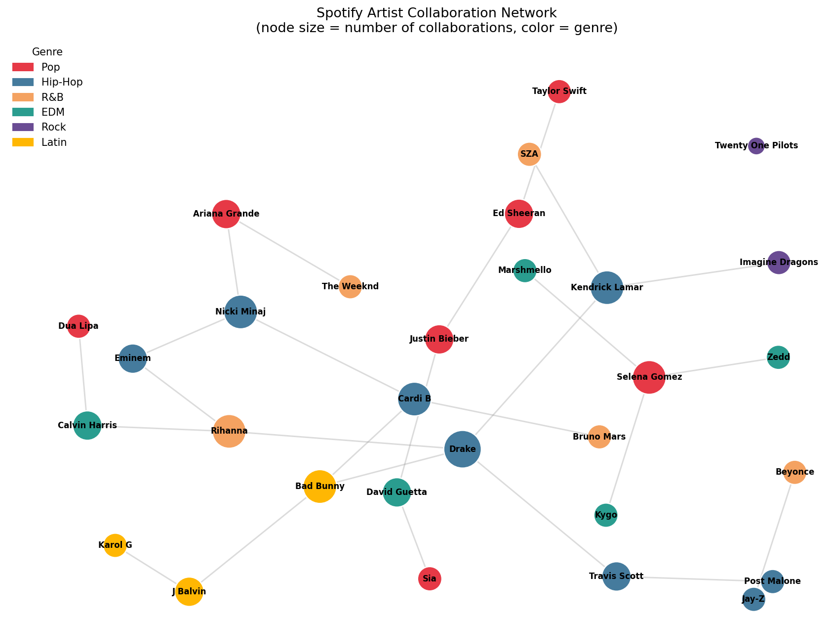




Graph fundamentals
Order and size
|V| = 30 artists and |E| = 26 collaborations: a finite, undirected, simple graph.
Isolated vertex
TwentyOne Pilots has degree 0, with no collaboration edge at all.
Pendent vertices
14 artists sit at degree 1, such as Taylor Swift, SZA and Karol G.
Complement graph
409 non-collaborating pairs (435 possible minus 26): the unexplored half.
Notes:
The complement flips every collaborated edge into a never-collaborated edge. 409 such pairs against only 26 real ones shows how sparse the network is and surfaces untapped pairings. Twenty One Pilots as an isolate reflects this sample honestly; a larger dataset might still add an edge for them.

Slide 7
Visual mapping and Gestalt principles
Data | Visual channel | Principle
Genre label | Node colour | Similarity
Collaboration count (degree) | Node size | Size signals importance
Who worked with whom | Edges and spring layout | Proximity
Structural cluster | Colour in a second view | Similarity (structure, not genre)
Genre palette
Hip-Hop
8 artists
Pop
7 artists
R&B
5 artists
EDM
5 artists
Layout and sizing in the code
Latin
3 artists
nx.spring_layout(G, seed=42, k=0.6)
node size = 300 + 260 x degree
A fixed seed keeps the figures reproducible.
Rock
2 artists
Notes:
Node size encodes degree rather than, say, monthly listeners because degree is native to the graph. Mixing in an external metric would combine two data sources in one visual channel and muddy the encoding.

Slide 8
Results: graph metrics matrix
Metric | Value
Vertices (artists) | 30
Edges (collaborations) | 26
Isolated vertices | 1 (TwentyOne Pilots)
Pendent vertices | 14
Average degree | 1.73
Density | 0.06
Connected components | 5
Detected communities | 7
Complement graph edges | 409
6%
density: 26 of 435 possible pairs have collaborated
18 of 30
artists sit in the largest connected component
50%
of artists have at most one collaboration (15 of 30)
Notes:
The network is sparse and fragmented: five connected components with sizes 18, 5, 4, 2 and 1. Average degree 1.73 is simply 2 x 26 / 30.

Slide 9
Top connected artists by degree
Hip-Hop
Pop
R&B
EDM
Latin
Rock
4
Drake's degree, 2.3x the network average of 1.73
6
artists at degree 3: Selena Gomez, Kendrick Lamar, Cardi B, Nicki Minaj, Rihanna, Bad Bunny
3
genres reached by Drake's four collaborators: Hip-Hop, R&B and Latin
Notes:
This is the top-15 degree bar chart from the script, rebuilt as a native chart with bars coloured by genre. Drake is a structural bridge, not just a prolific collaborator inside one scene: his neighbours are Rihanna (R&B), Kendrick Lamar and Travis Scott (Hip-Hop) and Bad Bunny (Latin).

Slide 10
Degree distribution
Degree | Artists | Share
0 | 1 | 3.3%
1 | 14 | 46.7%
2 | 8 | 26.7%
3 | 6 | 20.0%
4 | 1 | 3.3%
Nearly half of the artists (14 of 30) are pendent vertices, and only 7 have three or more collaborations. The network is skewed toward low degree: a few hubs, many one-collaboration artists.
Notes:
The sum of all degrees is 52, which is twice the 26 edges (handshake lemma). With only 30 vertices, describe the shape as skewed toward low degree rather than claiming a formal heavy tail.

Slide 11
Degree table
# | Artist | Genre | Degree
1 | Drake | Hip-Hop | 4
2 | Selena Gomez | Pop | 3
3 | Kendrick Lamar | Hip-Hop | 3
4 | Cardi B | Hip-Hop | 3
5 | Nicki Minaj | Hip-Hop | 3
6 | Rihanna | R&B | 3
7 | Bad Bunny | Latin | 3
8 | Ed Sheeran | Pop | 2
9 | Justin Bieber | Pop | 2
10 | Ariana Grande | Pop | 2
11 | Travis Scott | Hip-Hop | 2
12 | Eminem | Hip-Hop | 2
13 | Calvin Harris | EDM | 2
14 | David Guetta | EDM | 2
15 | J Balvin | Latin | 2
# | Artist | Genre | Degree
16 | Taylor Swift | Pop | 1
17 | Dua Lipa | Pop | 1
18 | Sia | Pop | 1
19 | Post Malone | Hip-Hop | 1
20 | Jay-Z | Hip-Hop | 1
21 | The Weeknd | R&B | 1
22 | SZA | R&B | 1
23 | Beyonce | R&B | 1
24 | Bruno Mars | R&B | 1
25 | Marshmello | EDM | 1
26 | Zedd | EDM | 1
27 | Kygo | EDM | 1
28 | Imagine Dragons | Rock | 1
29 | Karol G | Latin | 1
30 | Twenty One Pilots | Rock | 0
Ties share a degree; rows within a tie follow the order produced by the script. Source: degree_table.csv.
Notes:
This is the degree_table.csv the script exports. Ties are ordered as pandas sorts them, so the order inside a tie can differ slightly from the earlier bar chart image.

Slide 12
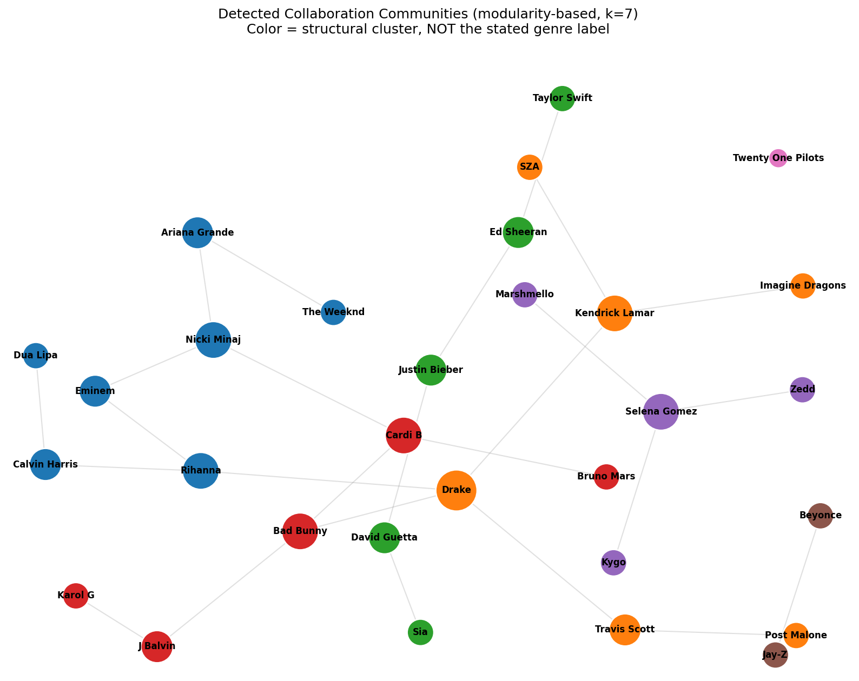
Genre labels vs detected clusters
6 of 7
65%
clusters mix two or more genres
of collaborations (17 of 26) cross genre lines
Cluster | Size | Genres present
0 | 7 | Pop, Hip-Hop, R&B, EDM
1 | 6 | Hip-Hop, R&B, Rock
2 | 5 | Pop, EDM
3 | 5 | Hip-Hop, R&B, Latin
4 | 4 | Pop, EDM
5 | 2 | Hip-Hop, R&B
6 | 1 | Rock
greedy_modularity_communities gives k = 7 (modularity Q = 0.68).
Notes:
Genre is external metadata; the cluster comes from modularity-based community detection on collaboration structure alone. Where they diverge, collaboration structure cuts across genre labels. Q = 0.68 was computed with networkx's modularity function on the same partition. How would this scale to the full Spotify catalog? A force-directed view degrades into a hairball past a few hundred nodes; switch to an adjacency matrix or pre-aggregate by genre and use node-link only for a filtered subgraph.

Slide 13





Interactive version in D3.js
Force-directed graph
Drag nodes, zoom and pan. Node size shows degree.
Network graph
Hover detail
Tooltips give genre, degree and who the artist worked with.
Ego-network click
Click a node or a bar to isolate that artist's neighbourhood.
Hover: highlights both ways
Click: isolates the ego-network
Filter: dims a genre in both
Genre filter
Legend chips dim a genre in both the graph and the bars.
Colour toggle
Switch between genre colour and detected cluster.
Bar chart
Linked bar chart
Sort by degree or A-Z; show Top 5, 10, 15 or All.
Notes:
The D3 page is a standalone HTML file (D3 v7 from cdnjs). Hovering a bar highlights that node and its edges, hovering a node outlines its bar, clicking either isolates the ego-network, and the genre legend filters both views.

Slide 14
Key outcomes
4
Drake is the hub
Highest degree, 2.3x the average. His four collaborators span Hip-Hop, R&B and Latin.
5
A sparse, fragmented network
Density is 0.06 and there are five components; the largest holds 18 of 30 artists.
50%
Half the artists are on the fringe
15 of 30 have at most one collaboration: 14 pendent vertices and Twenty One Pilots.
65%
Collaboration crosses genres
17 of 26 edges link different genres, and 6 of 7 detected clusters mix genres.
Notes:
Four outcomes: a clear hub (Drake), a sparse and fragmented network, half the artists on the fringe, and collaboration that cuts across genre labels.

Slide 15
Conclusions
1
Modelling credits as a graph exposes structure a track list hides: hubs, bridges, pendent vertices and isolates.
2
Encoding choices carry the message: colour for genre, size for degree and layout proximity for collaboration.
3
Collaboration structure cuts across genre labels, so genre alone is a weak guide to creative circles.
4
The workflow is reproducible: one Python script makes every table and figure, and a D3 page makes it explorable.
Notes:
Keep the claim about genre measured: the evidence is that clusters and most edges cross genre labels in this sample, which suggests genre alone is a weak guide to creative circles.

Slide 16


Limitations and future work
Limitations
Future work
Small, hand-coded sample: 30 well-known artists and 26 collaborations typed into the script, not pulled from Spotify's API.
Edges are unweighted and undirected: no track counts, dates, or main-versus-featured roles.
Bridge is judged from genre-spanning neighbours; betweenness centrality was not computed.
Greedy modularity is a heuristic and the spring layout depends on its seed, so both can change the picture.
TwentyOne Pilots as an isolate may reflect sampling, not behaviour.
Pull real collaboration data from the Spotify Web API or MusicBrainz and scale the sample up.
Weight edges by number of shared tracks and add time slices to show the network evolving.
Add betweenness and closeness centrality to test the bridge claim.
Compare Louvain or label-propagation communities with the greedy result.
Use adjacency-matrix or genre-aggregated views once the graph passes a few hundred nodes.
Notes:
Be direct about the biggest limitation: this is a curated sample, so the numbers describe this sample, not Spotify as a whole. Node-link views degrade into a hairball beyond a few hundred nodes, which is why the future-work list ends with matrix and aggregated views.

Slide 17
Questions and discussion
Graph Visualization
Notes:
Likely questions: why a spring layout (proximity), what the complement shows (sparsity and untapped pairings), why size encodes degree, how clusters differ from genre, how this scales.

