Slide 1
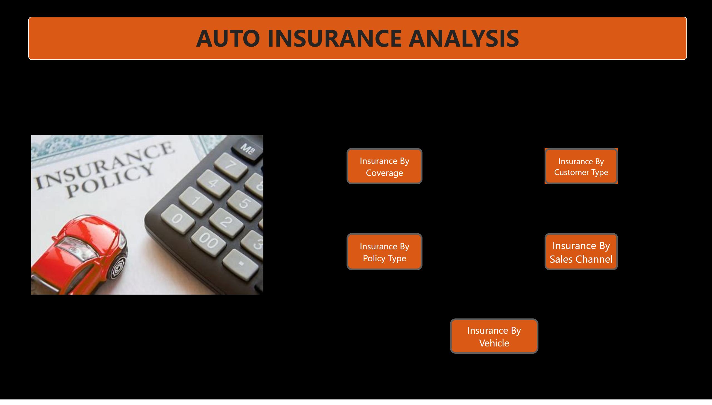
Landing Page
Notes:
textbox
No alt text provided
actionButton
No alt text provided
actionButton
No alt text provided
actionButton
No alt text provided
actionButton
No alt text provided
actionButton
No alt text provided
image
No alt text provided

Slide 2
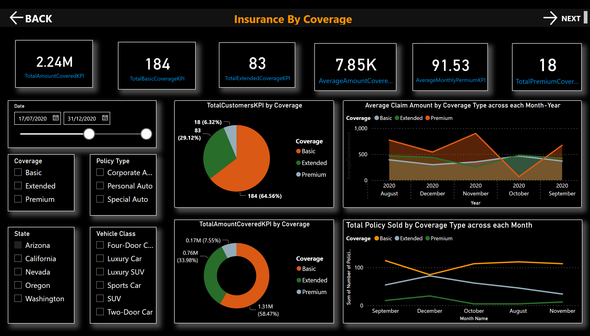
Insurance By Coverage
Notes:
textbox
No alt text provided
card
No alt text provided
card
No alt text provided
card
No alt text provided
card
No alt text provided
card
No alt text provided
card
No alt text provided
pieChart
No alt text provided
donutChart
No alt text provided
Average Claim Amount by Coverage Type across each Month-Year
No alt text provided
Total Policy Sold by Coverage Type across each Month
No alt text provided
slicer
No alt text provided
slicer
No alt text provided
slicer
No alt text provided
slicer
No alt text provided
actionButton
No alt text provided
actionButton
No alt text provided
slicer
No alt text provided

Slide 3
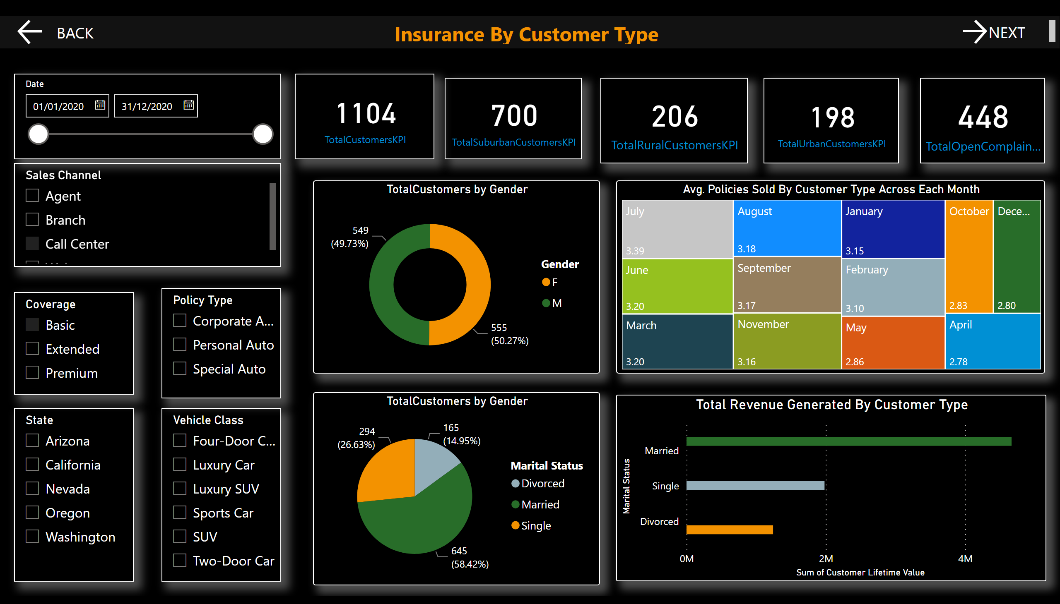
Insurance By Customer Type
Notes:
textbox
No alt text provided
card
No alt text provided
card
No alt text provided
card
No alt text provided
card
No alt text provided
card
No alt text provided
TotalCustomers by Gender
No alt text provided
Avg. Policies Sold By Customer Type Across Each Month
No alt text provided
Total Revenue Generated By Customer Type
No alt text provided
slicer
No alt text provided
slicer
No alt text provided
slicer
No alt text provided
slicer
No alt text provided
actionButton
No alt text provided
actionButton
No alt text provided
slicer
No alt text provided
slicer
No alt text provided
TotalCustomers by Gender
No alt text provided

Slide 4
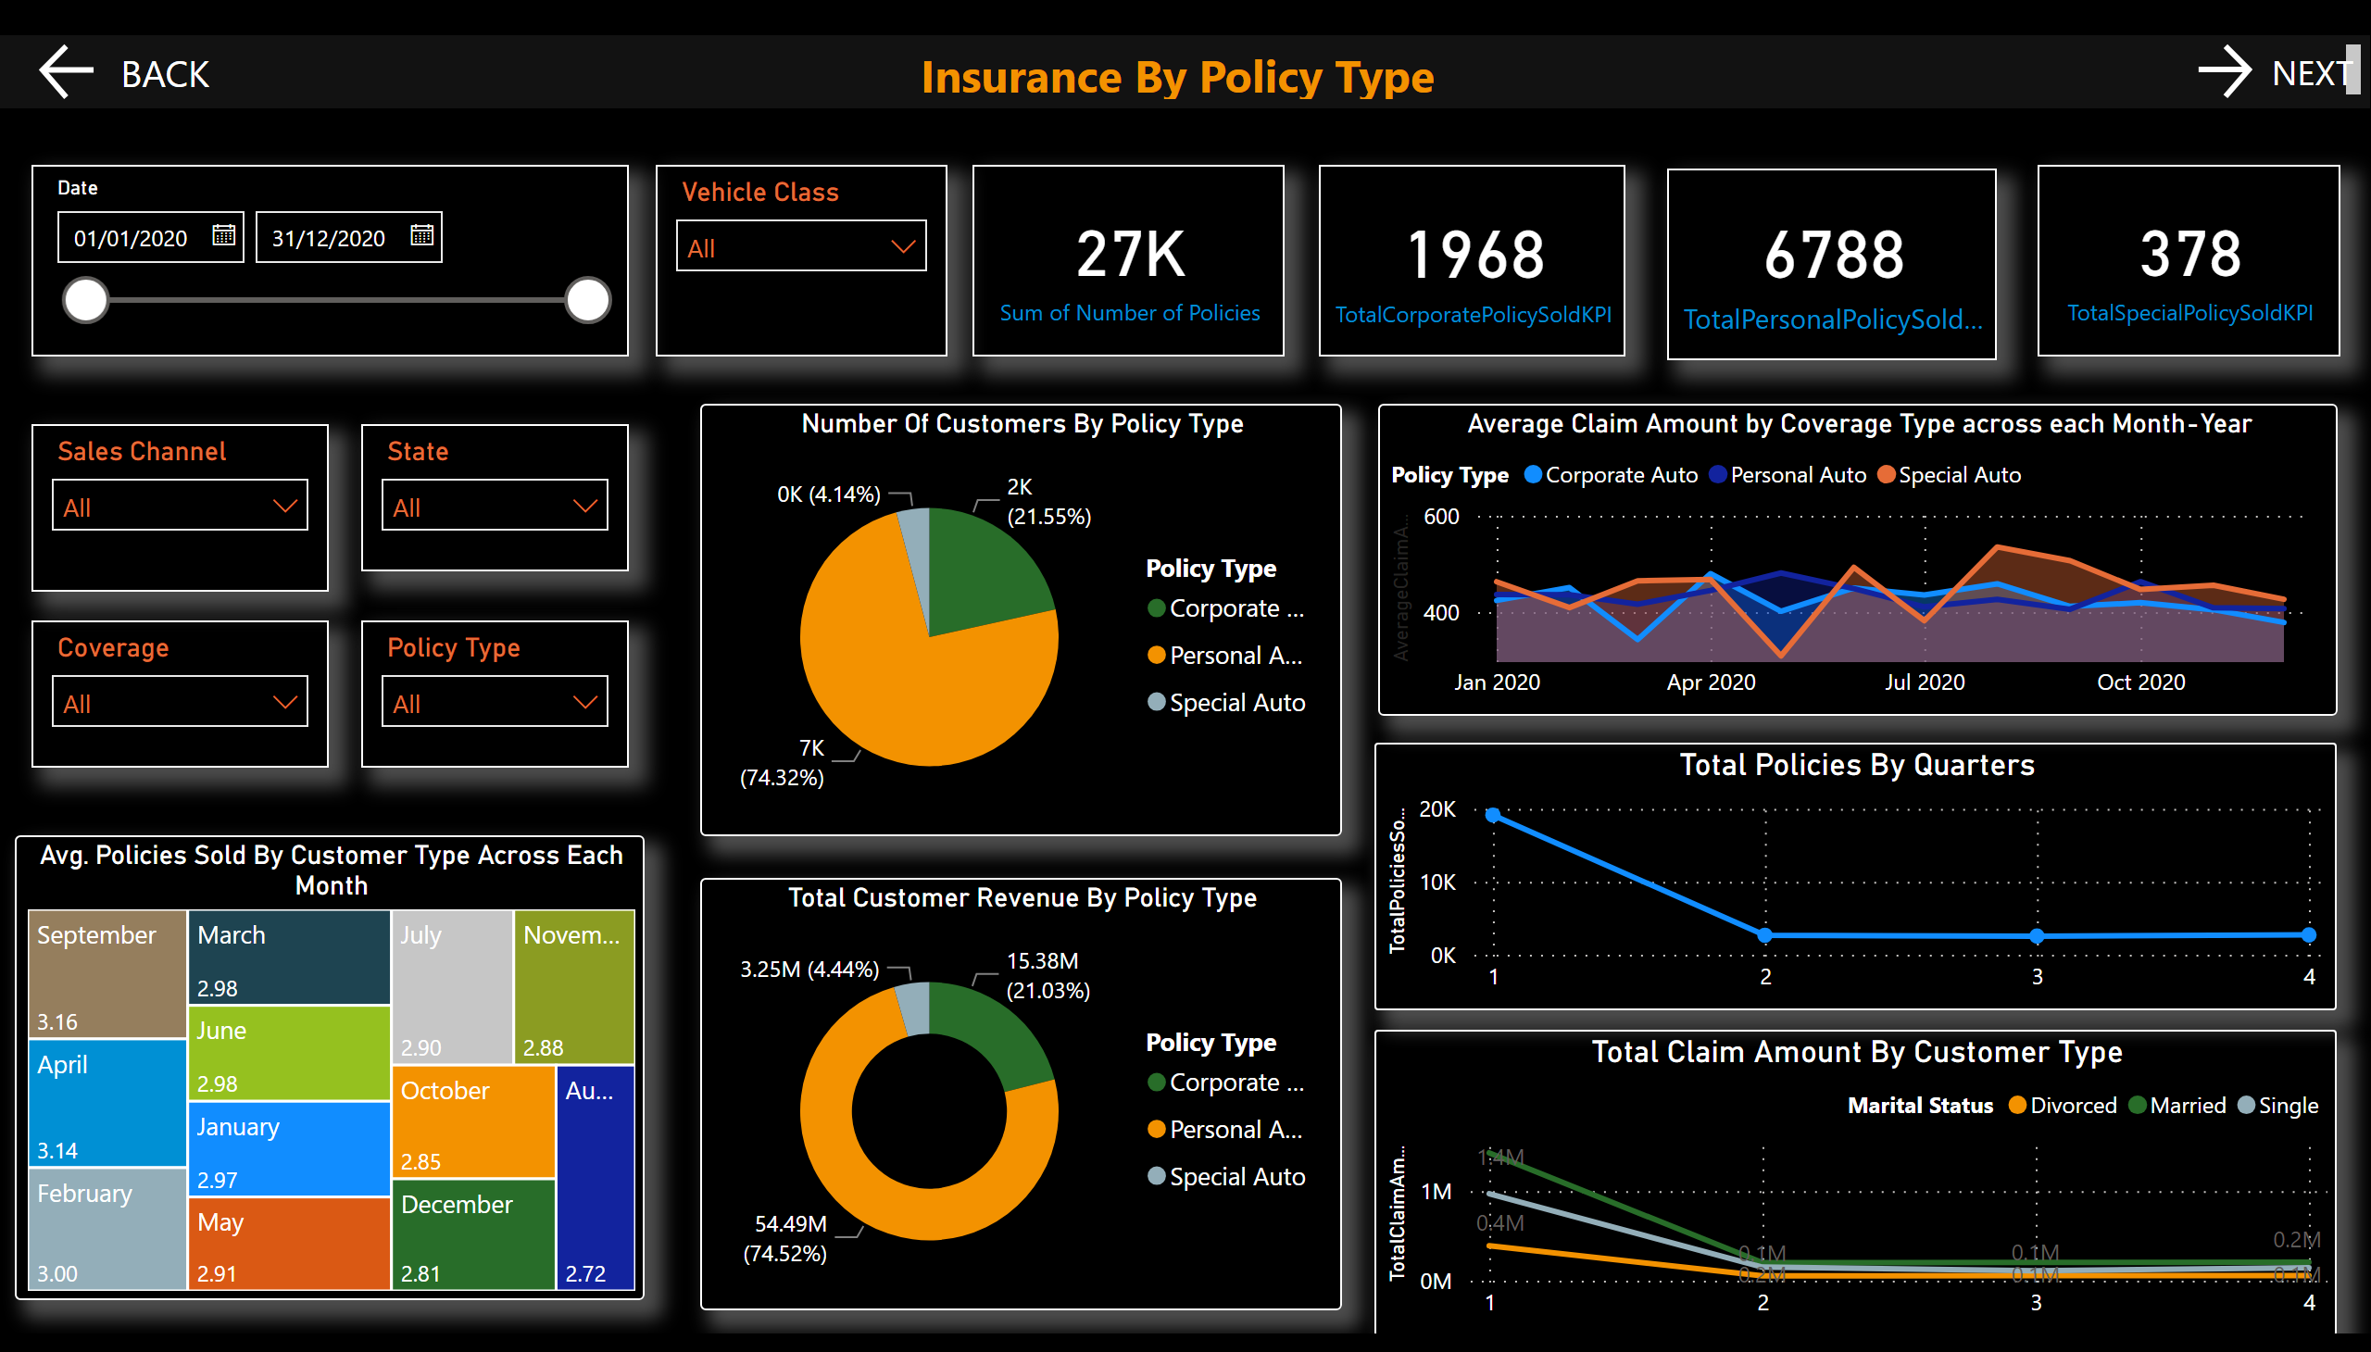
Insurance By Policy Type
Notes:
textbox
No alt text provided
card
No alt text provided
card
No alt text provided
card
No alt text provided
card
No alt text provided
Number Of Customers By Policy Type
No alt text provided
Avg. Policies Sold By Customer Type Across Each Month
No alt text provided
Total Policies By Quarters
No alt text provided
slicer
No alt text provided
slicer
No alt text provided
slicer
No alt text provided
slicer
No alt text provided
actionButton
No alt text provided
actionButton
No alt text provided
slicer
No alt text provided
slicer
No alt text provided
Total Customer Revenue By Policy Type
No alt text provided
Total Claim Amount By Customer Type
No alt text provided
Average Claim Amount by Coverage Type across each Month-Year
No alt text provided

Slide 5
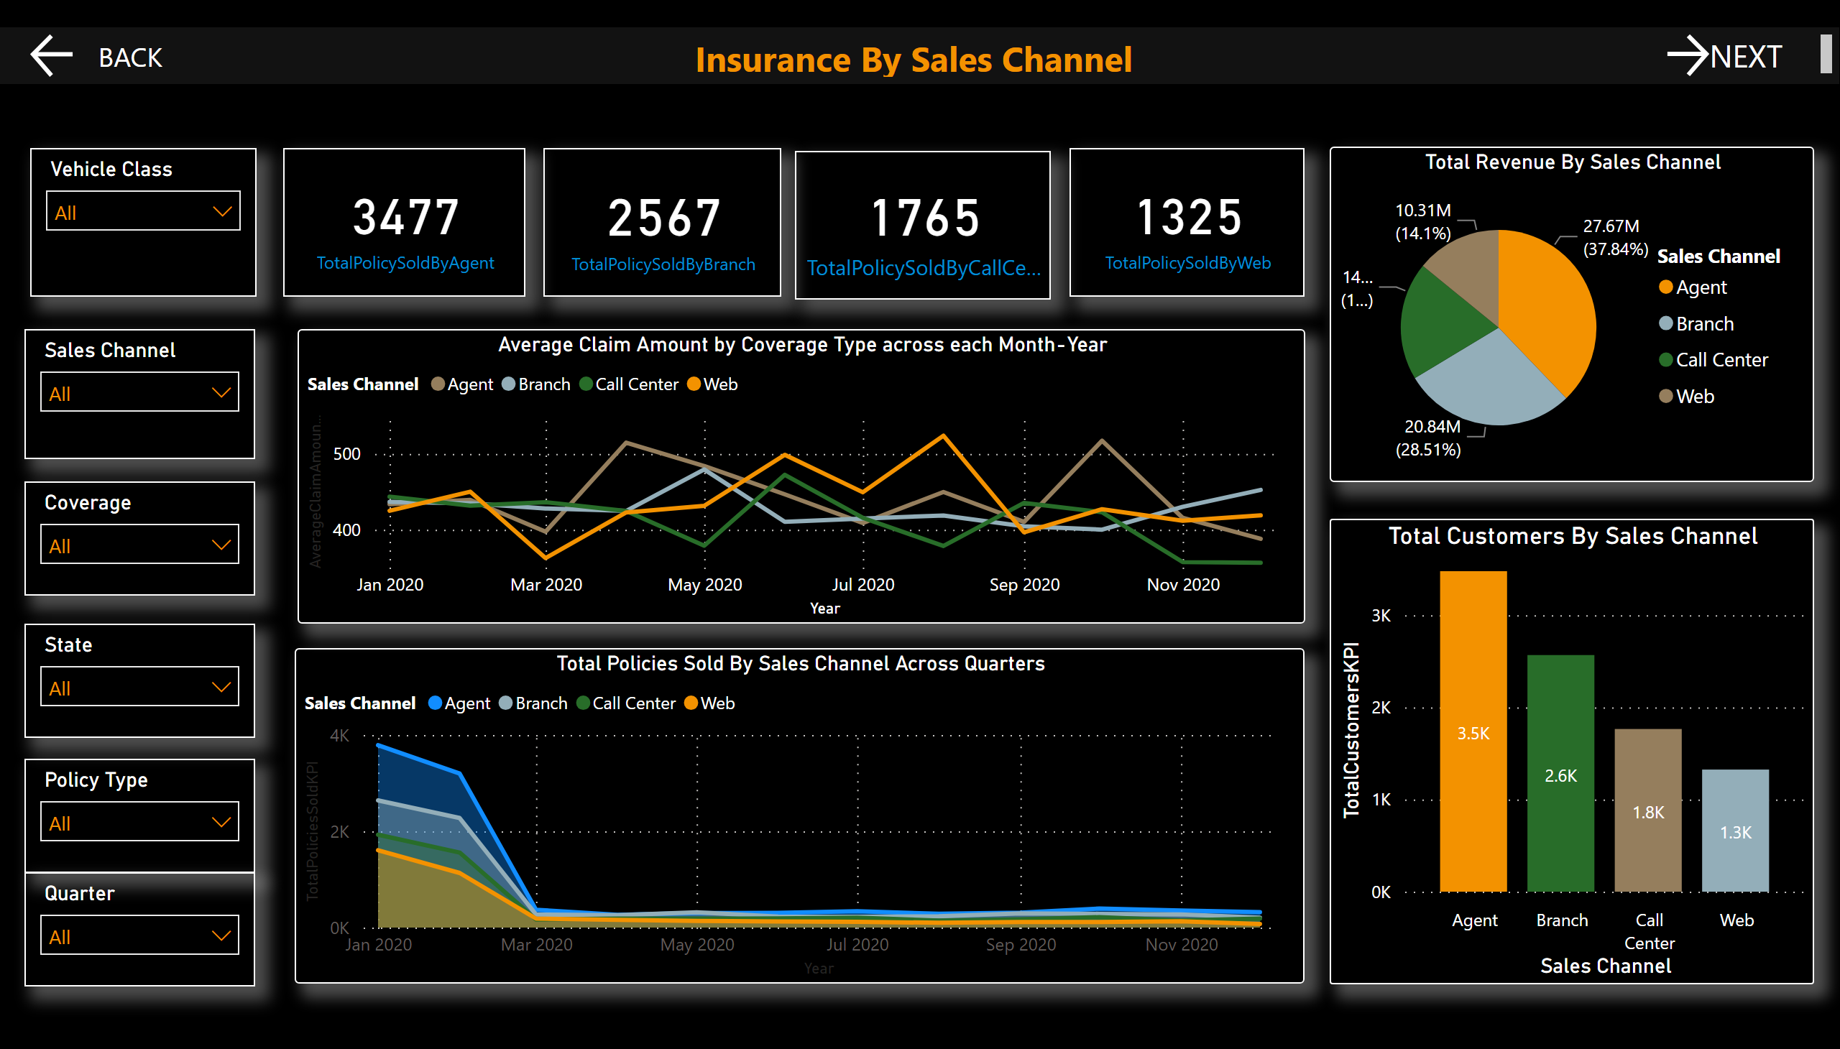
Insurance By Sales Channel
Notes:
textbox
No alt text provided
card
No alt text provided
card
No alt text provided
card
No alt text provided
card
No alt text provided
Total Revenue By Sales Channel
No alt text provided
Total Customers By Sales Channel
No alt text provided
slicer
No alt text provided
slicer
No alt text provided
slicer
No alt text provided
slicer
No alt text provided
actionButton
No alt text provided
actionButton
No alt text provided
slicer
No alt text provided
Total Policies Sold By Sales Channel Across Quarters
No alt text provided
Average Claim Amount by Coverage Type across each Month-Year
No alt text provided
slicer
No alt text provided

Slide 6
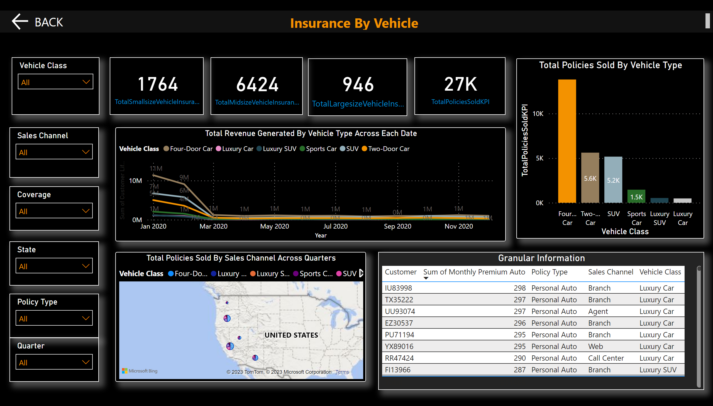
Insurance By Vehicle
Notes:
textbox
No alt text provided
card
No alt text provided
card
No alt text provided
card
No alt text provided
card
No alt text provided
Total Policies Sold By Vehicle Type
No alt text provided
slicer
No alt text provided
slicer
No alt text provided
slicer
No alt text provided
slicer
No alt text provided
actionButton
No alt text provided
slicer
No alt text provided
Total Policies Sold By Sales Channel Across Quarters
No alt text provided
Total Revenue Generated By Vehicle Type Across Each Date
No alt text provided
slicer
No alt text provided
Granular Information
No alt text provided

