Slide 1
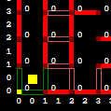
Known wall present
Known wall not present
Known wall changed to not present
Unknown wall

Slide 2
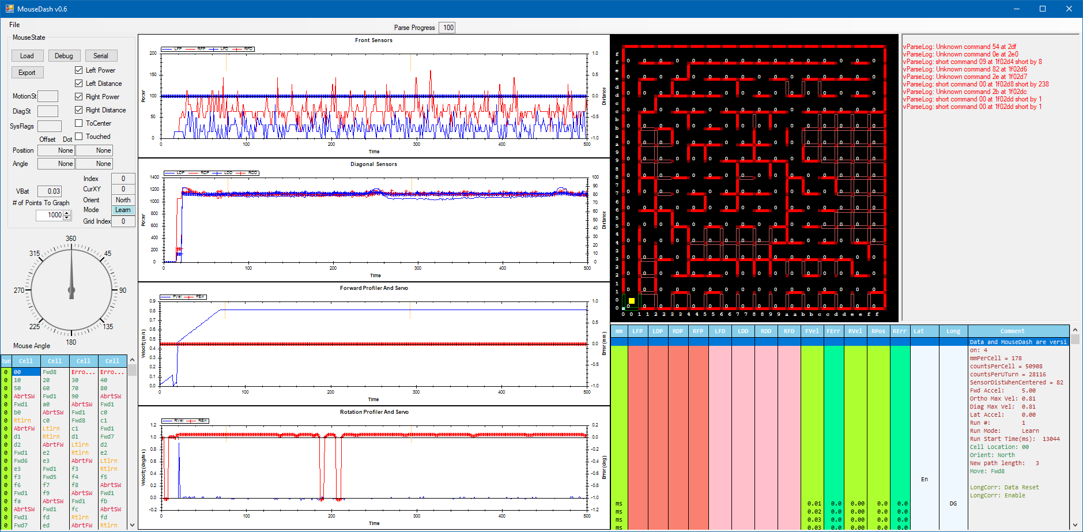
Front and Diagonal Sensor Raw and Distance information
Current Maze information
Information from MouseDash about log
Mouse State
Current Heading
Cell Selector
Forward and Rotational Profiler and Control loop information
Motion & Sensor information
Mouse & Debug information

Slide 3
