Slide 1

Healthcare Analytics for Doctor Visits
Name : K. Harjith
College : A.V.C College Of Engineering
AICTE STU ID : STU6a1881c5a398a1779990981

Slide 2

PROBLEM STATEMENT
Doctor visits vary a great deal from person to person, but it isn't always clear why -- some people never see a doctor in a given period, while a small number visit many times. Raw patient records don't by themselves explain which factors -- age, income, illness, chronic conditions, or access to healthcare support -- are actually associated with how often someone visits a doctor. The problem this project addresses is to analyze a 5,190-patient healthcare dataset and identify meaningful patterns, relationships, and differences in doctor-visit behavior using exploratory data analysis.

Slide 3
Project Description
This project analyzes a 5,190-record healthcare survey dataset covering demographics, income, illness and health indicators, healthcare support programs, and chronic conditions. Using Python (Pandas, Matplotlib, Seaborn) in a Jupyter Notebook, the workflow covers data cleaning, exploratory data analysis, and visualization to uncover which factors are most strongly associated with the number of doctor visits -- concluding with evidence-based recommendations for healthcare planning and outreach.

Slide 4

WHO ARE THE END USERS?
Healthcare policymakers and public health planners -- to allocate resources toward high-need patient groups
Hospital and clinic administrators -- to anticipate patient load and staffing needs
Health insurance providers -- to understand how coverage relates to patient visit patterns
Public healthcare support programs -- to evaluate whether targeted programs reach the right patients
Healthcare researchers -- to study the relationship between chronic conditions, income, and care-seeking behavior

Slide 5

Technology Used
Python 3 -- core programming language for the analysis
Pandas & NumPy -- data cleaning, transformation, and aggregation
Matplotlib & Seaborn -- statistical visualization (box plots, heatmaps, scatter plots, bar charts)
Jupyter Notebook -- interactive environment documenting the full analysis workflow

Slide 6
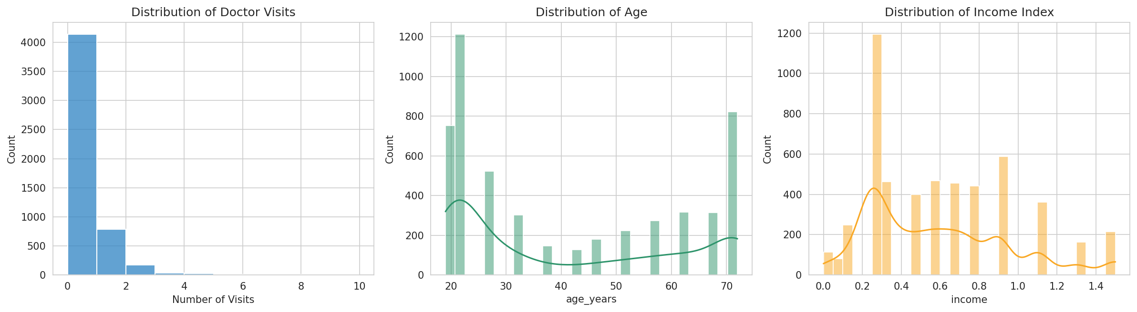
Results: Distribution of Visits, Age & Income
Univariate view of three key numeric variables
About 80% of patients report zero visits; age clusters at the young and oldest ends, income skews low.

Slide 7
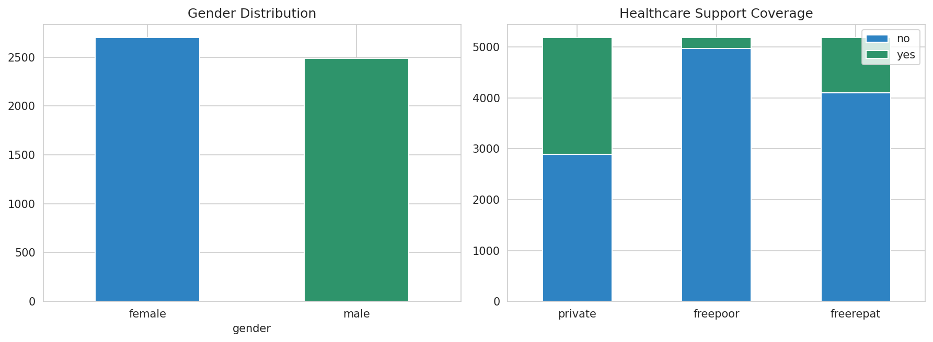
Results: Gender & Healthcare Support Coverage
How patients break down by gender and support program
Private insurance is the most common coverage; free-care programs reach smaller, targeted groups.

Slide 8
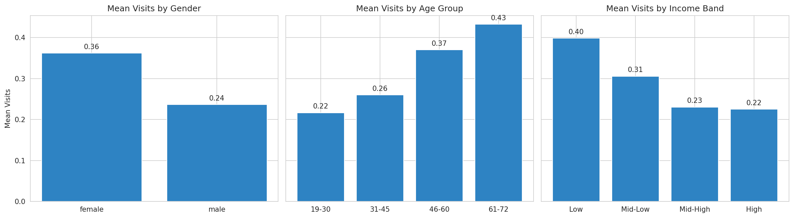
Results: Visits vs Demographics & Income
Mean visits by gender, age group, and income band
Women, older patients, and lower-income patients average more visits.

Slide 9
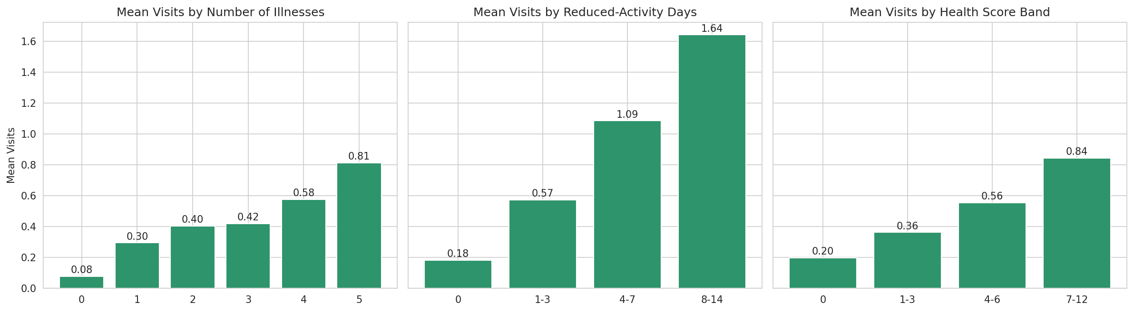
Results: Visits vs Health Indicators
Mean visits by illness count, reduced-activity days, and health-score band
Mean visits climb steadily with illness count, reduced-activity days, and health score.

Slide 10
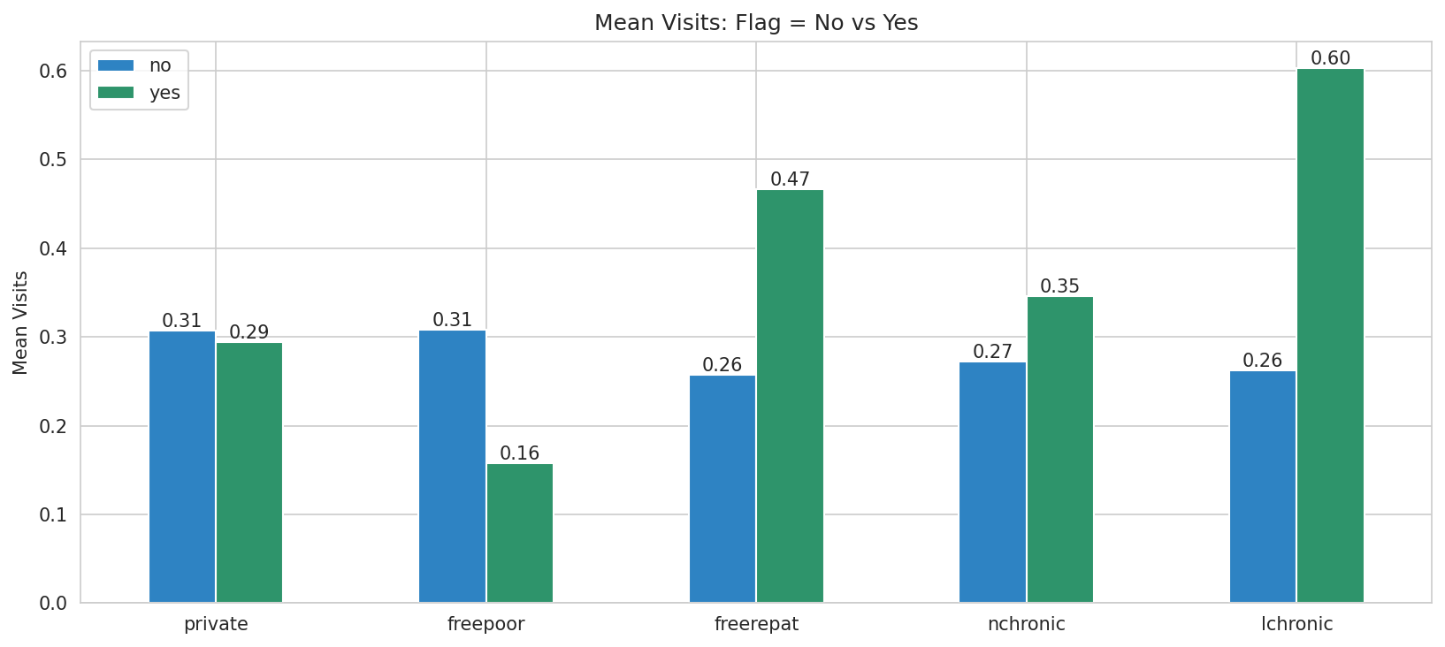
Results: Visits vs Healthcare Support & Chronic Conditions
Mean visits for patients with and without each support or chronic-condition flag
Long-term chronic and freerepat patients visit most; freepoor recipients visit least.

Slide 11
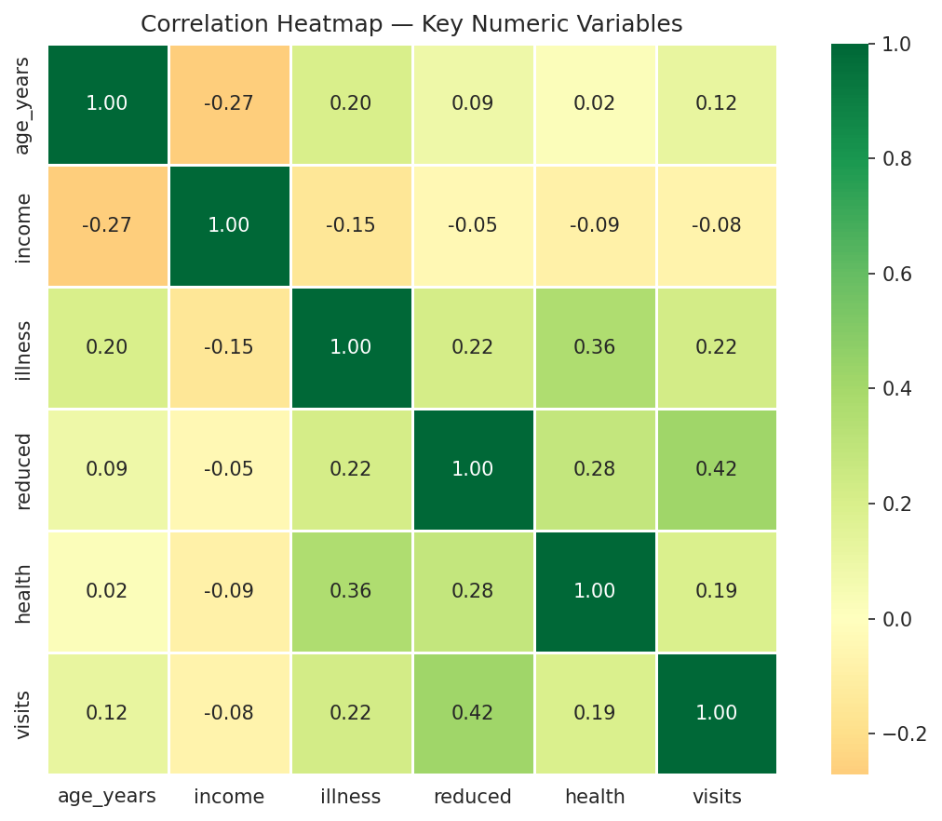
Results: Correlation Between Key Variables
Multivariate relationships across numeric variables
Reduced-activity days (0.42), illness (0.22) and health score (0.19) outrank age (0.12) and income (-0.08).

Slide 12
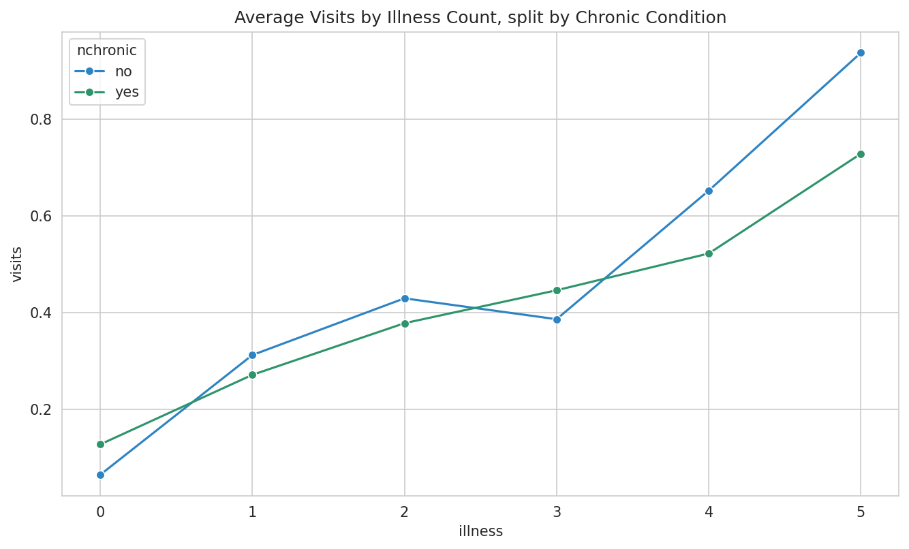
Results: Illness & Chronic Condition Interaction
Does a chronic condition add to the illness-visits relationship?
Once illness count is held constant, chronic-condition status adds little independent effect.

Slide 13
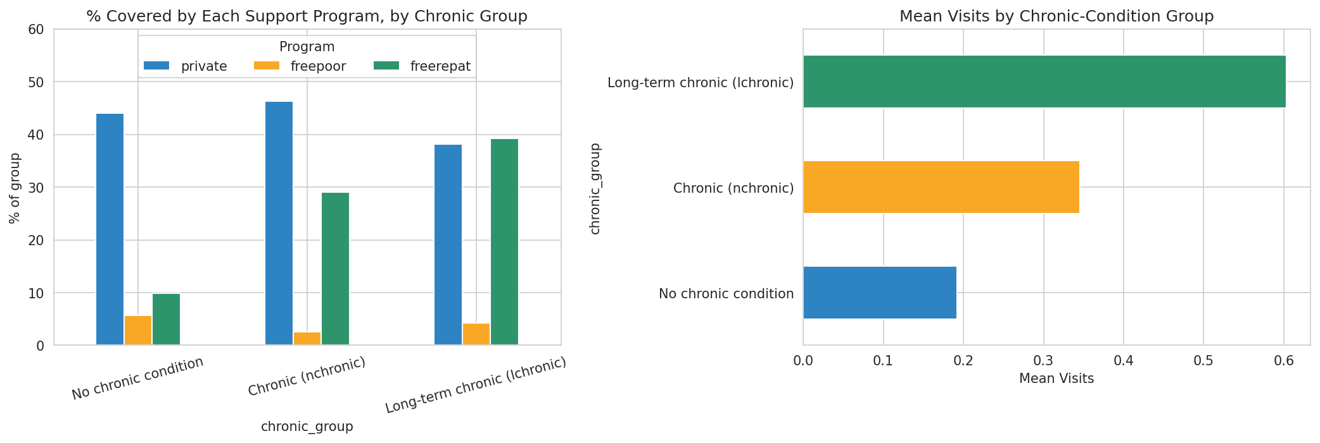
Student Analysis 1: Chronic Conditions & Healthcare Support
Support-program coverage and visits across the three chronic-condition groups
The long-term chronic (lchronic) group has the highest mean visits of all three chronic groups.

Slide 14
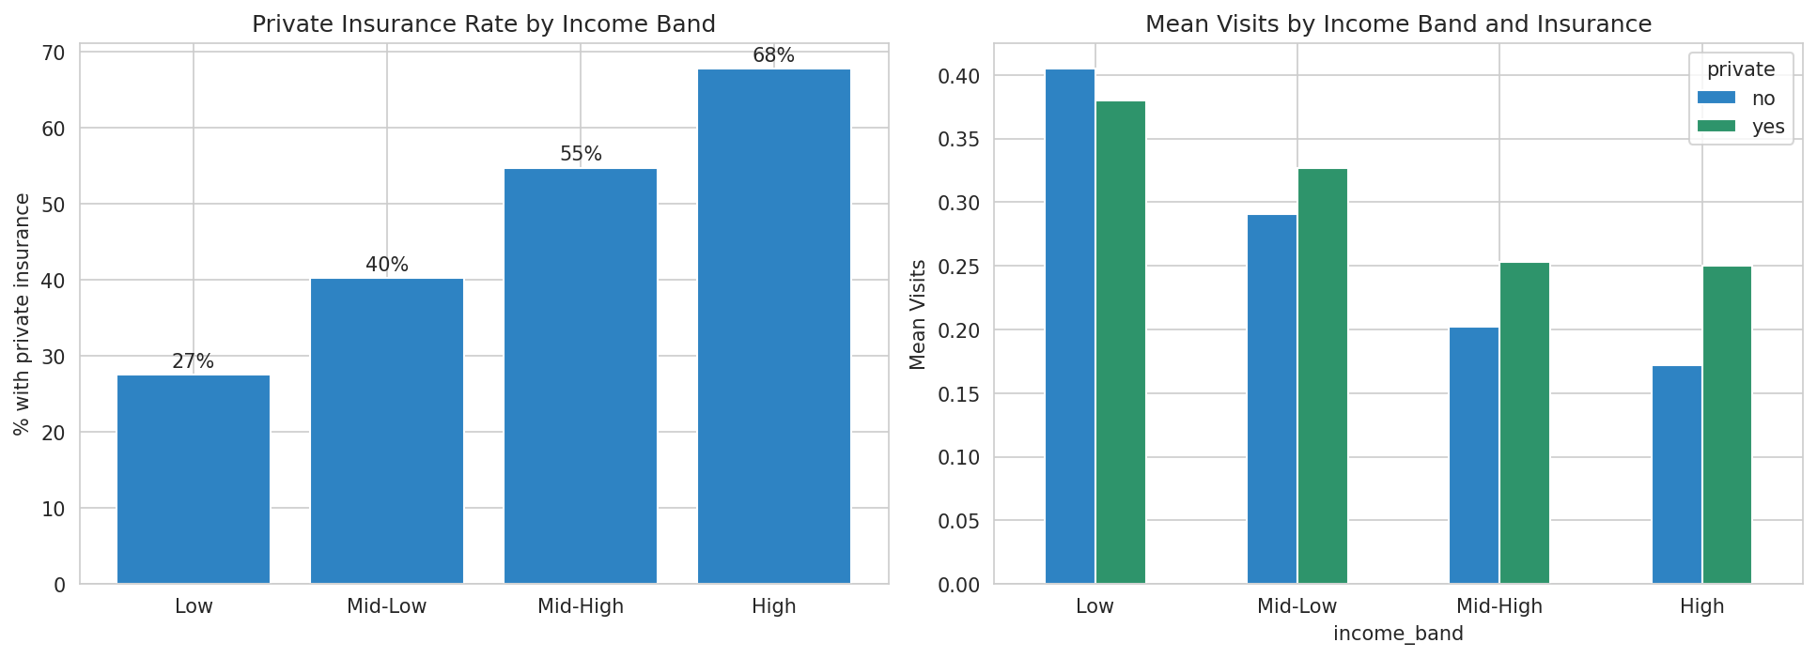
Student Analysis 2: Income & Private Insurance
Private insurance rate and mean visits across income bands
Private insurance rises from 27% to 68% with income, yet lower-income patients visit more.

Slide 15
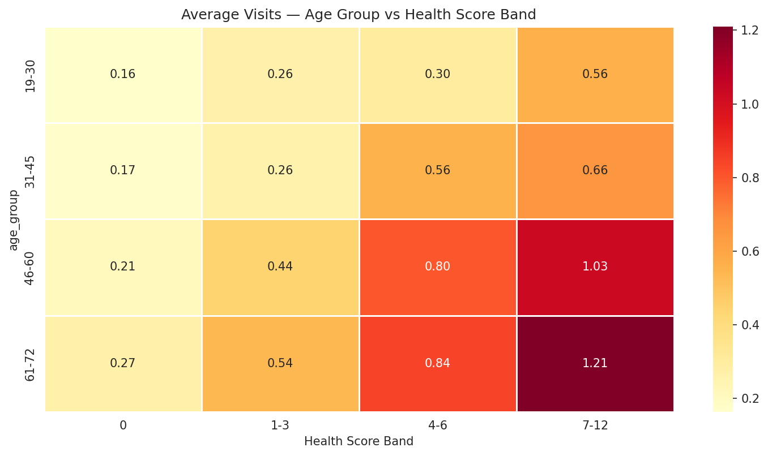
Student Analysis 3: Health Status vs Visits Across Age Groups
Average visits by age group and health-score band
Visits climb fastest with worsening health among the oldest patients (61-72).

Slide 16
GitHub Link :
https://github.com/Harjith2004/Healthcare-Analysis

Slide 17
Thank you
.
.

