Slide 1




NexusDevs
Harjot Singh
Neeraj Gandhi
Harjot Kaur
Jay Singh
ROUND 1
SUBMISSION
ORGANISED BY : GDSC BVP

Slide 2
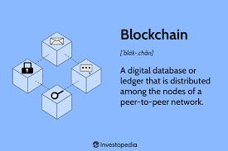
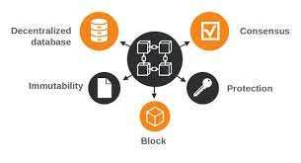
ABSTRACT
This project proposes the development of a robust system utilizing blockchain technology for the generation and validation of certificates tailored for government entities. Leveraging open-source software and blockchain's inherent immutability and transparency, the system aims to revolutionize certificate issuance and verification processes. Key objectives include seamless integration with a Digital Locker System and catering to the diverse needs of Government Offices, Students, Industries, and Institutes. Through the implementation of this blockchain-based solution, stakeholders can expect enhanced security, efficiency, and trust in the certificate management ecosystem.

Slide 3
problem statement
Developing a system for generating and validating certificates using blockchain technology for government entities
Blockchain-Based Certificate Generation and Validation: Create a system for custom digital certificate generation and validation using open-source software and blockchain technology. Expected output includes certificate integration with a Digital Locker System, catering to Government Offices, Students, Industries, and Institutes.
Fraud: The current academic credentialing system can be vulnerable to fraud and manipulation. Fake degrees or forged marksheets undermine the value of legitimate achievements and harm the reputations of institutions.
Inefficiency: Manual verification of academic certificates can be a slow, bureaucratic process. This creates time-lags for employers making hiring decisions, delays for students who need credentials recognized, and costs institutions significant resources.
Lack of Trust: In a system plagued by potential fraud and slow verification, the authenticity of an individual's qualifications can be called into question. This casts doubt for employers and creates barriers for qualified individuals.
Lack of Accessibility: Not all stakeholders have equal access to credential verification processes. Smaller institutions or businesses may not have the resources for robust verification checks.

Slide 4
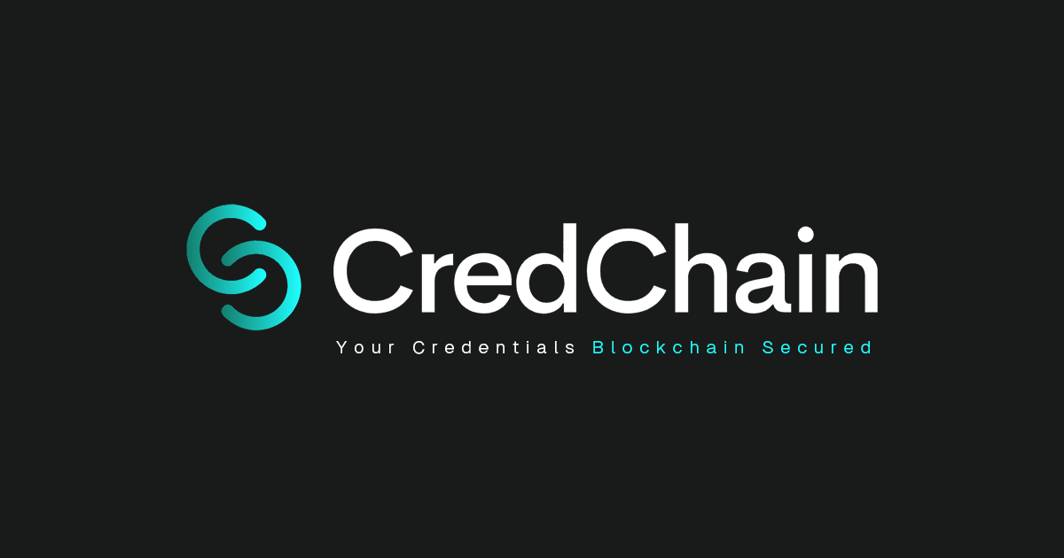
proposed solution
CREDCHAIN presents a cutting-edge solution for government entities and institutions seeking seamless certificate generation and validation powered by blockchain technology. Leveraging the latest web development technologies including Next.js, Node.js, Tailwind CSS, and Shadcn UI, alongside the robust Aptos Network and Aptos SDK for blockchain integration, CREDCHAIN ensures a secure, efficient, and user-friendly experience.

Slide 5
proposed solution
Key Features:
User-Friendly Interface: CredChain boasts an intuitive and easy-to-navigate interface, ensuring smooth user interaction for both certificate issuers and recipients.
Certificate Generation: Institutions can effortlessly create custom digital certificates using CredChain's streamlined interface, with options for customization to meet specific requirements.
Blockchain Integration: Built on the Aptos Network and Aptos SDK, CredChain ensures the immutability and transparency of certificates through blockchain technology, enhancing trust and security in the verification process.
Digital Locker System Integration: Seamless integration with Digital Locker Systems allows for efficient storage and retrieval of certificates, catering to the needs of government offices, students, industries, and institutes.
Multi-Stakeholder Support: CredChain caters to a diverse range of stakeholders, including government entities, educational institutions, corporate organizations, and individuals, facilitating comprehensive certificate management solutions.
Scalability and Performance: With Next.js and Node.js at its core, CredChain ensures scalability and high performance, accommodating the growing needs of users and institutions.
Easy Verification: Our user-friendly interface allows recipients and verifiers to quickly authenticate certificates by accessing the blockchain-based records, promoting trust and efficiency in the verification process.
Government Focus: While catering to all institutions, CredChain prioritizes the needs of government entities, offering tailored solutions and robust security measures to meet their specific requirements.

Slide 6
target audience
The target audience for CredChain includes a diverse range of stakeholders involved in certificate generation, verification, and management. Specifically, the primary target audience consists of:
Government Entities: Government offices, departments, and agencies responsible for issuing and verifying certificates, such as educational qualifications, licenses, and permits.
Educational Institutions: Schools, colleges, universities, and vocational training centers seeking a secure and efficient platform for issuing academic certificates and transcripts.
Students and Professionals: Individuals who receive certificates for completing educational programs, training courses, or professional certifications and require a reliable means to store and share their credentials.
Industries and Employers: Businesses, corporations, and organizations that frequently verify the qualifications and credentials of job applicants, employees, and contractors.
5. Certificate Verifiers: Entities tasked with authenticating certificates, including employers, government agencies, academic institutions, and regulatory bodies.
6. Technology Enthusiasts: Individuals interested in blockchain technology and its applications in enhancing the security and integrity of digital records, including certificates.
The target audience may vary in technical proficiency, ranging from government officials and business professionals to students and general users. However, all segments share a common need for a trustworthy, user-friendly platform to manage and verify certificates securely. CredChain aims to address these needs by providing a tailored solution that prioritizes ease of use, security, and reliability for all stakeholders involved in the certificate ecosystem.

Slide 7
Future scope
The future scope for CredChain encompasses several potential areas of expansion and enhancement, driven by technological advancements, market demands, and evolving user needs. Some key aspects of future scope include:
Mobile Application Development: Expand the platform's accessibility by developing a mobile application for iOS and Android devices, allowing users to generate, verify, and manage certificates on the go.
Enhanced User Dashboard: Introduce a personalized user dashboard that provides insights into certificate status, expiration dates, and renewal reminders, enhancing user experience and engagement.
Smart Contract Integration: Utilize smart contracts to automate certificate issuance, validation, and renewal processes, reducing administrative overhead and ensuring compliance with predefined criteria.
API Integration: Develop robust APIs to allow seamless integration with third-party systems such as HR software, educational management systems, and government databases, facilitating data exchange and interoperability.
Identity Verification Solutions: Partner with identity verification providers to offer integrated identity verification solutions, enabling users to verify their identities securely before issuing or receiving certificates.
Blockchain-based Diplomas and Transcripts: Extend CredChain's functionality to support the issuance and verification of blockchain-based diplomas and transcripts, catering to the needs of educational institutions and students.
Cross-Platform Compatibility: Ensure cross-platform compatibility by optimizing the platform for various web browsers and operating systems, guaranteeing a consistent user experience across different devices and environments.
Community Building and Education: Establish a community forum or knowledge base where users can share insights, best practices, and use cases related to certificate management and blockchain technology, fostering collaboration and learning.

Slide 8
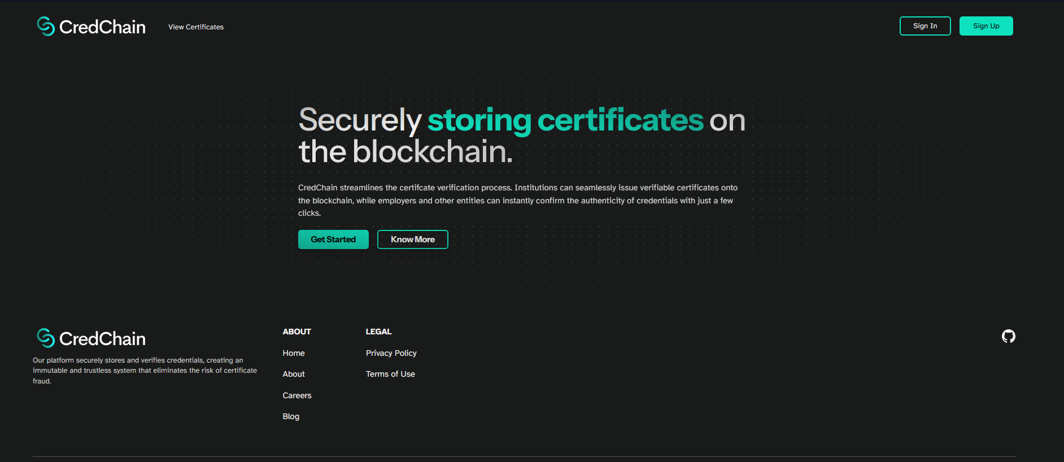
screenshot/images

Slide 9
