Slide 1

Random Forest or Gradient Boosting? - a practical comparison using R between two most popular ensemble methods He Jin hj2479 Dec 6th 2018

Slide 2
Outline
Background Intro
Algorithm comparison
Implementation In R
Further work

Slide 3
Background

Slide 4
Decision Trees
A tree-shaped graph or model of decisions used to determine a course of action or show a statistical probability
Separate the data according to series of questions and the questions automatically optimize the separation of the data points by the “target”

Slide 5
Decision Trees
Pros:
Not linear
Robust to correlated features
Robust to feature distributions
Robust to missing values
Simple to comprehend
Fast to train
Fast to score
Cons:
Poor accuracy
Cannot project
Inefficiently fits linear relationship
Notes:
Project: predict in the max and min value of the dataset, can not go to project on other dataset

Slide 6
Algorithm comparison

Slide 7
Ensembles Method
Random Forest:
Bagging
Fit many trees against different samples of the data and average together
Trees are independent
Gradient Boosting:
Boosting
Fit consecutive trees where each solves for the net error of the prior trees
Trees are dependent
Notes:
Ensembles, put a collection of trees to avoid the accuracy problem
Bagging: bootstrap aggregation
Boosting: First average the value and then figure out how good the average was and the difference between the average, and fit the trees to the difference, each new trees is fixing the difference of the entire system and continue this process.

Slide 8
Random Forest
Conceptual:
Combine multiple decision trees, each fit to a random sample of the original data
Randomly samples (both rows and columns)
Reduce variance, with minimal increase in bias
Practical:
Easy to use (few parameters, good default settings)
Robust
Competitive on more data set
Slow to score
Lack of transparency

Slide 9
Gradient Boosting
Conceptual:
Boosting (ensemble of weak learners)
Fit consecutive trees where each solves for the net error of the prior trees
Results of new trees are applied partially to the entire solution
Practical:
Often best possible model
Robust
Directly optimize cost function
Overfits (need to find proper stopping point)
Sensitive to noise and extreme values
Several hyperparameters
Lack of transparency
Notes:
Optimize means choose

Slide 10
Implementation in R

Slide 11
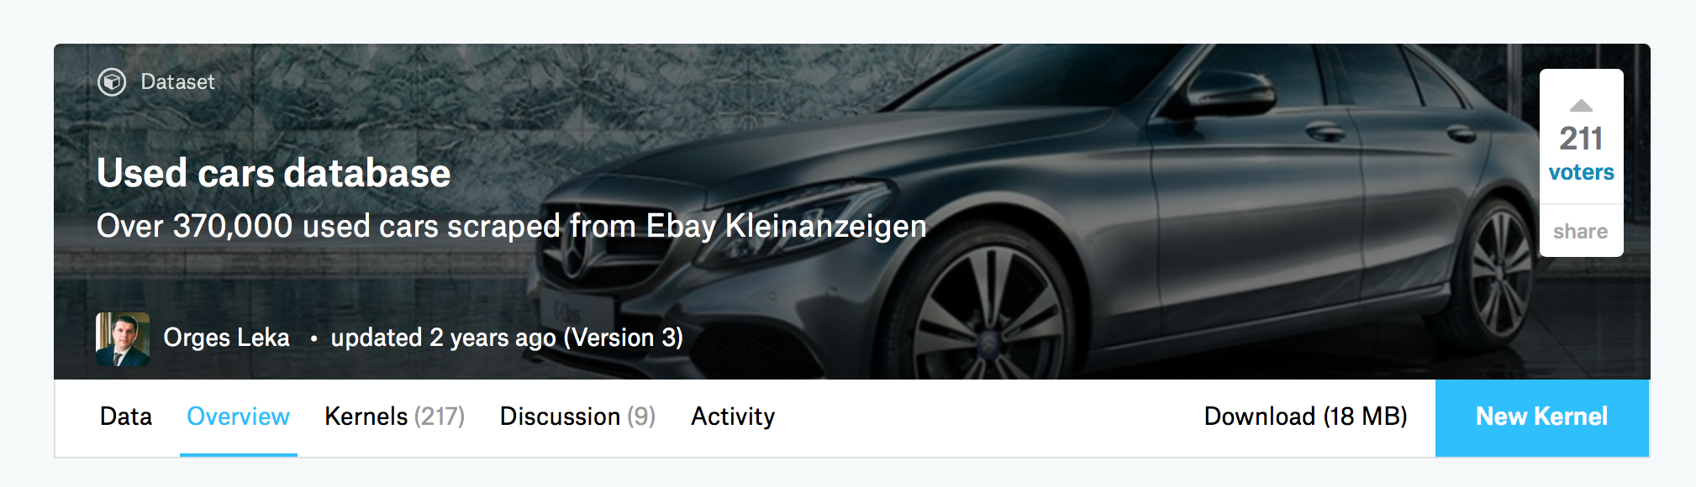
Dataset
Kaggle: Used car database
370,000 used car information from Ebay Kleinanzeigen
20 columns
Outcome of interest: Price
Regression Problem

Slide 12
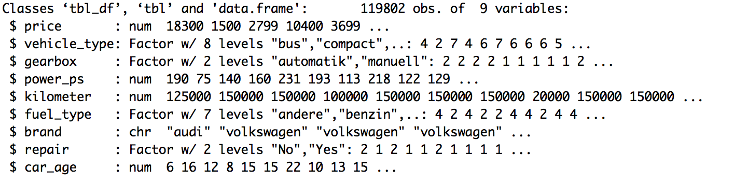
Dataset
After Preprocessing:
119,802 observations with 9 variables
Filter obvious outliers and NA
Selected Germany brand (BBA, Opel, Volkswagen & Porsche)
Notes:
In order to further shrink the dataset
We selected the target germany brand
They represented the entire Germany cars from entry level to luxury level

Slide 13
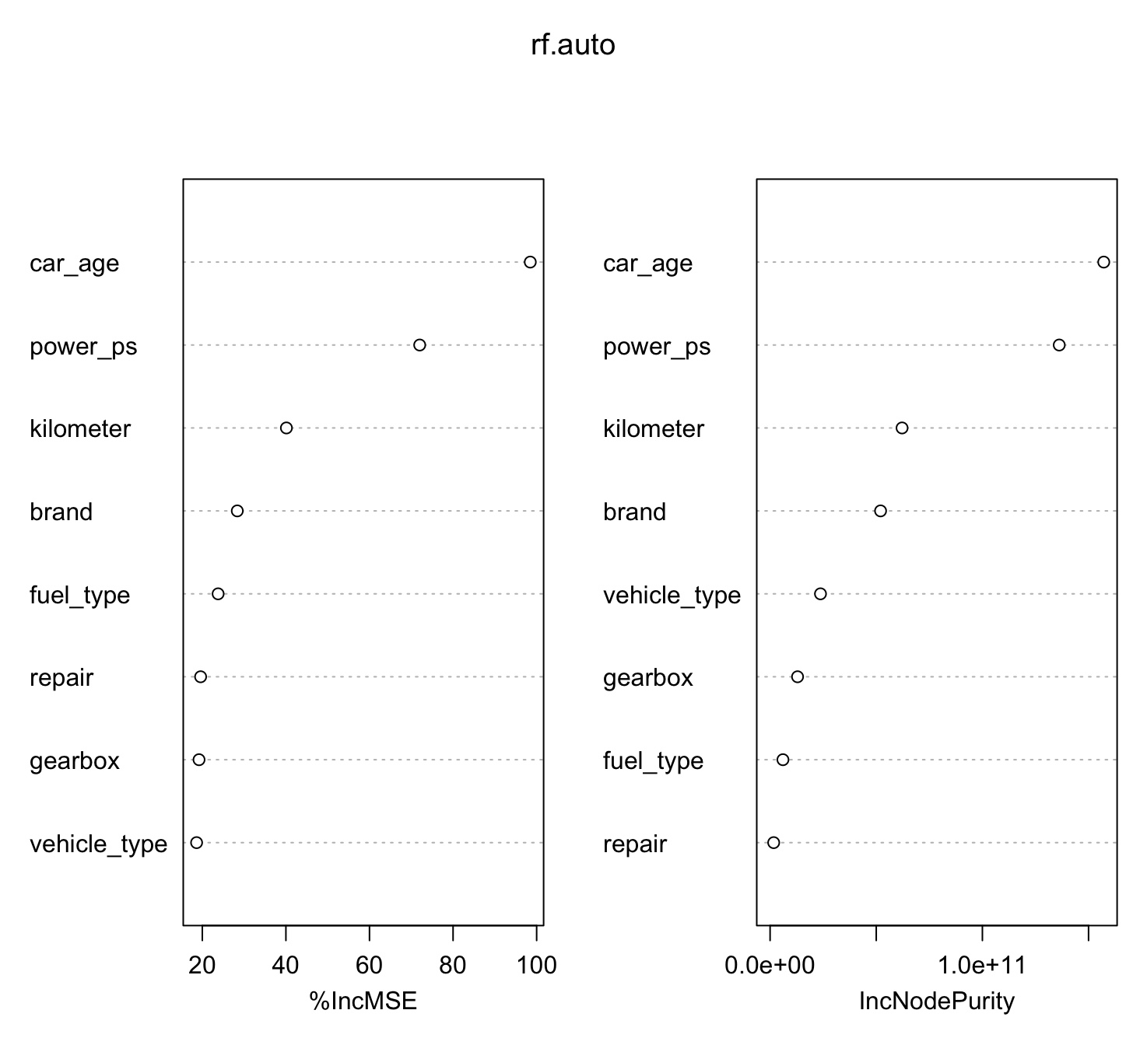
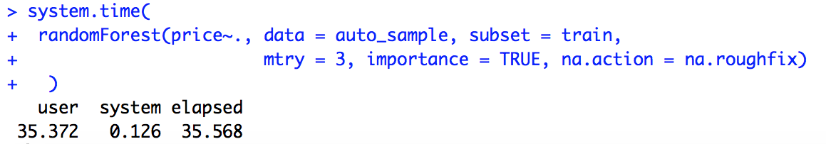
Model Fitting
Random Forest Regression:
Sample of 7000 (5000 training, 2000 testing)
Direct fitting, without tuning
mtry = p/3 = 3
500 trees
Notes:
Due to the computational time, here I only sub sample the dataset to 7000 observations, which is 1 over 20 of the original tidy dataset.

Slide 14
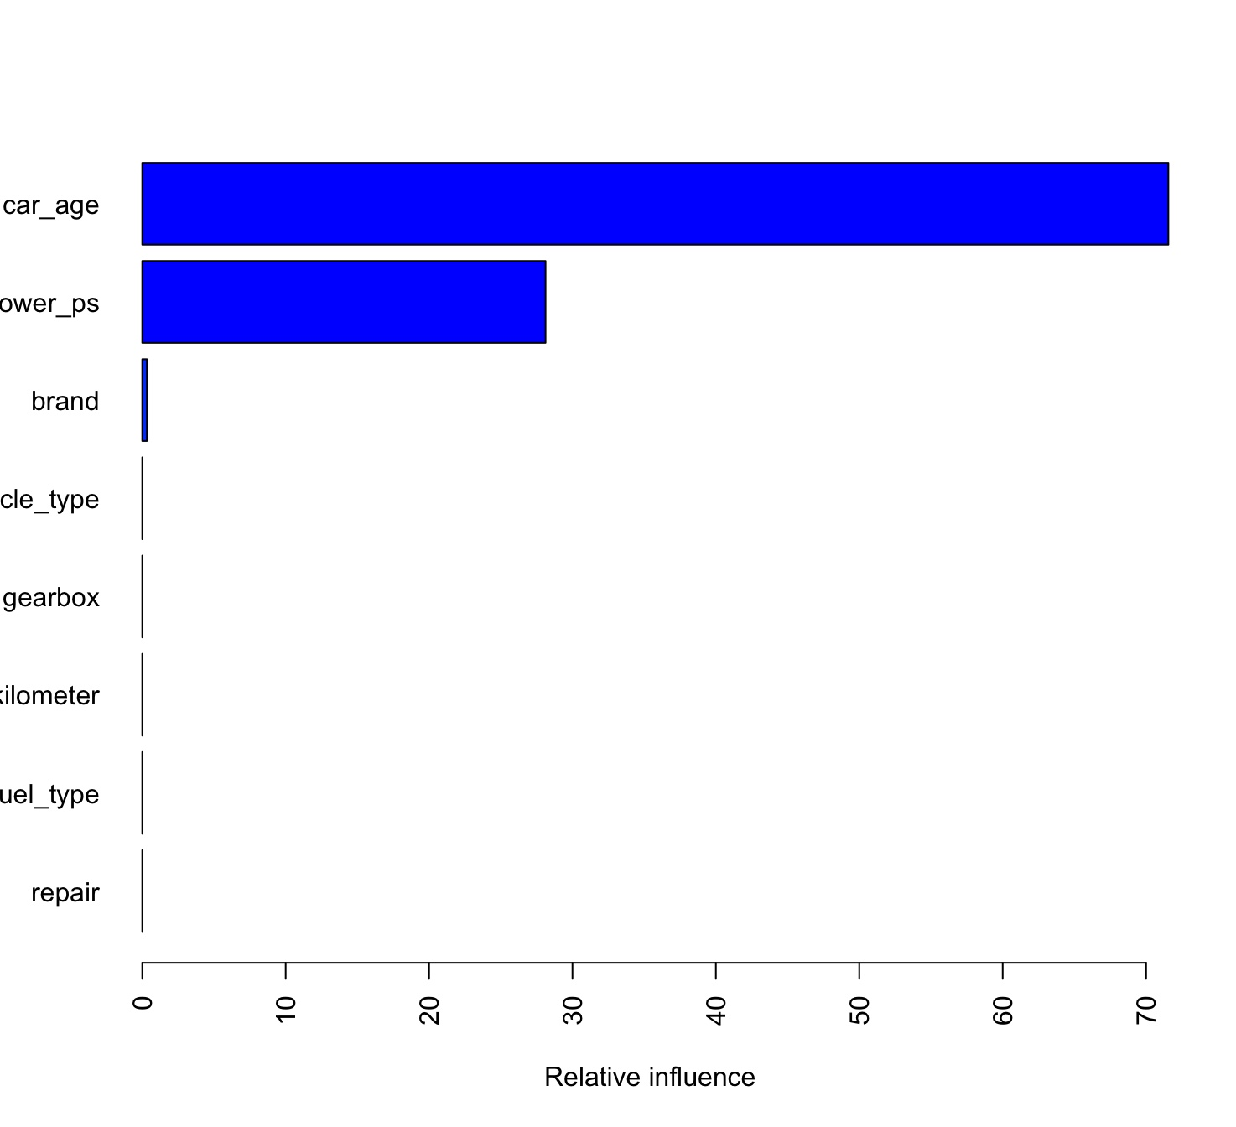
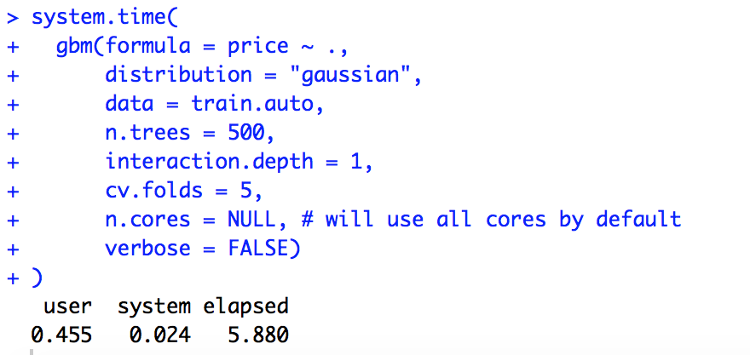
Model Fitting
Gradient Boosting for Regression:
Sample of 7000
Same tree size as random forest
Notes:
interaction.depth: the maximum depth of variable interactions or in the other word, the depth of each tree
The default value is 1
5 fold CV,
Fast
Not accurate, it only show two important variables

Slide 15
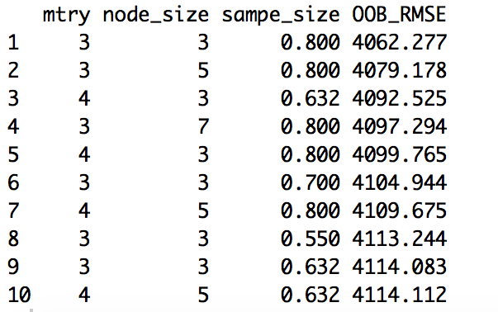
Model Tuning
Random Forest:
Use Ranger package instead of Random Forest to save time
Numbers of tree: 5000
Use OOB error to select the best model in the training set
Use test dataset to predict the model
Notes:
Mtry: number of variables to randomly sample as candidates at each split
nodesize: minimum number of samples within the terminal nodes
sampsize: number of samples to train on

Slide 16
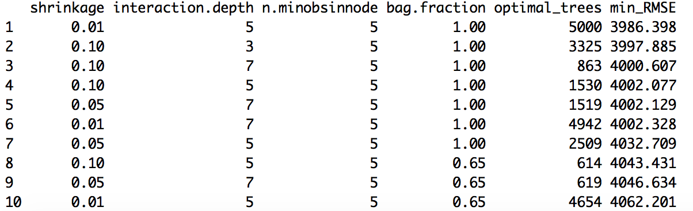

Model Tuning
Gradient Boosting:
Sample of 7000 (5000 training, 2000 testing)
Numbers of tree: 5000
Use train.fraction = .75 instead of cv = 5
Use test dataset to predict the model
Notes:
Shrinkage is the learning rate
Minbosinnode: minimum number of observations in the trees terminal nodes
Bag.fraction: the fraction of the training set observations randomly selected to propose the next tree in the expansion. This introduce stochastic gradient descent and prevent overfitting.
However, to speed up the tuning process, instead of performing 5-fold CV. I train on 75% of the training observations and evaluate performance on the remaining 25%.

Slide 17
Model Comparison
 | Random Forest | Gradient Boosting
Default Fitting RMSE | 4061.577 | 8674.454
Default Fitting Time | 35.372 | 0.455
Turing model RMSE | 4160.229 | 4287.328
Turing model Fitting Time | 50.012 | 15.091
Notes:
The original default RF is better than the turning model: The mtry is exactly the same, while the turning function is different, systematic difference, it also prove that the default random is relatively good enough and require fewer turning. And increase the number of trees does not always significant improve the performance when the tree numbers is enough.
The gradient boosting, with the turning and the enlarge of tree size, the performance improve a lot, but still not as good as the random forest. Generally, GBM should have better performance than RF,
The reason due to the less sample size we choose in the and also the training fraction we selected in GBM, when using train.fraction, it will take the first 75% of the data, that might cause some disadvantage, since the sample fraction for ranger is 80%, also it might due to less hyperparameter combinations, those reasons somehow limit the performance of GBM
Generally, when fit a single tree model, GBM is relatively faster than RF

Slide 18
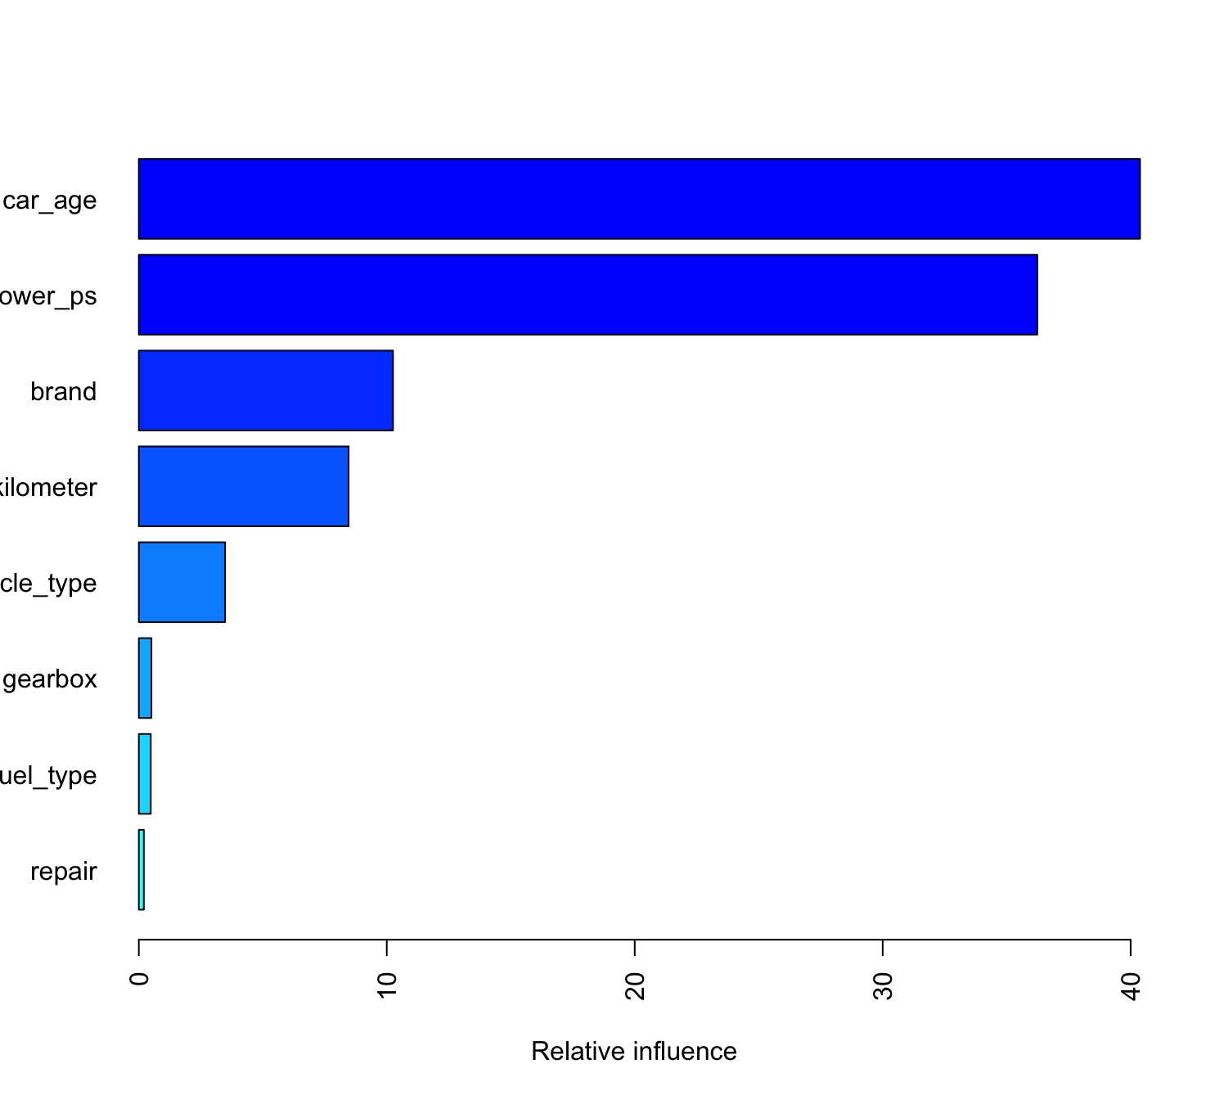
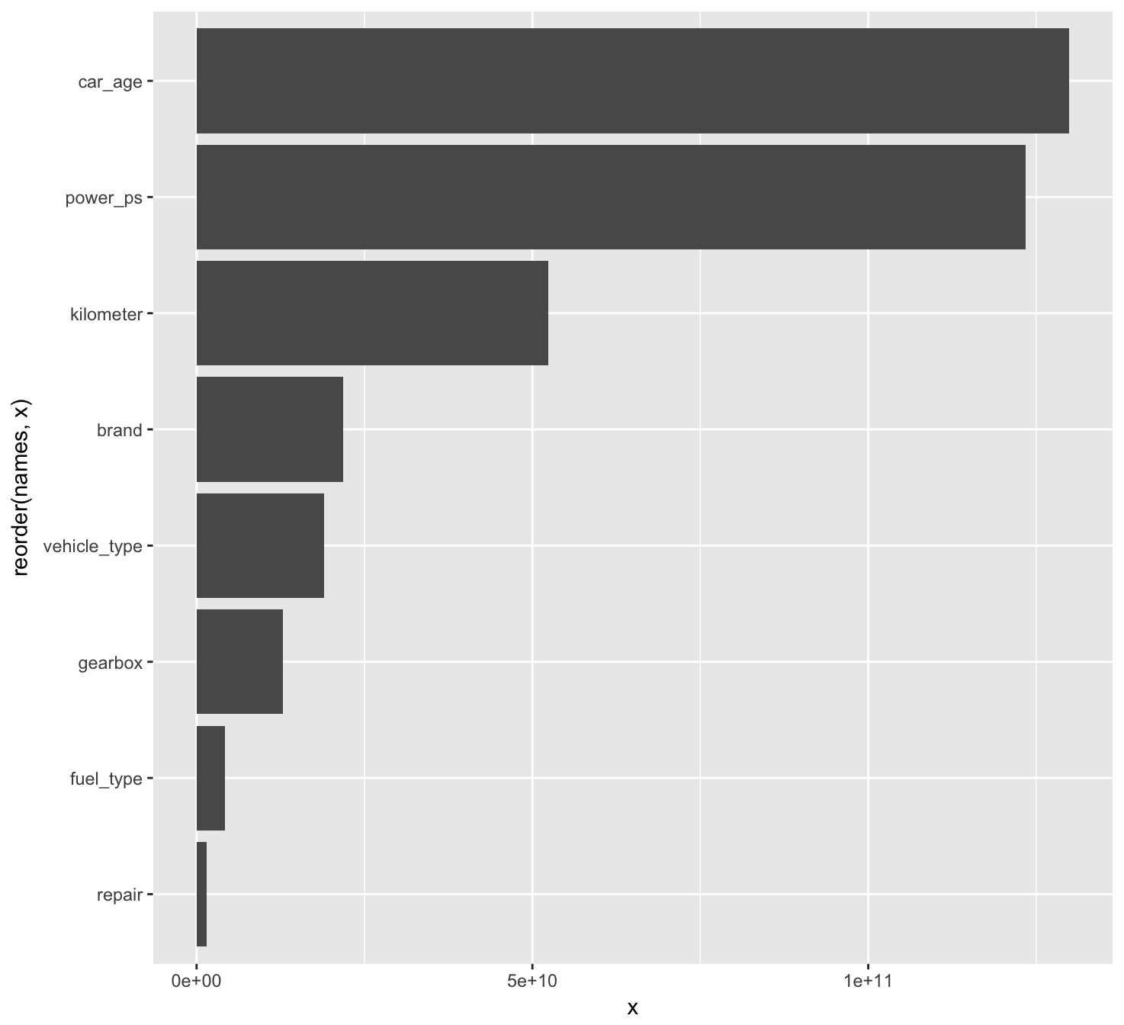
Model Comparison
Random Forest:
Gradient Boosting:

Slide 19
Further work

Slide 20
Further work
Choose larger sample
Enumerate more hyperparameter combinations and use CV to turn GBM
Compare two different methods under the same platform: h2o
Try classification tree
A more detailed analysis of the discrepancy in practical use
Finalize the result and summarize the finding
Notes:
The sample fraction would be expected to be exactly the same as RF
It would be much more fair to compare two different methods under the same platform
Use the multinomial distribution and calculate the error rate, it would be more intuitive

Slide 21
Thank you!

