Slide 1
Historical Precedents and Policy Analysis in the Development of Proposed Nuclear Mishap Response Plans
The Harker School
Manan Shah & Tiffany Zhu
Mentor: Dr. Eric Nelson
cif.harker.org

Slide 2
Objective
Recall the serious and dire threat of nuclear weapons with a deep dive into prior close calls and propose a comprehensive, multilateral solution to reduce the risk of ever increasing global nuclear vulnerability.

Slide 3
Effects of Nuclear Detonation
Components of a nuclear detonation
Actual blast, fires, radiation
Effects of residual radiation
Birth defects, cancer
Environmental Issues
Land and water contamination
Nuclear winter
Health Issues
Trauma, stress, mental disorders, suicide

Slide 4
Outline
Global Nuclear Vulnerability
What is GNV?
A theoretical explanation of GNV
Common factors in GNV
Nuclear Vulnerability: the International Arena
Critical Vulnerable Zones
The Global Nuclear Inventory
Prior Mishaps
Proposed Future Response Plans

Slide 5
Global Nuclear Vulnerability Definition
Global nuclear vulnerability (GNV) is a key risk exacerbated by the retention of nuclear weapons. GNV is defined as the worldwide vulnerability to nuclear weapon detonations, GNV is primarily characterized by the potentiality for nuclear accidents, or “close calls.”
GNV encompasses nuclear deterrence, nonproliferation, security, and disarmament as ways to diminish—not eliminate—vulnerability.

Slide 6
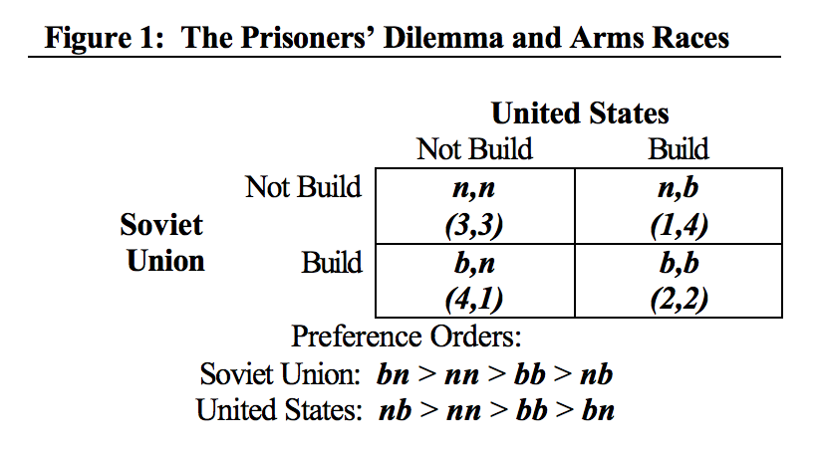
Game Theory to Explain GNV
The “build” strategy dominates the “not build” strategy
The Prisoner’s Dilemma as a Model for Arms Races

Slide 7
Game Theory to Explain GNV
No purely self-rational country is motivated to reduce their nuclear stores, and international agreements are largely ineffective in pursuing common nonproliferation goals
Because GNV’s existence is conditional on the existence of nuclear weapons, rational self-interest on the part of each nuclear nation is a major cause of continuing nuclear vulnerability

Slide 8
Factors in Nuclear Vulnerability
Modernization of nuclear weapons
US investing $300 B in next decade
Upgraded advanced cruise missiles would compose both a conventional and nuclear warhead
Ambiguity of warhead likely to cause error of judgment
Small, stealthy, precise weapons
Ability to target underground locations with great precision and yield
Could lead to more proliferative use
“Smaller makes the weapon more thinkable” (General James Cartwright)

Slide 9
Factors in Nuclear Vulnerability
High alert intercontinental ballistic missiles (ICBMs). In 2008, 2600 warheads were on high alert between US and Russia. Britain and France weapons are on low alert and China’s weapons are off-alert
Increases potential for miscalculation under time pressure
 | Missile numbers | Warhead numbers | Total yield (MT)
USA | 560 | 1302 | 315
Russia | 340 | 1279 | 870
Total | 900 | 2581 | 1185*

Slide 10
Factors in Nuclear Vulnerability
Diplomatic Stress
Only China of five nuclear states has committed to unconditional no first-use policy
US and Russia refuse to take the “no first use” pledge
Leads to modernization frenzy to enhance survivability and a credible nuclear deterrent
Risk of accidental detonation
False alarm due to warning sensor malfunction
False alarm due to accurate but ambiguous warning data
False alarm due to human error
Technical problems with command and control systems

Slide 11
Factors in Nuclear Vulnerability
Nuclear terrorism
Cyber attacks on civilian and government systems
SCADA systems vulnerable to cyber attacks
Nuclear power plants could be destabilized

Slide 12
Critical Zones of Nuclear Vulnerability
India-Pakistan
China
Debating to put nuclear weapons on high alert
Plans to build commercial scale reprocessing facility starting in 2020 to process spent nuclear fuel into plutonium
Large stockpiles of plutonium could increase the risk of weaponization
Middle East
Iran, Syria

Slide 13
Critical Zones of Nuclear Vulnerability
North Korea
Aims to build nuclear weapons with intent of mass destruction
Secretive nuclear and missile programs
US-Russia
Russia redrawing map of Europe
Ukraine crisis, annexation of Crimea
US plans to modernize weapons called “irresponsible” and “openly provocative” by Russia

Slide 14
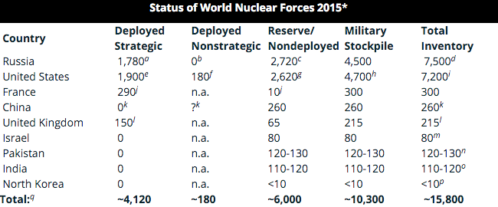
Global Nuclear Weapons Inventory
As of 2015, these nine countries share a stock of approximately 15,800 nuclear weapons

Slide 15
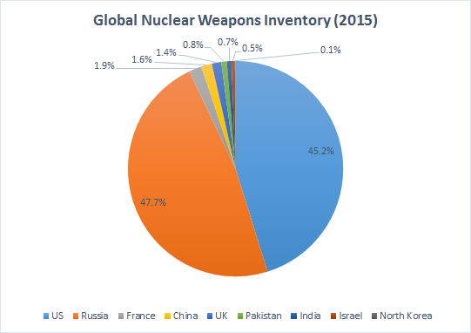
Global Nuclear Weapons Inventory
Russia and the United States hold the vast majority (93%) of the total inventory

Slide 16
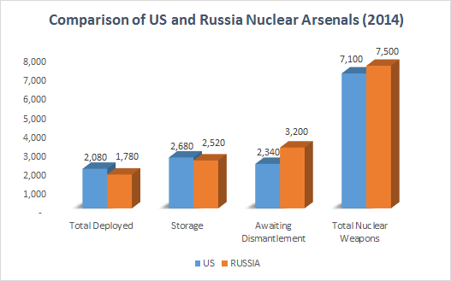
Comparison of US-Russia Nuclear Arsenals
After an aggressive reduction in nuclear acquisition at the end of cold war, Russia and the United States face a slowdown and challenges in further reductions of high number of nuclear weapons in storage and those awaiting dismantlement

Slide 17
A Breakdown of Prior Nuclear Mishaps
Underlying cause of all: Carelessness
Misinformation:
Black Brant (1995)
NORAD incidents (1979-80)
Negligence:
Tomsk-7 (1993)
Demon Core (1945-46)
Damascus (1980)

Slide 18
A Breakdown of Prior Nuclear Mishaps
Wholly unpredictable incidents
Palomares (1966)
Goldsboro (1961)

Slide 19
Misinformation Mishaps
Definition: “all systems operating correctly, a human provided incorrect data or information out of ignorance.”
Black Brant: Breakdown in the line of command
NORAD: Computer misinformation

Slide 20
Negligence Mishaps
Definition: Incidents in which there was “equipment or procedural failure caused by a problem not diagnosed in time.”
Tomsk-7: Failure in chemical reaction procedure
Demon Core: Failure in safety protocols
Damascus: Design failure

Slide 21
Wholly Unpredictable Incidents
Definition: Incidents with no clear method of prevention within standard nuclear safety procedures
Palomares: Plane breakup
Goldsboro: Plane crash

Slide 22
Proposed Future Response Plans
Phase 1: Reduce the risk of accidental launch by human error or technical error with individual governments funding and implementing technical training programs, worker safety and information programs
Phase 2: Enforce nonproliferation to stop the spread of weapons
Phase 3: Accelerate disarmament by stripping down arsenals

Slide 23
Proposed Future Response Plans
Proposed steps towards abolition of nuclear weapons include:
Reducing US reliance on nuclear weapons in national security
Reducing the number of deployed long range weapons in US and Russia
Reducing the number of stored weapons and dismantling them
Accelerating dismantlement of nuclear warheads to make reductions less easily reversible

Slide 24
Proposed Future Response Plans
Eliminating the remaining short range battlefield weapons
Taking ballistic missiles off high alert
This would prevent a “re-alerting race”
would reduce time pressured presidential decision making in case of crises
US decision to take missiles off high alert would have strategic implications and could affect the Chinese decision to out its nuclear weapons on high alert

Slide 25
Summary of Work
Prior nuclear mishaps case studies indicate a high probability of nuclear war due to accidental launch and human or technical error
The development of high-alert ICBMs, the trend towards modernization of nuclear weapons and the creation of smaller and stealthier weapons are increasing the diplomatic tension
The threats to increasing GNV are very real and we should cooperate and work towards the abolition of nuclear weapons to avoid its catastrophic consequences.

Slide 26
Acknowledgements
Dr. Eric Nelson for his mentorship and guidance
Harker CIF Team (in alphabetical order): Aashish Jain, Enya Lu, Nikhil Manglik, Parth Pendurkar, Manan Shah, Rahul Shukla, Arjun Subramaniam, Misha Tseitlin, Raymond Xu, Tiffany Zhu

