Slide 1



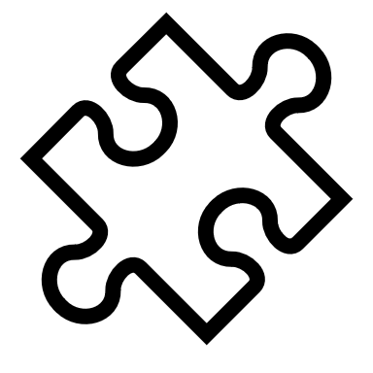







IOT & Healthcare
CYBERCUP 4.0
1 /5
1 /6
B y t e – S i z e d B r a i n s
Contents
Problem
Statement
Our
Solution
Key
Features

Slide 2
B y t e – S i z e d B r a i n s
IOT & Healthcare
CYBERCUP 4.0
2 /6
Problem Statement
Contents
Build an IoT enabled system that tracks both physiological (e.g., heart rate variability, sleep patterns) and environmental (e.g., noise, light) factors to assess mental health. The solution should offer personalized mental wellness recommendations, detect signs of stress or anxiety, and connect users to mental health professionals when needed.
Problem
Statement
Our
Solution
Key
Features

Slide 3
IOT & Healthcare
CYBERCUP 4.0
3 /6
Problem Statement
Contents
Build an IoT enabled system that tracks both physiological (e.g., heart rate variability, sleep patterns) and environmental (e.g., noise, light) factors to assess mental health. The solution should offer personalized mental wellness recommendations, detect signs of stress or anxiety, and connect users to mental health professionals when needed.
Problem
Statement
Our
Solution
Key
Features
Our Solution
A User-Friendly android application
With an integrated chatbot
It will analyse user’s health using various sensors in a mobile phone
Help the patient keep track of their mental health
Many different API(Google Fit, Android Sleep Codelab, etc) are used to collect data
Modules like Matplotlib, Seaborn, etc for data analysis

Slide 4
Problem Statement
Build an IoT enabled system that tracks both physiological (e.g., heart rate variability, sleep patterns) and environmental (e.g., noise, light) factors to assess mental health. The solution should offer personalized mental wellness recommendations, detect signs of stress or anxiety, and connect users to mental health professionals when needed.
IOT & Healthcare
CYBERCUP 4.0
4 /6
Our Solution
A User-Friendly website
With an integrated chatbot
It will analyse user’s health using various sensors in a mobile phone
Help the patient keep track of their mental health
Many different API(Google Fit, Android Sleep Codelab, etc) are used to collect data
Modules like Matplotlib, Seaborn, etc for data analysis

Slide 5





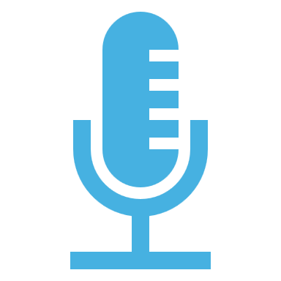
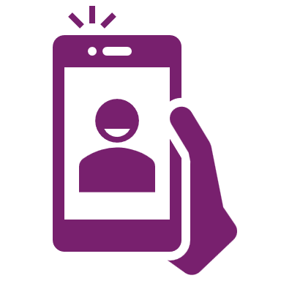

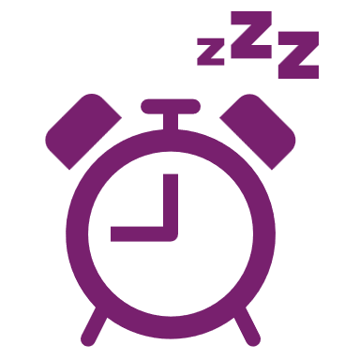
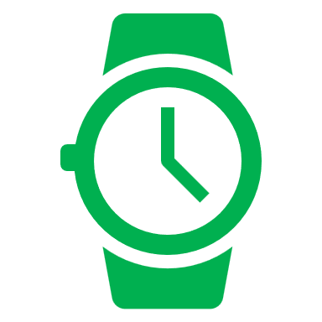


IOT & Healthcare
CYBERCUP 4.0
4 /6
Our Solution
A User-Friendly android application
With an integrated chatbot
It will analyse user’s health using various sensors in a mobile phone
Help the patient keep track of their mental health
Many different API(Google Fit, Android Sleep Codelab, etc) are used to collect data
Modules like Matplotlib, Seaborn, etc for data analysis
Key Features
Easy to use UI
Meditation and breathing exercises
Speech to text
Sentiment analysis
Heartrate monitoring using camera
Background noise analysis using microphone
Symptoms detected using image analysis
Games to kill anxiety
Sleep cycle analysis using screen time
Data is also collected from smart watches
Voice analysis
Professional help

Slide 6
Our Solution
A User-Friendly android application
With an integrated chatbot
It will analyse user’s health using various sensors in a mobile phone
Help the patient keep track of their mental health
Many different API(Google Fit, Android Sleep Codelab, etc) are used to collect data
Modules like Matplotlib, Seaborn, etc for data analysis
IOT & Healthcare
CYBERCUP 4.0
5 /6
Key Features
Easy to use UI
Meditation and breathing exercises
Speech to text
Sentiment analysis
Heartrate monitoring using camera
Background noise analysis using microphone
Symptoms detected using image analysis
Games to kill anxiety
Sleep cycle analysis using screen time
Data is also collected from smart watches
Voice analysis
Professional help

Slide 7
Our Solution
IOT & Healthcare
CYBERCUP 4.0
6 /6
Q&a

Slide 8
Our Solution
IOT & Healthcare
CYBERCUP 4.0
6 /6
Thank you

