Slide 1

总 结
——刘洪彬

Slide 2

图的鲁棒性

Slide 3



f-fraction reachable set
r-reachable set
$$≥p\left|V_{i}\right|,0<p<1$$
$$Given D=(V,Σ),nonempty set S⊂V,∃ⅈ∈S,\left|V_{i}∖S\right|≥r,r∈Z>0$$
1
$$≥p\left|V_{i}\right|$$
2
…
$$≥r$$
S
3
4
An example of r-reachable set
f-fraction reachable set

Slide 4






r-robustness
f-fraction robustness
$$Given D=(V,Σ),any pair of nonempty set S_{1},S_{2}⊂V,S_{1}∩S_{2}=∅,S_{1} or S_{2} is r−reachable$$
$$f−fraction reachable$$
$$≥p\left|V_{i}\right|,0<p<1$$
1
$$≥r$$
2
…
$$D$$
$$S_{1}$$
5
$$S_{2}$$
3
6
4
7
…
An example of r-robustness
f-fraction robustness

Slide 5

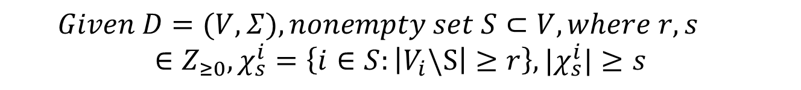



(r,s)-reachable set
$$Given D=(V,Σ),nonempty set S⊂V,where r,s∈Z_{≥0},χ_{s}^{i}=\left\{i∈S:\left|V_{i}\backslash S\right|≥r\right\},|χ_{s}^{i}|≥s$$
$$≥s$$
…
S
…
…
…
$$≥r$$
$$≥r$$
$$≥r$$
An example of (r,s)-reachable set

Slide 6
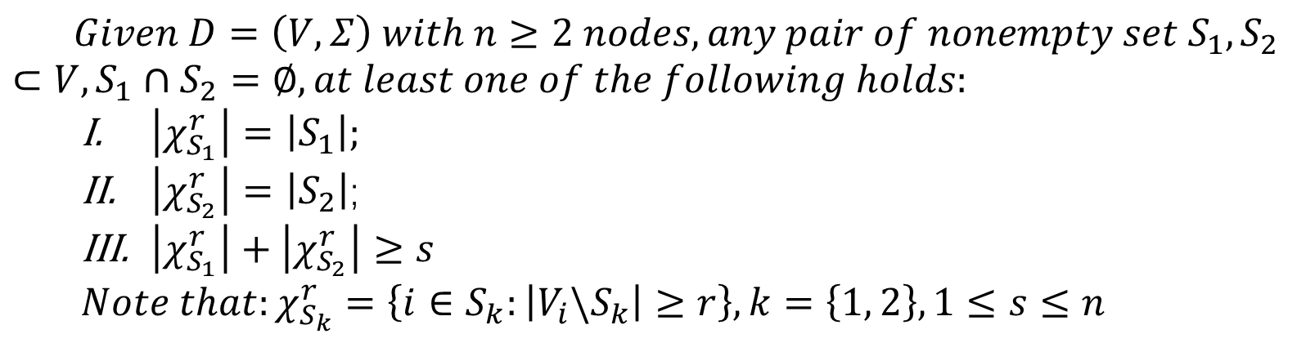
(r,s)-robustness
$$Given D=\left(V,Σ\right) with n≥2 nodes,any pair of nonempty set S_{1},S_{2}⊂V,S_{1}∩S_{2}=∅, at least one of the following holds:$$
$\left|χ_{S_{1}}^{r}\right|=\left|S_{1}\right|;$
$\left|χ_{S_{2}}^{r}\right|=\left|S_{2}\right|$;
$\left|χ_{S_{1}}^{r}\right|+\left|χ_{S_{2}}^{r}\right|≥s$
$$Note that:χ_{S_{k}}^{r}=\left\{i∈S_{k}:\left|V_{i}\backslash S_{k}\right|≥r\right\},k=\left\{1, 2\right\},1≤s≤n$$
2
5
8
12
1
3
6
9
11
13
4
7
10
14
Example of a (r,s)-robustness topology

Slide 7
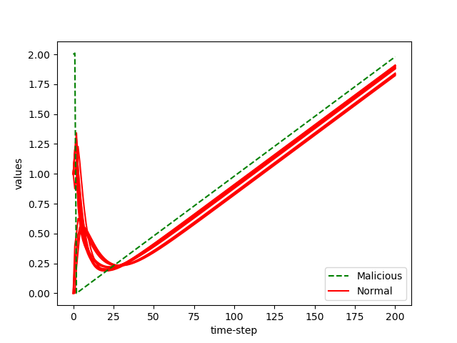
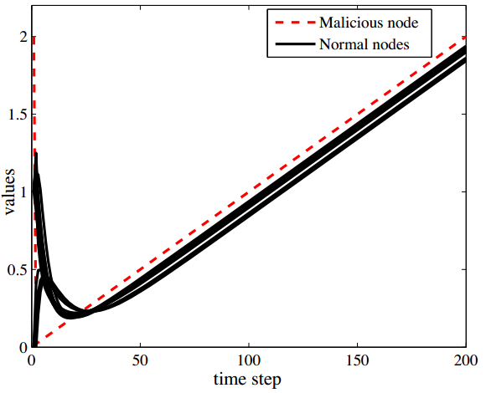
Stimulations
LCP

Slide 8
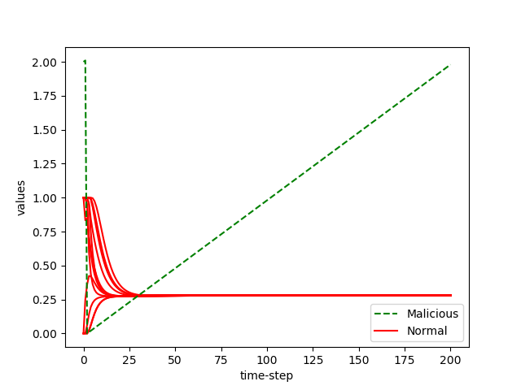
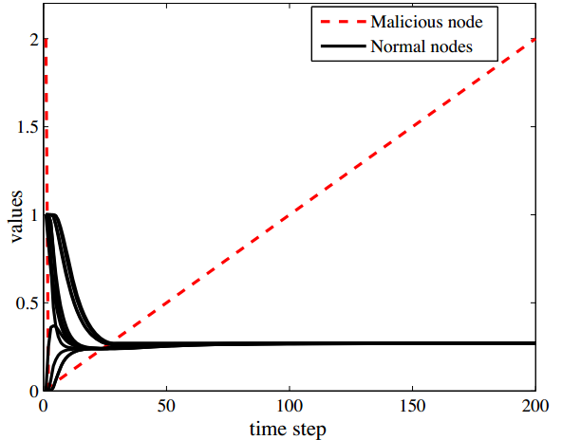
Stimulations
W-MSR

Slide 9
符号图中的一致性问题

Slide 10
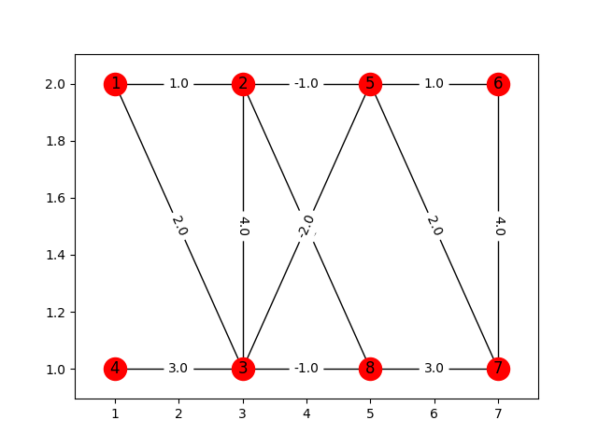
Signed Graph
Balanced graph

Slide 11
Problem Formulation

Slide 12
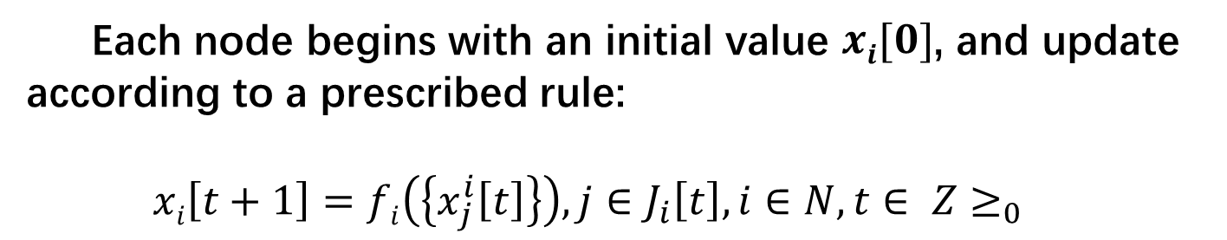
Update Model
Each node begins with an initial value $xi[0]$, and update according to a prescribed rule:
$$xi\left[t+1\right]=fi\left(\left\{x_{j}^{i}\left[t\right]\right\}\right), j∈J_{i}\left[t\right], i∈N, t∈ Z≥_{0}$$
In-neighbors for digraph, neighbors for undirected graph
Neighbors & node i
Normal nodes

Slide 13
Threat Model
Byzantine: send not the same value, apply some other function f.
Malicious: send the same value, apply some other function f.

Slide 14
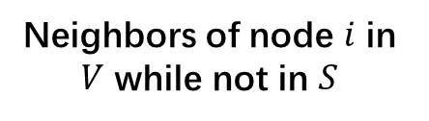
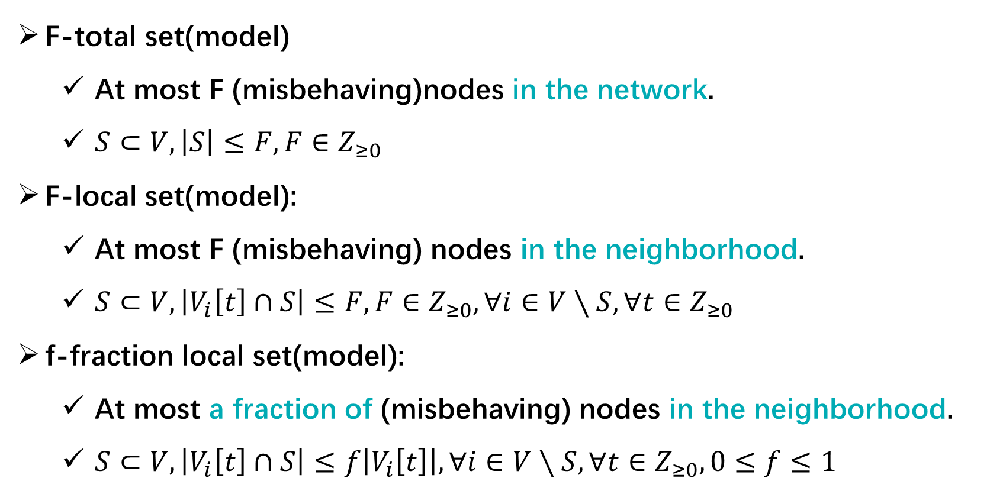
Scope of Threats
F-total set(model)
At most F (misbehaving)nodes in the network.
$S⊂V,\left|S\right|≤F, F∈Z_{≥0}$
F-local set(model):
At most F (misbehaving) nodes in the neighborhood.
$S⊂V,\left|V_{i}\left[t\right]∩S\right|≤F, F∈Z_{≥0},∀ⅈ∈V∖S,∀t∈Z_{≥0}$
f-fraction local set(model):
At most a fraction of (misbehaving) nodes in the neighborhood.
$S⊂V,\left|V_{i}\left[t\right]∩S\right|≤f\left|V_{i}\left[t\right]\right|, ∀ⅈ∈V∖S,∀t∈Z_{≥0},0≤f≤1$
Neighbors of node $ⅈ$ in $V$ while not in $S$

Slide 15
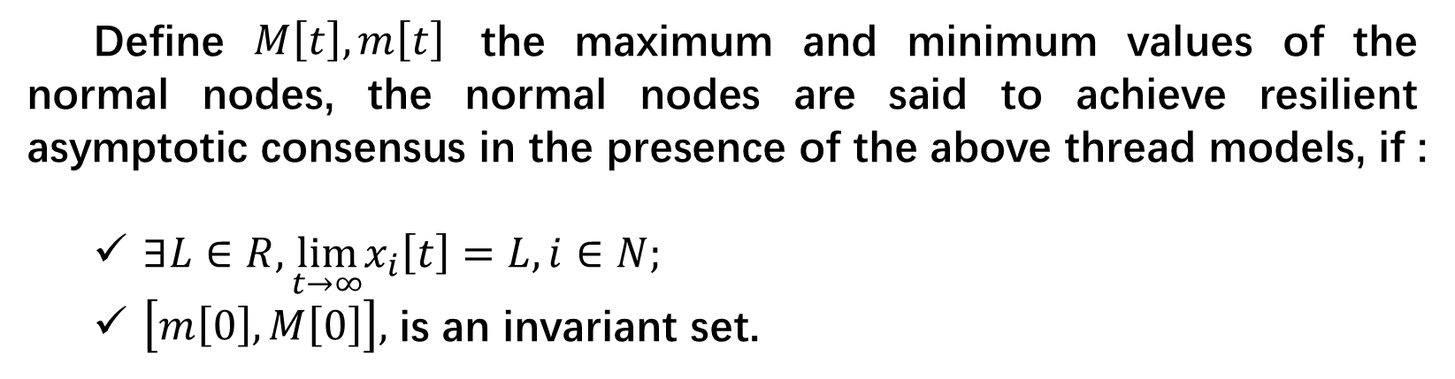
Resilient Asymptotic Consensus
Define $M\left[t\right],m\left[t\right]$ the maximum and minimum values of the normal nodes, the normal nodes are said to achieve resilient asymptotic consensus in the presence of the above thread models, if :
$∃L∈R,\lim_{t→∞}x_{i}\left[t\right]=L,i∈N;$
$\left[m\left[0\right],M\left[0\right]\right],$ is an invariant set.
agreement condition
safety condition
All normal nodes must converge to must lie within the range of initial values of the normal nodes.
validity condition

Slide 16
Consensus Algorithm

Slide 17
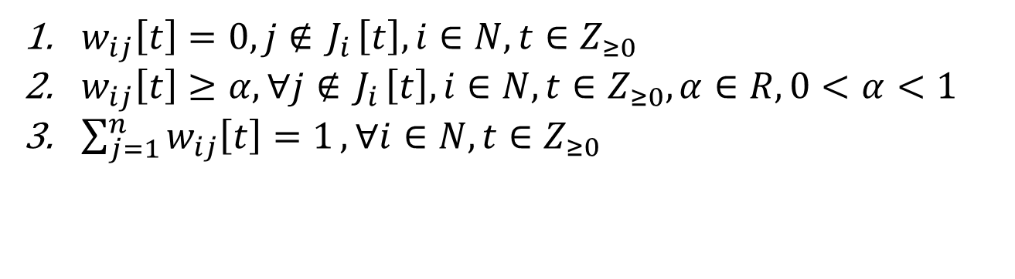

Linear Consensus Protocol
$$xi\left[t+1\right]=\sum_{j∈J_{i}[t]}{w_{ij}\left[t\right]x_{j}^{i}[t]}$$
$w_{ij}\left[t\right]=0, j∉{ J}_{i}\left[t\right],i∈N,t∈Z_{≥0}$
$w_{ij}\left[t\right]≥α, ∀j∉{ J}_{i}\left[t\right],i∈N,t∈Z_{≥0},α∈R, 0<$ $α<1$
$\sum_{j=1}^{n}{w_{ij}\left[t\right]=1}, ∀i∈N,t∈Z_{≥0}$

Slide 18
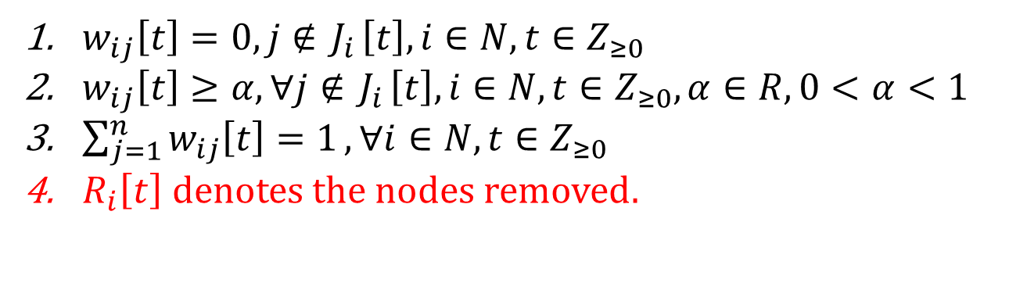

Weighted Mean Subsequence Reduced
Remove F values strictly larger or smaller than itself:
$$xi\left[t+1\right]=\sum_{j∈J_{i}[t]\backslash R_{i}\left[t\right]}{w_{ij}\left[t\right]x_{j}^{i}[t]}$$
$w_{ij}\left[t\right]=0, j∉{ J}_{i}\left[t\right],i∈N,t∈Z_{≥0}$
$w_{ij}\left[t\right]≥α, ∀j∉{ J}_{i}\left[t\right],i∈N,t∈Z_{≥0},α∈R, 0<$ $α<1$
$\sum_{j=1}^{n}{w_{ij}\left[t\right]=1}, ∀i∈N,t∈Z_{≥0}$
$R_{i}\left[t\right] denotes the nodes removed.$

Slide 19
Robust Network Topologies

Slide 20
Proposition 1
$$n,F∈Z_{>0},F≤\left\lfloor \frac{n}{2}\right\rfloor ,∃G,k=\left\lfloor \frac{n}{2}\right\rfloor +F−1$$
Can not achieve consensus using W-MSR with param. F.
1
5
1
2
6
2
3
7
8
8
4
Example of a 5-connected graph satisfying Prop. 1 with F = 2

Slide 21
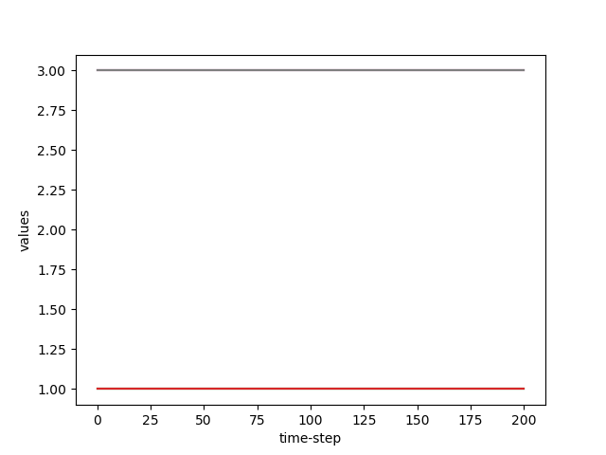
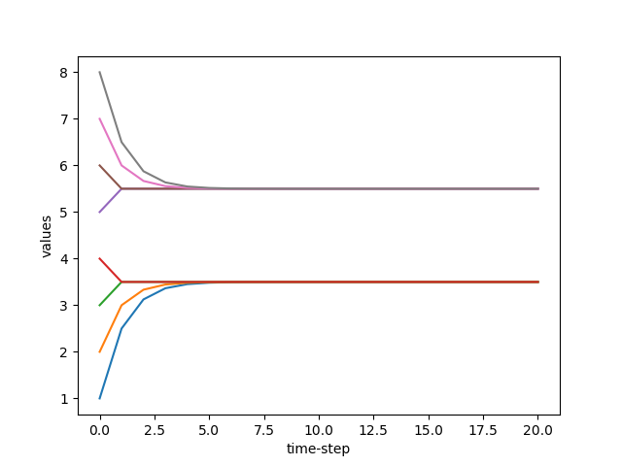
Proof
Stimulation of a 5-connected graph satisfying Prop. 1 with F = 2

Slide 22
Resilient Consensus Analysis

Slide 23

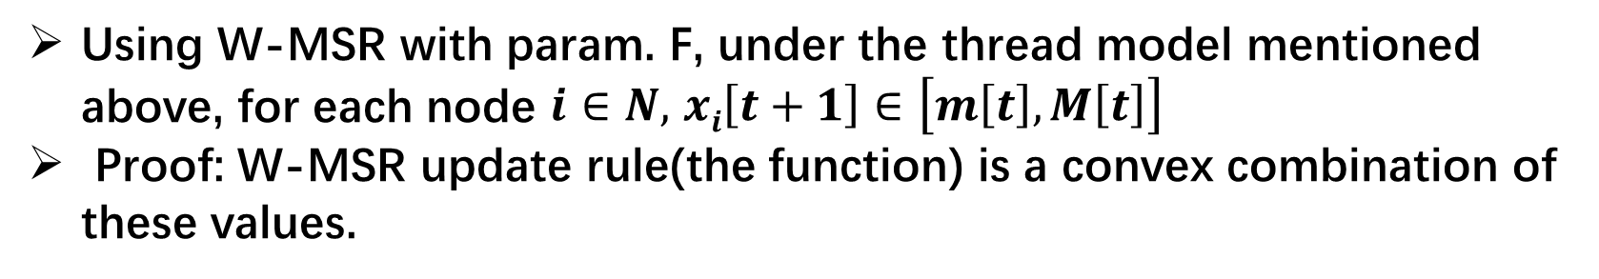
Lemma 1
Using W-MSR with param. F, under the thread model mentioned above, for each node $i∈N,$ $xi\left[t+1\right]∈\left[m\left[t\right],M\left[t\right]\right]$
Proof: W-MSR update rule(the function) is a convex combination of these values.
$$The convex conbination of x_{1},x_{2},…x_{n} is$$
$a_{1}x_{1}+a_{2}x_{2}+…{+a_{n}x_{n}∈[\min\left(x_{1},x_{2},…x_{n}\right),max⁡(x_{1},x_{2},…x_{n})]{,a}_{1}+a_{2}+…{+a_{n}=1}}$
$\left[m\left[t+1\right],M\left[t+1\right]\right]$ $⊂$ $\left[m\left[t\right],M\left[t\right]\right]$
safety condition

Slide 24
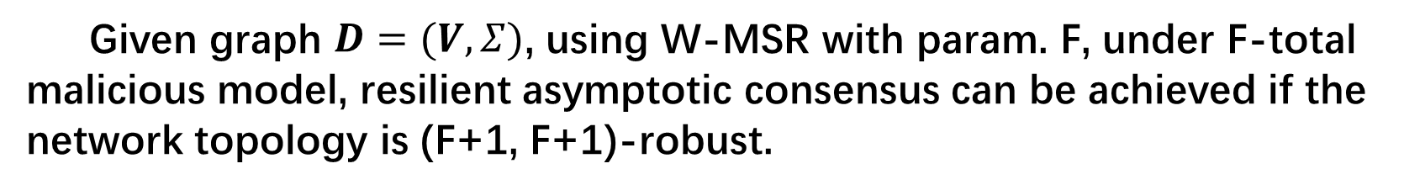
Theorem 1
Given graph $D=(V, Σ)$, using W-MSR with param. F, under F-total malicious model, resilient asymptotic consensus can be achieved if the network topology is (F+1, F+1)-robust.
agreement condition

Slide 25

Stimulation Results

Slide 26
Stimulations
0
1
1
1
0
0
1
2
1
1
0
1
1
1
Example of a (2,2)-robust topology

Slide 27
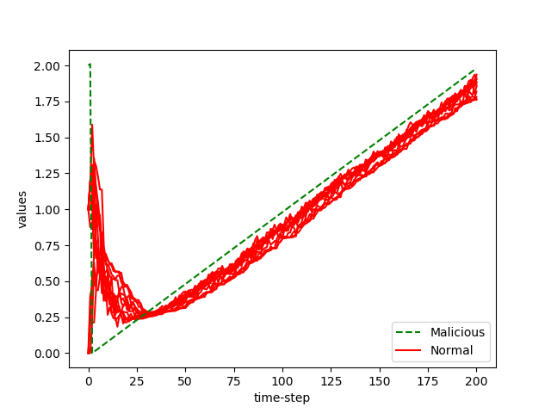
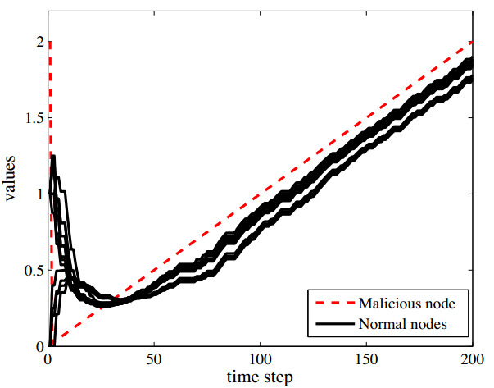
Stimulations
LCP with time-varying

Slide 28
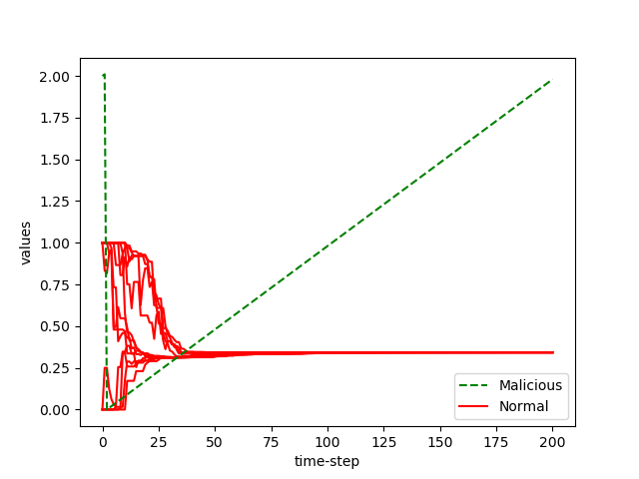
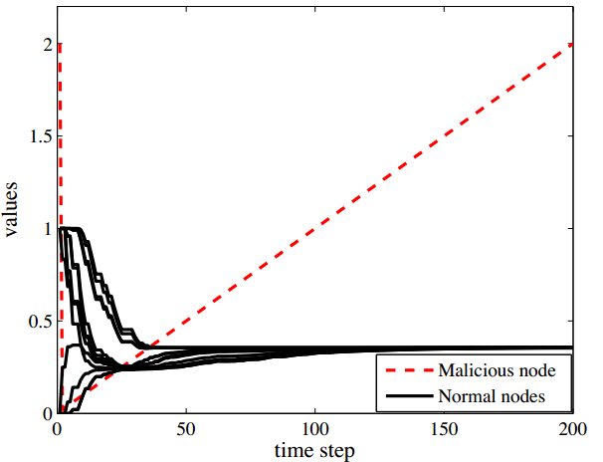
Stimulations
W-MSR with time-varying

Slide 29
Network Construction

Slide 30
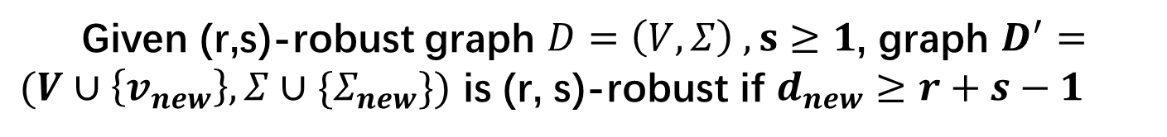
Theorem 2
Given (r,s)-robust graph $D=\left(V,Σ\right) ,s≥1$, graph $D^{′}=(V∪\left\{v_{new}\right\},Σ∪\{Σ_{new}\})$ is (r, s)-robust if $d_{new}≥r+s−1$

Slide 31
Thanks

