Slide 1
ENGI 301 CV Door Opener Proposal
9/23/2022
<Name>

Slide 2
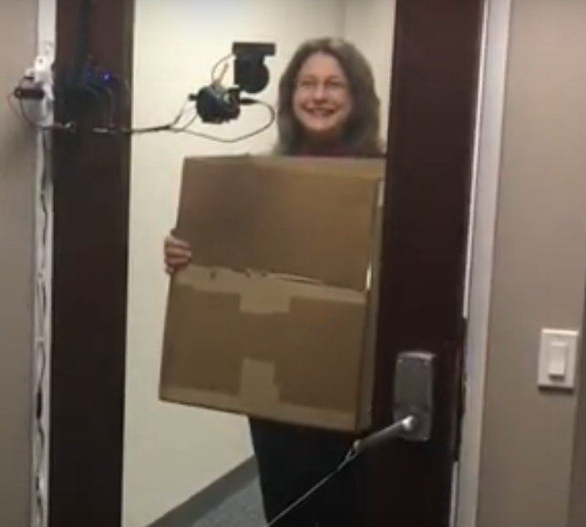
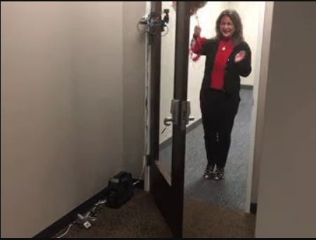
Background Information
What is being proposed?
An automatic door opener that uses computer vision software to only let certain people in
Trainable to multiple people
https://www.hackster.io/beaglefriends-octavosystems/biometric-door-opener-with-facial-recognition-voice-output-b4d62e#overview is the project this is based on, only mine will be a bit simpler as it will not include the speakers
What improvements / additions over existing project
My project will add functionality by creating a more user-friendly interface, including adding a way to add or delete faces from the database of allowed faces, and a screen to display maintenance statuses, welcome messages, and security inputs.
This is inspired by accessibility limitations in the residential colleges, and hopefully this project can be a system that will transform any room into an accessible one for a low cost. I want to use facial recognition to practice using open-source software, but facial recognition could be replaced by an RFID tag or a different hands-free system

Slide 3
System Block Diagram
Button to force face scan
OLED screen
Motion sensor
Code is correct, user uploads pictures for training, stored in the pocket beagle memory
User inputs security code; user adds new pictures via USB
Motion detected, turns on system
If face is correct, welcome message displayed and motor control module given power
Motor control module
Pocket Beagle
SPI
User
Camera turned on
USB camera
MCM sends power to motor to open the door
Camera detects face
Motor

Slide 4
Power Block Diagram
Motion sensor
LCD screen
Motor control module
Pocket Beagle
Power adapter
USB camera
Motor
Always on power
Power when motion detected

Slide 5
Components / Budget
Component | Need to Buy | Cost | Link
Webcam - Logitech HD C920 | yes | $35 on ebay $60 on amazon | link
Motor | Several found in OEDK free items bins | $0
Power adapter for motor | (depends on motor?) yes | $11.21 | link
OLED screen | yes |  | link
Button | no | Free at OEDK
Motor control module | (depends on motor?) yes | $17.59 | link
Motion detector (ultrasonic sensor) | (possibly available in OEDK) | $6.69 (if not free) | link
Cable | Free at OEDK | $0
Other structural parts made from wood/3D printed | Free/OEDK prices | $0
Total Projected Cost: $68.80 - $103.49
Need all components to be purchased by instructor listed; additional components may be purchased by student

Slide 6
Next steps
Make a priority list, do most important things first
Focus rn on UI/UX stuff, really mapping out the door opening process from start to finish
How to add/delete pictures?
Set up pocket beagle, look at software

