Slide 1
CloudNova: AWS Architecture & Monitoring

Slide 2
Architecture Overview
The diagram illustrates a multi-tier architecture deployed across two Availability Zones (AZs) to ensure redundancy, fault tolerance, and load balancing. It integrates core AWS components like EC2, RDS, S3, CloudFront, and Route 53 for a complete cloud deployment
Link for Lucid Diagram:
https://lucid.app/lucidchart/0e645210-4836-4b9e-8aca-bc3da26ca9f1/edit?viewport_loc=-3351%2C-1835%2C6056%2C2722%2C0_0&invitationId=inv_ba5ff272-33b8-416f-976f-d1869b75e683

Slide 3
VPC and Subnet Design
Subnet Name | Availability Zone | CIDR Block | Purpose
Public-Subnet-A | us-east-1a | 10.0.0.0/20 | Bastion Host, NAT Gateway, and ALB
Private-Subnet-A | us-east-1a | 10.0.16.0/20 | Hosts EC2 Web Server (App Tier)
DB-Subnet-A | us-east-1a | 10.1.0.0/24 | Primary Database RDS
Public-Subnet-B | us-east-1b | 10.0.32.0/20 | Redundant Public Tier (for High Availaibility / ALB Failover)
Private-Subnet-B | us-east-1b | 10.0.48.0/20 | Hosts Second Web Server (App Tier)
DB-Subnet-B | us-east-1b | 10.1.1.0/24 | Database Standby RDS (Reader / Replica)
Two CIDR blocks:
10.0.0.0/18 — Main network (public + private subnets)
10.1.0.0/20 — Dedicated for the database layer
Each zone contains public, private, and database subnets

Slide 4
Route Table Configuration
Route Table Name | Associated Subnets | Purpose | Routes
CN-Public-RT | Public-Subnet-A, Public-Subnet-B | Enables internet access for public-tier resources like the Bastion Host, NAT Gateway, and ALB. | 10.0.0.0/18 → local 10.1.0.0/20 → local 0.0.0.0/0 → igw-0da37cefa1dc1f791 (Internet Gateway)
CN-Private-RT-A | Private-Subnet-A (us-east-1a) | Allows private-tier instances to initiate outbound internet access via NAT Gateway in AZ-1a. | 10.0.0.0/18 → local 10.1.0.0/20 → local 0.0.0.0/0 → nat-0a0e26f4cc4f00b0e (NAT Gateway-A) pl-63a5400a → vpce-0297ce12046a85f17 (S3 Gateway Endpoint)
CN-Private-RT-B | Private-Subnet-B (us-east-1b) | Allows private-tier instances in AZ-1b to reach the internet through NAT Gateway-B. | 10.0.0.0/18 → local 10.1.0.0/20 → local 0.0.0.0/0 → nat-046c0deee7c5562cb (NAT Gateway-B) pl-63a5400a → vpce-0297ce12046a85f17 (S3 Gateway Endpoint)
CN-DB-Route-Table | DB-Subnet-A, DB-Subnet-B | Dedicated to the database layer, allowing only local communication inside the VPC. | 10.0.0.0/18 → local 10.1.0.0/20 → local
four route tables were created to manage network traffic flow and ensure isolation between tiers

Slide 5
Security Groups (SGs)
Security Group | Purpose / Attached To | Inbound Rules | Outbound Rules
SG-ALB | Application Load Balancer (Public Subnets) | • HTTP (80) – Allow from 0.0.0.0/0 • HTTPS (443) – Allow from 0.0.0.0/0 | • HTTP (80) – Allow to anywhere • HTTPS (443) – Allow to anywhere
SG-Bastion | Bastion Host (Public Subnet) | • SSH (22) – Allow from specific admin IPs (e.g., 0.0.0.0/0 for lab testing) | • SSH (22) – Allow to private web servers (SG-Web) for administration
SG-Web | EC2 Web Servers (Private Subnets) | HTTP (80) – Allow from SG-ALB • HTTPS (443) – Allow from SG-ALB • SSH (22) – Allow from SG-Bastion | • HTTP (80) – Allow to ALB for responses • HTTPS (443) – Allow to ALB • MySQL/Aurora (3306) – Allow to SG-RDS for database connections
SG-RDS | Aurora Database Cluster (DB Subnets) | • MySQL/Aurora (3306) – Allow from SG-Web only | • All traffic – Allowed internally (for RDS system updates within VPC)
Security Groups are stateful firewalls that enforce least-privilege access.

Slide 6
Network ACLs (NACLs)
Network ACL | Associated Subnets | Inbound Rules (Allow) | Outbound Rules (Allow) | Purpose
CN-Public-Subnet-NACL | Public-Subnet-A, Public-Subnet-B | HTTP (80), HTTPS (443), SSH (22) – from 0.0.0.0/0 • Ephemeral ports (1024–65535) – for return traffic | HTTP (80), HTTPS (443), SSH (22) – to 0.0.0.0/0 • Ephemeral ports (1024–65535) – for responses | Allows public internet access for ALB and Bastion hosts while maintaining control on allowed protocols.
CN-Private-Web-NACL | Private-Subnet-A, Private-Subnet-B | HTTP (80), HTTPS (443) – from ALB subnets • MySQL (3306) – to DB subnets • Ephemeral ports (1024–65535) – bidirectional | • HTTP/HTTPS (80/443) – responses to ALB • MySQL (3306) – outbound to RDS • Ephemeral ports (1024–65535) – bidirectional | Protects private web servers; only allows inbound web traffic from ALB and outbound DB traffic.
CN-Private-DB-NACL | DB-Subnet-A, DB-Subnet-B | MySQL (3306) – from private subnets only • Ephemeral ports (1024–65535) – for responses | MySQL (3306) – outbound responses to private tier • Ephemeral ports (1024–65535) – for return traffic | Restricts DB subnets for internal use only. Denies all external inbound/outbound internet traffic.
A Network ACL (Access Control List) is a stateless, subnet-level firewall in AWS that controls incoming and outgoing traffic for an entire subnet.

Slide 7
Bastion Host
Bastion Host is a critical component for secure admin access.
Two bastion hosts are applied in both zones. One is primary and the other is stand-by
Bastion needs a public IP so administrators can SSH into it
From there, it can SSH into private EC2 instances
Protects private servers by blocking direct SSH from the internet

Slide 8
Application Load Balancer (ALB)
Distributes traffic across Web Server A & B
Works across two Availability Zones
Performs health checks
Sends traffic only to healthy servers
Supports HTTP (80) and HTTPS (443)
Improves reliability and uptime

Slide 9
EC2 Web Servers (Private Subnets)
Two EC2 web servers (AZ-1a & AZ-1b)
Placed in private subnets for security
Accessible only through:
Bastion Host (SSH)
Load Balancer (HTTP/HTTPS)
Hosts the web application
Isolated from the public internet

Slide 10
EBS Volumes + Auto-Mount Setup
Each server has a 20 GB EBS volume and 5 GB extra
Device appears as /dev/xvda
Formatted using the XFS filesystem
Mounted to /data
/etc/fstab entry added for auto-mount after reboot
Ensures persistent, stable storage

Slide 11
HTTPS Certificate (ACM)
SSL/TLS certificate created in AWS Certificate Manager
Attached to ALB HTTPS listener (port 443)
Encrypts all user traffic
“Not Secure” warning due to internal certificate
Secure access tested using HTTPS
Follows AWS best security practices

Slide 12
Auto Scaling Group (ASG)
Automatically adds/removes EC2 instances
Based on CPU or demand
Uses Launch Template (AMI + instance type)
Operates across two AZs
Improves performance, reliability, and cost efficiency

Slide 13
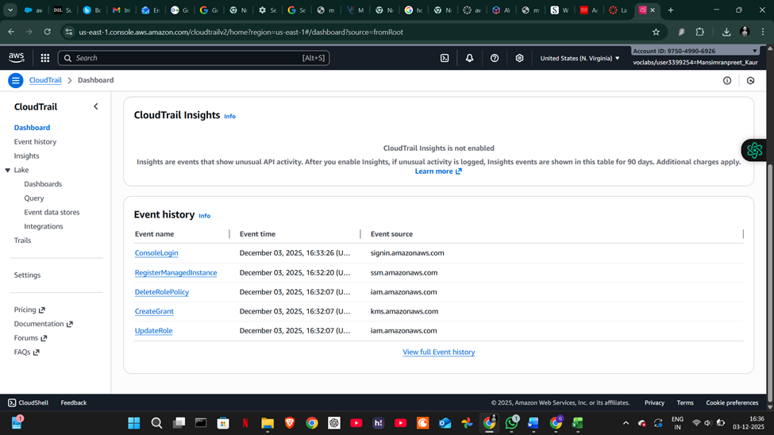
CloudTrail is like a security camera for your AWS account.
CloudTrail captures:
Every login to AWS
Every resource creation
Every resource deletion
Permission changes
Security Group changes
Starting/stopping EC2
S3 bucket modifications
IAM actions

Slide 14
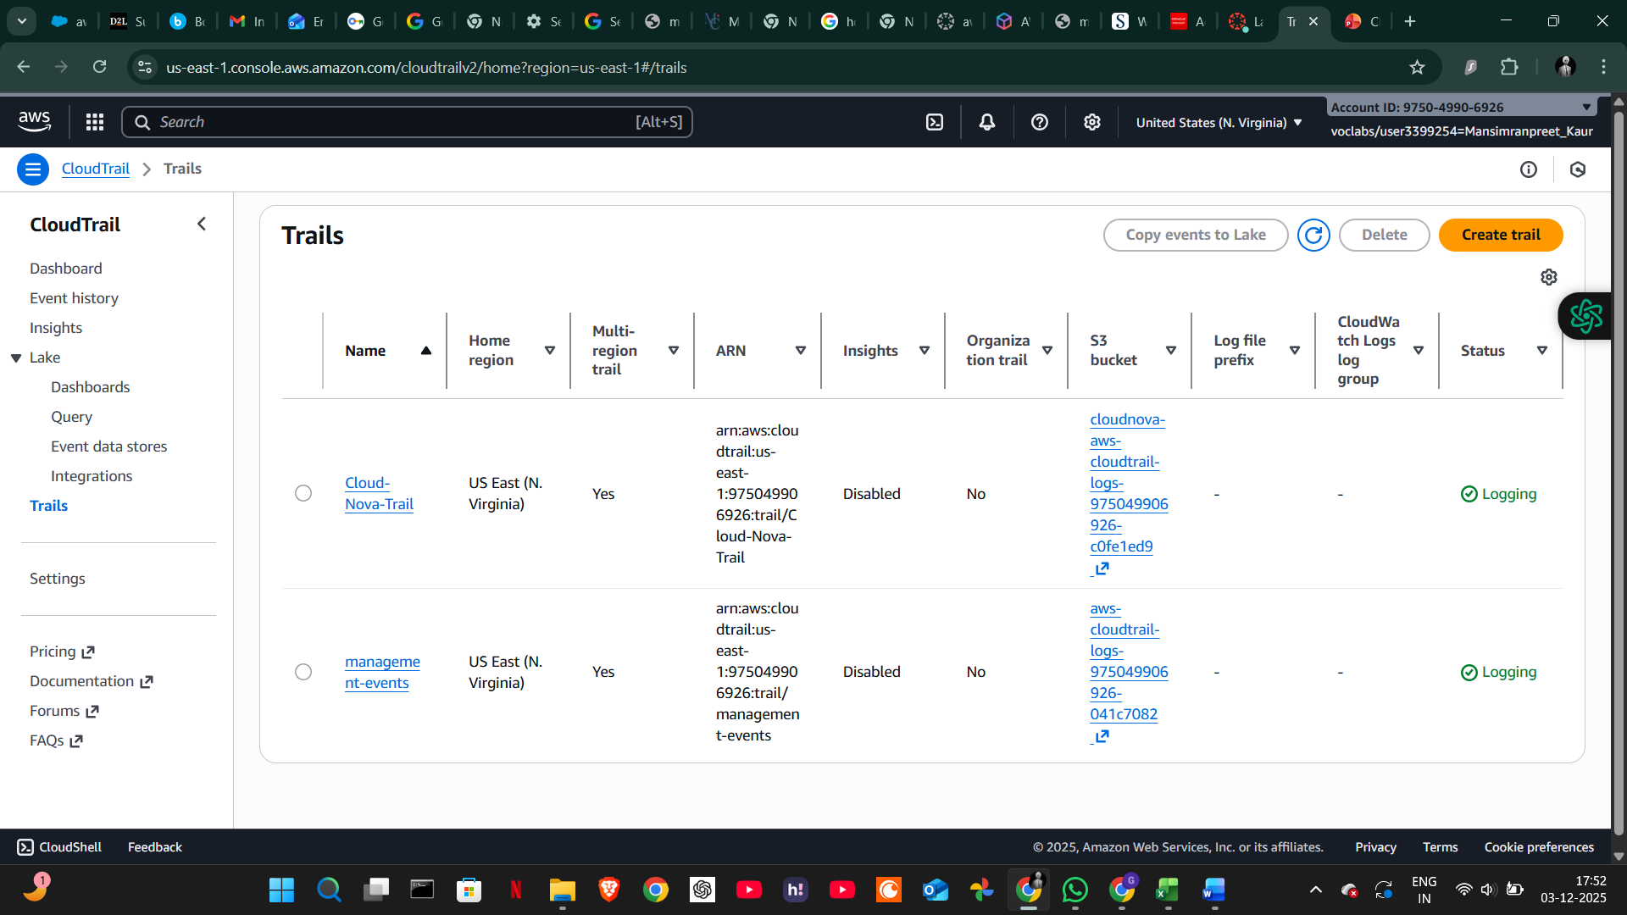
Cloud Trail S3 bucket

Slide 15
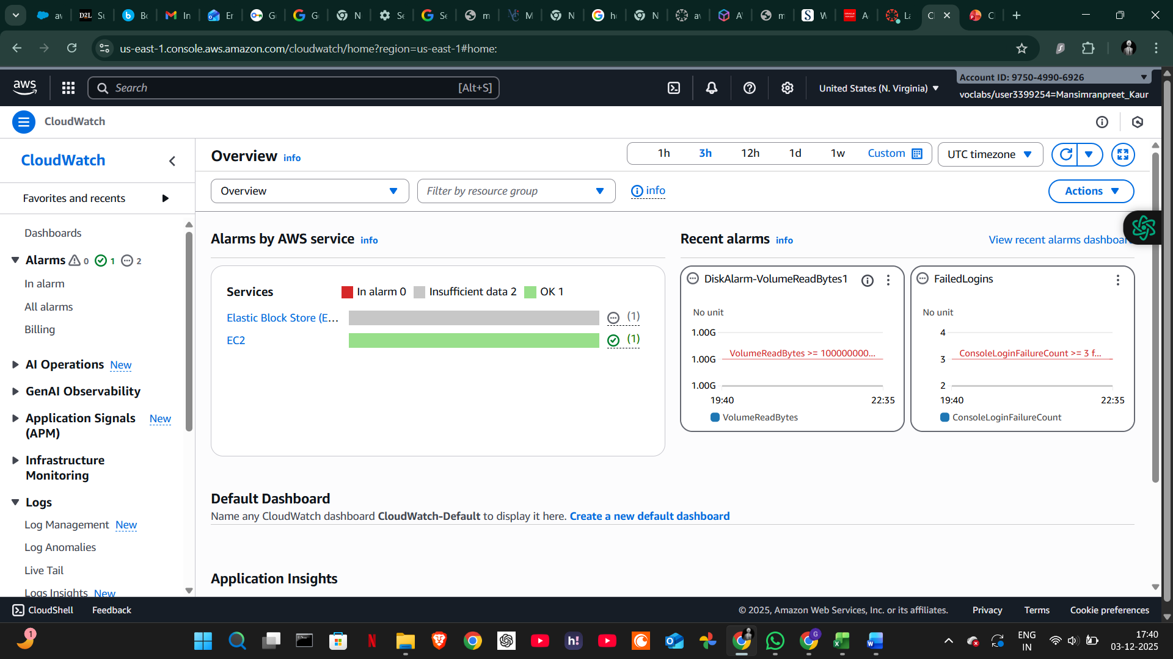
What is Amazon CloudWatch?
CloudWatch is a monitoring service.
It watches:
EC2 performance
CPU usage
RAM (if using agent)
Network traffic
Disk activity
Application logs
Metric-based alarms

Slide 16
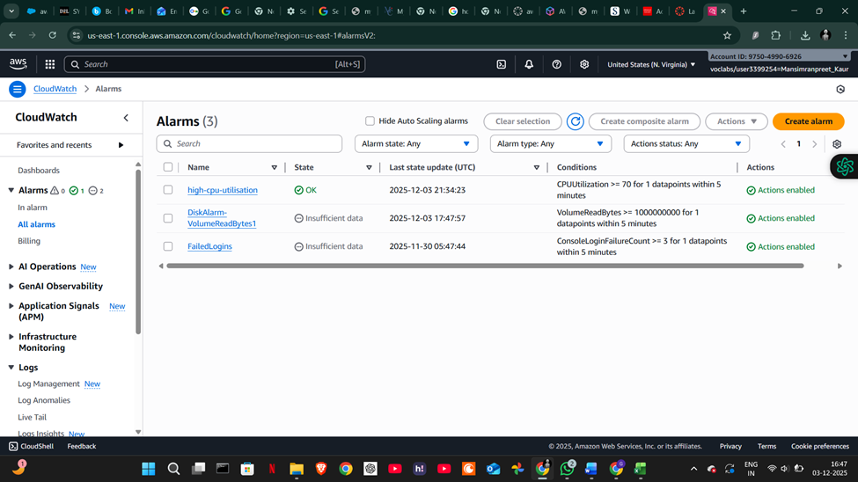
CloudWatch Alarms
CloudWatch Alarms make automatic alerts when a metric crosses a threshold.
Types of alarms you used:
CPU Alarm → CPUUtilization ≥ 70%
Disk Alarm → VolumeReadBytes
Failed Login Alarm → Custom metric based on CloudTrail

Slide 17
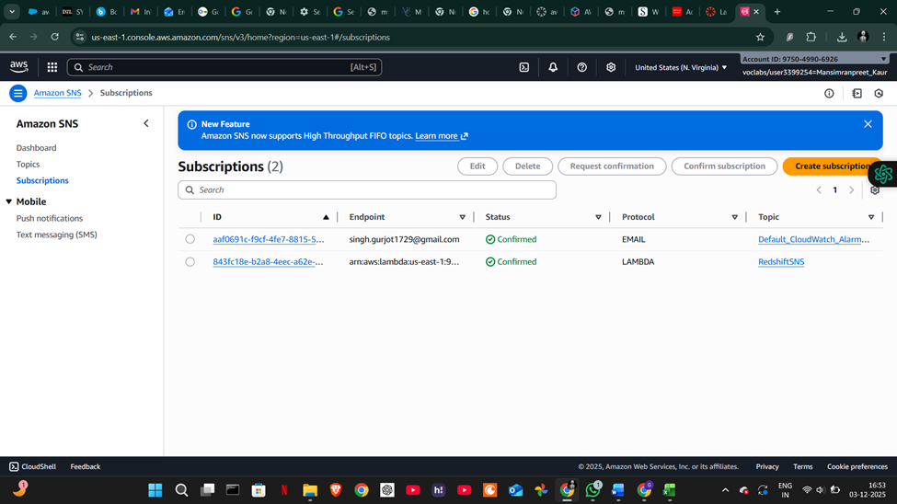
Amazon SNS – simple notification services
Email

Slide 18
GuardDuty Threat Detection
AWS GuardDuty is Amazon’s threat detection service. It continuously analyzes CloudTrail logs, VPC Flow Logs, and DNS logs to detect:
Suspicious API calls
Unusual network activity
Unauthorized access
Potential malware
It basically works like a security monitoring system for the entire AWS account

Slide 19
Our GuardDuty Findings
After enabling GuardDuty, we checked the Summary and Findings dashboards.
Our GuardDuty results showed 0 findings, which means:
No brute-force attempts
No suspicious IP addresses
No unusual API behavior
No compromised EC2 instances
Even though there were no alerts, enabling GuardDuty is still very important. It ensures that if anything dangerous does happen in the future, we will get notified immediately.

Slide 20
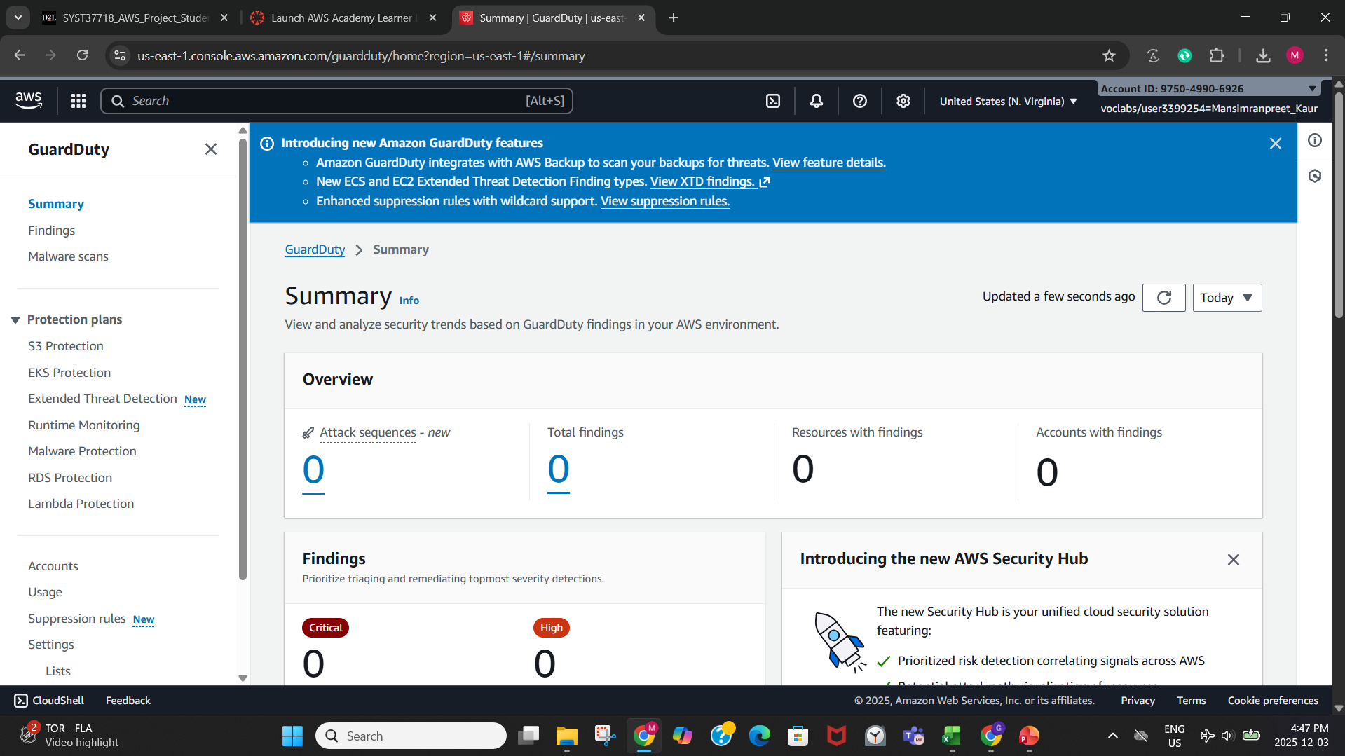

Slide 21
AWS Trusted Advisor
Trusted Advisor is a tool that gives recommendations to improve:
Security
Cost
Performance
Service limits
Fault tolerance
It checks our AWS resources and tells us where we can improve our configuration.

Slide 22
Our Trusted Advisor Findings
In our project, Trusted Advisor gave several recommendations:
Security warning: MFA not enabled for the root account
Security warning: Some security groups allowed open access (0.0.0.0/0)
Service limits: Elastic IP usage near the quota
Other checks: Most areas were green, meaning properly configured
These findings helped us identify where our environment can be improved for better security and reliability.

Slide 23
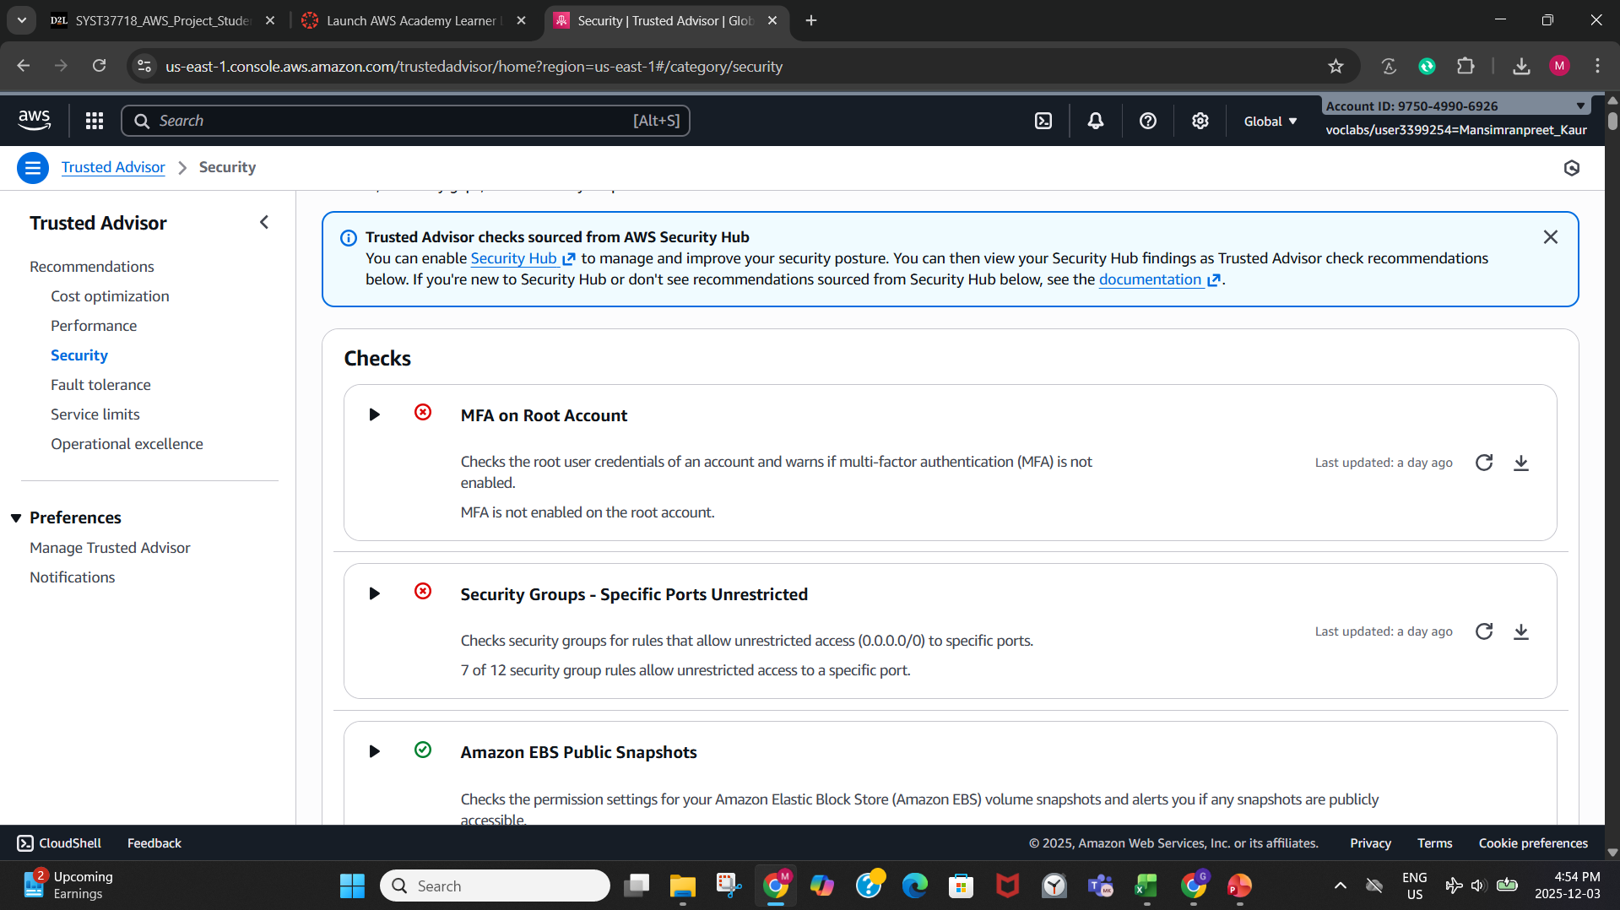

Slide 24
Log Archiving + Compliance Reflection
For log management, we created an S3 lifecycle rule to simulate automated log archiving.
Logs transition to Standard-IA after 30 days
This reduces cost and keeps logs available for auditing
In terms of compliance and privacy, this project helped us understand:
The importance of monitoring with GuardDuty
How audit logs help with security investigations
How lifecycle policies support retention requirements
How Trusted Advisor guides organizations toward best practices
Overall, these tools improve visibility, reduce risks, and support compliance with security standards.

