Slide 1
Project name: Daily Needs (An android application)
Team members
Mani Goyal
Nandan Pandey
Mehar Singh
Veeresh Raj Bahri
Harleen Kaur
For TEKsystems Global Services Pvt. Ltd.

Slide 2
CONTENTS
Project Objective
Software Requirements
Individual Contributions
End Users
Future Enhancements
What We Learnt

Slide 3
PROJECT OBJECTIVE
To develop an interacting android application for:
Simplying the food ordering mechanism.
To make it easy for customers to order food from home in a convenient way.
Making the food ordering system online which is easy for the restaurants and customers for interaction as a medium.
Customers to order food from a digital menu.
Creating options of different restaurants, food items and categories for users to chose from.
Easy to use for customers.

Slide 4
SOFTWARE REQUIREMENTS
Android version 2.2 and higher versions.
Standard Development Kit (SDK)
Eclipse, JDK
Permissions:
INTERNET
ACCESS_NETWORK_STATE
WAKE_LOCK

Slide 5
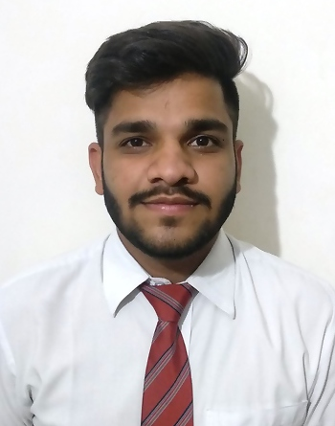
INDIVIDUAL CONTRIBUTIONS
MANI GOYAL (Roll Number 1628108)
Modules contributed:
Home.java
FoodList.java
FoodViewHolder.java
MenuViewHolder.java

Slide 6
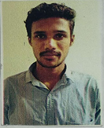
INDIVIDUAL CONTRIBUTIONS
NANDAN PANDEY (Roll Number 16BCS311)
Modules contributed:
Database.java
tomato.db
SignUp.java

Slide 7
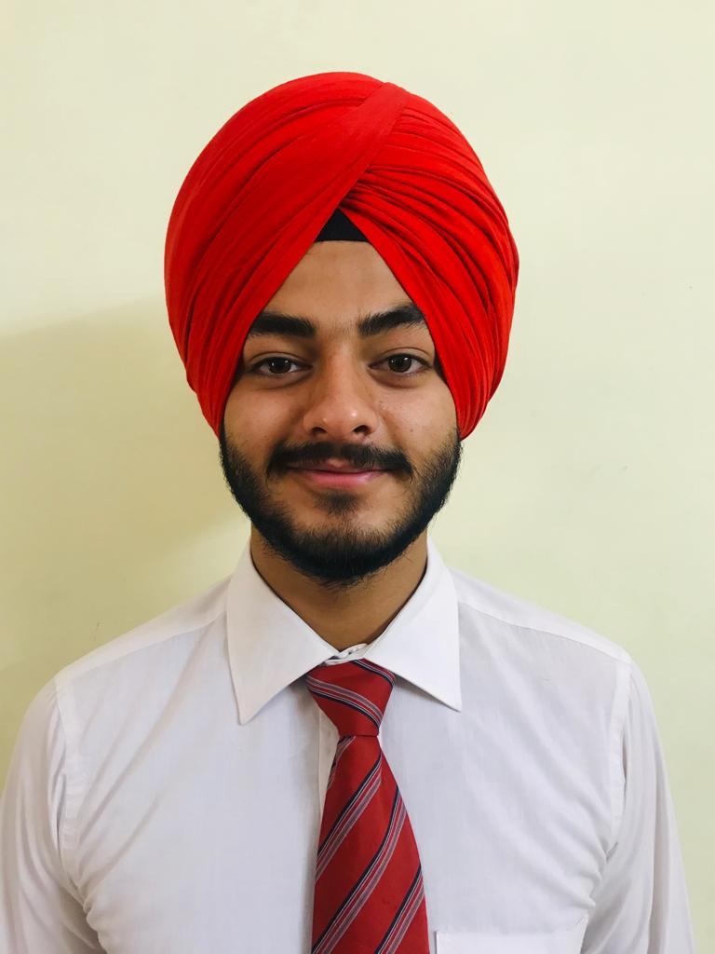
INDIVIDUAL CONTRIBUTIONS
MEHAR SINGH (Roll Number 1603317)
Modules contributed:
Cart.java
CartAdapter.java
FoodDetails.java

Slide 8
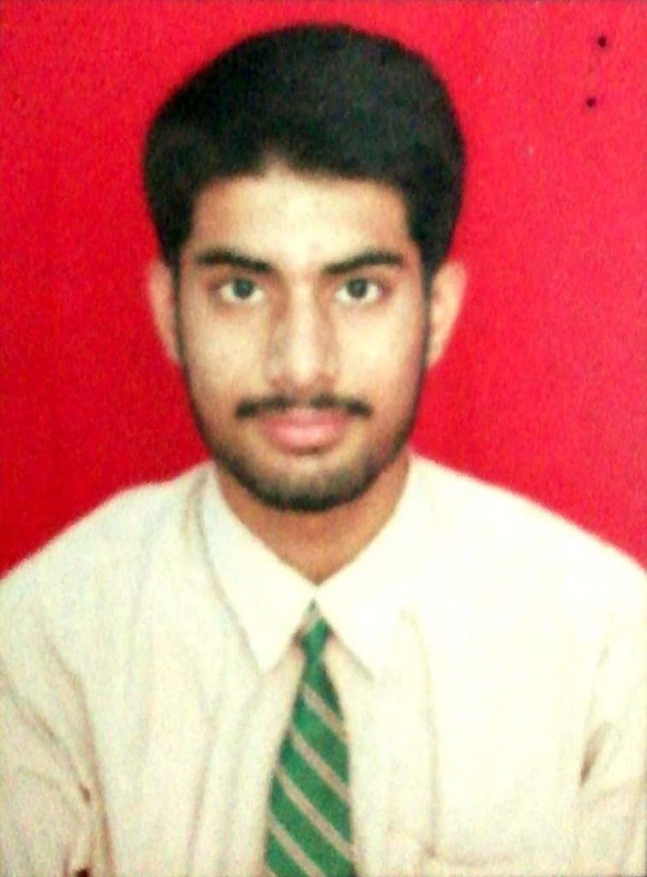
INDIVIDUAL CONTRIBUTIONS
Veeresh Raj Bahri (Roll Number 16BCS3059)
Modules contributed:
MainActivity.java
SignIn.java
Managing XML files(front end)

Slide 9
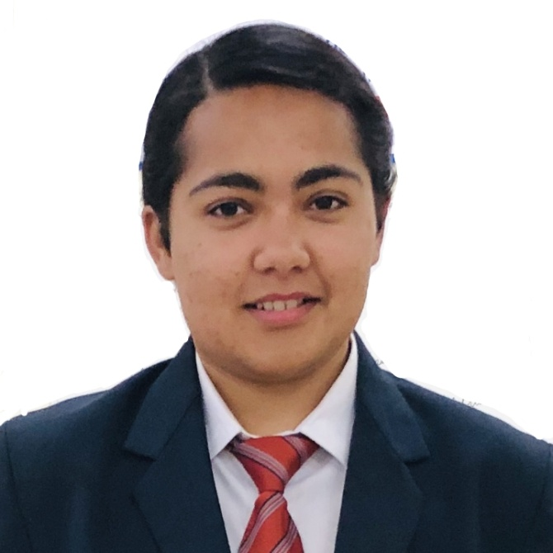
INDIVIDUAL CONTRIBUTIONS
HARLEEN KAUR (Roll Number 1628054)
Modules contributed:
Category.java
Food.java
Order.java
Request.java
User.java

Slide 10
END USERS
Foodies who want food from their favorite restaurants anytime and anywhere.
Users who want a simple and easy to use application to fulfill their daily needs or carvings for food.
Android Users
Enterprises may use this as USER END application to run a food ordering business.

Slide 11
FUTURE ENHANCEMENTS
More options for restaurants can be added.
More categories for food items can be added.
Options to check order status can be added.

Slide 12
WHAT WE LEARNT
Developing a fully working application in 48 hours.
Team work

Slide 13
THANK YOU

