Slide 1

DAV UNIVERSITY
Smart Food Delivery & Restaurant Insight Dashboard
A Data-Driven Analytics Dashboard for Restaurant Performance & Delivery Insights
STUDENT
COURSE
SESSION
TRAINING PARTNER
[Student Name]
[Course Name]
[Session, e.g. 2022–2026]
O7 Services

Slide 2



Introduction
Online food delivery has become part of everyday life in Indian cities. As platforms handle thousands of restaurants and orders every day, the data they generate holds valuable clues about customer behaviour, restaurant performance, and delivery efficiency.
A Fast-Growing Industry
Online food delivery services are expanding rapidly across Indian cities, generating massive amounts of daily data.
The Value of Data Analysis
Restaurant ratings, pricing, and delivery data hold patterns that are easy to miss without proper analysis.
Dashboards Aid Decisions
A well-built dashboard turns raw numbers into clear insights that support faster, smarter business decisions.
Smart Food Delivery & Restaurant Insight Dashboard
2

Slide 3





Training Partner
O7 Services works with students to deliver hands-on industrial training and guided project development, helping learners turn classroom concepts into real, portfolio-ready work.
Industrial Training
Structured, hands-on training programs that build real-world technical skills.
Project Development
Training & Project Partner
End-to-end support in planning, building, and refining student projects.
Areas of Expertise
Data Analytics, Web Development, Machine Learning, and Software Engineering.
Smart Food Delivery & Restaurant Insight Dashboard
3

Slide 4



Problem Statement
Data Too Large to Read Manually
Hidden Trends Go Unnoticed
Decisions Need to Be Fast
Restaurant datasets contain thousands of records — far too many to study row by row.
Patterns in ratings, pricing, and delivery performance stay hidden without proper analysis.
Businesses need quick, accurate insights to act on — not slow, manual reporting.
Smart Food Delivery & Restaurant Insight Dashboard
4

Slide 5




Project Objectives
Clean & Organize Data
Identify Popular Cuisines
Prepare raw restaurant data for accurate, reliable analysis.
Find which cuisines and food types drive the most orders.
Analyze Ratings & Delivery
Generate Recommendations
Study customer ratings alongside delivery performance.
Turn findings into clear, practical business suggestions.
Compare City Trends
Identify how performance varies across different cities.
Smart Food Delivery & Restaurant Insight Dashboard
5

Slide 6





Project Features
Interactive Dashboard
City-wise Filtering
Restaurant Analysis
Rating Analysis
Delivery Time Analysis
KPI Cards
Business Insights & Recommendations
Smart Food Delivery & Restaurant Insight Dashboard
6

Slide 7







Technologies Used
Python
Pandas
Streamlit
Plotly
Matplotlib
Seaborn
GitHub
Streamlit Cloud
Smart Food Delivery & Restaurant Insight Dashboard
7

Slide 8


Project Workflow
01
02
03
04
05
06
›
›
›
›
›
Data
Collection
Data
Cleaning
Data
Analysis
Data
Visualization
Dashboard
Development
Insights &
Recommendations
Smart Food Delivery & Restaurant Insight Dashboard
8

Slide 9
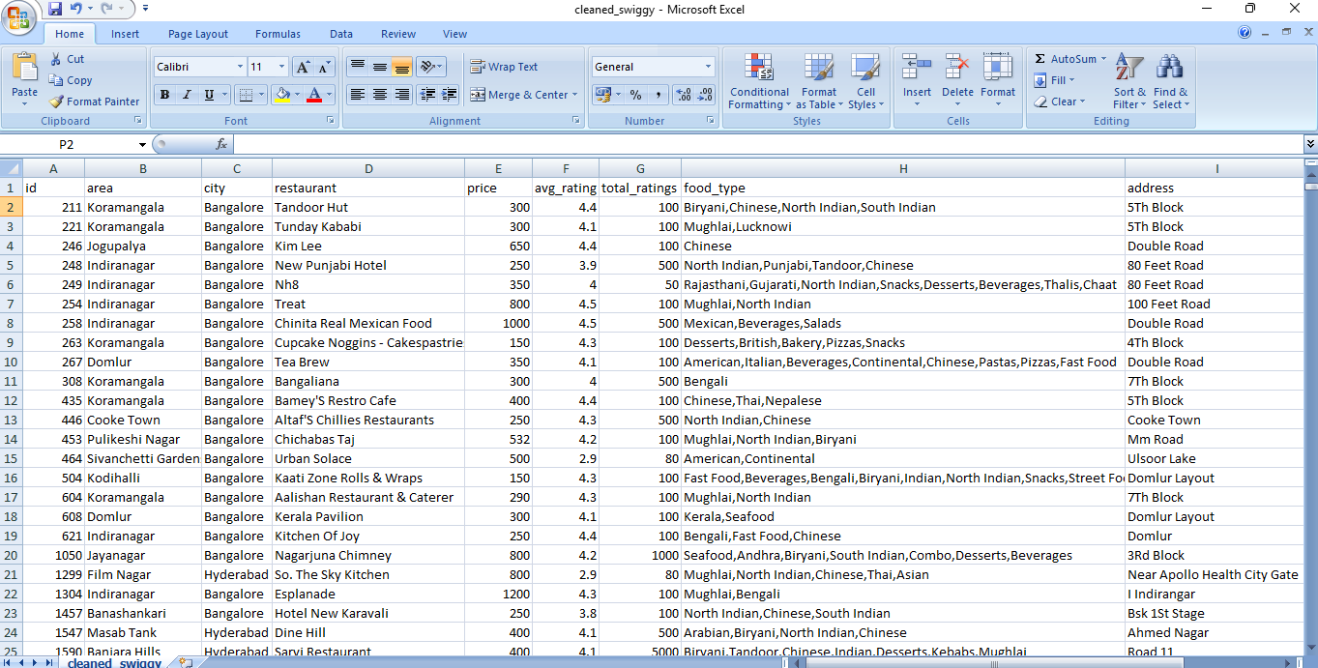

Dataset Overview
The dataset brings together restaurant listings, customer ratings, pricing, and delivery-time records across multiple cities, forming the foundation for every analysis in this dashboard.
8,680+
10
RECORDS
FEATURES
IMPORTANT COLUMNS
[Insert Dataset Screenshot]
Restaurant Name
City & Area
Cuisine / Food Type
Average Rating
Total Ratings
Price
Delivery Time
Smart Food Delivery & Restaurant Insight Dashboard
9

Slide 10
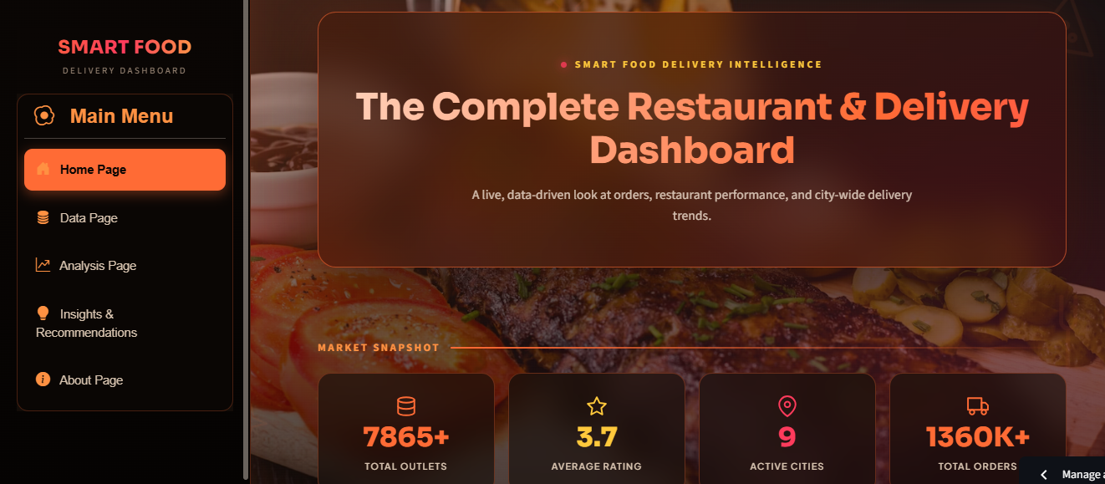
Dashboard Overview
DASHBOARD PAGES
Home
Live snapshot of market-wide KPIs
Data Explorer
Search, filter, and inspect records
Analysis Center
[Insert Dashboard Screenshot]
Charts across ratings, delivery & pricing
Insights & Recommendations
Business takeaways and next steps
Smart Food Delivery & Restaurant Insight Dashboard
10

Slide 11

Key Findings
Faster Delivery Improves Ratings
Restaurants with shorter delivery times consistently receive higher customer ratings.
Major Cities Drive Order Volume
Larger cities generate a disproportionate share of total orders.
Popular Cuisines Attract More Customers
Certain cuisines consistently draw higher order counts across cities.
Delivery Efficiency Shapes Satisfaction
Delivery speed has a direct, measurable impact on customer satisfaction.
Smart Food Delivery & Restaurant Insight Dashboard
11

Slide 12
Recommendations
Reduce Delivery Delays
Promote Top-Rated Restaurants
Add rider hubs in high-demand zones to cut average delivery time.
Give high performers more visibility to boost order value.
Improve Delivery Planning
Expand in Growing Markets
Use route and demand data to plan smarter dispatching.
Prioritise emerging cities showing strong growth potential.
Smart Food Delivery & Restaurant Insight Dashboard
12

Slide 13

Conclusion & Future Scope
Project Summary
This dashboard turns raw restaurant and delivery data into a clear, interactive tool for exploring performance across cities, cuisines, and customers.
Business Benefits
Faster, data-backed decisions on delivery planning, restaurant promotion, and market expansion.
Future Enhancements
Real-time data feeds, predictive delivery-time modelling, and expanded city and restaurant coverage.
Smart Food Delivery & Restaurant Insight Dashboard
13

Slide 14

Thank You
Questions & Answers
Smart Food Delivery & Restaurant Insight Dashboard

