Slide 1
CSE185 Introduction to Computer Vision Lab 02: For Loop Operation
Instructor: Prof. Ming-Hsuan Yang
TA: Siddharth Seth & Kuan-Chih Huang & Yu-Ju Tsai

Slide 2
If statement
If statement
If-else statement
if EXPRESSION
...
end
if EXPRESSION
...
else
...
end
if EXPRESSION
...
elseif EXPRESSION
...
else
...
end

Slide 3
Loop
For loop
While loop
for i = 1:10
...
end
while EXPRESSION
...
end

Slide 4
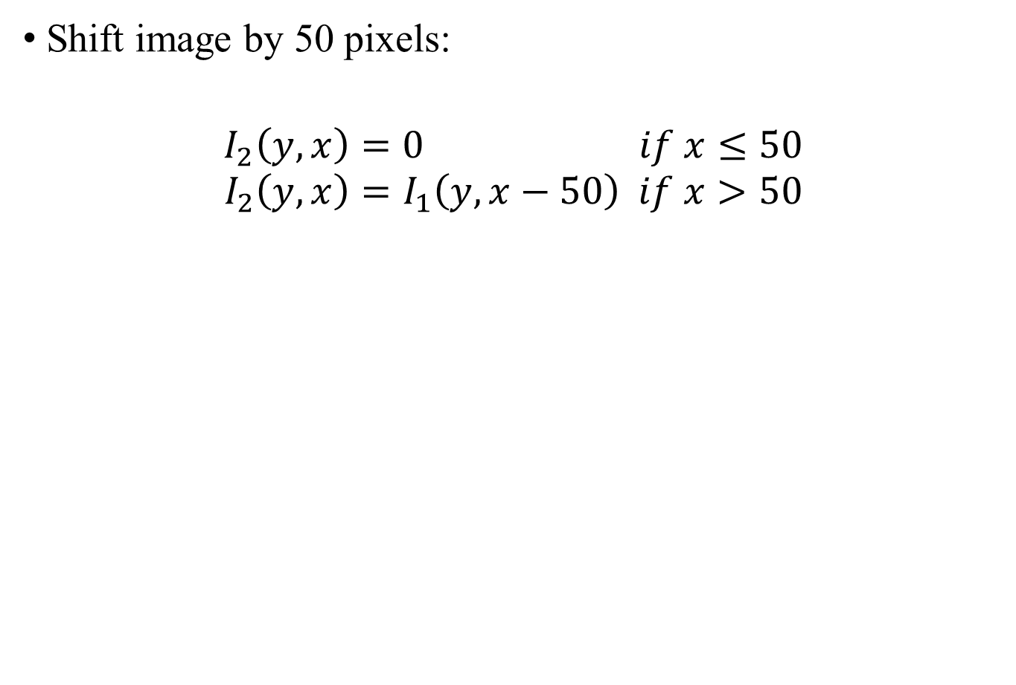
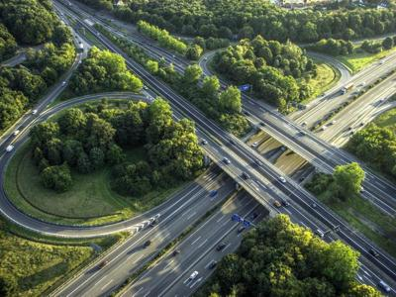
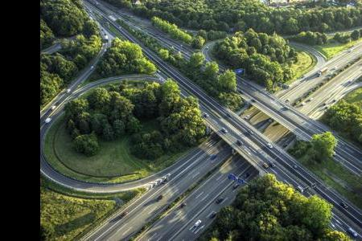
Translation
50

Slide 5
Translation
Shift image by 50 pixels
Use For loop
Use submatrix indexing
I2 = zeros(300, 400 + 50, 3, ‘uint8’);
for y1 = 1 : 300
for x1 = 1 : 400
y2 = ???
x2 = ???
I2(y2, x2, :) = I1(y1, x1, :);
end
end
I2 = zeros(300, 400 + 50, 3, ‘uint8’);
I2(1:300,51:400+50,:) = I1;

Slide 6
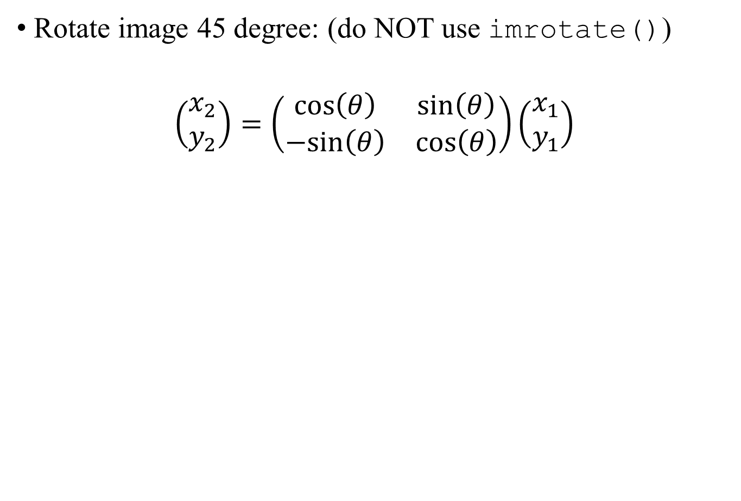
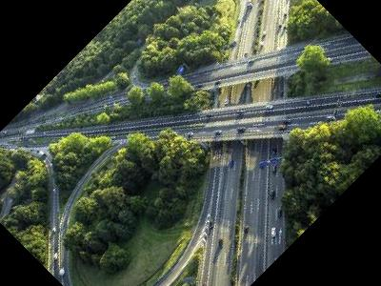
Rotation
(1, 1)

Slide 7
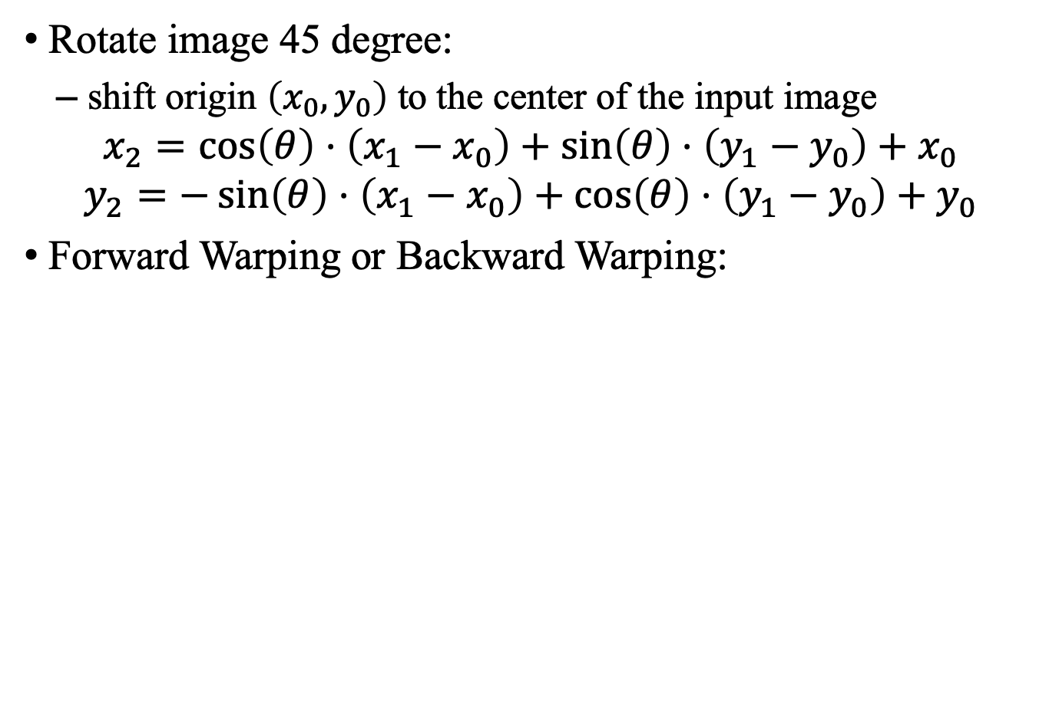

Rotation
(1, 1)

Slide 8
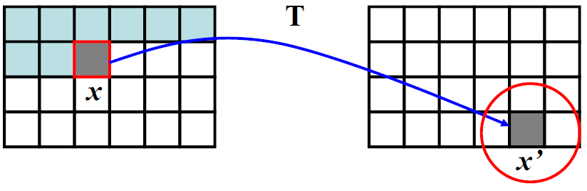
Forward Warping
Suppose I1 is input image, I2 is warped image
Pseudocode:
for each pixel (y1, x1) in I1:
(y2, x2) = Rotate(y1, x1)
if (y2, x2) is inside I2:
I2(y2, x2) = I1(y1, x1)
end
end
I1
I2

Slide 9
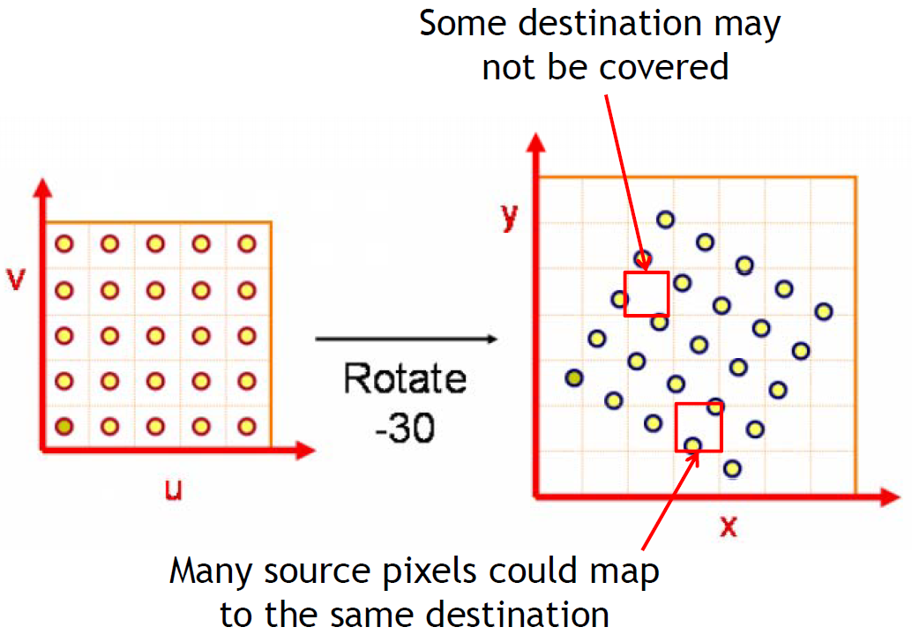
Forward Warping
Forward warping will produce “holes”:

Slide 10
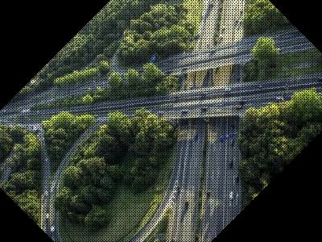
Forward Warping
Forward warping will produce “holes”:

Slide 11
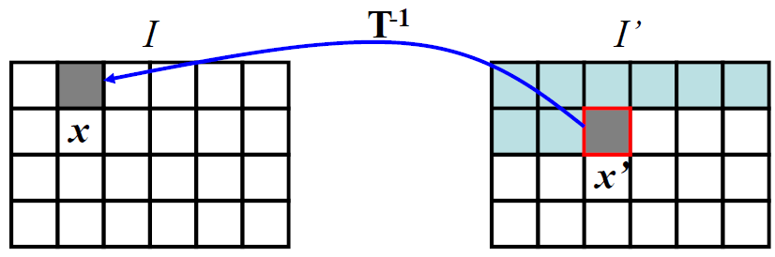
Backward/Inverse Warping
Suppose I1 is input image, I2 is warped image:
for each pixel (y2, x2) in I2:
(y1, x1) = Rotate^{^-1}(y2, x2)
if (y1, x1) is inside I1:
I2(y2, x2) = I1(y1, x1)
end
end
Rotate^{^-1} = Inverse warping
I1
I2

Slide 12
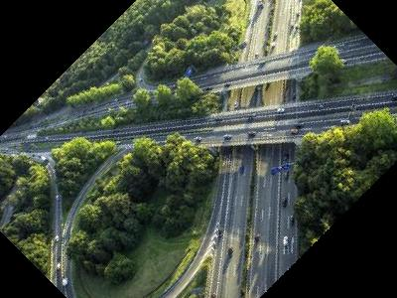
Backward/Inverse Warping

Slide 13
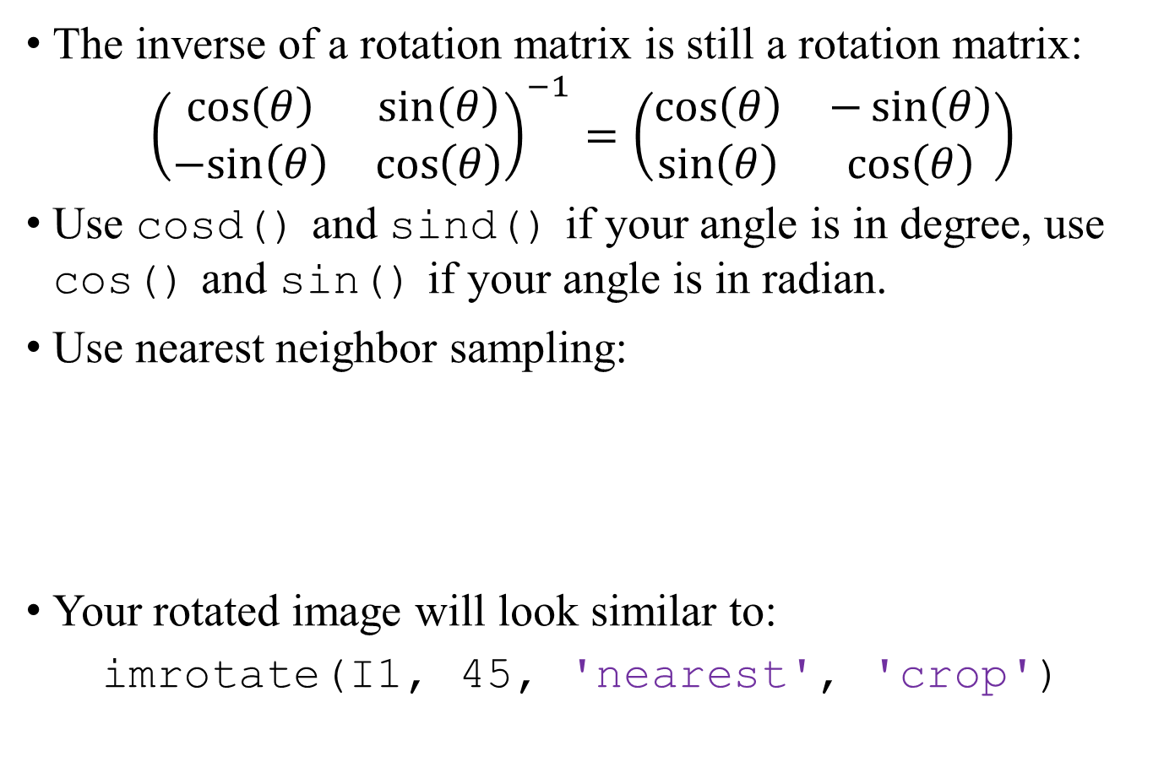
Backward/Inverse Warping: Hints
(y1, x1) = Rotate^{^-1}(y2, x2)
y1 = round(y1);
x1 = round(x1);
If( 1 <= y1 && y1 <= H && 1 <= x1 && x1 <= W )
...
Implemented by sin and cos

Slide 14
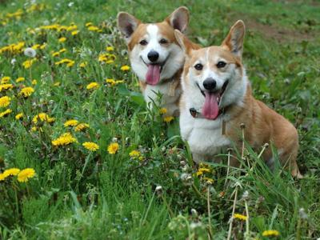
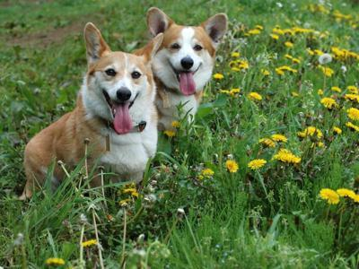
Image Processing in MATLAB
Horizontally flip image: do NOT use flip()
Use For loop, or submatrix indexing:
>> vec = [10, 20, 30, 40, 50];
>> vec(5:-1:1)
ans =
50 40 30 20 10
Specify the step size to -1

Slide 15
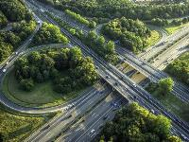
Scaling
Down-sample image by a factor of 2: do NOT use imresize()
Your result should look like
imresize(I1, 0.5, 'nearest')
You should use For loop or submatrix indexing

Slide 16
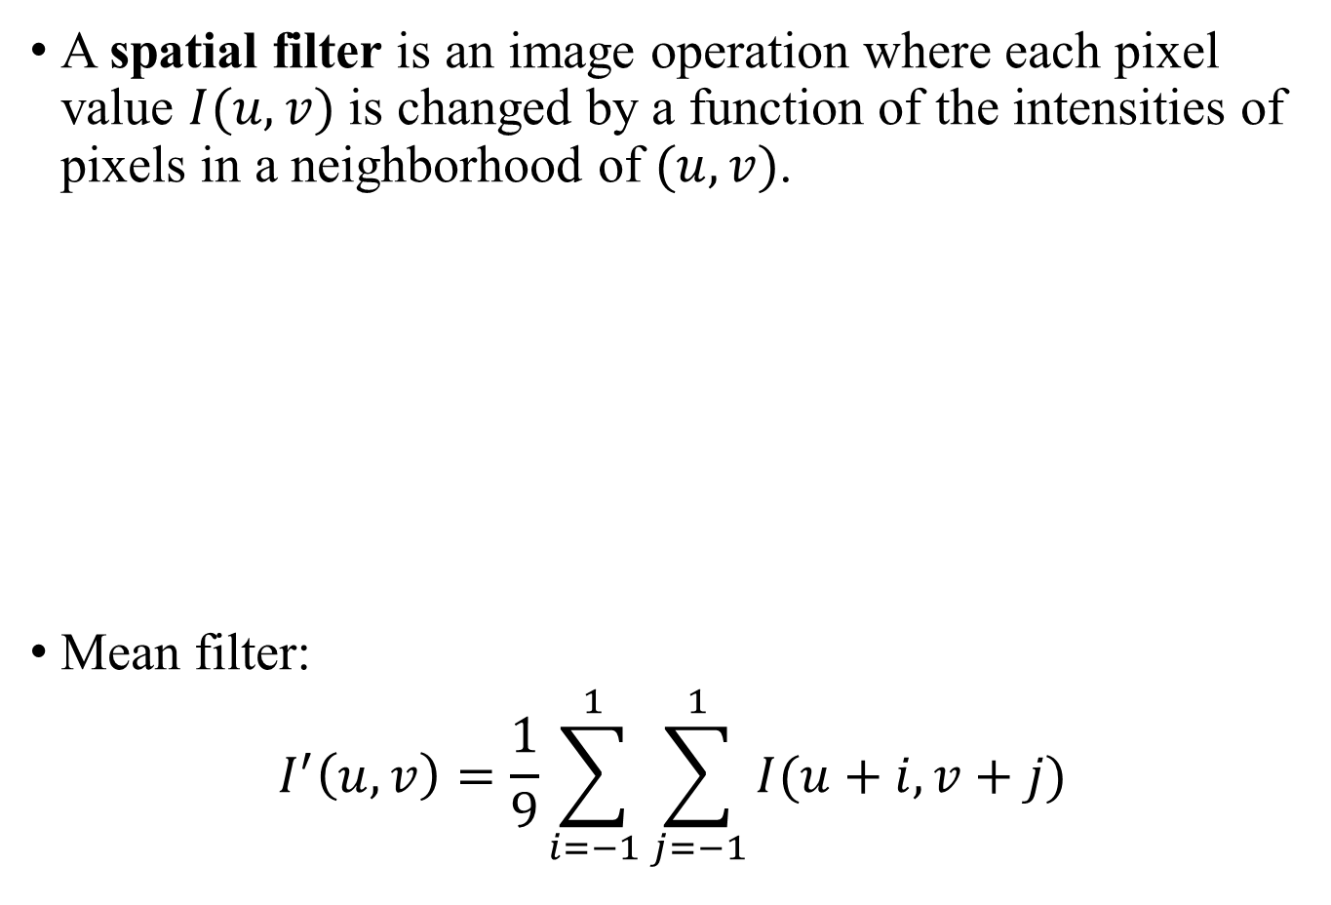
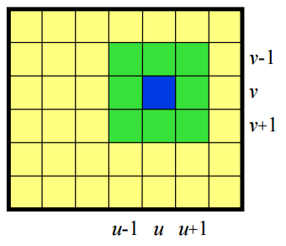
Spatial Filter

Slide 17
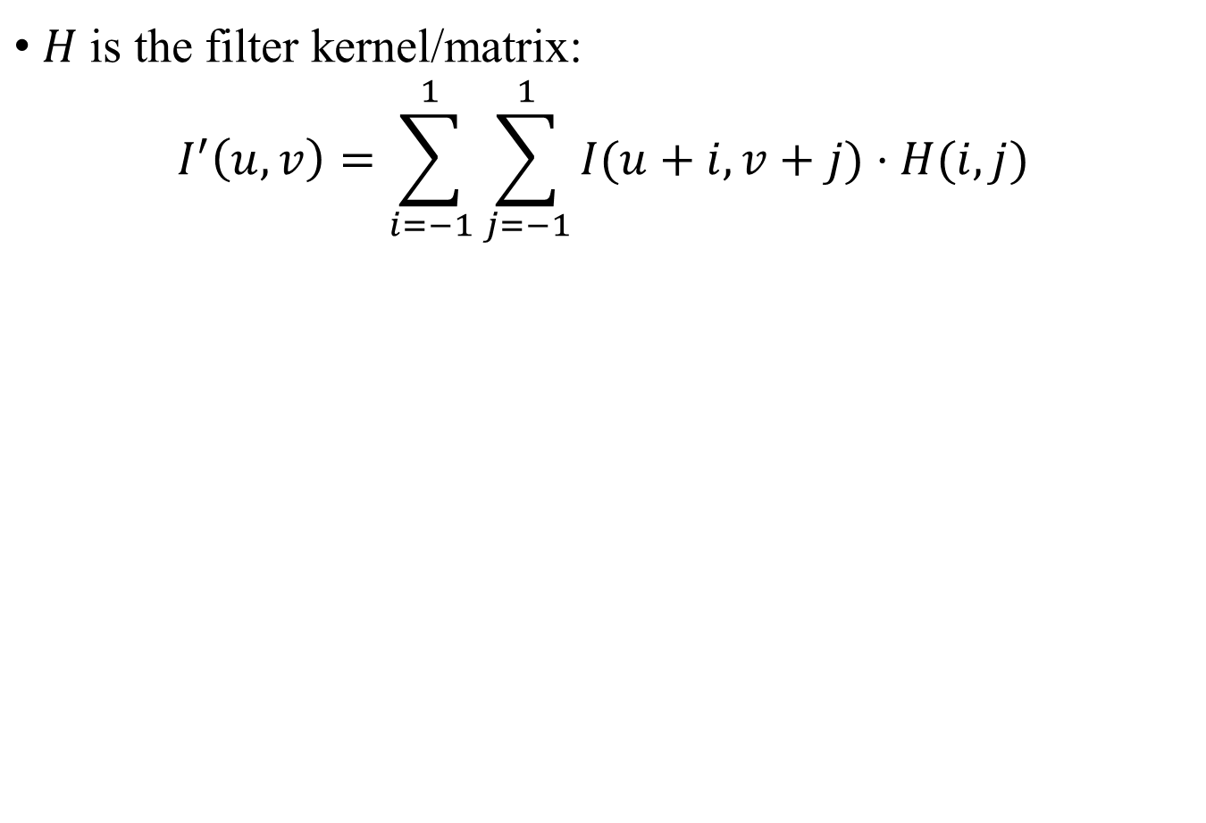
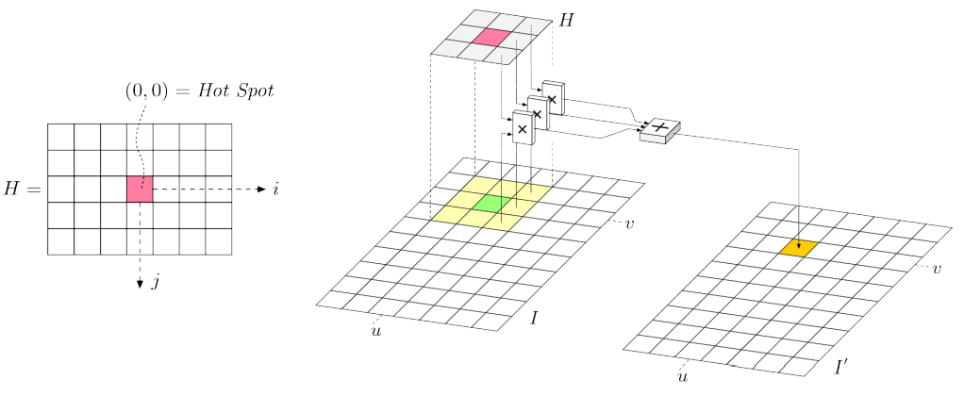
Linear Filter

Slide 18
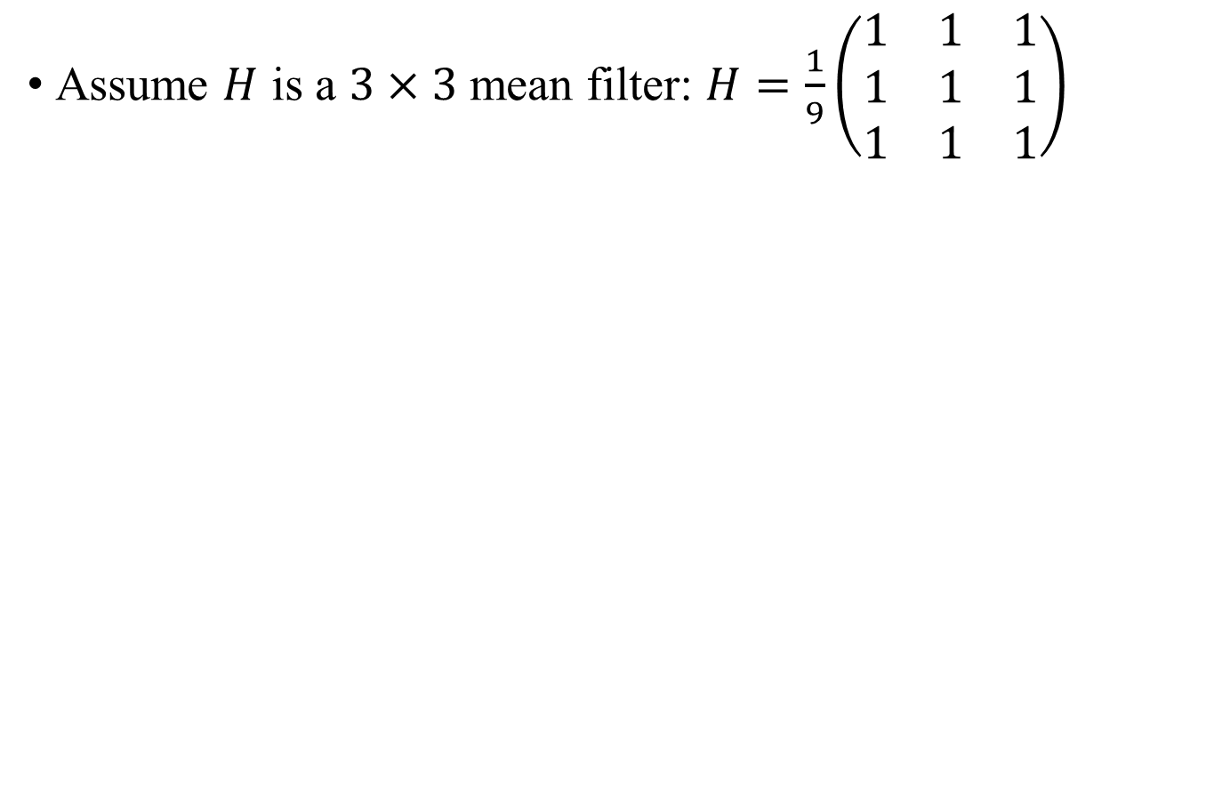
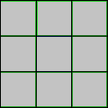
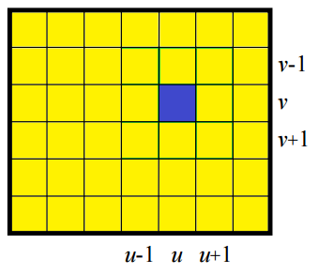
Linear Filter
I1 = im2double(imread(‘lena.jpg’));
I2 = zeros(size(I1));
for u = 1 : size(I1, 2)
for v = 1 : size(I1, 1)
value = ???;
I2(v, u) = value;
end
end

Slide 19
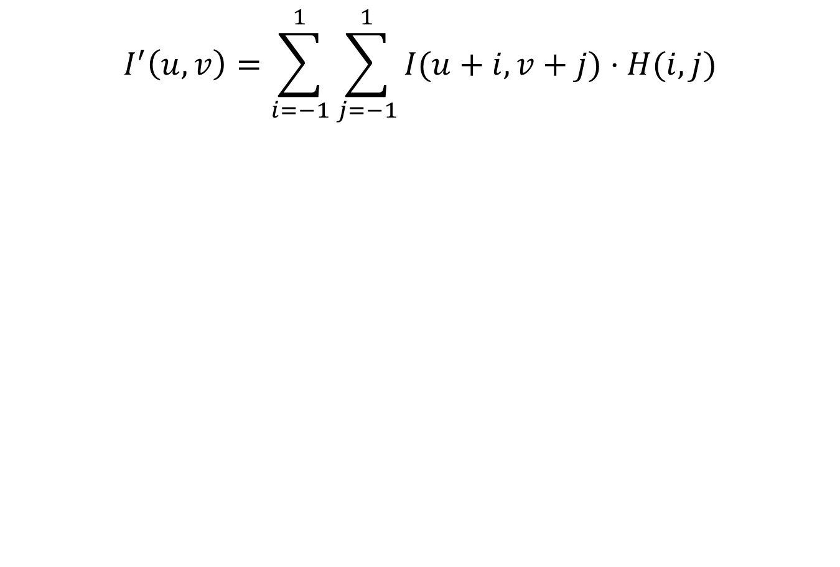
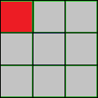

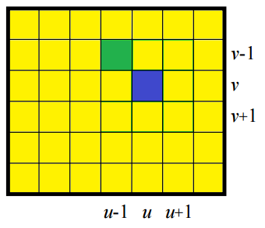
Linear Filter
I1 = im2double(imread(‘lena.jpg’));
I2 = zeros(size(I1));
for u = 1 : size(I1, 2)
for v = 1 : size(I1, 1)
value = 0;
for i = -1:1
for j = -1:1
value = value + ???
end
end
I2(v, u) = value;
end
end
Select neighborhood

Slide 20
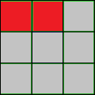

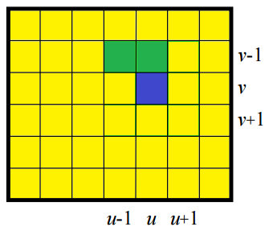
Linear Filter
I1 = im2double(imread(‘lena.jpg’));
I2 = zeros(size(I1));
for u = 1 : size(I1, 2)
for v = 1 : size(I1, 1)
value = 0;
for i = -1:1
for j = -1:1
value = value + ???
end
end
I2(v, u) = value;
end
end
Select neighborhood

Slide 21
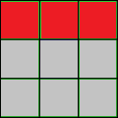
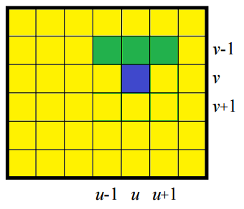
Linear Filter
I1 = im2double(imread(‘lena.jpg’));
I2 = zeros(size(I1));
for u = 1 : size(I1, 2)
for v = 1 : size(I1, 1)
value = 0;
for i = -1:1
for j = -1:1
value = value + ???
end
end
I2(v, u) = value;
end
end
Select neighborhood

Slide 22
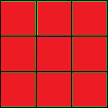
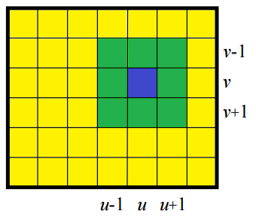
Linear Filter
I1 = im2double(imread(‘lena.jpg’));
I2 = zeros(size(I1));
for u = 1 : size(I1, 2)
for v = 1 : size(I1, 1)
value = 0;
for i = -1:1
for j = -1:1
value = value + ???
end
end
I2(v, u) = value;
end
end
Select neighborhood

Slide 23
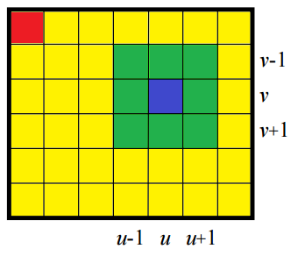
Linear Filter
Be careful around boundaries
ignore the pixels on boundaries
padding/extend boundaries [Optional]
I1 = im2double(imread(‘lena.jpg’));
I2 = zeros(size(I1));
for u = 1 : size(I1, 2)
for v = 1 : size(I1, 1)
value = 0;
for i = -1:1
for j = -1:1
value = value + ???
end
end
I2(v, u) = value;
end
end
Be careful about the index

Slide 24

Linear Filter
Note: For Loop in MATLAB is very slow!
Tips: use tic and toc to measure the elapsed time
%% Gaussian filter
hsize = 11;
sigma = 4;
tic
I = gaussian_filter_slow(img, hsize, sigma);
toc
tic
I = gaussian_filter_fast(img, hsize, sigma);
toc

Slide 25
Linear Filter
Extract patch/sub-matrix, and do matrix/vector operation.
Again, be careful about the index around image boundaries
I1 = im2double(imread(‘lena.jpg’));
I2 = zeros(size(I1));
for u = 1 : size(I1, 2)
for v = 1 : size(I1, 1)
x1 = ???; x2 = ???;
y1 = ???; y2 = ???;
patch = I1(y1:y2, x1:x2);
% convert matrix to vector
% matrix/vector operations
value = ???;
I2(v, u) = value;
end
end
Check index range

Slide 26
Linear Filter
Skip boundary pixels
How many pixels to shift?
I1 = im2double(imread(‘lena.jpg’));
I2 = zeros(size(I1));
for u = 1+shift_u : size(I1, 2)-shift_u
for v = 1+ shift_v : size(I1, 1)- shift_v
x1 = ???; x2 = ???;
y1 = ???; y2 = ???;
patch = I1(y1:y2, x1:x2);
% convert matrix to vector
% matrix/vector operations
value = ???;
I2(v, u) = value;
end
end
Shift depends on the filter size

Slide 27
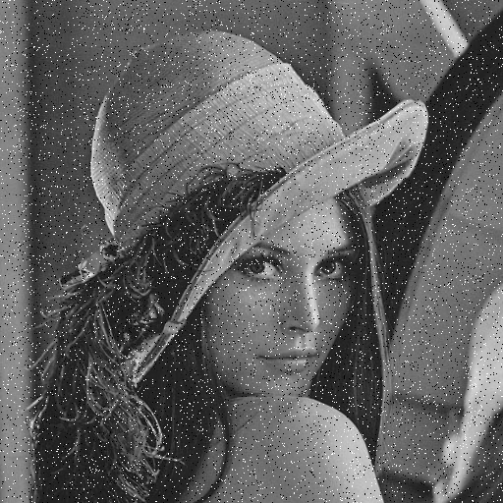

Median Filter
Extract patch with the same size as the filter
Calculate the median value of the patch (Use median())
Fill in the median value to the output pixel
Noisy input image
Median filter output

Slide 28
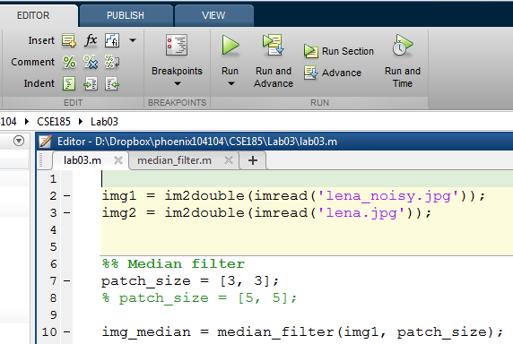
MATLAB Function
Function template:
lab02.m is your main function, run this script instead of the function
function output = median_filter(input, patch_size)
output = input;
end
Assign output value, it will be automatically returned at the end of the function
call your function

Slide 29
Median Filter
median_filter.m
In lab02.m:
Compare your result with built-in function:
I = medfilt2(img, patch_size);
function output = median_filter(img, patch_size)
% YOUR CODE HERE
end
img = im2double(imread(‘lena_noisy.jpg’));
%% Median filter
patch_size = [3, 3];
% patch_size = [5, 5];
img_median = median_filter(img, patch_size);
imwrite(img_median, ‘median.jpg’);

Slide 30
Median Filter: Hints
MATLAB function median():
But we need a single value
convert matrix to vector first
or apply function twice
Question: are the results the same?
>> A = [1, 2, 3;
4, 5, 6;
7, 8, 9];
>> median(A)
ans =
4 5 6

Slide 31
Lab Assignment 02: image warping & filter
Rotate 01.jpg by 45 degrees using forward warping, and save as rotate_0.jpg
Rotate 01.jpg by 45 degrees using backward warping, and save as rotate_1.jpg
Implement median_filter.m for lena_noisy.jpg, use patch size = 3 and save the image as median_0.jpg
Use patch size = 5, and save the image as median_1.jpg
* Save your main code as lab02.m, and function for Q3, 4 as median_filter.m
* Upload your output images, lab02.m, median_filter.m (one .zip file) to CatCourses
* Do NOT use any built-in function (e.g., imrotate)

