Slide 1
CSE185 Introduction to Computer Vision Lab 03: Spatial Filters
Instructor: Prof. Ming-Hsuan Yang
TA: Siddharth Seth & Kuan-Chih Huang & Yu-Ju Tsai

Slide 2
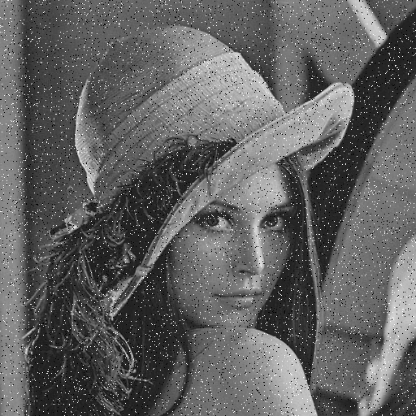

Overview
Median filter
Noisy input image
Median filter output

Slide 3

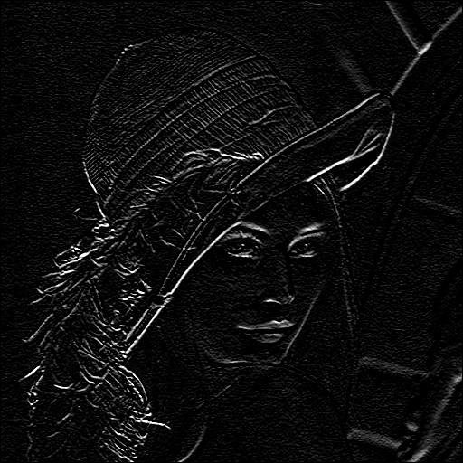
Overview
Sobel filter
Input image
Sobel filter output

Slide 4
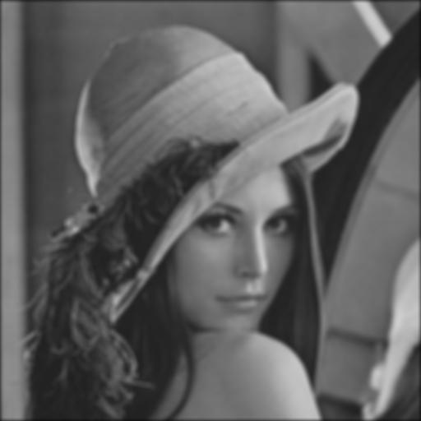
Overviews
Gaussian filter
Input image
Gaussian filter output

Slide 5
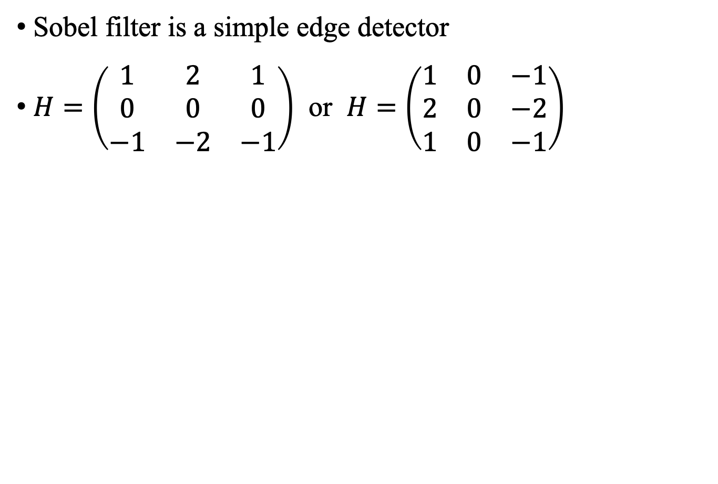
Sobel Filter
Input image
Sobel filter output

Slide 6
Sobel Filter
sobel_filter.m
In lab03.m:
Compare your result with I = imfilter(img, H);
function output = sobel_filter(img, kernel)
% YOUR CODE HERE
end
img = im2double(imread('lena.jpg'));
%% Sobel filter
H = [1, 2, 1; 0, 0, 0; -1, -2, -1]; % horizontal edge
%H = [1, 0, -1; 2, 0, -2; 1, 0, -1]; % vertical edge
img_sobel = sobel_filter(img, H);
figure, imshow(img_sobel);
imwrite(img_sobel, 'sobel_h.jpg');

Slide 7
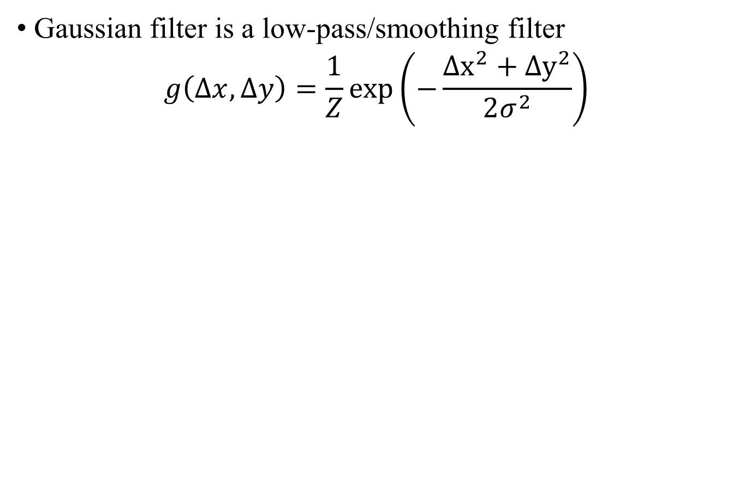

Gaussian Filter
Input image
Gaussian filter output

Slide 8
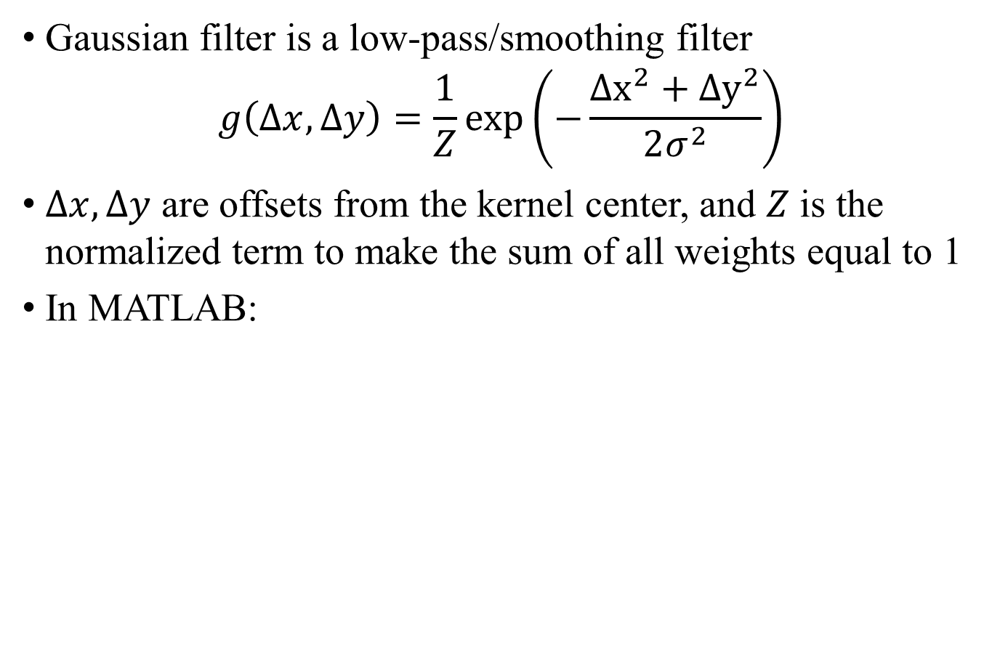
Gaussian Filter
0.0113 | 0.0149 | 0.0176 | 0.0186 | 0.0176 | 0.0149 | 0.0113
0.0149 | 0.0197 | 0.0233 | 0.0246 | 0.0233 | 0.0197 | 0.0149
0.0176 | 0.0233 | 0.0275 | 0.029 | 0.0275 | 0.0233 | 0.0176
0.0186 | 0.0246 | 0.029 | 0.0307 | 0.029 | 0.0246 | 0.0186
0.0176 | 0.0233 | 0.0275 | 0.029 | 0.0275 | 0.0233 | 0.0176
0.0149 | 0.0197 | 0.0233 | 0.0246 | 0.0233 | 0.0197 | 0.0149
0.0113 | 0.0149 | 0.0176 | 0.0186 | 0.0176 | 0.0149 | 0.0113

Slide 9
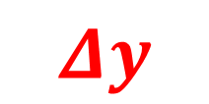
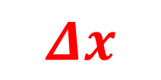
Gaussian Filter
0.0113 | 0.0149 | 0.0176 | 0.0186 | 0.0176 | 0.0149 | 0.0113
0.0149 | 0.0197 | 0.0233 | 0.0246 | 0.0233 | 0.0197 | 0.0149
0.0176 | 0.0233 | 0.0275 | 0.029 | 0.0275 | 0.0233 | 0.0176
0.0186 | 0.0246 | 0.029 | 0.0307 | 0.029 | 0.0246 | 0.0186
0.0176 | 0.0233 | 0.0275 | 0.029 | 0.0275 | 0.0233 | 0.0176
0.0149 | 0.0197 | 0.0233 | 0.0246 | 0.0233 | 0.0197 | 0.0149
0.0113 | 0.0149 | 0.0176 | 0.0186 | 0.0176 | 0.0149 | 0.0113

Slide 10
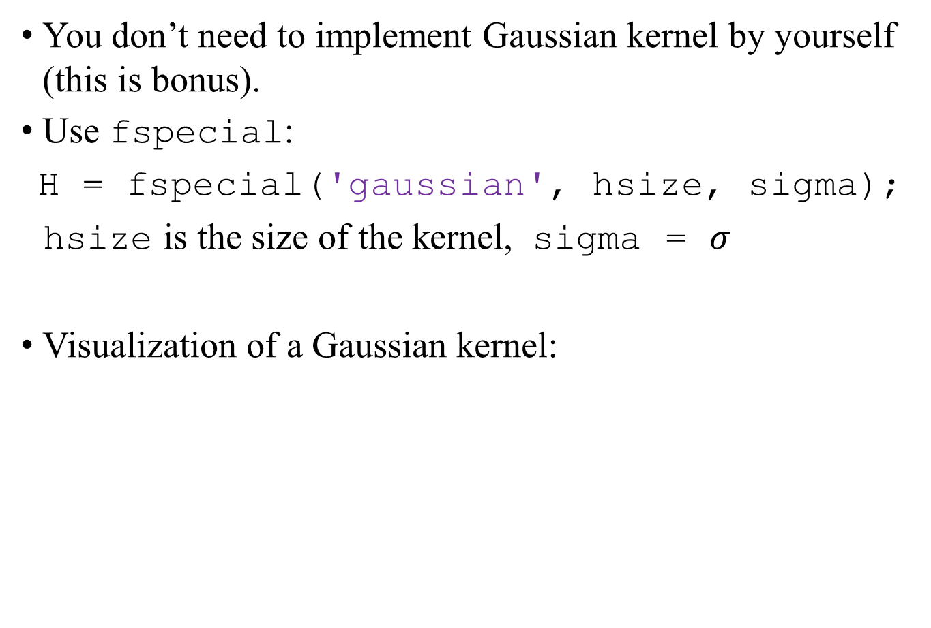

Gaussian Filter

Slide 11
Gaussian Filter
gaussian_filter.m
In lab03.m:
Compare your result with I = imfilter(img, H);
function output = gaussian_filter(img, hsize, sigma)
H = fspecial('gaussian', hsize, sigma);
% YOUR CODE HERE
end
%% Gaussian filter
hsize = 5; sigma = 2;
% hsize = 9; sigma = 4;
img_gaussian = gaussian_filter(img, hsize, sigma);
figure, imshow(img_gaussian);
imwrite(img_gaussian, 'gaussian_5.jpg');

Slide 12
Lab assignment 03
Implement sobel_filter.m, use horizontal filter and save the image as sobel_h.jpg
Use vertical filter and save the image as sobel_v.jpg
Implement gaussian_filter.m, use hsize = 5, sigma = 2, and save the image as gaussian_5.jpg
Use hsize = 9, sigma = 4, and save the image as gaussian_9.jpg
Upload your output images and lab03.m, sobel_filter.m, and gaussian_filter.m
* Use ‘lena.jpg’ as the input image for all questions.

Slide 13
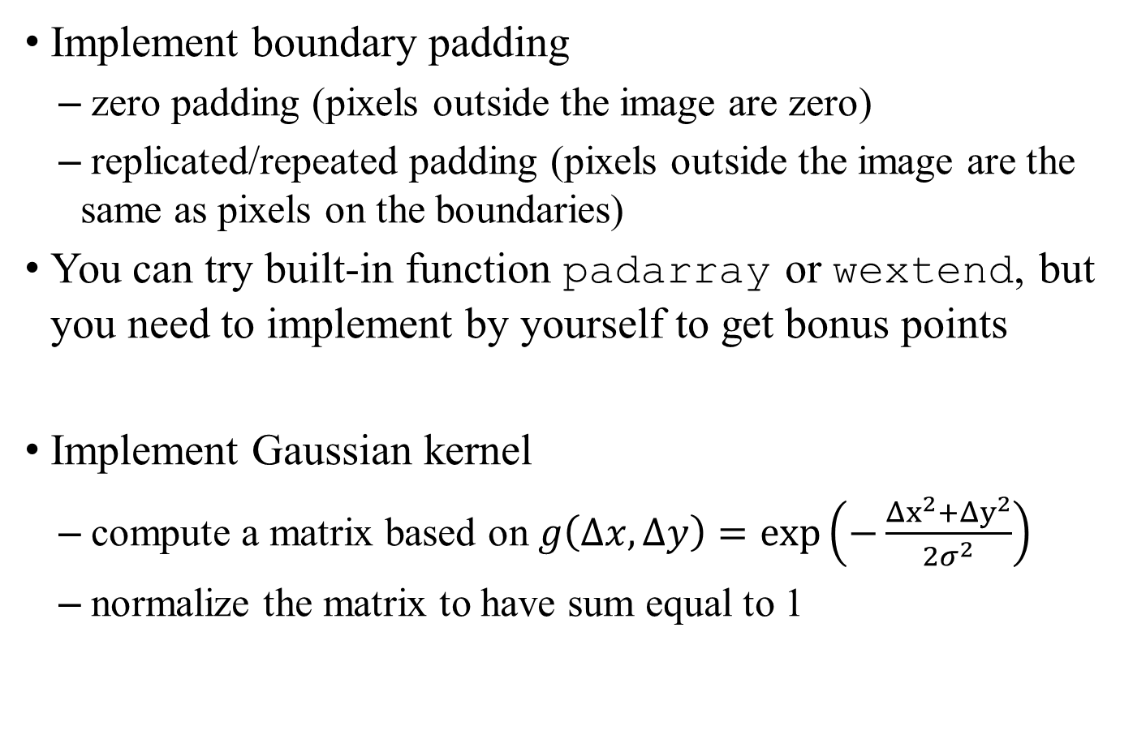
Bonus

Slide 14
Reference
Spatial Filtering
Linear Algebra and MATLAB Tutorial
Awesome Computer Vision

