Slide 1
CSE185 Introduction to Computer Vision Lab 06: Edge Detection and Face Recognition
Instructor: Prof. Ming-Hsuan Yang
TA: Siddharth Seth & Kuan-Chih Huang & Yu-Ju Tsai

Slide 2
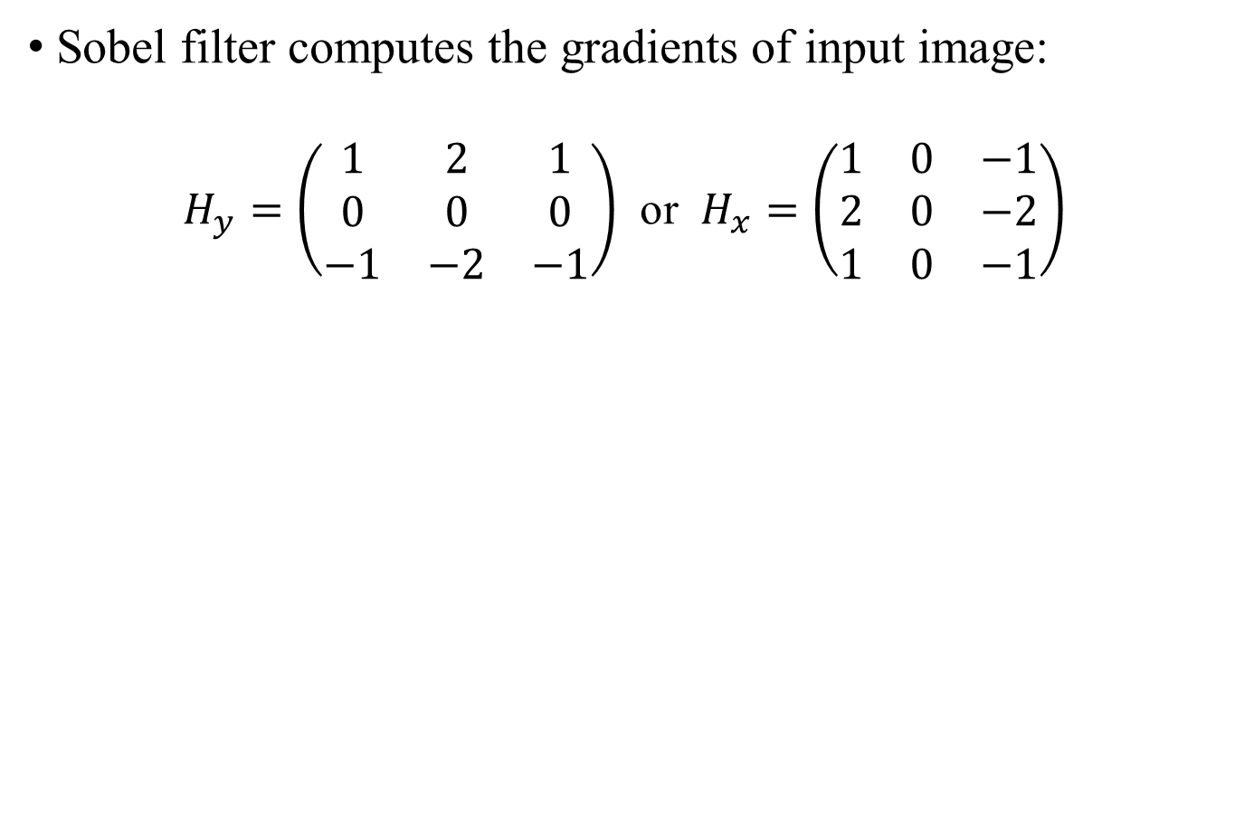
Sobel Filtering

Slide 3
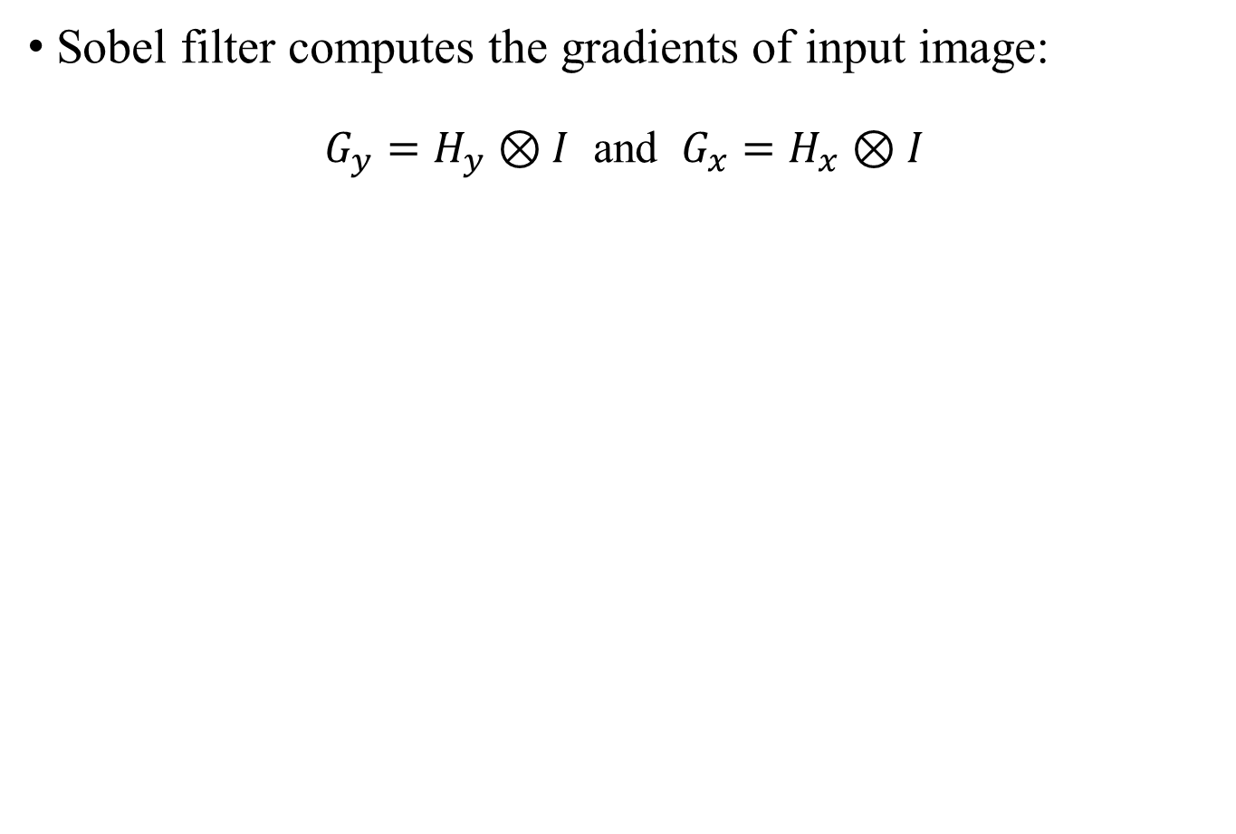
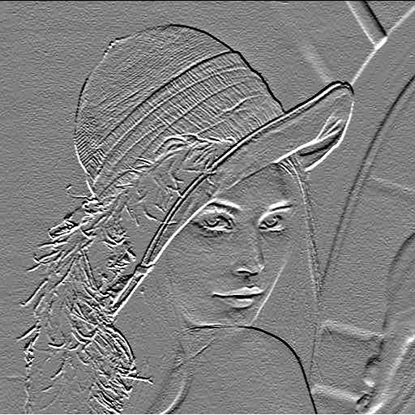
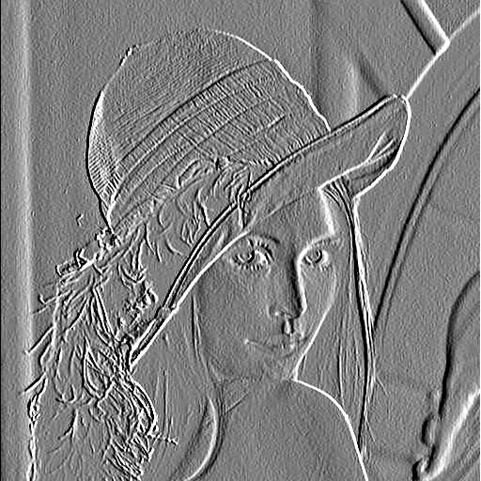
Sobel Filtering
convolution, or spatial filtering
Horizontal Edge Response
Vertical Edge Response

Slide 4
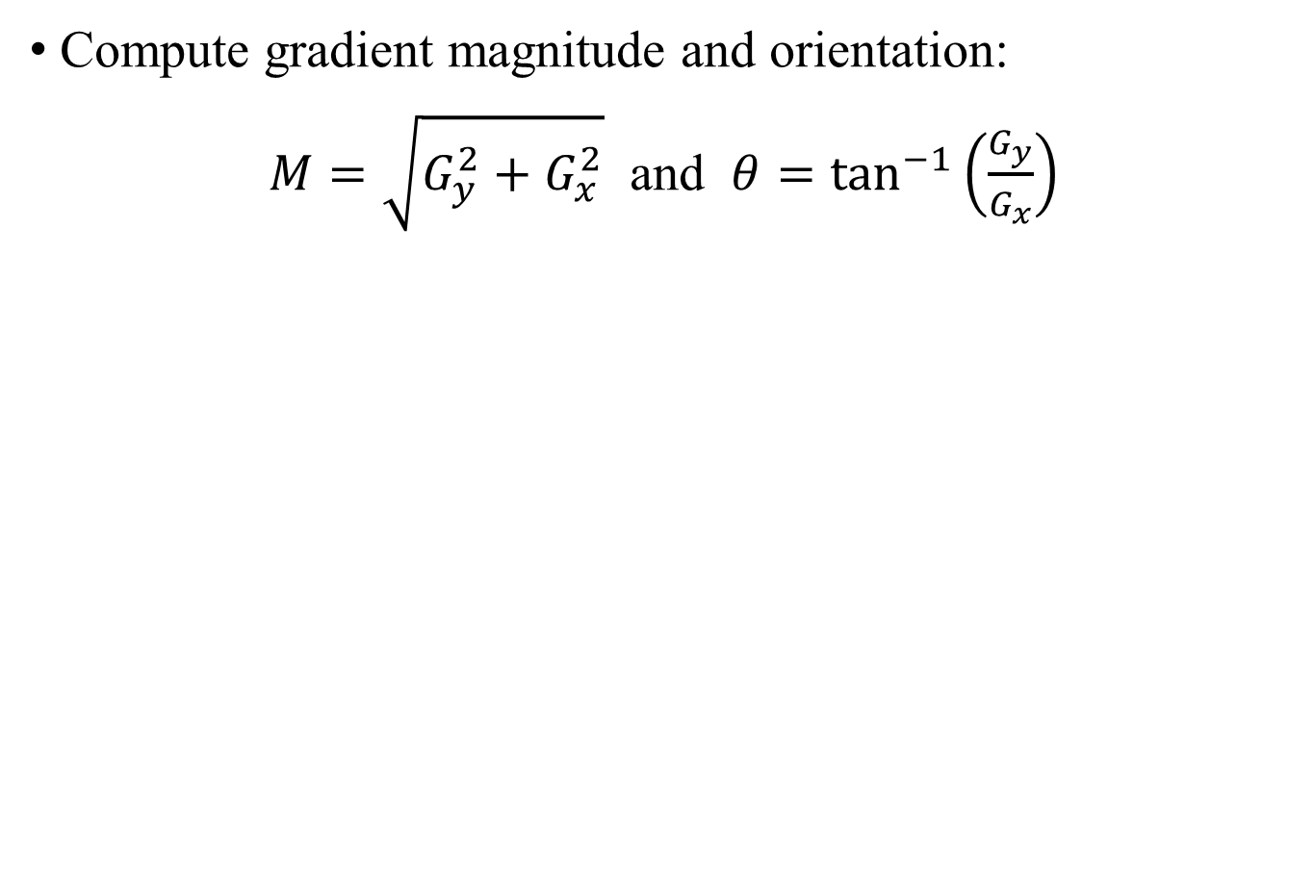
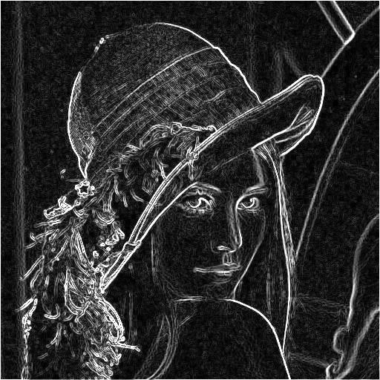
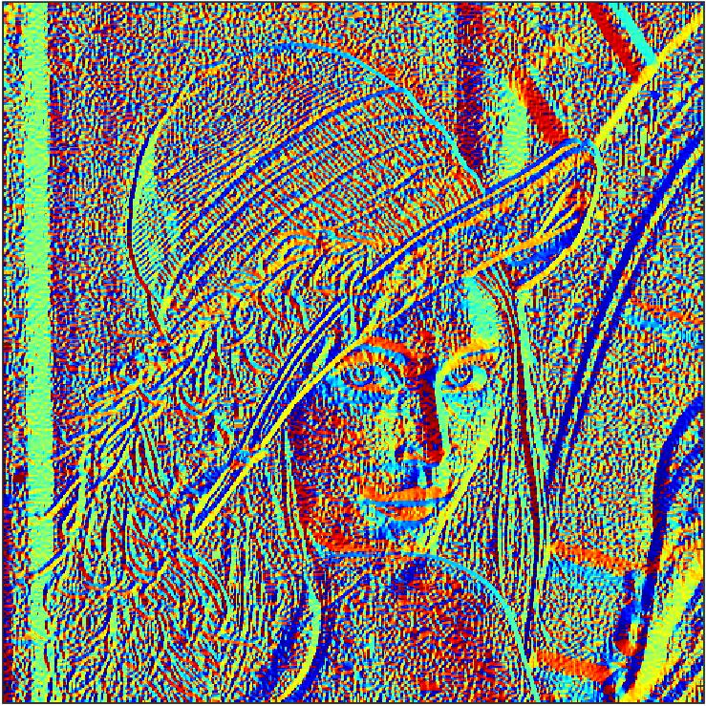
Sobel Filtering
use atan2(y, x) in MATLAB
Magnitude
Orientation

Slide 5
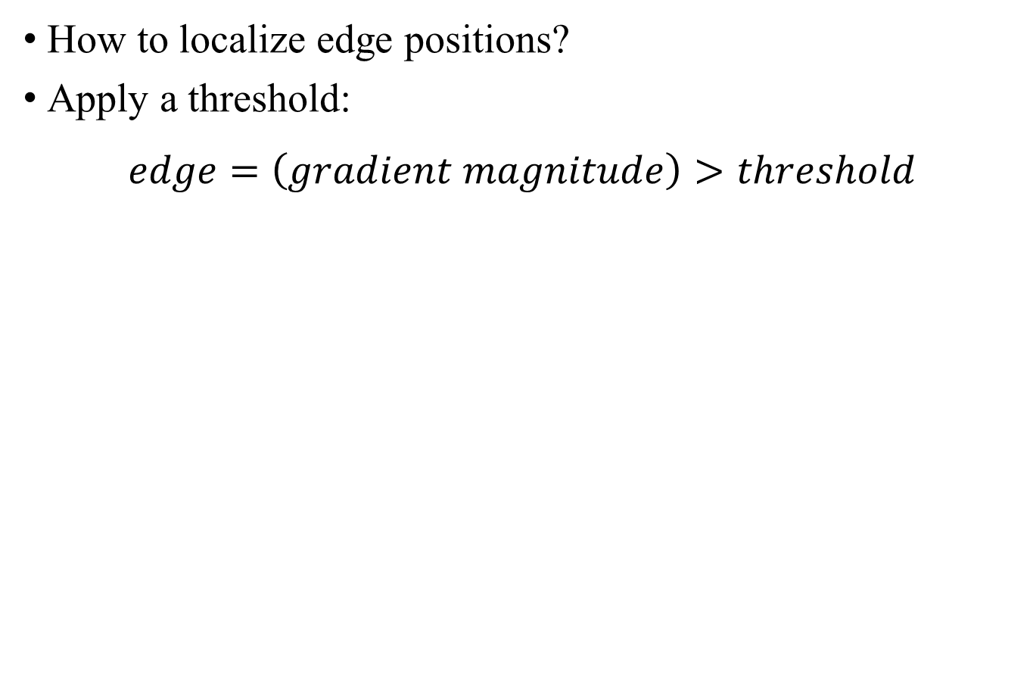
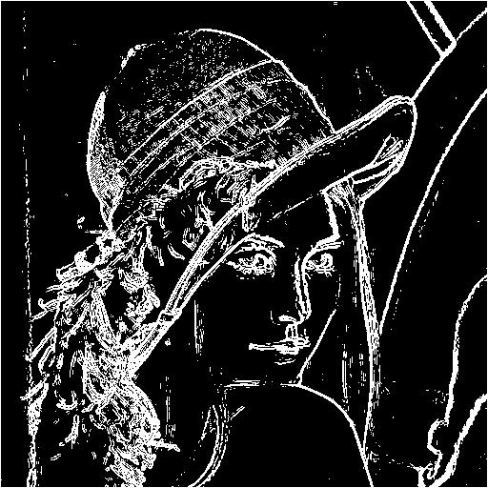
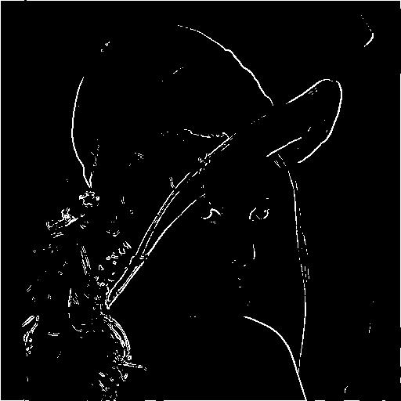
Edge Detection
threshold = 0.3
threshold = 1

Slide 6
sobel_feature.m
In sobel_feature.m:
function [magnitude, orientation] = sobel_feature(img)
% horizontal edge
Hy = [1, 2, 1; 0, 0, 0; -1, -2, -1];
% vertical edge
Hx = [1, 0, -1; 2, 0, -2; 1, 0, -1];
%% Sobel filtering
%% compute gradient magnitude and orientation
magnitude = img;
orientation = img;
end
use imfilter or your sobel_filter.m from lab03

Slide 7
lab06_edge.m
In lab06_edge.m:
img = im2double(imread('lena.jpg'));
%% compute gradient magnitude and orientation with Sobel filter
[magnitude, orientation] = sobel_feature(img);
%% apply thresholding to detect edge
threshold = 0.3;
e = magnitude > threshold;

Slide 8
From Sobel Filter to Canny Edge Detection
How to remove noise and detect accurate edges?
Canny edge detection:
Apply Gaussian filter to input image in order to remove noise
Compute image gradient
Apply non-maximum suppression to detect local maxima
Apply double thresholding to detect weak and strong edges
Apply hysteresis thresholding to localize connected edges

Slide 9
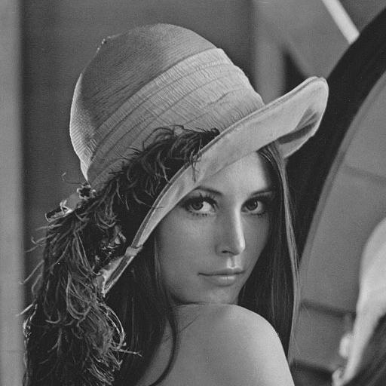
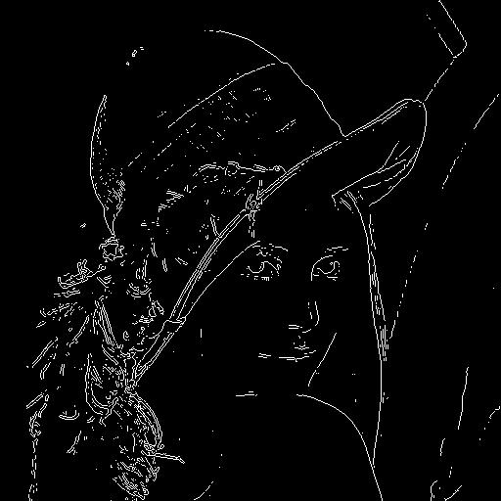
Sobel Edge Detector
In MATLAB, use edge(img, ‘Sobel’)
Input Image
Sobel Edge Detection

Slide 10
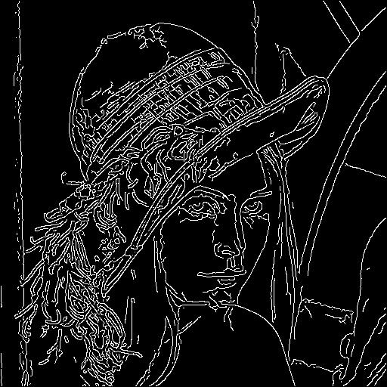
Canny Edge Detector
In MATLAB, use edge(img, ‘Canny’)
Input Image
Canny Edge Detection

Slide 11
lab06_edge.m
In lab06_edge.m:
%% use built-in function to detect edge
e1 = img; % change img to sobel edge detection
e2 = img; % change img to canny edge detection
figure, imshow(img);
figure, imshow(e1); title('Sobel Edge');
figure, imshow(e2); title('Canny Edge');

Slide 12
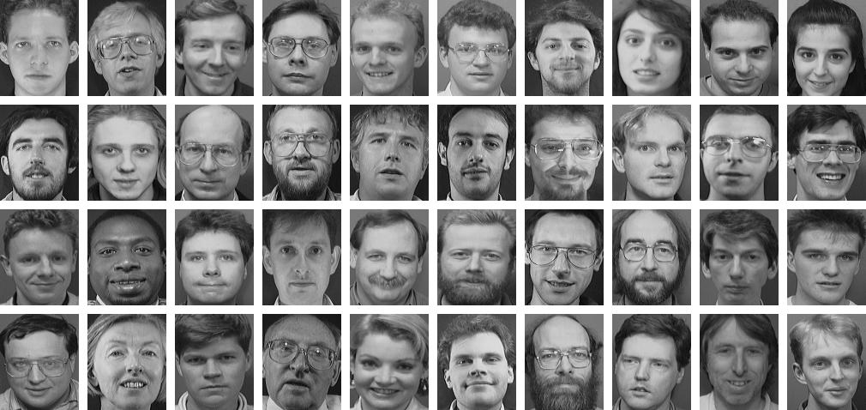
AT&T Face Dataset
There are 40 training images and 160 testing images from 40 different identities/people (labeled as 1 to 40).
AT&T Face dataset: http://www.cl.cam.ac.uk/research/dtg/attarchive/facedatabase.html

Slide 13
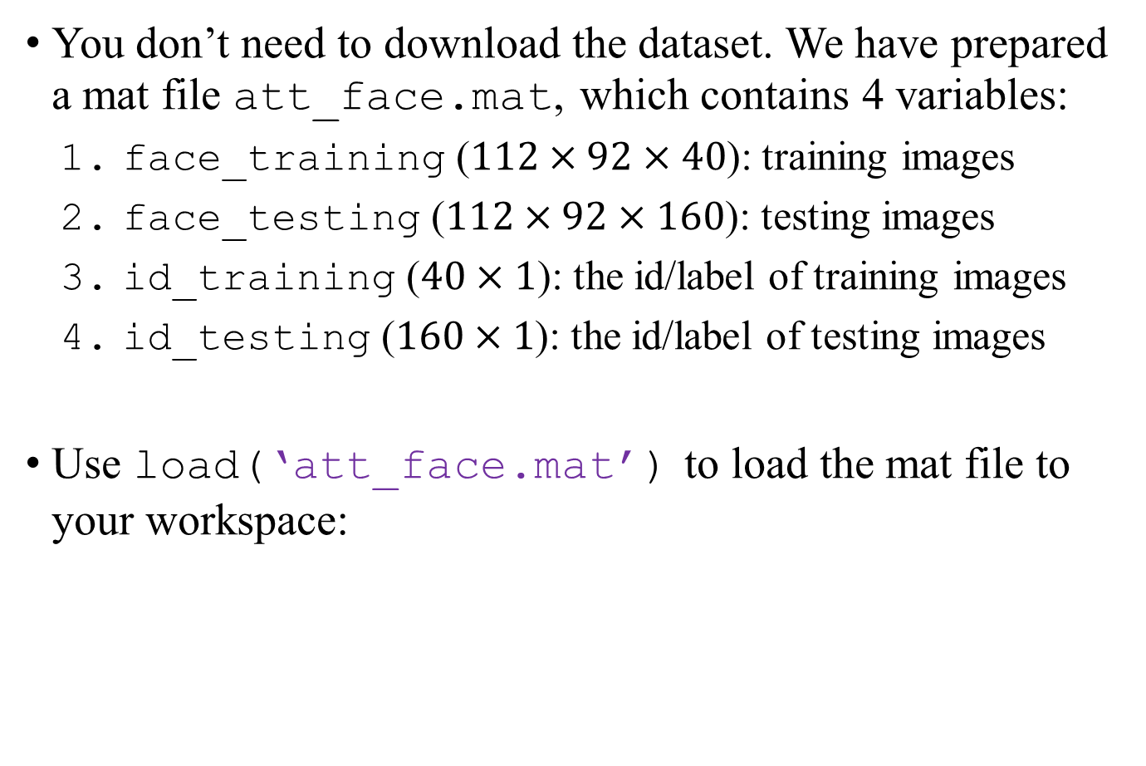

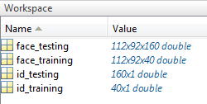
AT&T Face Dataset

Slide 14
Face Recognition
Our goal: predict the id/labels for 160 testing images
Steps:
For each testing image, compute the 40 square errors from the training images
Find the index with the minimum square error
Calculate the accuracy between your predict labels and the ground truth labels (id_testing)

Slide 15
lab06_face.m
In lab06_face.m:
for i = 1:num_testing
%% extract testing image
img_test = face_testing(:, :, i);
vec_test = img_test(:);
error = zeros(num_training, 1);
for j = 1:num_training
%% extract training image
img_train = face_training(:, :, j);
vec_train = img_train(:);
%% compute the square error between feature vectors
diff = vec_train - vec_test;
error(j) = sum( diff .^2 );
end
%% find the image id with minimal error
[~, min_id] = min(error);
id_predict(i) = min_id;
end
use image intensity as feature vector
use image intensity as feature vector
element wise operation

Slide 16
lab06_face.m
Compute accuracy:
Accuracy = 0.7375 if using intensity as feature vectors
Your job: change feature vectors to multi-scale Sobel features (magnitude or orientation)
%% compute accuracy
accuracy = sum(id_testing == id_predict)/num_testing;
fprintf('Accuracy = %f\n', accuracy);

Slide 17
multiscale_sobel_feature.m
In multiscale_sobel_feature.m:
function feature = multiscale_sobel_feature(img, scale)
% initialize feature vector
feature = [];
for i = 1:scale
% compute sobel feature
f = ???;
% concatenate feature vector
feature = cat(1, feature, f(:));
% down-sample image by 2
end
end
use your sobel_feature.m

Slide 18
lab06_face.m
In lab06_face.m:
for i = 1:num_testing
%% extract testing image
img_test = face_testing(:, :, i);
vec_test = multiscale_sobel_feature(img_test, scale);
error = zeros(num_training, 1);
for j = 1:num_training
%% extract training image
img_train = face_training(:, :, j);
vec_train = multiscale_sobel_feature(img_train, scale);
%% compute the square error between feature vectors
diff = vec_train - vec_test;
error(j) = sum( diff .^2 );
end
%% find the image id with minimal error
[~, min_id] = min(error);
id_predict(i) = min_id;
end

Slide 19
lab06_face.m
In lab06_face.m:
% Using gradient magnitude as features:
%---------------------------------------%
% Scale | Accuracy
%---------------------------------------%
% 1 | 0.5313
%---------------------------------------%
% 2 |
%---------------------------------------%
% 3 |
%---------------------------------------%
%
% Using gradient orientation as features:
%---------------------------------------%
% Scale | Accuracy
%---------------------------------------%
% 1 | 0.5563
%---------------------------------------%
% 2 |
%---------------------------------------%
% 3 |
%---------------------------------------%

Slide 20
Assignment
Implement sobel_feature.m to compute gradient magnitude and orientation from Sobel filtering (save the output images as lena_sobel_magnitude.jpg, lena_sobel_orientation.jpg and lena_edge_threshold_i.jpg for edge detection thresholding at i)
Use edge() to apply Sobel and Canny Edge detection in lab06_edge.m (save the output images as lena_sobel.jpg and lena_canny.jpg)
Run lab06_face.m and understand the code
Implement multiscale_sobel_feature.m, and replace image feature vectors
Fill in the form in the bottom of lab06_face.m
Upload all output images and your sobel_feature.m, multiscale_sobel_feature.m, lab06_edge.m, lab06_face.m separately.

