Slide 1
CSE185 Introduction to Computer Vision Lab 07: Harris Corner Detection
Instructor: Prof. Ming-Hsuan Yang
TA: Siddharth Seth & Kuan-Chih Huang & Yu-Ju Tsai

Slide 2
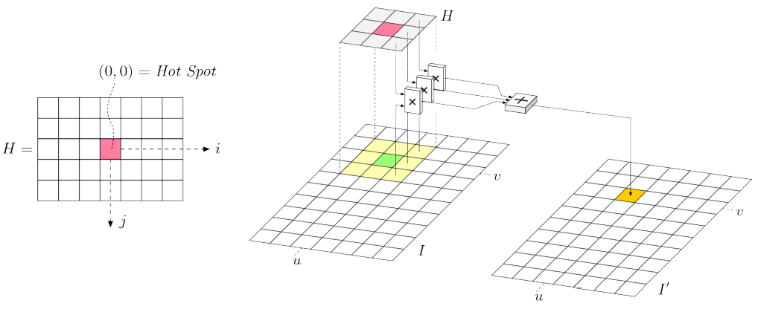

Spatial Filtering
Filtering: sliding inner product
$$I^{′}\left(u, v\right)=\sum_{i=−1}^{1}{\sum_{j=−1}^{1}{I(u+i, v+j)}}⋅H(i, j)$$

Slide 3
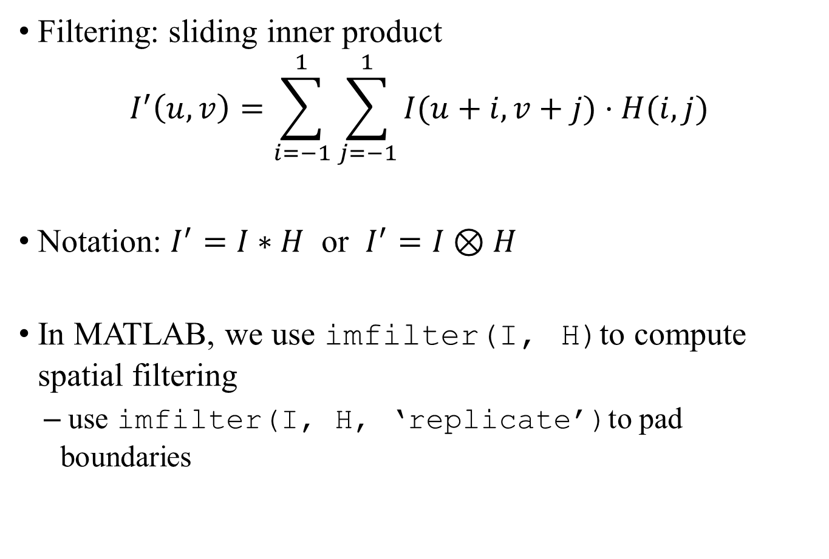
Spatial Filtering
Filtering: sliding inner product
$$I^{′}\left(u, v\right)=\sum_{i=−1}^{1}{\sum_{j=−1}^{1}{I(u+i, v+j)}}⋅H(i, j)$$
Notation: $I^{′}=I∗H$ or $I^{′}=I⊗H$
In MATLAB, we use imfilter(I, H)to compute spatial filtering
use imfilter(I, H, ‘replicate’)to pad boundaries

Slide 4
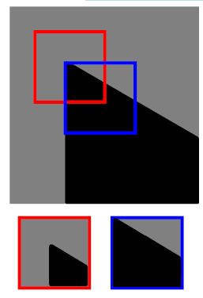
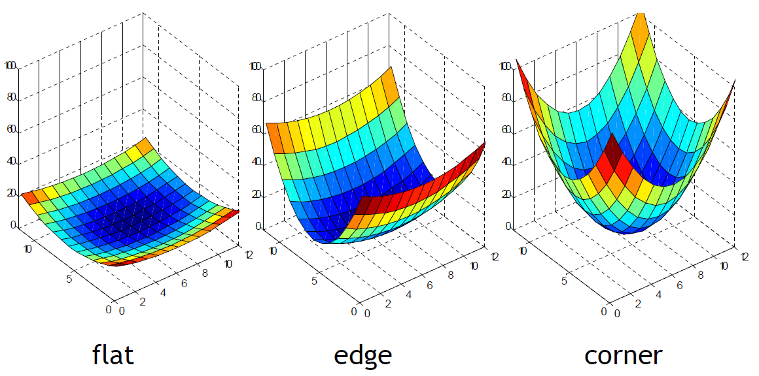
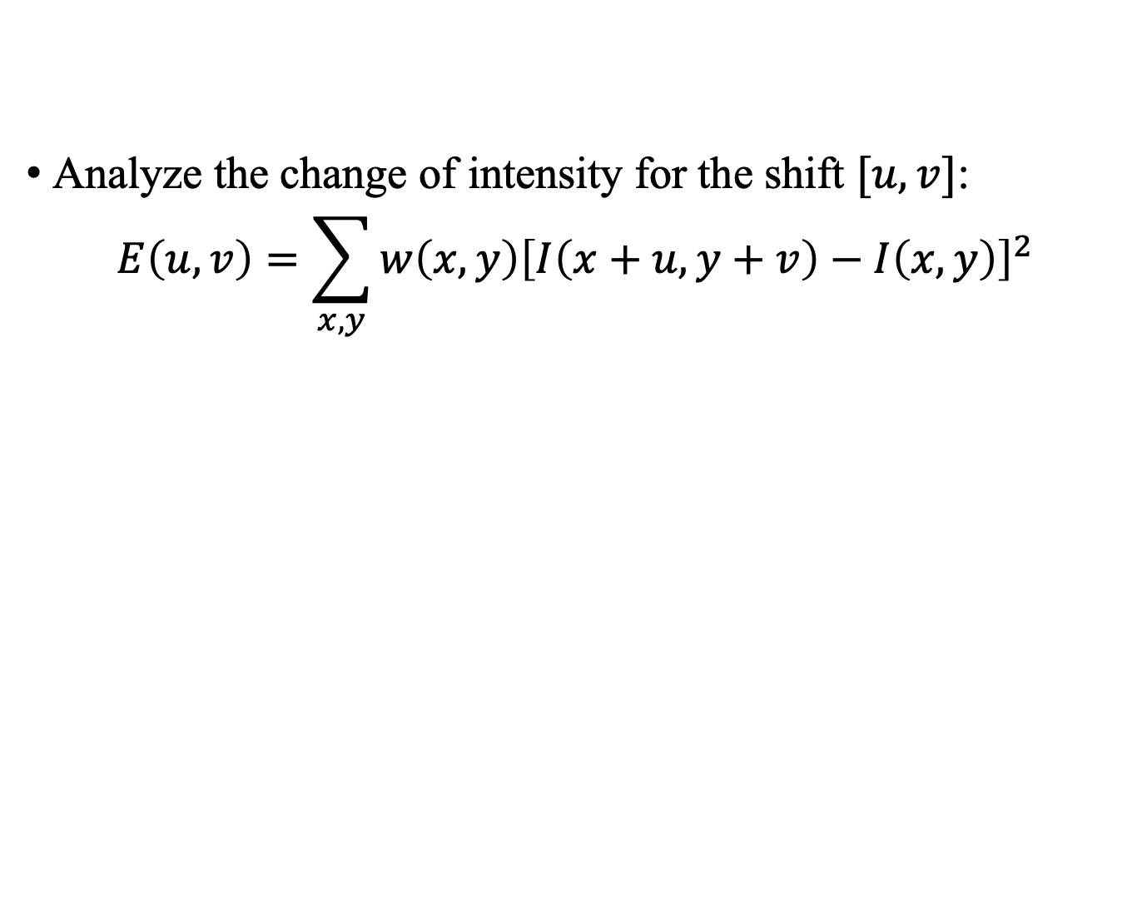
Harris Corner Detection
Analyze the change of intensity for the shift $[u, v]$:
$$E\left(u, v\right)=\sum_{x,y}{w\left(x,y\right){\left[I\left(x+u,y+v\right)−I\left(x,y\right)\right]}^{2}}$$

Slide 5
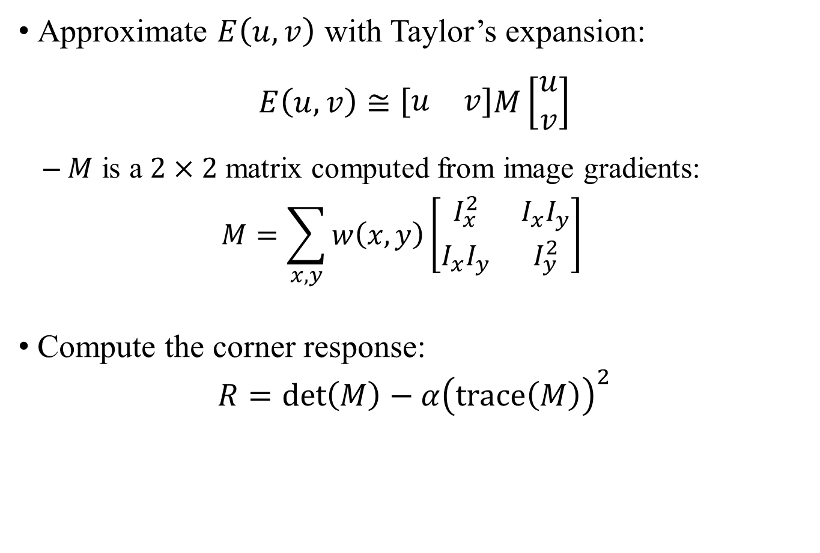
Harris Corner Detection
Approximate $E\left(u, v\right)$ with Taylor’s expansion:
$$E\left(u, v\right)≅\left[\begin{matrix}u & v\end{matrix}\right]M\left[\begin{matrix}u \\ v\end{matrix}\right]$$
$M$ is a $2×2$ matrix computed from image gradients:
$$M=\sum_{x,y}{w\left(x,y\right)\left[\begin{matrix}I_{x}^{2} & I_{x}I_{y} \\ I_{x}I_{y} & I_{y}^{2}\end{matrix}\right]}$$
Compute the corner response:
$$R=\det\left(M\right)−α{\left(trace\left(M\right)\right)}^{2}$$
determinant

Slide 6
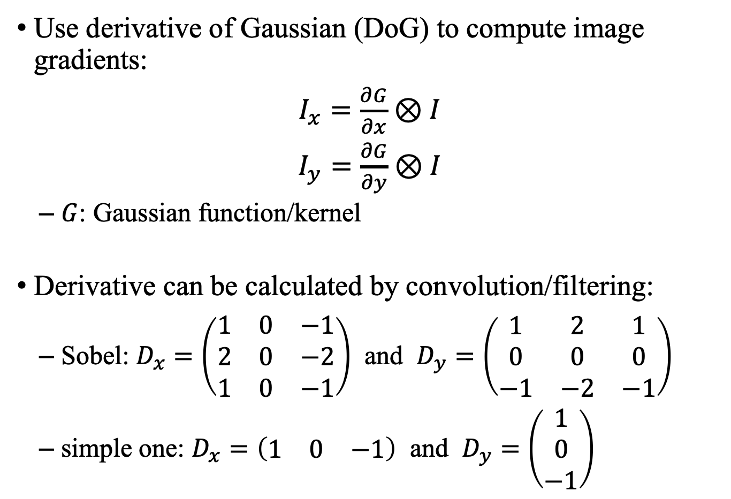
Step 1: Image Gradients
Use derivative of Gaussian (DoG) to compute image gradients:
$I_{x}=\frac{∂G}{∂x}⊗I$
$I_{y}=\frac{∂G}{∂y}⊗I$
$G$: Gaussian function/kernel
Derivative can be calculated by convolution/filtering:
Sobel: $D_{x}=\left(\begin{matrix}1 & 0 & −1 \\ 2 & 0 & −2 \\ 1 & 0 & −1\end{matrix}\right)$ and $D_{y}=\left(\begin{matrix}1 & 2 & 1 \\ 0 & 0 & 0 \\ −1 & −2 & −1\end{matrix}\right)$
simple one: $D_{x}=\left(\begin{matrix}1 & 0 & −1\end{matrix}\right)$ and $D_{y}=\left(\begin{matrix}1 \\ 0 \\ −1\end{matrix}\right)$

Slide 7
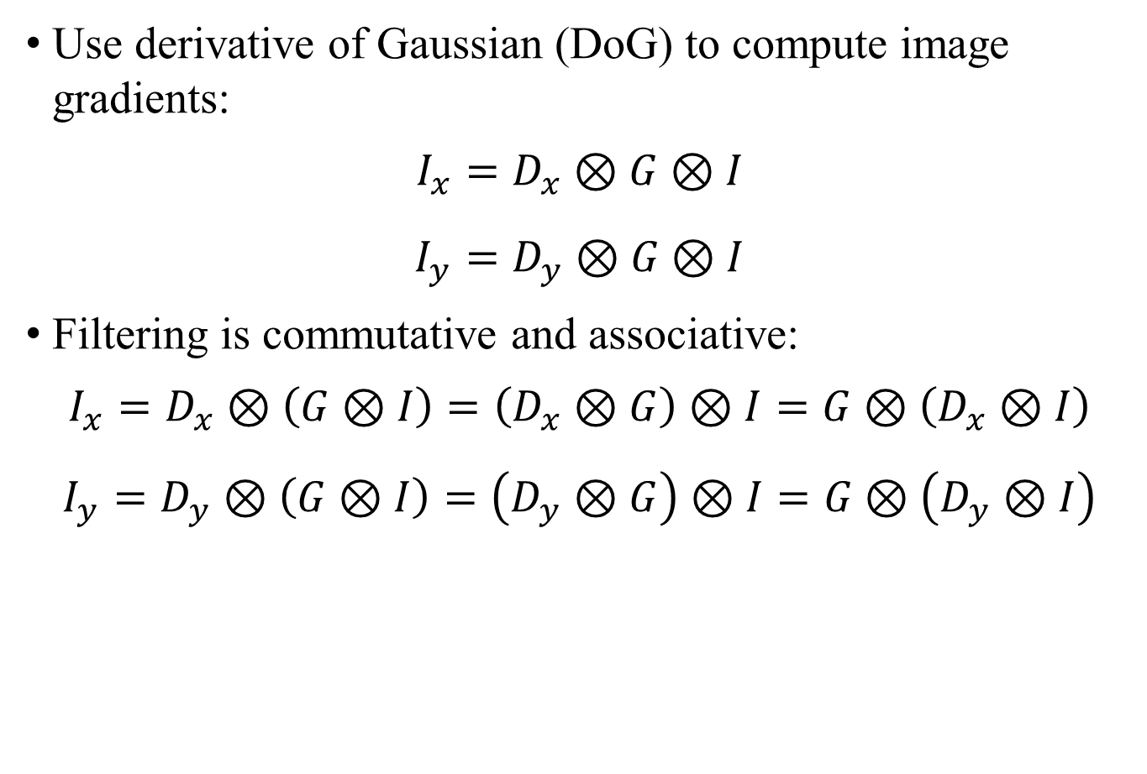
Step 1: Image Gradients
Use derivative of Gaussian (DoG) to compute image gradients:
$$I_{x}=D_{x}⊗G⊗I$$
$$I_{y}=D_{y}⊗G⊗I$$
Filtering is commutative and associative:
$$I_{x}=D_{x}⊗\left(G⊗I\right)=\left(D_{x}⊗G\right)⊗I=G⊗\left(D_{x}⊗I\right)$$
$$I_{y}=D_{y}⊗\left(G⊗I\right)=\left(D_{y}⊗G\right)⊗I=G⊗\left(D_{y}⊗I\right)$$

Slide 8
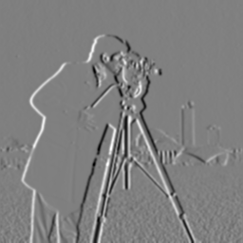
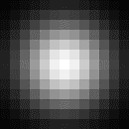
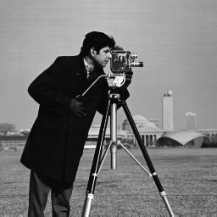
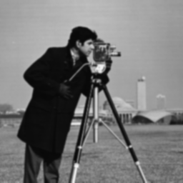
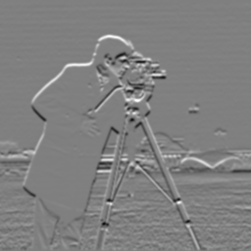







Step 1: Image Gradients
Method 1: Apply Gaussian filtering to image, and then compute image gradients
$I_{x}=D_{x}⊗\left(G⊗I\right)$ and $I_{y}=D_{y}⊗\left(G⊗I\right)$
$$D_{x}$$
$$I_{x}$$
$$D_{y}$$
$$I$$
$$G⊗I$$
$$I_{y}$$

Slide 9
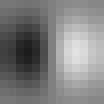





Step 1: Image Gradients
Method 2: Compute the derivative of Gaussian, and then apply filtering to image
$I_{x}=\left(D_{x}⊗G\right)⊗I$ and $I_{y}=\left(D_{y}⊗G\right)⊗I$
$$D_{x}$$
$$I_{x}$$
$$I$$
$$D_{y}$$
$$I_{y}$$

Slide 10
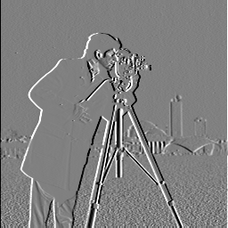
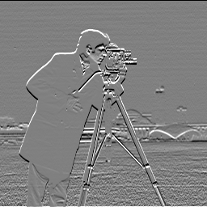






Step 1: Image Gradients
Method 3: Compute the gradient of image, and then apply Gaussian filtering
$I_{x}=G⊗\left(D_{x}⊗I\right)$ and $I_{y}=G⊗\left(D_{y}⊗I\right)$
$$D_{x}$$
$$D_{x}⊗I$$
$$I_{x}$$
$$D_{y}$$
$$I$$
$$D_{y}⊗I$$
$$I_{y}$$

Slide 11

Step 2: Products of Gradients
Compute products of gradients at every pixel
$$I_{xx}=I_{x}⋅I_{x}$$
$$I_{yy}=I_{y}⋅I_{y}$$
$$I_{xy}=I_{x}⋅I_{y}$$
Use element-wise multiplication

Slide 12
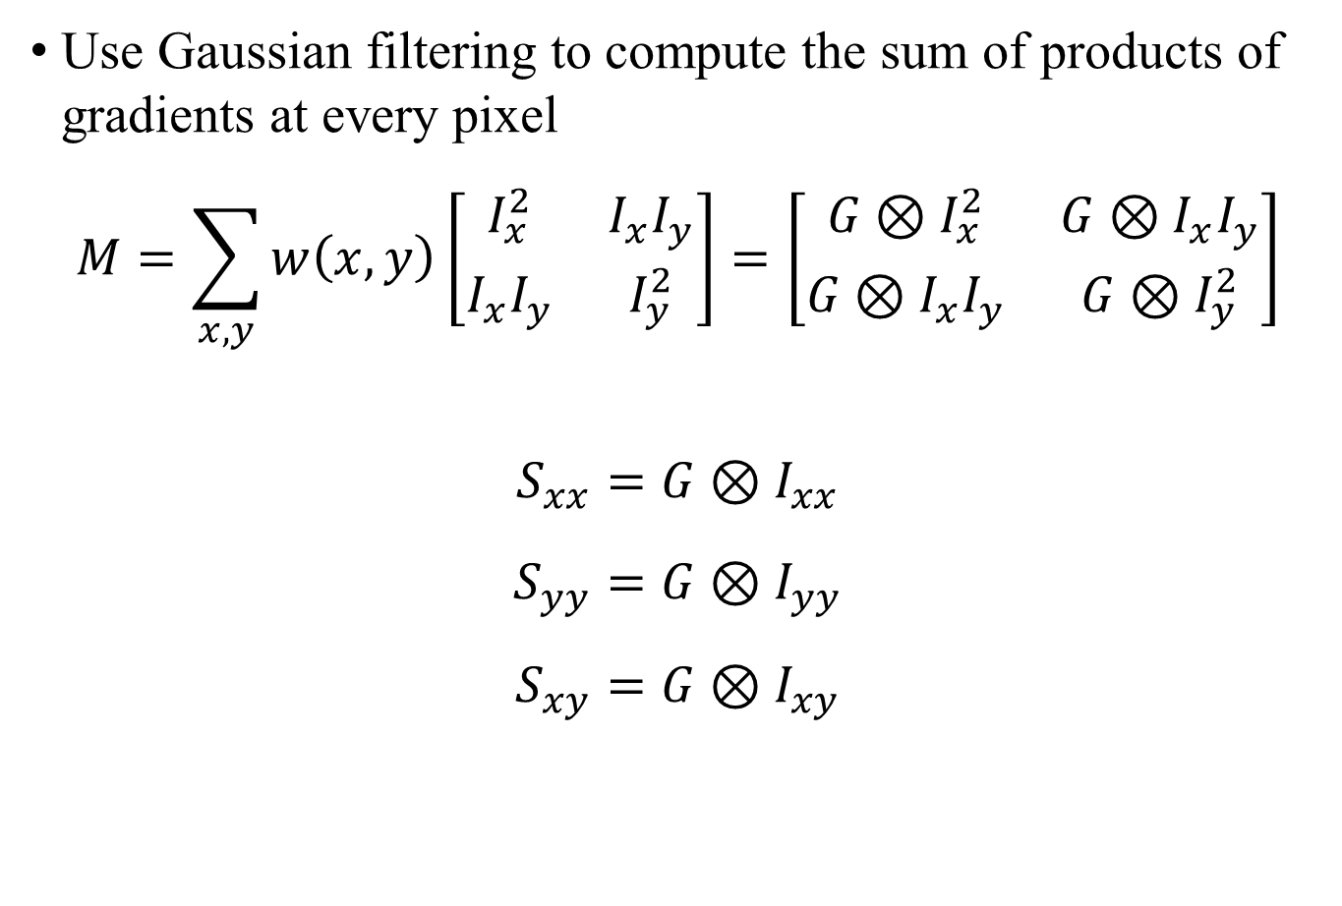
Step 3: Matrix M
Use Gaussian filtering to compute the sum of products of gradients at every pixel
$$M=\sum_{x,y}{w\left(x,y\right)\left[\begin{matrix}I_{x}^{2} & I_{x}I_{y} \\ I_{x}I_{y} & I_{y}^{2}\end{matrix}\right]}=\left[\begin{matrix}G⊗I_{x}^{2} & G⊗I_{x}I_{y} \\ G⊗I_{x}I_{y} & G⊗I_{y}^{2}\end{matrix}\right]$$
$$S_{xx}=G⊗I_{xx}$$
$$S_{yy}=G⊗I_{yy}$$
$$S_{xy}=G⊗I_{xy}$$

Slide 13
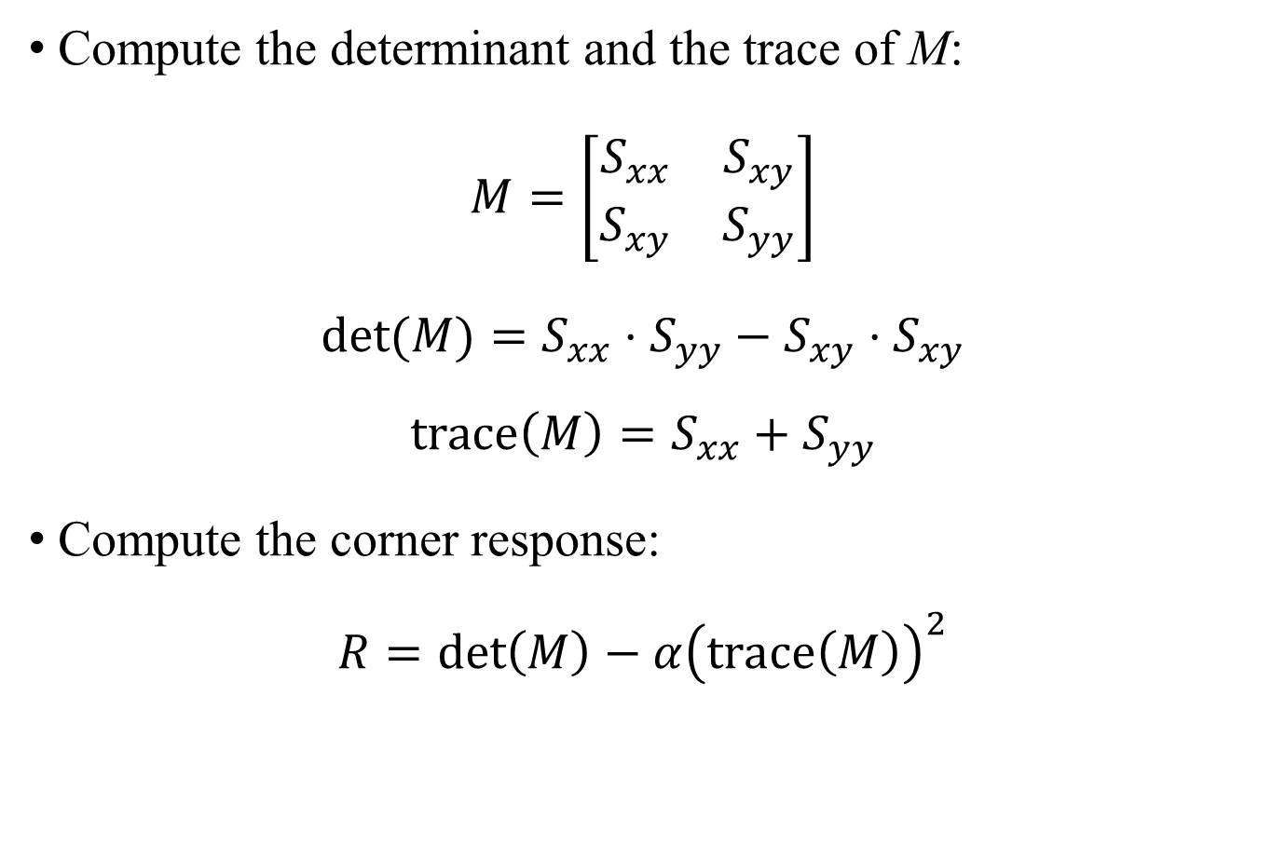
Step 4: Corner Response
Compute the determinant and the trace of M:
$$M=\left[\begin{matrix}S_{xx} & S_{xy} \\ S_{xy} & S_{yy}\end{matrix}\right]$$
$$\det{(M)}=S_{xx}⋅S_{yy}−S_{xy}⋅S_{xy}$$
$$trace\left(M\right)=S_{xx}+S_{yy}$$
Compute the corner response:
$$R=\det\left(M\right)−α{\left(trace\left(M\right)\right)}^{2}$$
element-wise
.*
element-wise
.^2

Slide 14
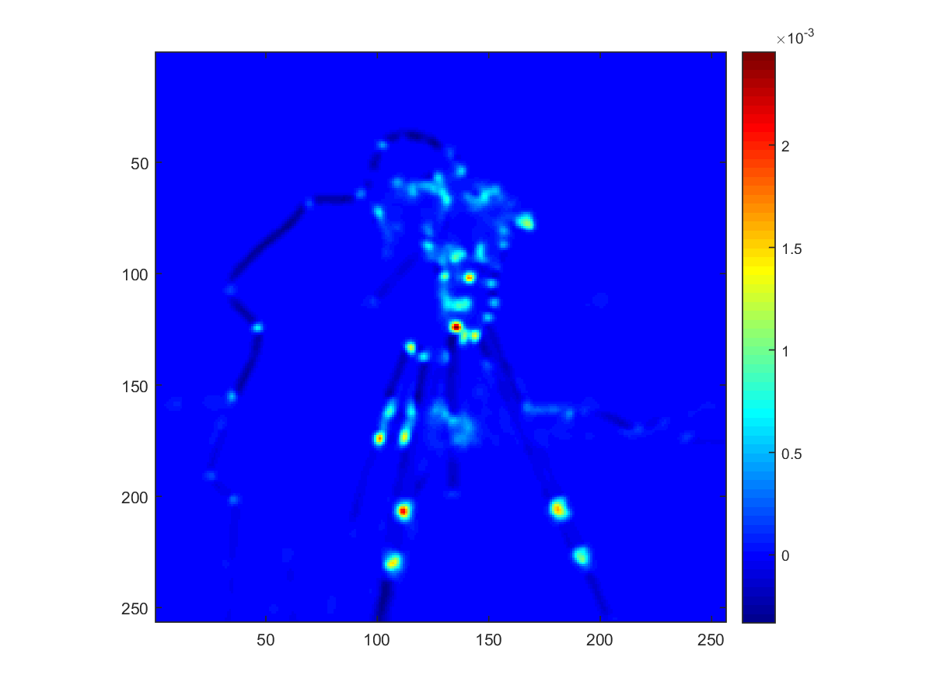
Step 4: Corner Response

Slide 15
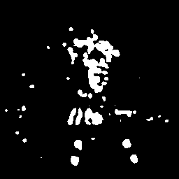

Step 4: Corner Response
Apply thresholding on R: $R>R_{threshold}$

Slide 16
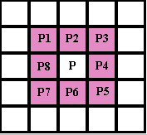
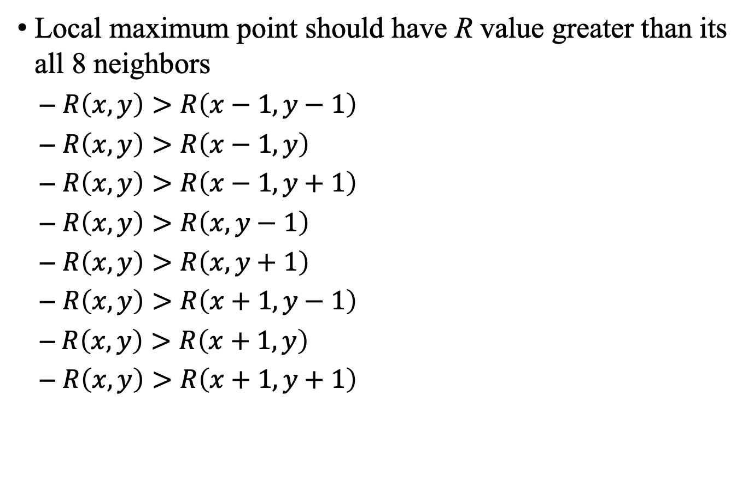
Step 5: Non-maximum Suppression
Local maximum point should have R value greater than its all 8 neighbors
$R\left(x, y\right)>R\left(x−1, y−1\right)$
$R\left(x, y\right)>R\left(x−1, y\right)$
$R\left(x, y\right)>R\left(x−1, y+1\right)$
$R\left(x, y\right)>R\left(x, y−1\right)$
$R\left(x, y\right)>R\left(x, y+1\right)$
$R\left(x, y\right)>R\left(x+1, y−1\right)$
$R\left(x, y\right)>R\left(x+1, y\right)$
$R\left(x, y\right)>R\left(x+1, y+1\right)$

Slide 17
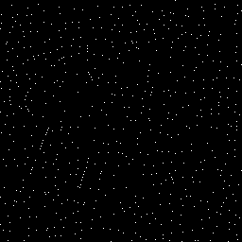
Step 5: Non-maximum Suppression
In MATLAB, use imregionalmax(R)
Bonus: implement your own function
Local Maxima

Slide 18
Step 5: Non-maximum Suppression
Apply AND (&) to your corner map and local-maxima
Corner Map

Slide 19
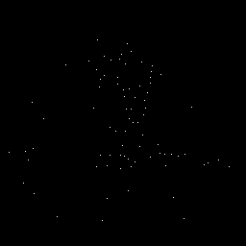
Step 5: Non-maximum Suppression
Apply AND (&) to your corner map and local-maxima
Final Corner Map

Slide 20

Step 6: Extract corner points and plot
Use find to extract $(x,y)$ of corner points:
Plot corners:
[corner_y, corner_x] = find(final_corner_map);
%% visualize results
figure, imshow(I); hold on;
plot(corner_x, corner_y, 'ro');

Slide 21
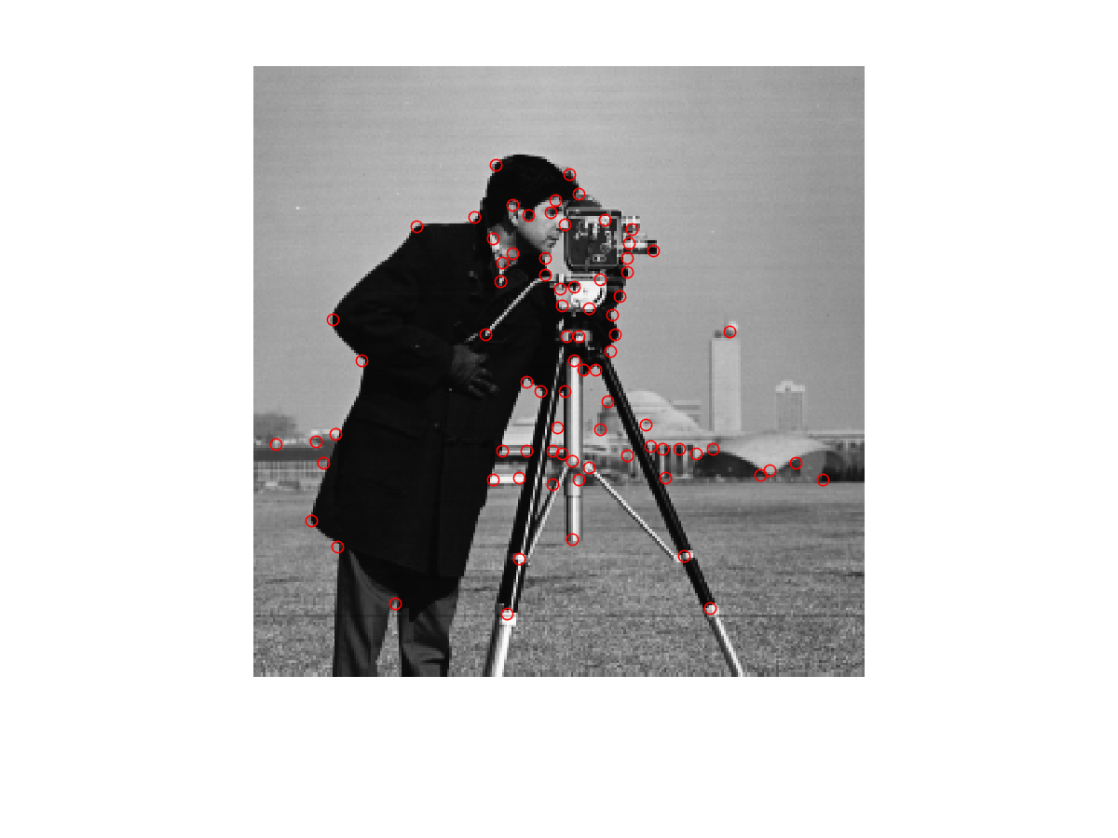
Results: cameraman

Slide 22
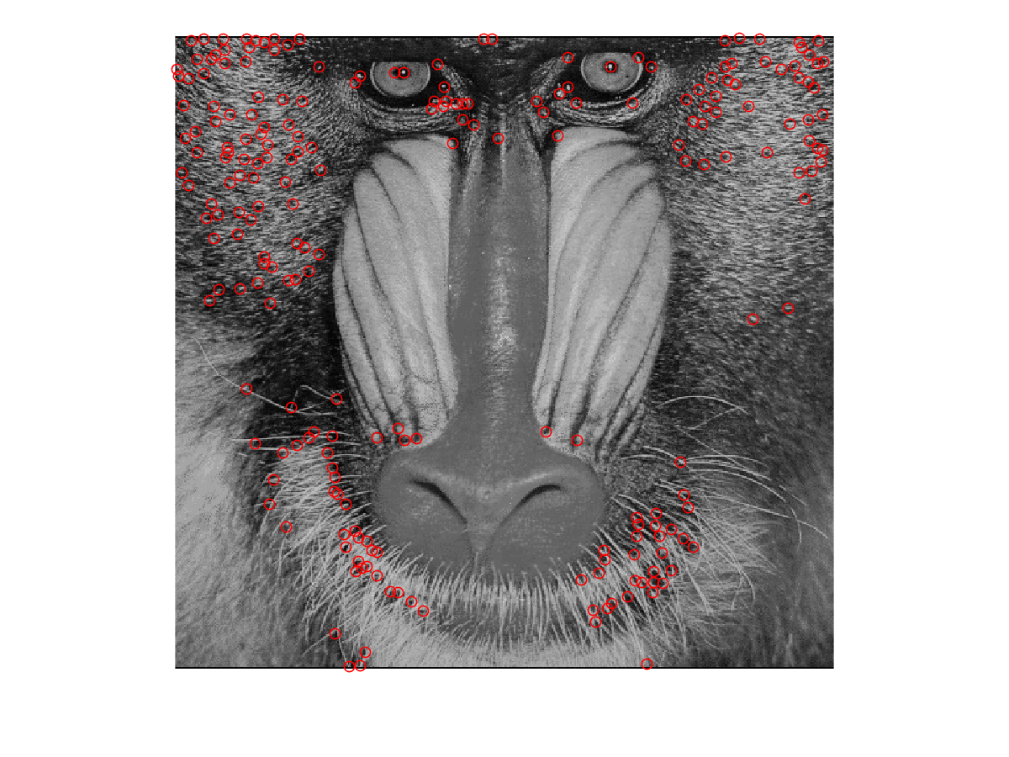
Results: baboon

Slide 23
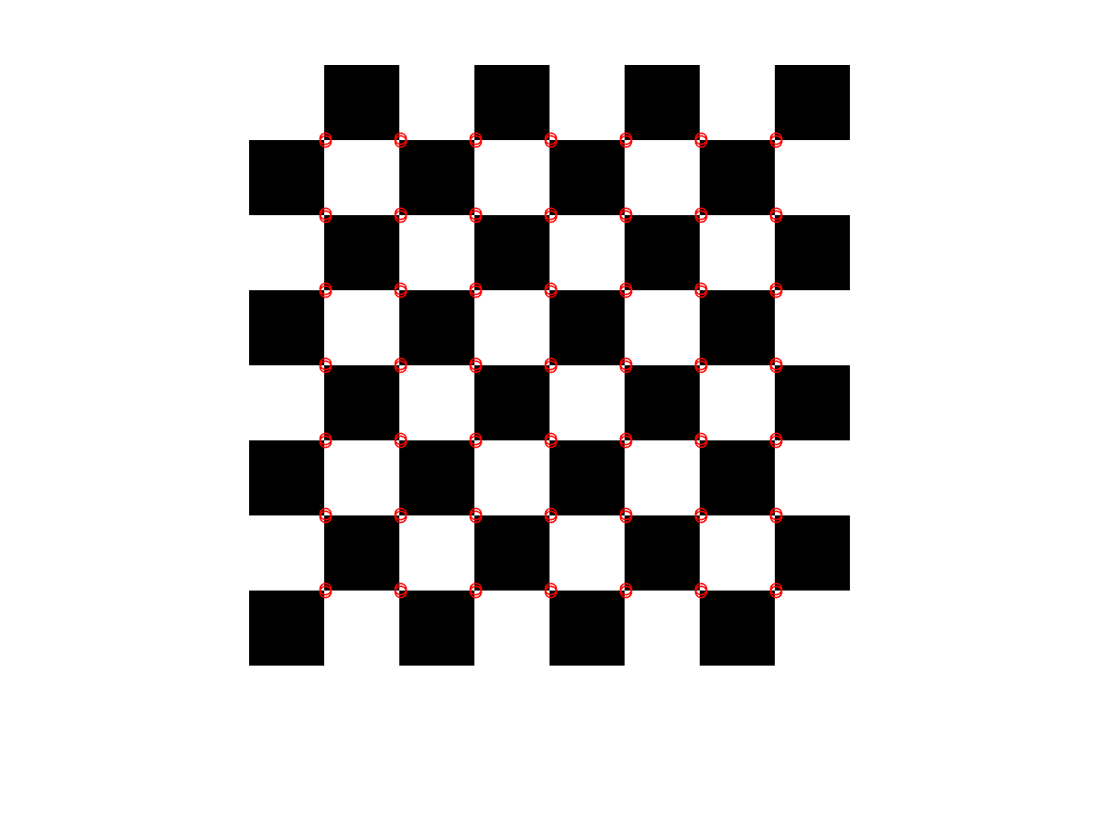
Results: checkboard

Slide 24
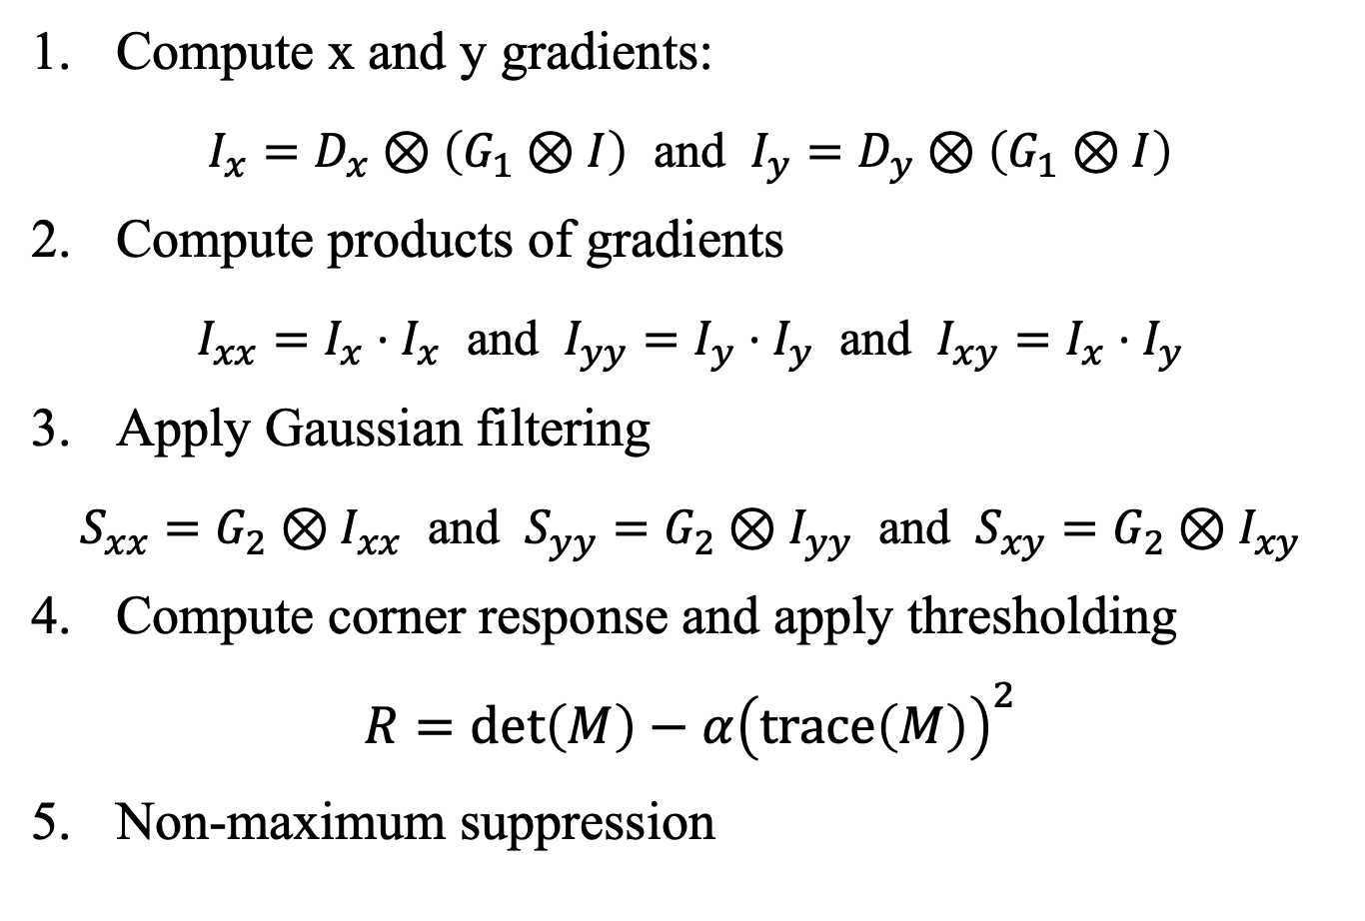
Summary
Compute x and y gradients:
$I_{x}=D_{x}⊗\left(G_{1}⊗I\right)$ and $I_{y}=D_{y}⊗\left(G_{1}⊗I\right)$
Compute products of gradients
$I_{xx}=I_{x}⋅I_{x}$ and $I_{yy}=I_{y}⋅I_{y}$ and $I_{xy}=I_{x}⋅I_{y}$
Apply Gaussian filtering
$S_{xx}=G_{2}⊗I_{xx}$ and $S_{yy}=G_{2}⊗I_{yy}$ and $S_{xy}=G_{2}⊗I_{xy}$
Compute corner response and apply thresholding
$$R=\det\left(M\right)−α{\left(trace\left(M\right)\right)}^{2}$$
Non-maximum suppression
Different Gaussians

Slide 25
Lab Assignment 07
Implement Harris_corner_detector.m
Bonus: implement non-maximum suppression
Upload lab07.m, Harris_corner_detector.m and all output images (7 images for each given image) separately.
Output images: I_x (name_Ix.png), I_y (name_Iy.png), two Corner responses in Step 4 (name_R.png, name_corner_map.png), Local Maxima (name_local_maxima.png), final corner map in Step 5 (name_final_corner_map.png) and result (name_corners.png) for each input name.png.
Images must match the codes.

