Slide 1
CSE185 Introduction to Computer Vision Lab 08: Hough Transform
Instructor: Prof. Ming-Hsuan Yang
TA: Siddharth Seth & Kuan-Chih Huang & Yu-Ju Tsai

Slide 2
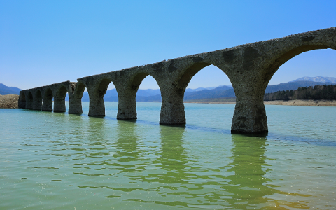
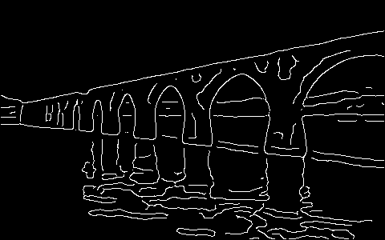
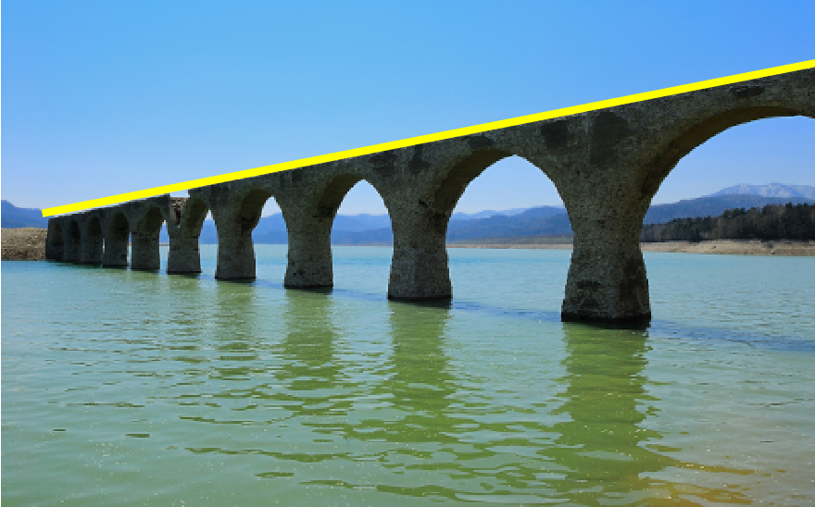
Line Fitting
Given an input image, detect straight lines from the edge map

Slide 3




Line Equation in Cartesian Coordinate
In image space:
$$y=m⋅x+b$$
In parameter/Hough space:
$$m=−\frac{1}{x}⋅b+\frac{y}{x}$$
m: slope/gradient
b: intercept/offset
$$m=−\frac{1}{x}⋅b+\frac{y}{x}$$
$$y=m⋅x+b$$
$$b$$
Image Space
Parameter Space

Slide 4
Line Equation in Cartesian Coordinate
In image space:
$$y=m⋅x+b$$
In parameter/Hough space:
$$m=−\frac{1}{x}⋅b+\frac{y}{x}$$
m: slope/gradient
b: intercept/offset
$$m=−\frac{1}{x}⋅b+\frac{y}{x}$$
$$y=m⋅x+b$$
$$b$$
Image Space
Parameter Space

Slide 5
Line Equation in Cartesian Coordinate
In image space:
$$y=m⋅x+b$$
In parameter/Hough space:
$$m=−\frac{1}{x}⋅b+\frac{y}{x}$$
m: slope/gradient
b: intercept/offset
$$m=−\frac{1}{x}⋅b+\frac{y}{x}$$
$$y=m⋅x+b$$
$$b$$
Image Space
Parameter Space

Slide 6
Line Equation in Cartesian Coordinate
In image space:
$$y=m⋅x+b$$
In parameter/Hough space:
$$m=−\frac{1}{x}⋅b+\frac{y}{x}$$
m: slope/gradient
b: intercept/offset
$$m=−\frac{1}{x}⋅b+\frac{y}{x}$$
$$y=m⋅x+b$$
$$b$$
Image Space
Parameter Space

Slide 7
Line Equation in Cartesian Coordinate
In image space:
$$y=m⋅x+b$$
In parameter/Hough space:
$$m=−\frac{1}{x}⋅b+\frac{y}{x}$$
m: slope/gradient
b: intercept/offset
$$m=−\frac{1}{x}⋅b+\frac{y}{x}$$
$$y=m⋅x+b$$
$$b$$
Image Space
Parameter Space

Slide 8
Hough Transform
Algorithm:
quantize parameter space (m, b)
create a 2D accumulate matrix V
for each (x, y) in edge map:
for each b:
compute m = -1 / x * b + y / x
add vote to V
end
end
find the maximal votes in V
find the corresponding value of m and b

Slide 9
Hough Transform
In hough_transform.m
function [m, b] = hough_transform(edge_map)
%% find x, y position from edge map
[edge_y, edge_x] = find(edge_map);
%% range of b
H = size(edge_map, 1);
b_range = -H : 1 : H;
%% range of m
m_step = 0.01;
m_max = 5;
m_min = -m_max;
m_range = m_min : m_step : m_max;
%% create vote matrix
V = zeros(length(m_range), length(b_range));

Slide 10
Hough Transform
In hough_transform.m
%% create vote matrix
V = zeros(length(m_range), length(b_range));
%% TODO: add votes
%% plot votes
figure, imagesc(V); xlabel('b'); ylabel('m');
%% find the maximal vote
max_vote = max(V(:));
[max_m_index, max_b_index] = find(V == max_vote);
m = m_range(max_m_index);
b = b_range(max_b_index);

Slide 11
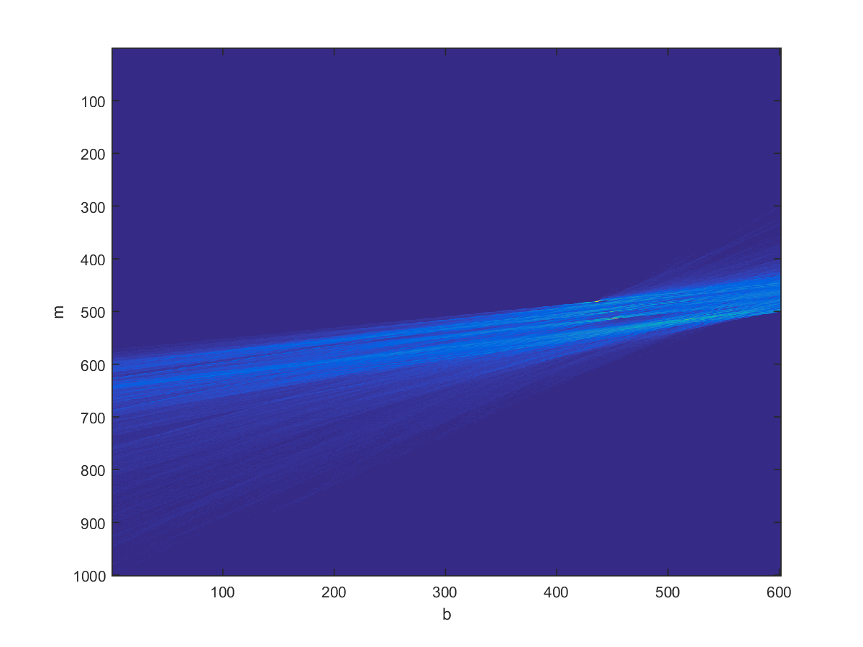
Visualization of vote matrix

Slide 12
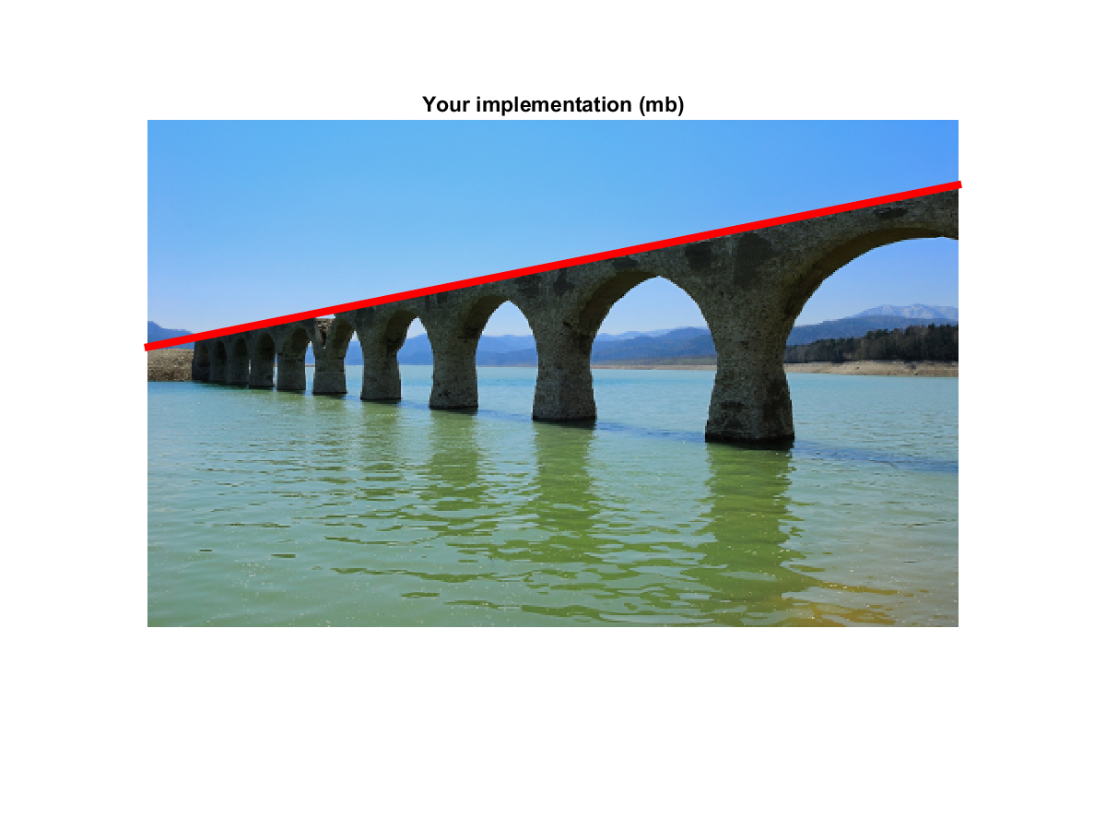
Detected Line

Slide 13
Hints
for each (x, y) in edge map:
for each b:
for i = 1:length(edge_y)
y = edge_y(i);
x = edge_x(i);
for b_index = 1:length(b_range)
b = b_range(b_index);

Slide 14
Hints
Before you add votes to V, check the range of m:
m_min <= m <= m_max
You should convert m, b to their indexes in matrix V
add 1 because index start from 1
m_index = round( (m – m_min) / m_step ) + 1;
V(m_index, b_index) = V(m_index, b_index) + 1;

Slide 15


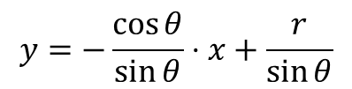


Line Equation in Polar Coordinate
$y=m⋅x+b$ cannot represent vertical lines ($m→∞$):
Use polar representation:
$r=x\cos{θ}+y\sin{θ}$
$$y=−\frac{\cos{θ}}{\sin{θ}}⋅x+\frac{r}{\sin{θ}}$$
$$r$$
$$r=x\cos{θ}+y\sin{θ}$$
$$θ$$
Image Space
Parameter Space

Slide 16
Hough Transform
Algorithm:
quantize parameter space (r, theta)
create a 2D accumulate matrix V
for each (x, y) in edge map:
for each theta:
compute r = x * cos(theta) + y * sin(theta)
add vote to V
end
end
find the maximal votes in V
find the corresponding value of r and theta

Slide 17
Hough Transform
In hough_transform_polar.m
function [r, theta] = hough_transform_polar(edge_map)
%% find x, y position from edge map
[edge_y, edge_x] = find(edge_map);
%% range of r
H = size(edge_map, 1);
W = size(edge_map, 2);
r_max = round(sqrt(H^2 + W^2));
r_min = -r_max;
r_step = 1;
r_range = r_min : r_step : r_max;
%% range of theta
theta_step = 0.01;
theta_range = -pi/2 : theta_step : pi/2;

Slide 18
Hough Transform
In hough_transform_polar.m
%% create vote matrix
V = zeros(length(r_range), length(theta_range));
%% TODO: add votes
%% visualize votes
figure, imagesc(votes);
xlabel('theta'); ylabel('r');
%% find the maximal vote
max_vote = max(votes(:));
[max_r_index, max_theta_index]
= find( votes == max_vote );
r = r_range(max_r_index);
theta = theta_range(max_theta_index);

Slide 19
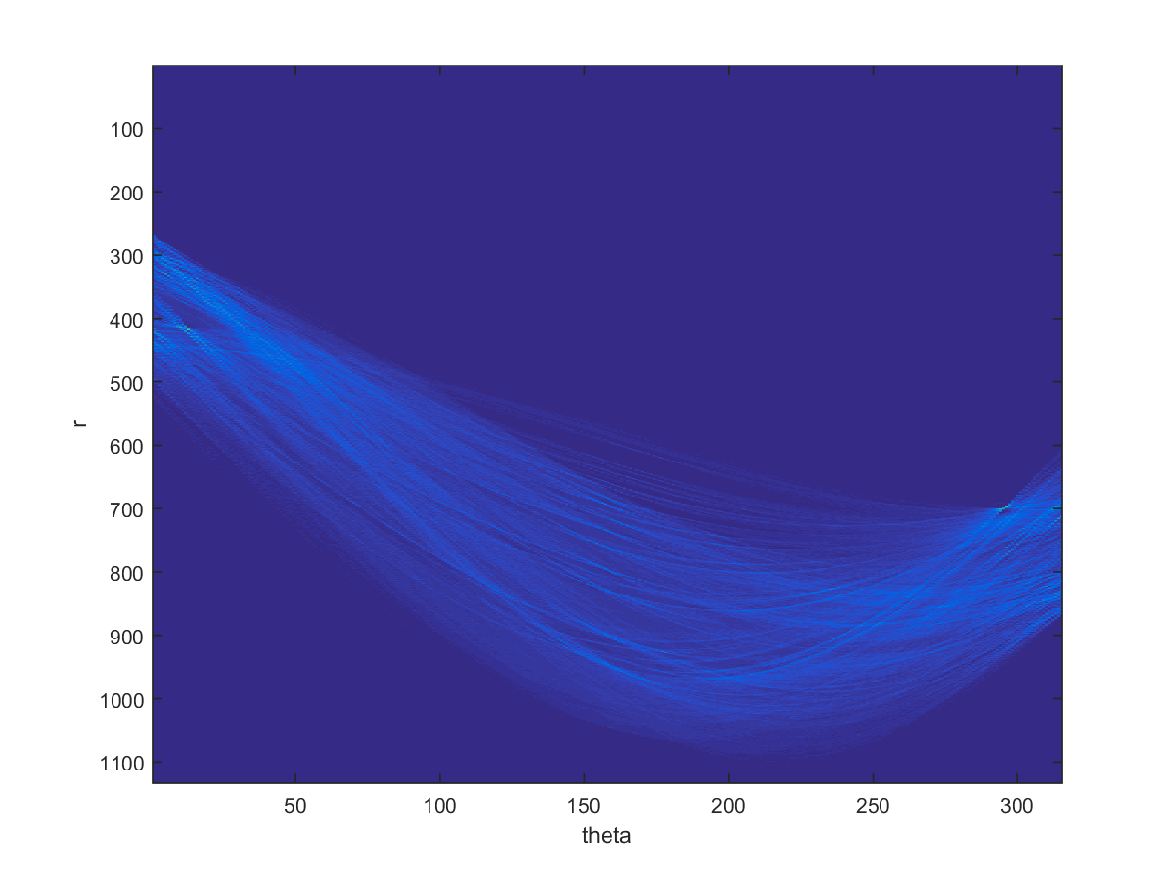
Visualization of vote matrix

Slide 20
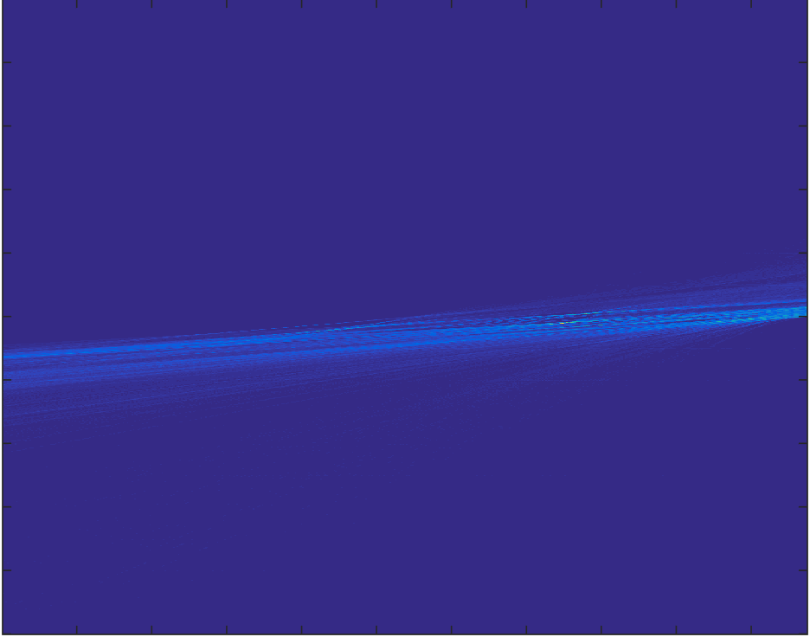
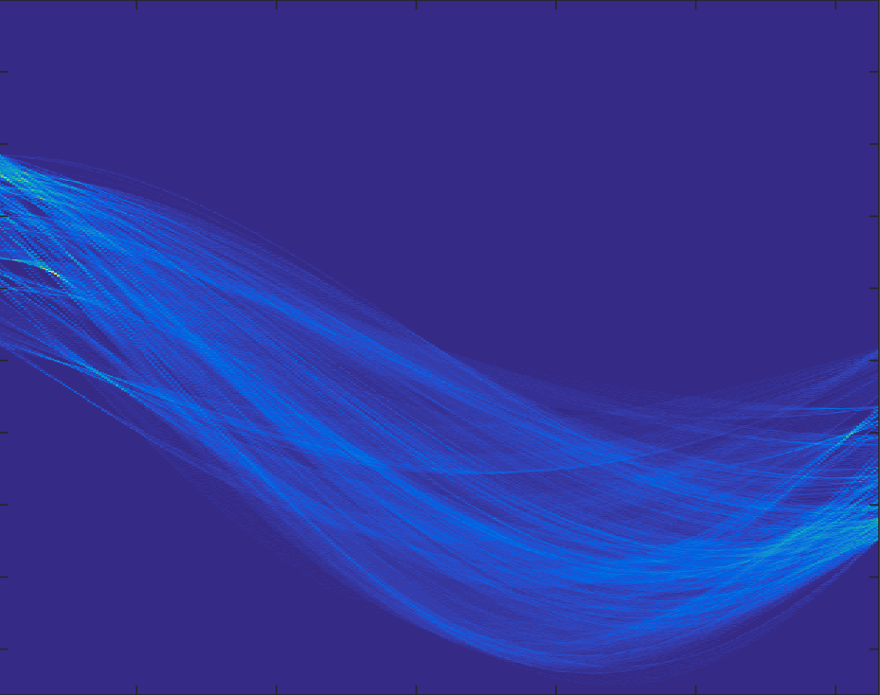
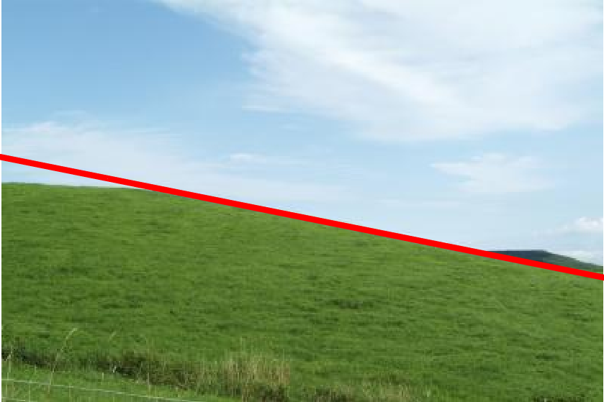
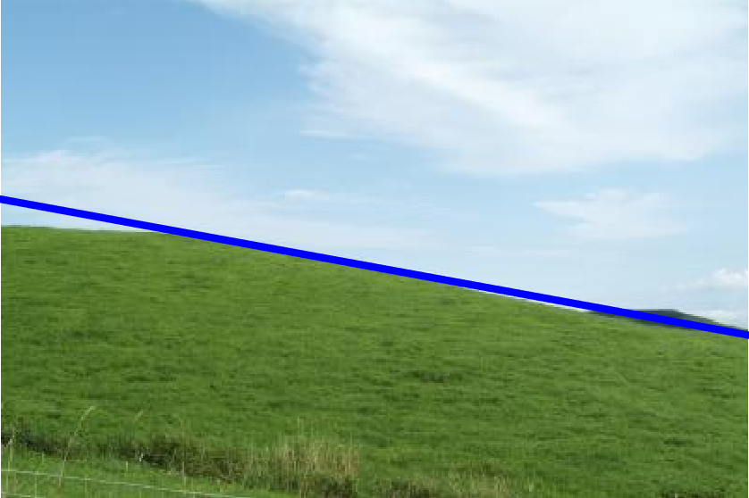


Outputs
Cartesian space $(m,b)$
Polar space $(r, θ)$

Slide 21



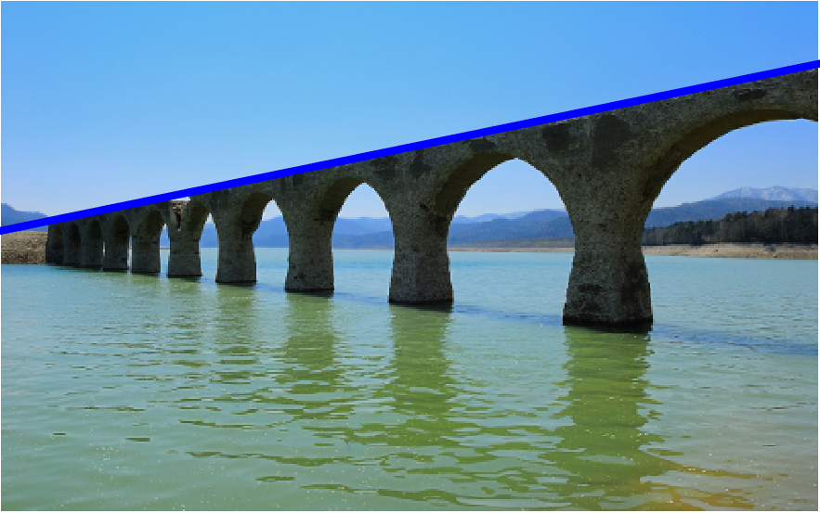
Outputs
Cartesian space $(m,b)$
Polar space $(r, θ)$

Slide 22
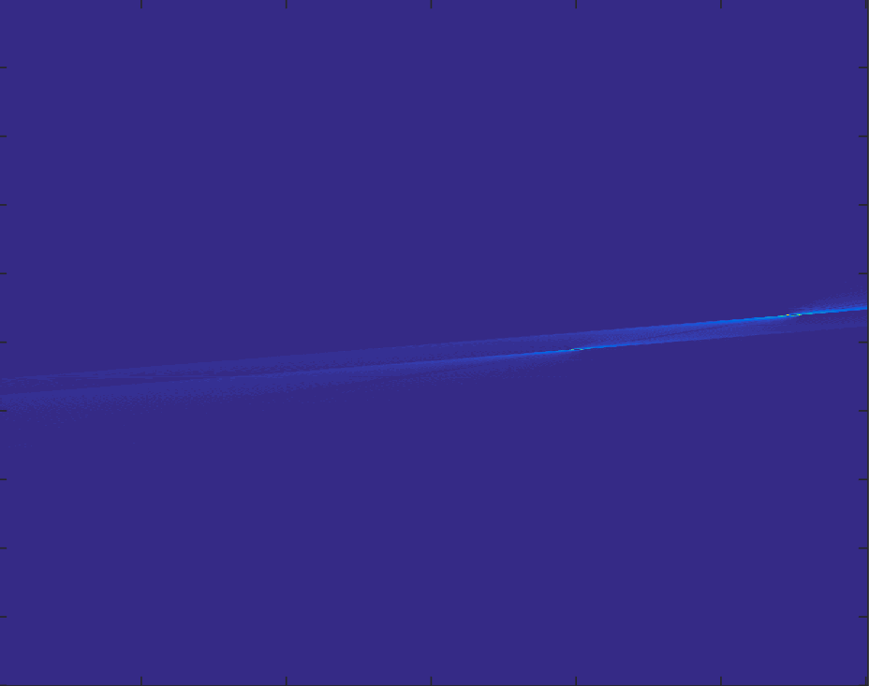
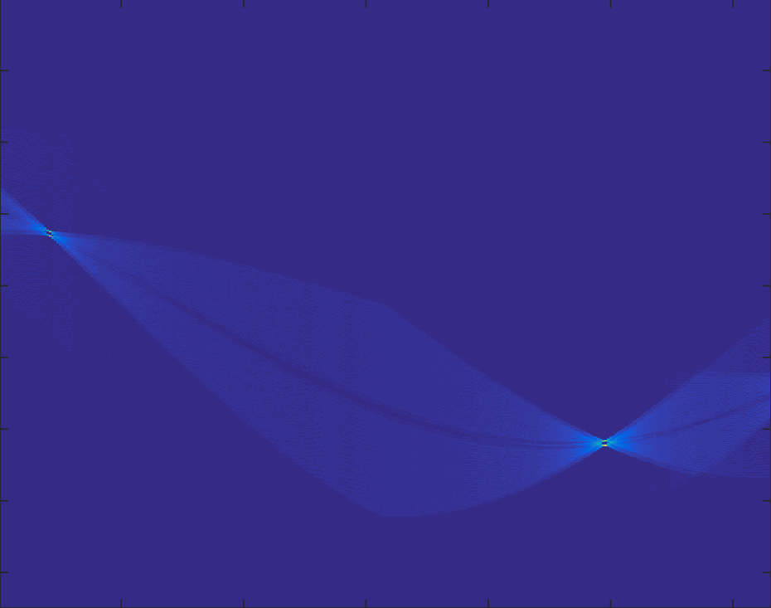
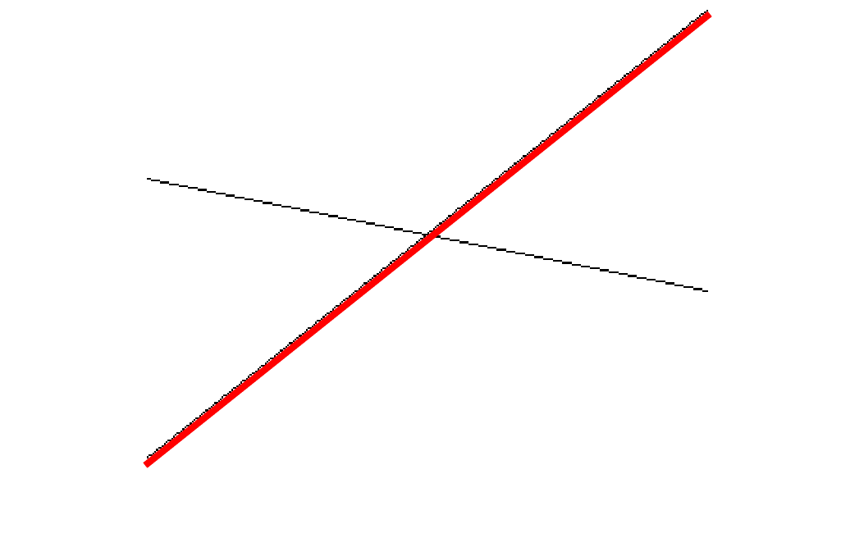
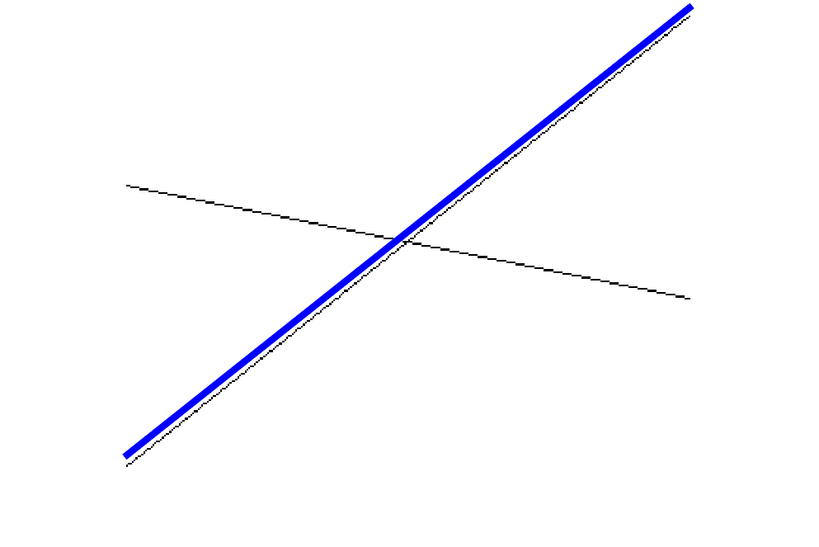
Outputs
Cartesian space $(m,b)$
Polar space $(r, θ)$

Slide 23
Lab Assignment 08
Implement hough_transform.m and hough_transform_polar.m
Upload lab08.m, hough_transform.m, hough_transform_polar.m and XXX_mb_line.png, XXX_polar_line.png (XXX = lines, bridge, hill) separately

