Slide 1

Low-cost Quantification of Fluid Flow Parameter Sensitivity
using Reduced-order Modeling
Harley Hanes¹, Michael W. Lee², Donya Ramezanian³, Ralph C. Smith¹
¹North Carolina State University, ²NASA Langley Research Center, ³University of Southern California
AIAA SciTech Forum
01/25/23

Slide 2
Overview
Sensitivity analysis using Morris screening
The boundary penalty method for POD-ROM
Lid-driven cavity test problem
Sensitivity analysis of POD-ROM with boundary penalty
Conclusions and future work

Slide 3
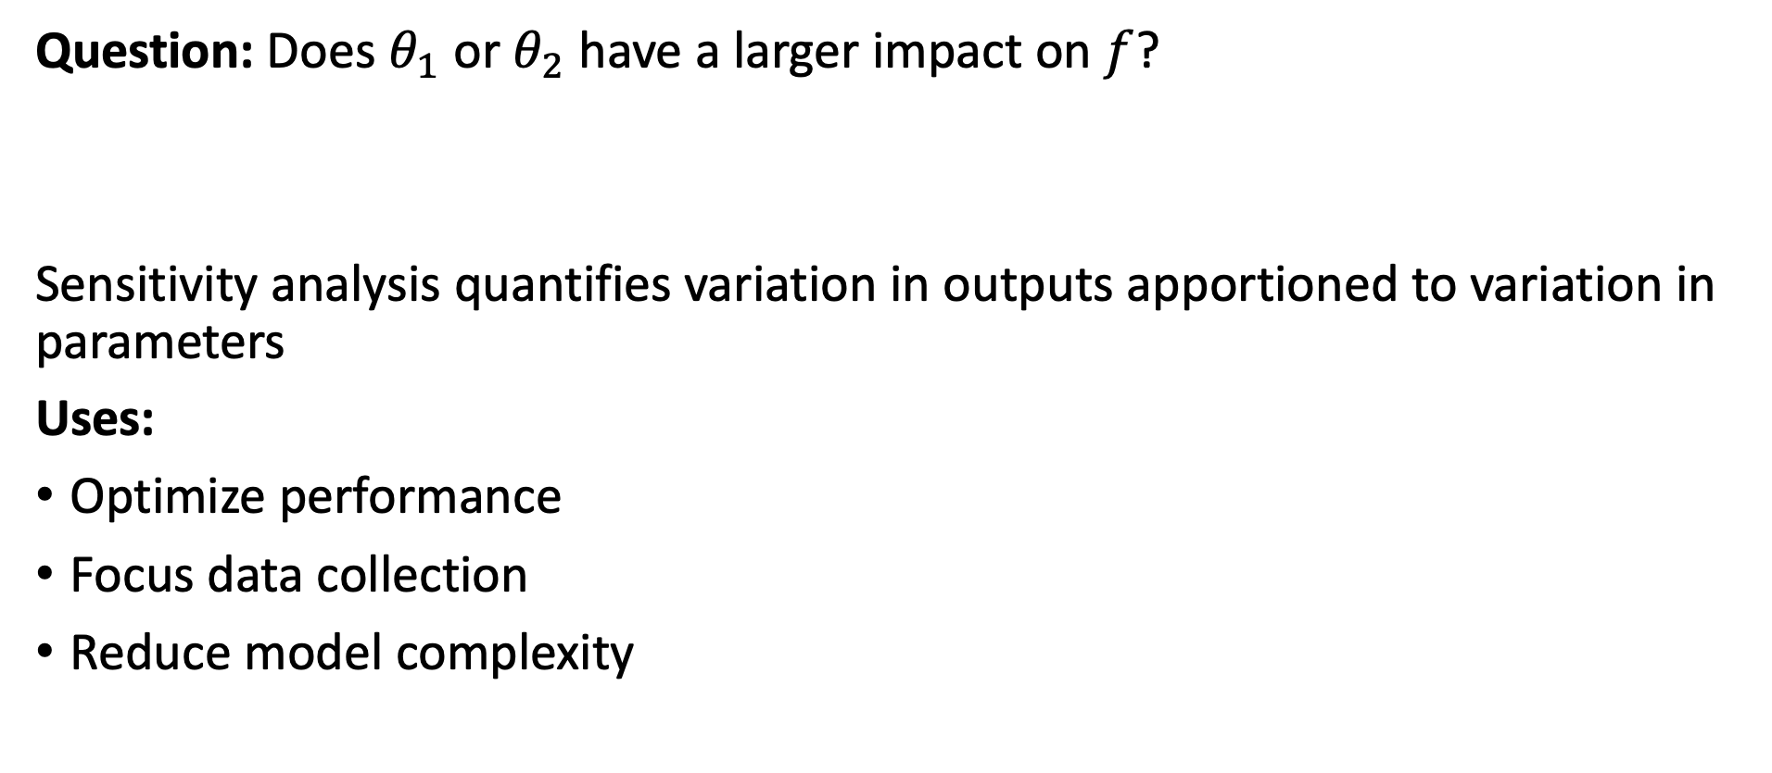
Sensitivity Analysis Quantifies Influence of Parameters
Question: Does $θ_{1}$ or $θ_{2}$have a larger impact on $f$?
Sensitivity analysis quantifies variation in outputs apportioned to variation in parameters
Uses:
Optimize performance
Focus data collection
Reduce model complexity

Slide 4
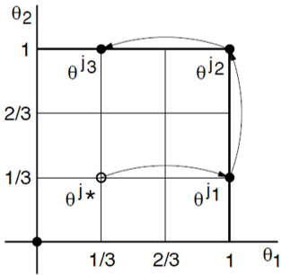
Morris Screening Averages Derivative Approximations
Method: Morris screening averages derivative approximations
[1] Smith, 2014
We test sensitivity of incompressible flow problem

Slide 5
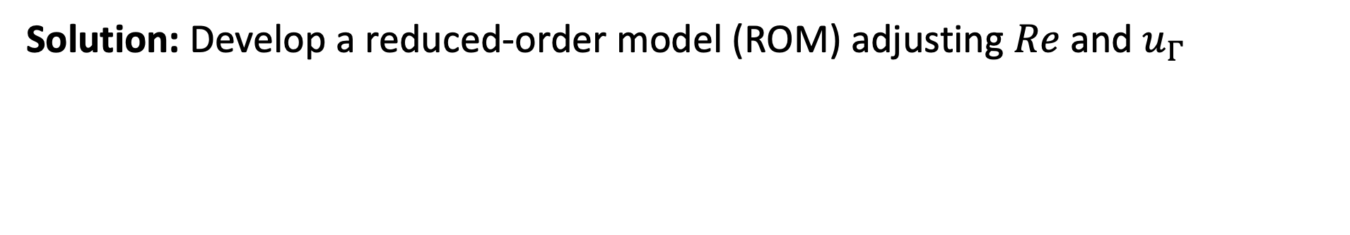

Solving Navier-Stokes is Computationally Expensive
Consider the incompressible Navier-Stokes Equations,
Goal: Quantify sensitivity of turbulent solutions to $Re$and $u_{Γ}$
Problem: Direct numerical solutions (DNS) computationally expensive
Solution: Develop a reduced-order model (ROM) adjusting $Re$and $u_{Γ}$

Slide 6
POD-ROMs Simplify PDEs into ODEs
Mean-reduce snapshot data,
Assume separation of variables and compute first N POD modes,
Apply Navier-Stokes to construct ODE,

Slide 7
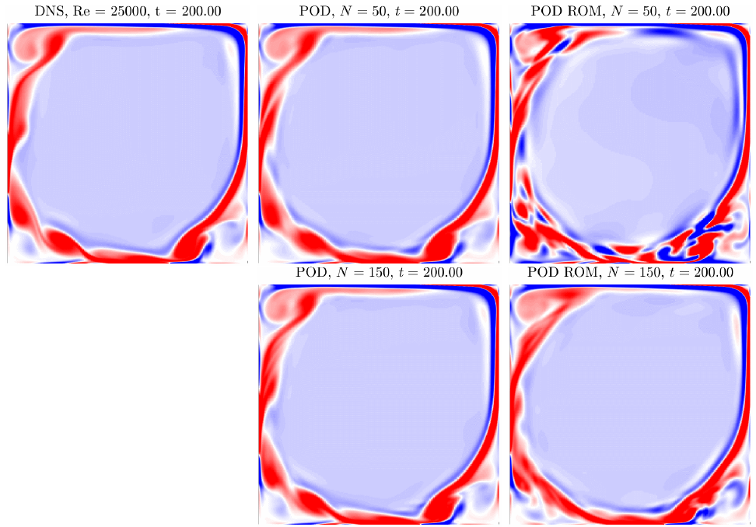
POD-ROMs are Effective for a Lid-Driven Cavity
DNS, POD, and ROM vorticity for the lid-driven cavity, [2] Lee, 2020

Slide 8
Penalties Define Boundary Conditions in a POD-ROM
Problem: POD-ROMs do not include boundary conditions
Solution: Adding boundary penalties
New ODE for modal coefficients,

Slide 9
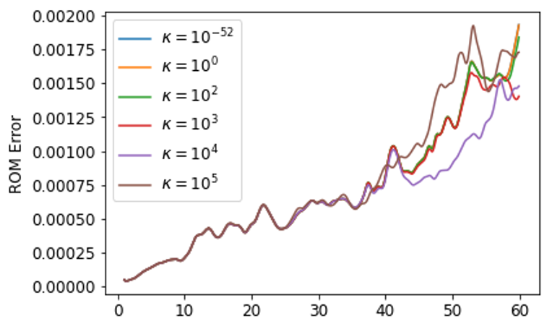
Boundary Penalties Increase POD-ROM Accuracy
Boundary penalties can improve accuracy and stability of POD-ROM
We test using penalties to apply new boundary conditions

Slide 10
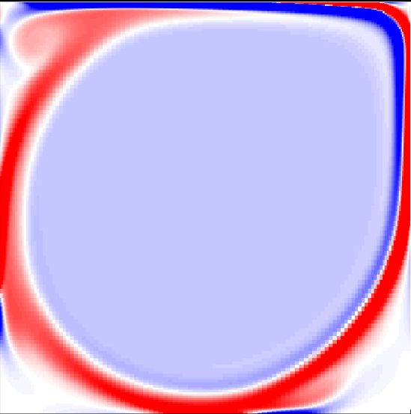
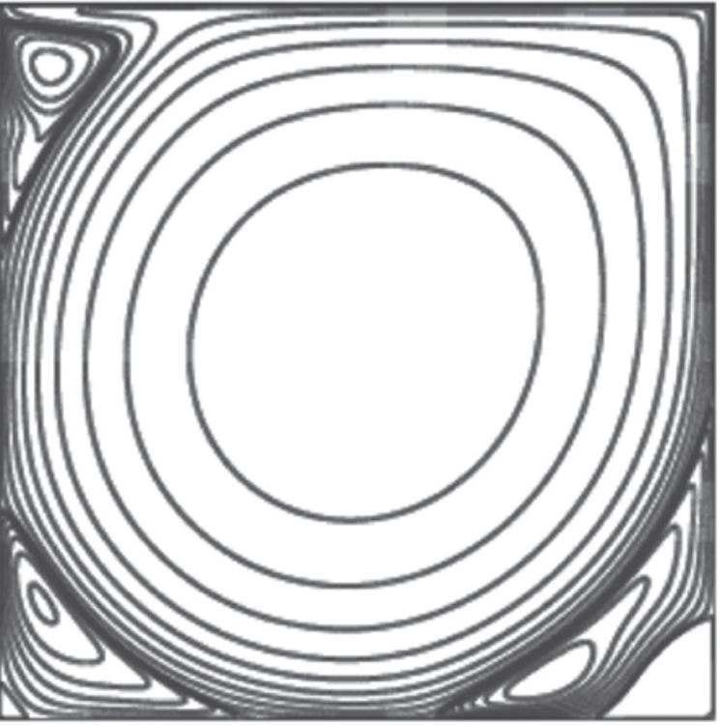


Two Common Lid-Driven Cavity Boundary Conditions
Regularized: $u_{Γ}{=(1−x)}^{2}{(1+x)}^{2}$
\
[2] Lee, 2020
Unregularized: $u_{Γ}=1$
[3] Nuriev, 2016
Notes:
Both models use homogeneous Dirichlet boundary conditions except for top which rotates,

Slide 11
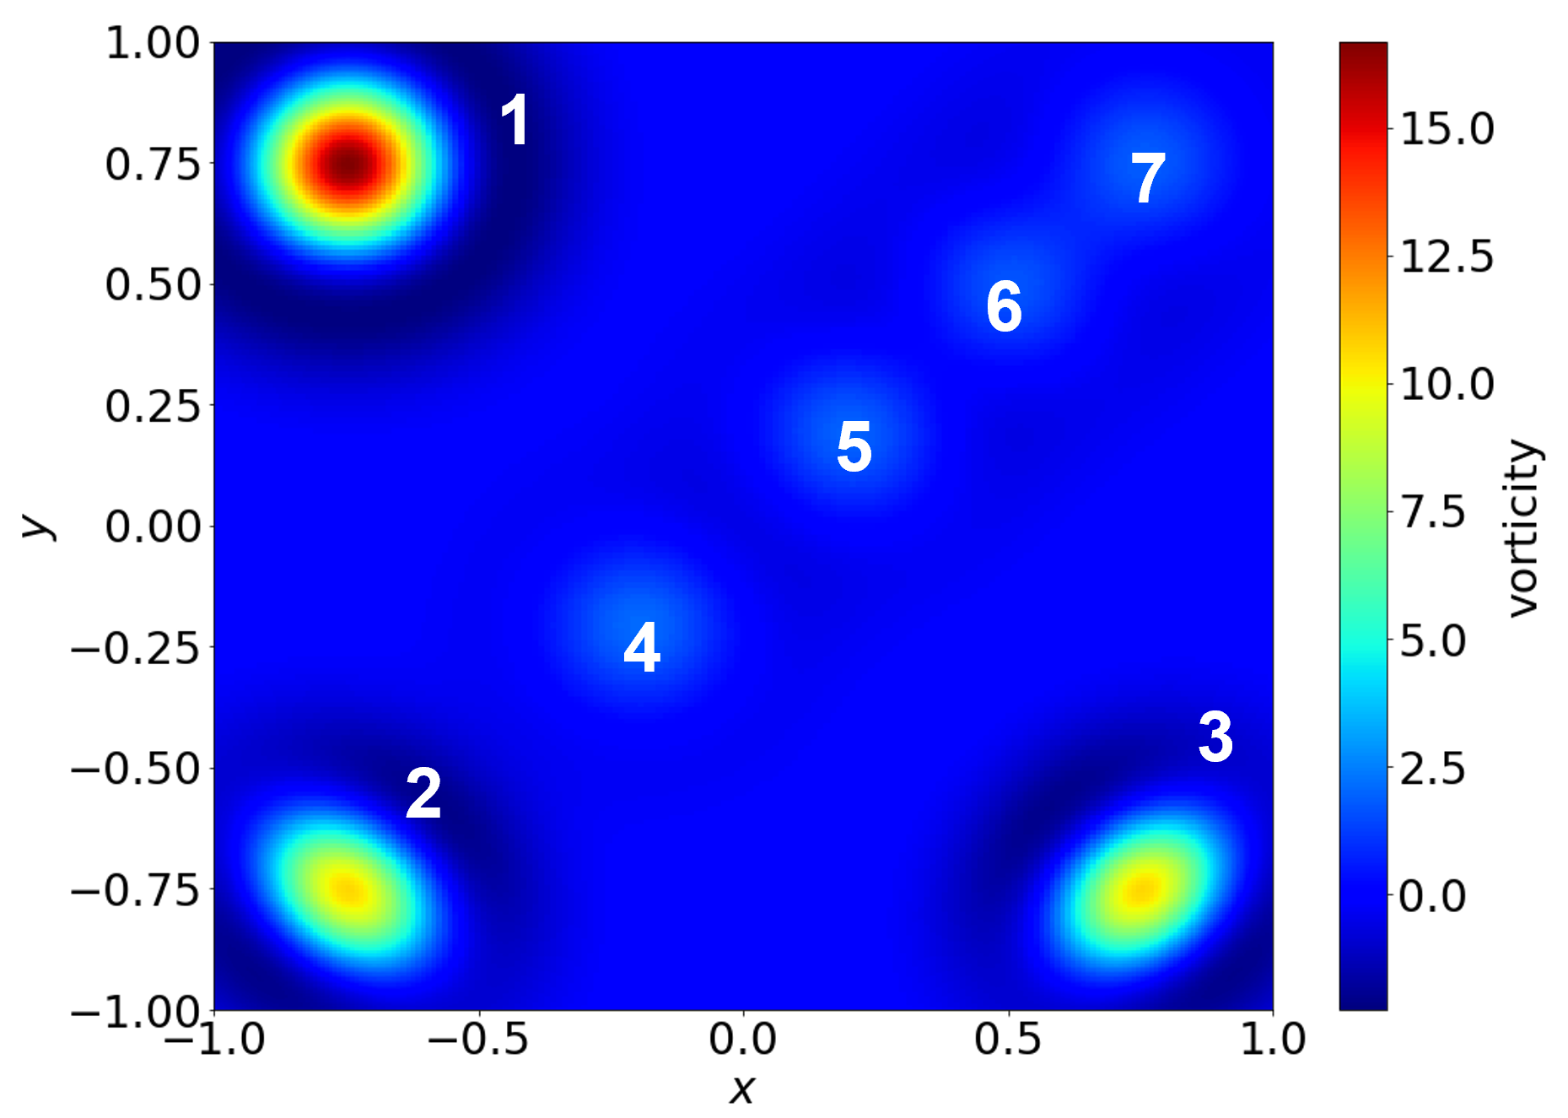
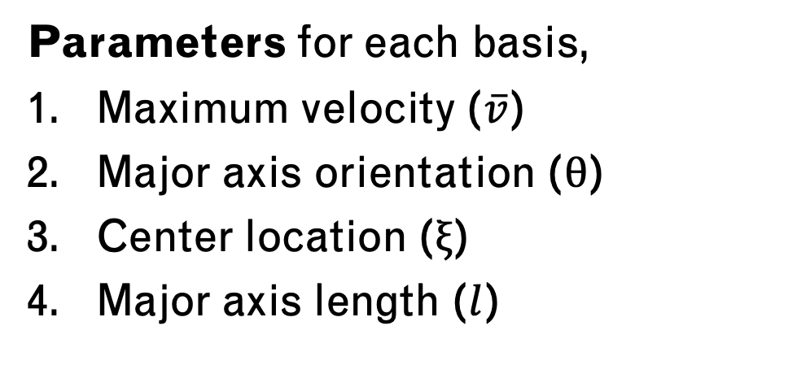
Mean Reduction Method
Classify flow into three regions,
High vorticity eddies (1-3)
Low velocity flow (4-5)
Main rotational flow (6-7)
Parameters for each basis,
Maximum velocity ($\overline{v}$)
Major axis orientation ($θ$)
Center location ($ξ$)
Major axis length ($l$)
Measure kinetic energy, total vorticity and vorticity at each basis

Slide 12
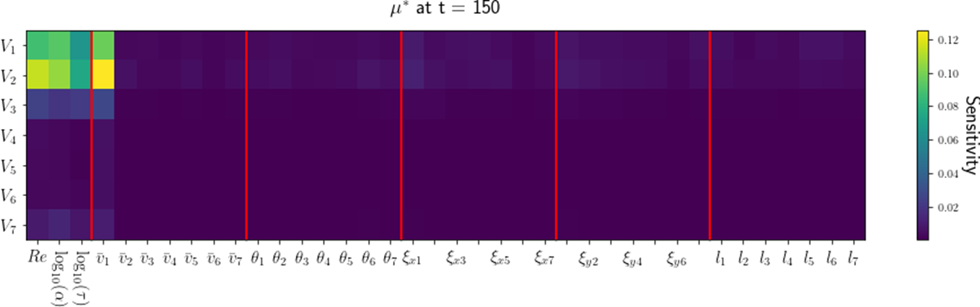

Sensitivity of Local Vorticities to all Parameters
Mean reduction insensitive except for velocity in top-left $({\overline{v}}_{1})$
Notes:
Only left side of flow ($V_{1}$, $V_{2}$) is sensitive to parameters

Slide 13
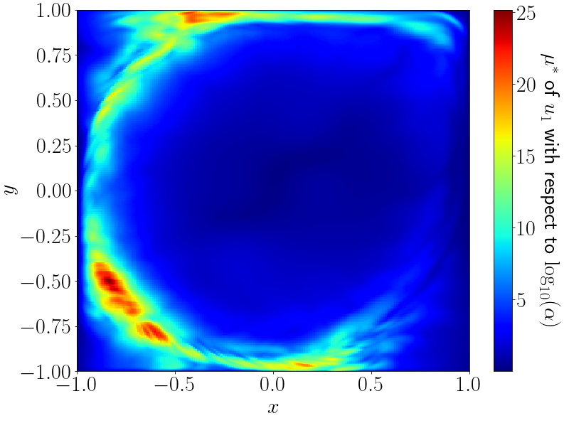
Sensitivity of X-Velocity to Boundary Regularization
Most Sensitive: left-side turbulent areas
No sensitivity in top corners

Slide 14
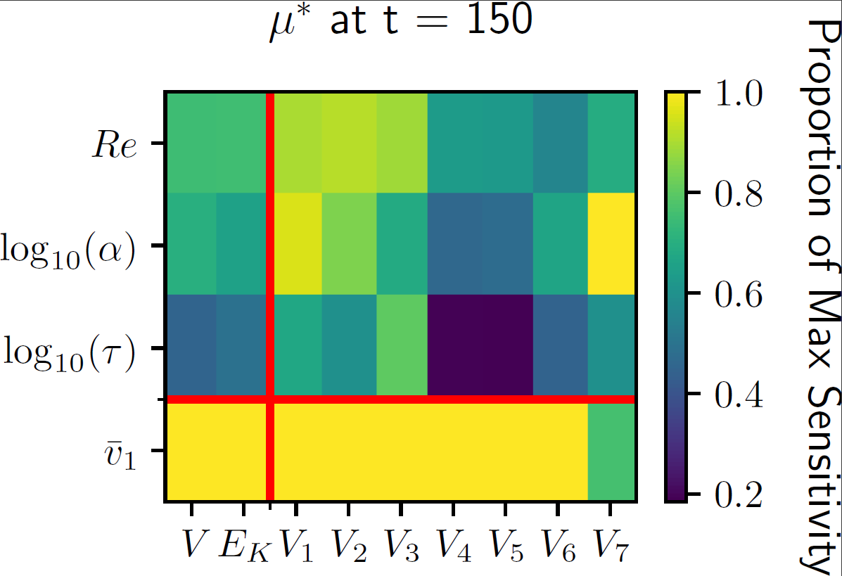
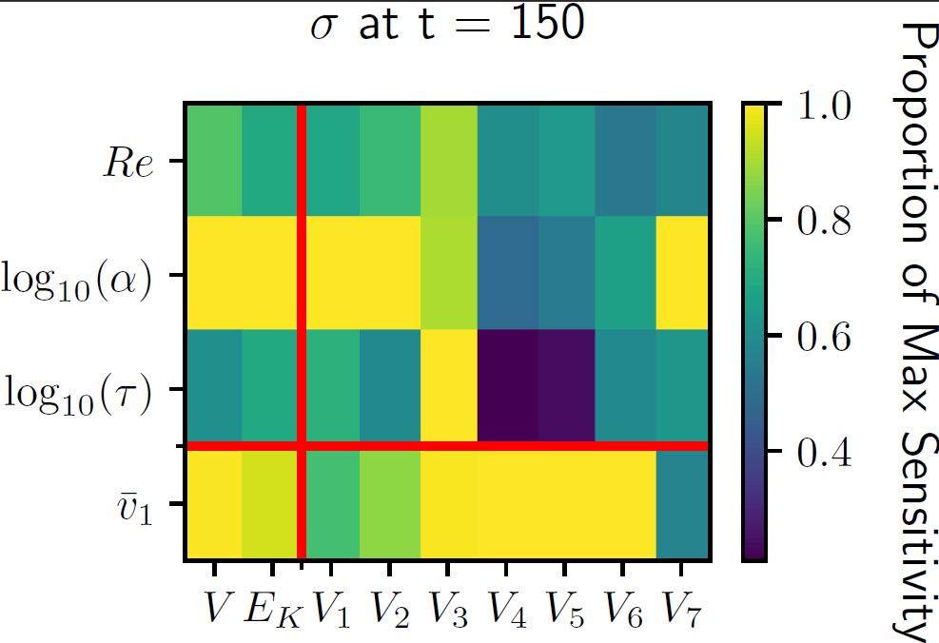

Scaled Absolute and Standard Deviation Sensitivities
Top-left mean reduction $({\overline{v}}_{1})$ is most sensitive parameter
Boundary regularization ($α$) has highest standard deviation
Notes:
Top-left mean reduction $({\overline{v}}_{1})$ is most sensitive parameter: except for vorticity in top-right ($V_{7}$)

Slide 15
Conclusions
Boundary penalties allow sensitivity analysis of boundary conditions in POD-ROMs
Sensitivity of lid-driven cavity agree with comparisons of different boundary conditions
Mean decomposition is sensitive only near changing boundary
Boundary penalties cannot quantify sensitivity in stable areas of POD basis

Slide 16
Future Work
Finding: Boundary penalty effectively quantify sensitivity to boundary conditions
Next Step: Measure Orion lander sensitivity to surface roughness with boundary penalty
Notes:
POIs: Surface roughness of each lander panel
Significance:
QOIs: Lift/ drag coeff

Slide 17
References
[1] R. C. Smith, Uncertainty Quantification: Theory, Implementation, and Applications, SIAM, Philadelphia, 2014.
[2] M. Lee. (2020). On Improving the Predictable Accuracy of Reduced-order Models for Fluid Flows. PhD thesis, Duke University.
[3] Nuriev, A.N. et al. (2016). Bifurcation analysis of steady-state flows in the lid-driven cavity. Fluid Dynamics Research, 48.

