Slide 1
Exosomes Secreted Under Hypoxia Enhance Invasiveness and Stemness of Prostate Cancer Cells by Targeting Adherens Junction Molecules.
Ramteke, A et al. 2015.
Notes:
Introduce name etc.
Somewhat related to my project, exosomes in PC3 cells, but I focus on miRNAs and the mechanism of export.

Slide 2
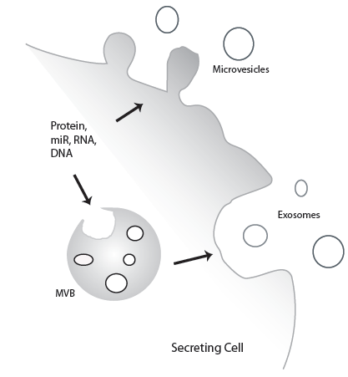
Exosomes.
Subpopulation of extracellular vesicles.
Garbage disposal. g Intercellular communications.
Little known about formation, sorting and content.
Strong links to roles in cancer, stress signaling and immunity.

Slide 3
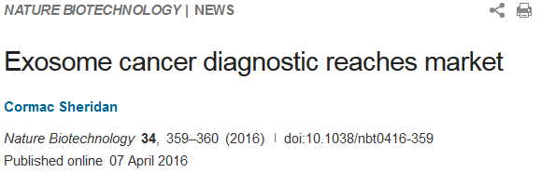
Exosomes in Cancer
Knockdown of exosome biogenesis, via RAB proteins reduced tumour growth and metastasis in Melanoma.
Addition of Colorectal cancer derived exosomes to healthy cells induced migration.
Suggested as a target for cancer diagnostics and treatment targets.
Notes:
Rab27 allows for the return of the MVB to the plasma membrane.

Slide 4
Prostate Cancer (PCA)
High incidence, low mortality UNLESS.. Metastatic.
Advanced PCA results in survival of 12-15months.
Tends to spread to bone or lymph nodes.
Necessity to understand metastasis
(GLOBOCAN 2012)

Slide 5
Hypoxia in Cancer
What is hypoxia
What it does
Issues associated with its formation
Graphs and shit

Slide 6
Hypotheses and Aims
Hypothesis:
Hypoxic prostate tumour cells secrete exosomes containing pro-invasive, and metastasising proteins which can be absorbed by surrounding cells.
Aims:
Establish the differences in exosome content between hypoxic and normoxic cells.
Determine the invasiveness, migration and stemness induced by hypoxic exosomes.
Elucidate the causative action induced by the hypoxic exosomes.

Slide 7
Is there a difference between exosomes?

Slide 8
Does the hypoxia derived exosome induce invasiveness?

Slide 9
Does the hypoxia derived exosome induce Migration?

Slide 10
Does the hypoxia derived exosome induce stemness?

Slide 11
Is there distinct proteomic content?

Slide 12
Does this protein content mediate any particular pathways?

Slide 13
Limitation and strengths, future directions.

Slide 14
Conclusion and Proposed Mechanism

