Slide 1
Selective Export of MicroRNAs via Extracellular Vesicles

Slide 2
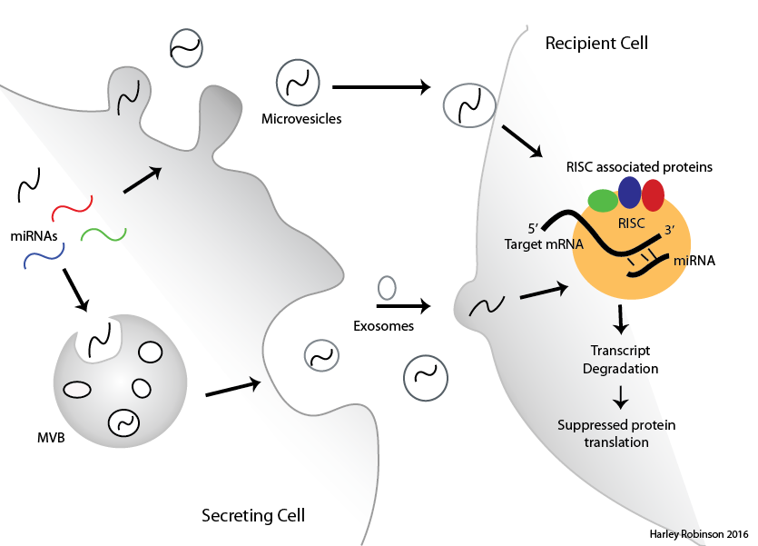
MicroRNAs in Extracellular Vesicles
EVs transfer cellular material between cells
MicroRNAs regulate RNA degradation
Sorting of microRNAs to EVs evident but mechanism not known

Slide 3
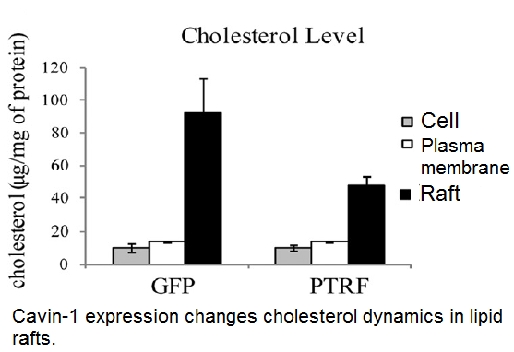
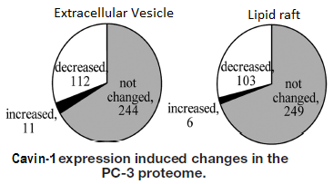
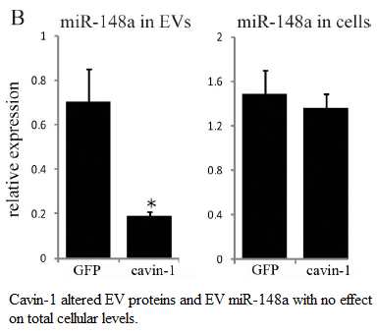
PC3 cell line.
Caveolin-1 expression: No Cavin-1 expression.
Addition of cavin-1 to these cells attenuates:
Oncogenic behaviour
Cholesterol re-distribution
MicroRNA EV content.

Slide 4
Aims and Hypotheses:
Hypothesis: miRNAs are selectively exported via extracellular vesicles indirectly moderated by cavin-1 in the PC3 model by mediating miRNA escort proteins in the EVs.
Identify the selectively exported miRNAs.
Identify candidate miRNA escort proteins.
Verify candidate miRNA escort proteins ability to bind to miRNAs and transport to extracellular vesicles.

Slide 5
Selectively Exported MiRs.
RNA-seq for small RNAs by Illumina in triplicate for GFP and cavin-1 cell lines AND in exosome and cell.
R package: DESeq2
Filter, normalise, compare between cell lines then between cellular localisation.
Only 95 MiRs.
9 miRs of interest

Slide 6
Selectively Exported MiRs.
Extract RNA from exosomes and cell (exoRNeasy and Mirvana Kits)
Normalized to miR-125a-3p
ddCT
MiR targets for pull down and validation of mechanism

Slide 7
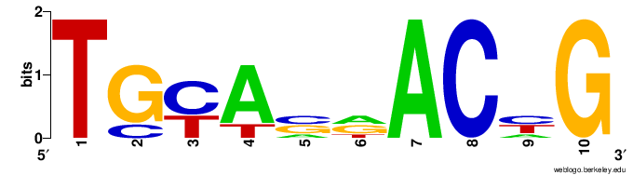
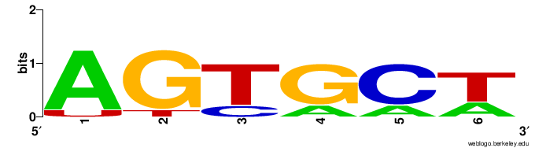
RNA-binding proteins and Motifs.
TAMO software suite: combines several different algorithms to identify motifs, evaluate enrichment and map motifs to sequences.

Slide 8
Proteins correlate to differential export.
Venn diagram of criteria and data that fulls under the criteria. Correlation to paper for hnRNPK

Slide 9
Westerns and Immunofluorescence:

Slide 10
To Do:
Confirm miRNA-Protein interaction via pull down/Western/MS
Determine importance of Sumoylation on the proteins.
In vitro colocalization between protein and miRNA (using Cy5-oglio)

