Slide 1
Control of extracellular vesicle microRNA export in prostate cancer.
Harley Robinson.
Supervisor: Assoc.Prof Michelle Hill
Co-supervisor: Dr. Alexandre Cristino

Slide 2
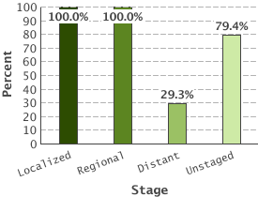
Prostate Cancer
5 Year Relative Survival:
Prostate cancer by stage
2nd highest diagnosed cancer in men worldwide
(SEER 2016)
Bone metastasis leads to poor outcome.
(Body et al 2015)
Metastasis reduced 5 year survival to 29.3%
(SEER 2016)
(SEER 2016)
Notes:
Diagnostics, advanced= increased mortalities due to additional comorbidities. Need to identify biomarkers and processes that contribute to metastatic progression. 25s

Slide 3
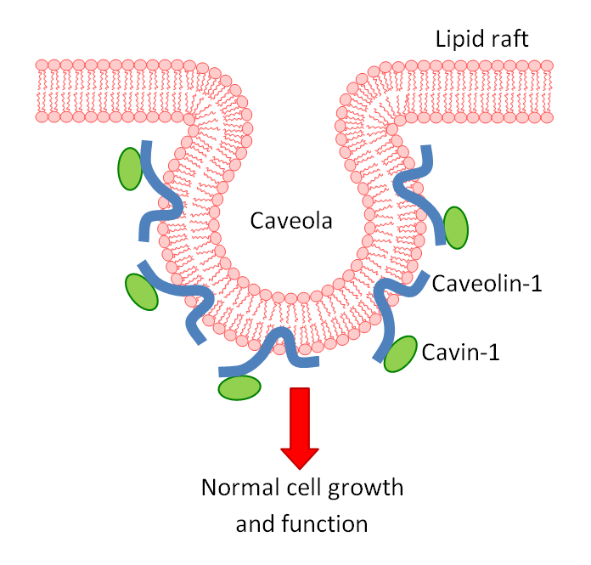
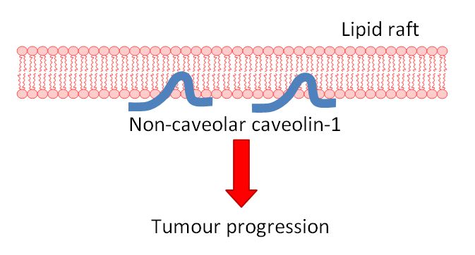
Caveolin-1 and Cavin-1 in Cancer;
Healthy Tissue
Caveolin-1 biomarker for cancer progression.
(Freeman et al 2012)
Co-expressed with cavin-1 in healthy cells. (Inder et al 2012, Moon et al 2014)
Advanced prostate cancer, PC3, cells overexpress caveolin, linked to metastasis.
(Bennett et al 2009)
Addition of cavin-1 in PC3 reduces aggressiveness evoked by caveolin.
(Sugie et al 2015, Inder et al 2014)
Tumour
?
Notes:
An important biomarker in cancer progression is caveolin-1… Linker: kd or addition of cavin-1 was found to reduce this phenotype in prostate cancer cells. 60s

Slide 4
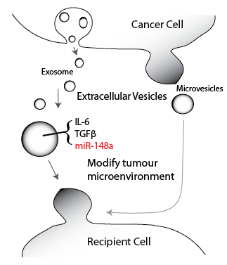
Extracellular Vesicles in Cancer
EVs (exosomes and microvesicle) transfer biologically active material between cells (Zaborowski 2015)
Cancer derived EVs have roles in tumour microenvironment modifications.
(Webber 2015, Neviani et al 2015)
Cavin-1 modulated protein and microRNA content of EVs. (Inder et al 2014)
miR-148a involved in bone metastasis through gene silencing. (Cheng et al 2013)
Notes:
45s. One novel mechanism revealed in recent years is the role of extracellular vesicles in cancer progression.

Slide 5
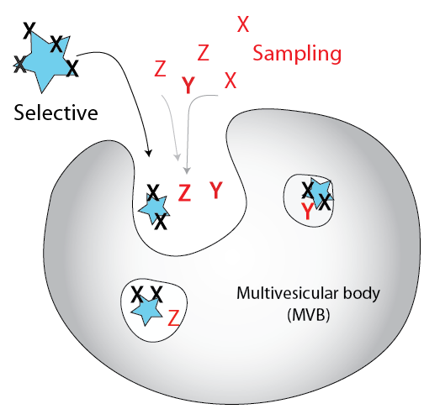
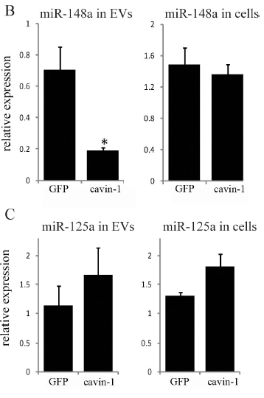
Cargo loading by sampling or export
Put smapled microrna in.
Put in diagram
(Inder et al 2014)
Notes:
60s. While protein content of Evs is commonly researched and regulation is understood, the same cannot be said for microRNAs. Previously microRNAs were thought to only be contained in Evs due to random uptake, or sampling which where the forming EVs engulfs surrounding microRNAs. Because of this, EV content would be proportionate to the cellular concentration of these microRNAs, as shown by miR-125a in our study. In contrast, recent studies had found that some microRNAs don’t display this activity. Rather, these microRNAs can change EV concentration disproportionally to the cellular concentration, as observed by miR-148a. This is believed to occur due to the regulation of EXPORT PROTEINS, where the EVs can become enriched in specific miR species. Prevention of this export will then modify the EV cargo and affect the biological action induced by the EVs. However what this export mechanism is and how it works is unknown.

Slide 6
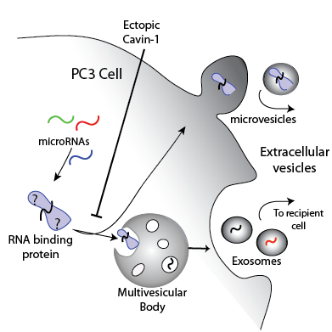
Aims:
Identify miRNAs exported in this system
Identify candidate export protein
Investigate the interaction between export protein and miRNA
Hypothesis:
Cavin-1 expression in PC3 cell limits the extracellular vesicle export of a subset of microRNAs by modulating the export of their RNA-binding proteins
Ectopic Cavin-1
Caveolin +ve
Notes:
45s

Slide 7
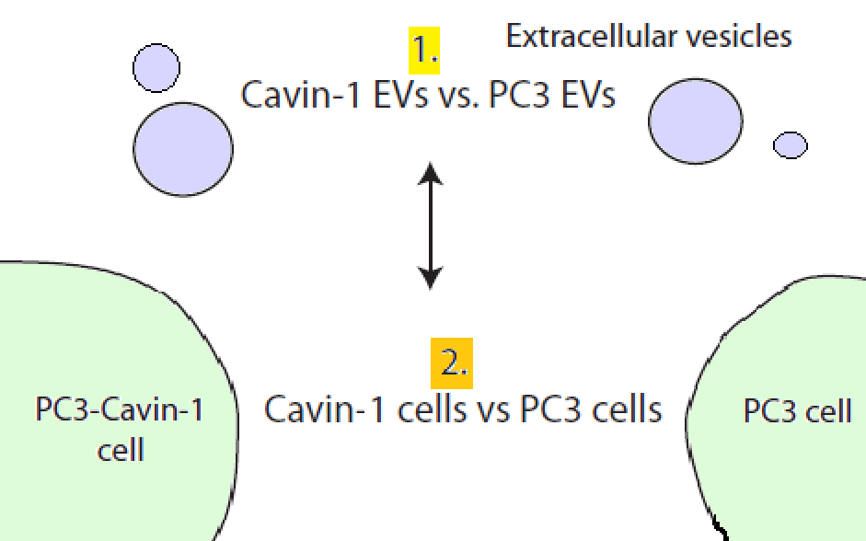
Aim 1. Identify miRNAs targeted by export mechanism
Selective vs sampling export.
RNA-seq quantification of miRNAs **.
DESeq2 analysis for R to analyze cavin-1 effects.
Analyses differences in export
Analyses differences in expression
** prepared and completed by Jayde Ruelcke
and Nicole Cloonan
Notes:
40s

Slide 8
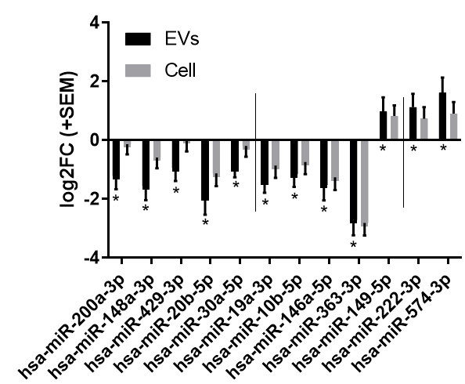
MicroRNAs are selectively exported
95 miRNAs detected in EVs.
12 miRNAs significantly modified in EVs by cavin-1 expression.
Both sampling and selective export occurring.
*
* p ≤ 0.05 from Wald p-value test, n=3
Used to compare between cell lines
Notes:
40s

Slide 9
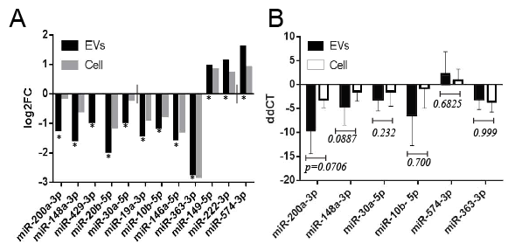
RT-qPCR validation
EV and cell collection
RNA extraction
cDNA synthesis and poly-A tailing
RT-qPCR
Delta delta CT analysis
Normalized to miR-125a-3p
Mann-Whitney U test
Notes:
45s

Slide 10
Aim 2. Identify candidate export protein
Hypothesis:
Cavin-1 expression in PC3 cell limits the extracellular vesicle export of a subset of microRNAs by modulating the export of their RNA-binding proteins
RNA-binding proteins bind to conserved RNA regions.
Caveolin+
Notes:
20sec

Slide 11
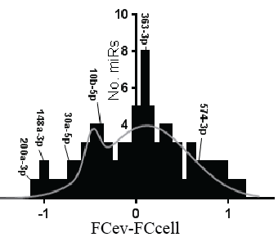
Expanding the sample set
*
19 miRNAs selectively exported most with links to cancer.
(Huang et al 2014, Pola 2013, )
Notes:
… We now know which micrornas are being selectively exported from this system, some of which are validated, that can be used to understand mechanism overall. Next we wanted to understand whether these microRNAs possess similarities to explain their export. 90s

Slide 12
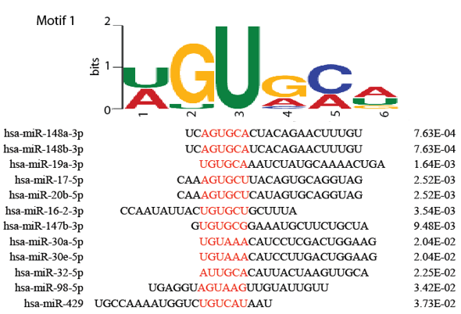
Motifs enriched in exported microRNAs
Assumption: Exported microRNAs share sub-sequences that RNA-binding export proteins bind to.
8/19
Motif conserved across 12 of the selectively exported miRNAs.
No matches to sampled miRNAs.
Only prediction: experimental
validation required.
Notes:
Used the 19 micrornas that were selectively exported, from last analysis.
MEME: 4-10 nucleotides in length.
x/19 is how many of the miRs contained that motif. 60s

Slide 13
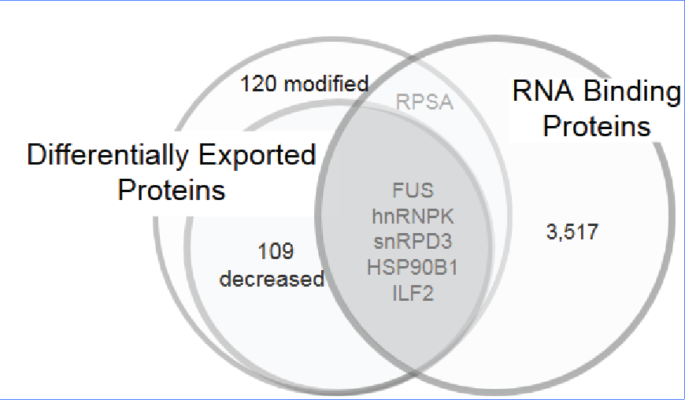
Quantitative proteomics of EVs
Export proteins should:
Possess differential export due to cavin-1
Possess RNA binding ability
Predicted to bind the exported miRNAs.
Mass spectrometry compared proteomic content of EVs from PC3 and PC3-cavin-1 cells. (Inder et al 2012)
Gene Ontology analysis for RNA binding.
hnRNPK predicted to match to the selective export motif (p=0.0435, via FIMO prediction).
Candidates
Notes:
60s Next we looked at potential proteins that could be interacting with those selectively exported micrornas… Based on this criteria… From this analysis we found 5 proteins that could be potential export proteins. We then assessed these further by looking into the literature to determine if any of these proteins are more suited for the position.

Slide 14
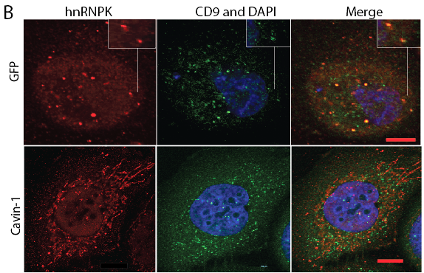
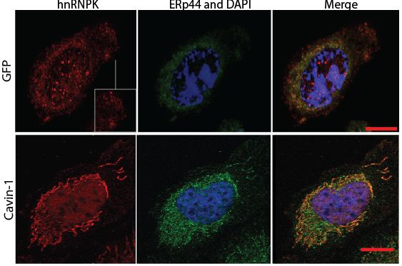
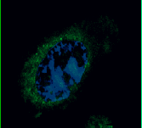
hnRNPK translocate between MVB and ER
hnRNPK commonly overexpressed in cancers with aberrant cytoplasmic localization
(Welton 2010, Ji 2013, Ramteke 2015, Zheng 2015)
Scale bar= 10µm
hnRNPK ERp44 and DAPI Merge
PC3
PC3-Cavin-1
CD9: MVB and exosome marker
ERp44: endoplasmic reticulum marker
Notes:
60s. Interestingly, hnRNPK is commonly found to exhibit ABNORMAL cytoplasmic localisation in advanced cancers where usually hnRNPK is a nuclear protein. For this reason we wanted to assess the localization of hnRNPK in our cells. This found that hnRNPk localized to MVBs in the PC3 cell line, consistent with the MS data, that does not occur in the cavin-1 positive cell lines. In contrast, hnRNPK seems to prefer localization to Endoplasmic Reticulum. While this reveals that a distinct subcellular localization is occurring due to the expression of cavin-1, hnRNPK localization to the ER has never been observed before. Further work is needed to determine whether this is a result of the cell model/system or a usual hnRNPK activity that simply hasn’t been seen. These results indicate a change in localization is mediating the activity of the export mechanism.

Slide 15
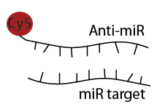
Aim 3. Investigate the interaction between export protein and microRNA. microRNA in situ hybridization
Fluorophore tagged complimentary RNA hybridizes to target
In addition with IF for hnRNPK localization
Notes:
30s. Next, we wanted to know and confirm that hnRNPK actually interacts with its predicated targets. We attempted to do this by looking at in situ colocalization using a modified method. This uses a fluorophore tagged hybridization probe that targets the microRNAs. In combination with immunofluorosence for hnRNPK we can determine if miRNA and protein interact.

Slide 16
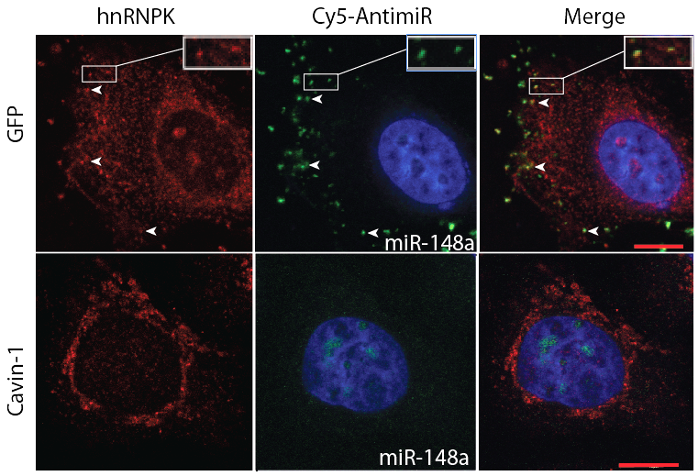
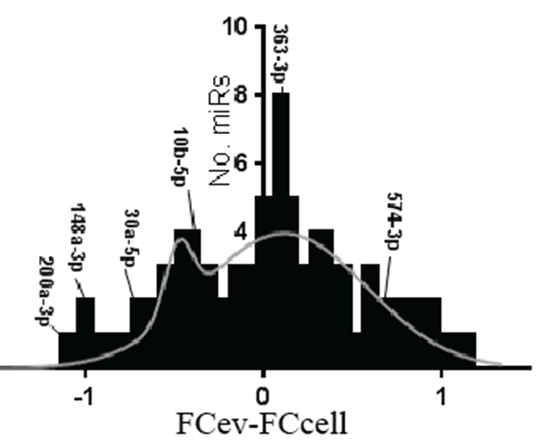
hnRNPK co-localizes with miR-148a
miR-148a
PC3
+ miR-148a contains
binding motif
PC3-Cavin-1
Notes:
60s. Here we looked at the colocalization ability of hnRNPK and mir-148a. This microRNA was found to be abundantly exported in the PC3 cell line, reduced in the PC3 cavin-1 and predicted to bind to the hnRNPK. We found from our in situ data hnRNPK and miR-148a do indeed colocalize in the PC3 cells to puncta, which we assume to be forming exosomes or MVBs. This is consistent with the binding information, RNA-seq and MS data. In contrast, HNRNPK in the cavin-1 cells, while changing subcellular localization also no longer associate to their targets. This may indicate not only a change in localization but also a change in binding ability that could be mediating the export activity of hnRNPK. Yet how this occurring is yet to be determined.

Slide 17
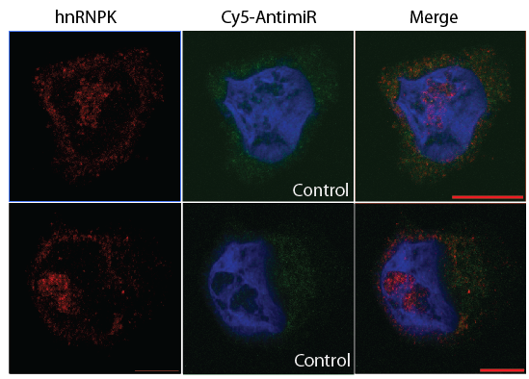
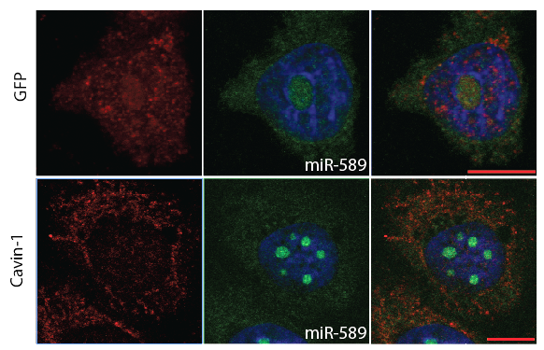
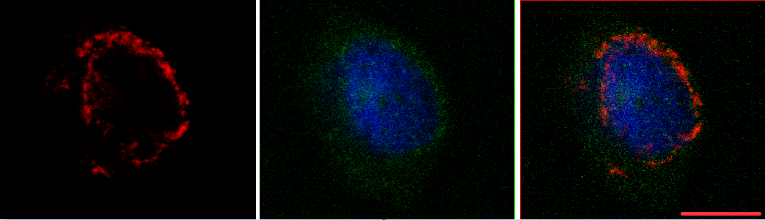
Scrambled-148a: negative control. Displays baseline intensity for probes.
hnRNPK Cy5-antimiR Merge
hnRNPK Cy5-antimiR Merge
PC3
PC3
PC3-Cavin-1
PC3-Cavin-1
miR-589: ‘sampling’.
Not expected to co-localize with hnRNPK or be found in puncta.
Notes:
Next I wanted to observe the normal localization of microRNAs when not undergoing selective export and also whether hnRNPk colocalizes to them. As expected from the binding predictions, hnRNPK doesn’t colocalize to sampled microRNAs, and these sampled microRNAs don’t enrich in punctate structures. Hereby, hnRNPK is believed to only localize with selectively export microRNAs, however further studies are required with the other selectively exported microRNAs. 25s

Slide 18
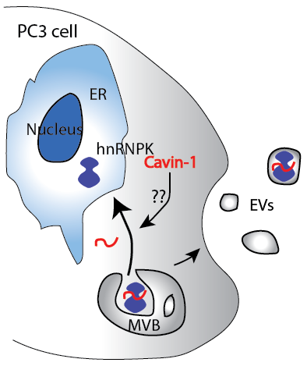
Conclusion:
Mechanism:
hnRNPK translocate to MVB/exosomes
Presence and absence of hnRNPK in MVB correlates to miRNA change.
Addition of cavin-1 limits hnRNPK in EVs potentially by sequestering to ER
Therefore reduces miRNA export
Notes:
25s. Ultimately, from this study, we identified a viable export protein to mediate the microRNA content of EVs, and idenfitied some of its targets. Additionally, we found that the expression of tumour suppressor cavin-1 modulates its activity, though exactly how this is occurring is yet to be determined. Ultimately, this regulation is thought to mediate the export of oncogenic microRNAs by modulating export of hnRNPK.

Slide 19
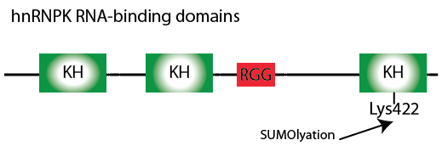
Future directions and significance:
Confirm hnRNPK- miRNA interaction: optimized pull-down assays and further validations.
Assess the link between cavin-1 and hnRNPK activity: several hypotheses for this.
Significance:
Extracellular vesicle cargo regulation
microRNA regulation
Identification of underlying processes mediating advanced prostate cancer progression.
KH= K homology domain
RGG= RGG box
SUMO a Change in subcellular localization and binding of RNA.
(Lee et al. 2012, Paziewska et al 2004)
Notes:
90s. However, there is still plenty that needs to completed. Ideally we need to confirm the interaction between hnRNPK and the selectively exported microRNAs. Throughout the year I optimised a pull-down assay to detect RNA targets of hnRNPK. Now completing this pull down will confirm that hnRNPK directly binds to miRNAs and verifies the motif discovery predictions. But more importantly, we’d like to figure out what it is about cavin-1 that mediates the activity of hnRNPK. We have hypothesis that may explain this, one of which involves post translational modifications. HNRNPK has 4 RNAbinding domains as shown here. In some disease states, one of these domain is sumolyated which results in localization changes and hinders its ability tobind to RNA targets. This may explain why hnRNPK in the cavin-1 PC3 cells changes localization and no longer colocalizes with its targets. However this needs to be investigated. Determining this will add to the current knowledge of extracellular vesicle cargo regulation, microRNA regulation and the underlying processes that mediate aggressiveness of advanced prostate cancers.

Slide 20



Acknowledgements
Supervisors: Assoc. Prof Michelle Hill and Dr. Alex Cristino
Hill Lab:
Jayde Ruelcke
Amanda Oliver (Former)
UQDI microscopy facility
Nicole Cloonan and Kerry Inder for RNA-seq and MS results.

Slide 21
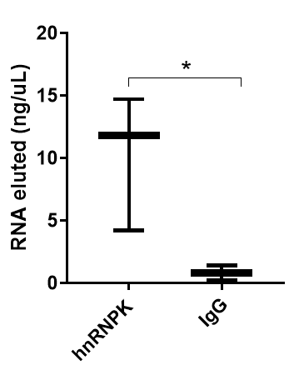
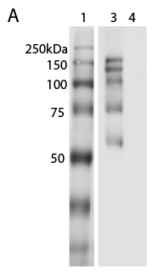
hnRNPK co-localizes with miR-148a, but does it bind?
Crosslinked immunoprecipitation: pull down hnRNPK and its binders, including RNA.
hnRNPK
immunoblot
hnRNPK IP
rabbit IgG

Slide 22
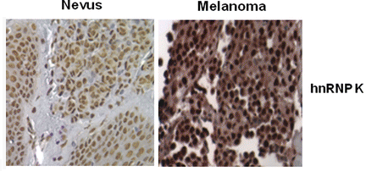
Heterogeneous Nuclear RiboNucleoProtein K
hnRNPK regulates mRNA metabolism and transport in/from the nucleus in complex with other hnRNP members and chromatin remodeling. (Review Chaudhury 2010)
Individual function not fully understood.
Overexpressed in cancer with aberrant cytoplasmic localization. (Wen et al 2010, Barboro 2014, Propepper 2011)
Often the cytoplasmic location of hnRNPK isn’t clear.
hnRNPK commonly exported in advanced cancer derived EVs
(Zhang 2015, Ji 2013, Welton 2010, Remteke 2015)
Notes:
Memebers of the hnRNP family appear to be involved with the export of mirs in other cell lines, which indicates that FUS or hnrnpk may be better suited for this role… Linker: together, this indicates that hnRNPK fulfills the criteria for export protein.

Slide 23
Motif Discovery: MEME
Unbiased approach to find most similar string of nucleotides in inputted sequences.
Seq 1 | AUGCCC
Seq 2 | CCCGAG
Seq 3 | CCCUGU
Assign randomly positions (red)
Where are these positions?
How well do these match?
Does this positions match the expectation?
Maximise the positions.
Background: A 0.25 U 0.25 G 0.25 C 0.25
1. | p1 | p2 | p3 | P4
S1 | 1 | 0 | 0 | 0
S2 | 0 | 0 | 1 | 0
S3 | 0 | 0 | 0 | 1
2. | 1 | 2 | 3
A | 1 | 0 | 1
U | 1 | 1 | 1
G | 0 | 2 | 1
C | 1 | 0 | 0
1 | 2 | 3
0.33 | 0 | 0.33
0.33 | 0.33 | 0.33
0 | 0.66 | 0.33
0.33 | 0 | 0
AUG = 0.33*0.33*0.33= 0.035
CGA = 0.33*0.66*0.33= 0.071
UGU= 0.33*0.33*0.33= 0.035

Slide 24
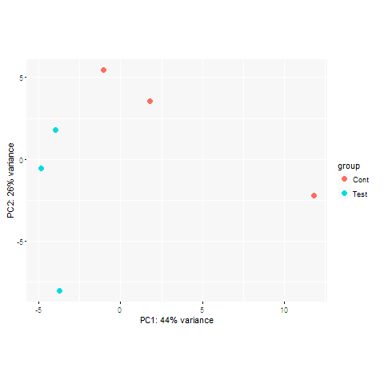
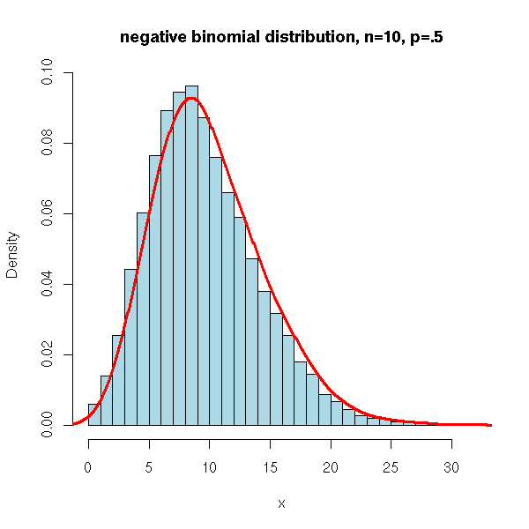
DESeq2 pipeline:
Quality control
Normalise across replicates to negative binomial dist.
Diff. Analysis:
Log2FoldChange, Standard Error, and Wald test pvalue.
PCA plot

Slide 25
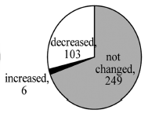
Lipid rafts, caveolin, cavin-1 and hnRNPK
PC3- cavin-1 cells
PC3 cells
+Cavin-1
-- Cholesterol
-- associated
proteins
Lipid rafts contained in EVs
hnRNPK is a known lipid raft protein
Cavin-1 also modified the amount of hnRNPK in lipid rafts, may include EV lipid rafts??
Proteins modified in lipid rafts between cell lines

Slide 26
MicroRNA biogenesis and Function:

