Slide 1
Selective Export of MicroRNAs via Extracellular Vesicles

Slide 2
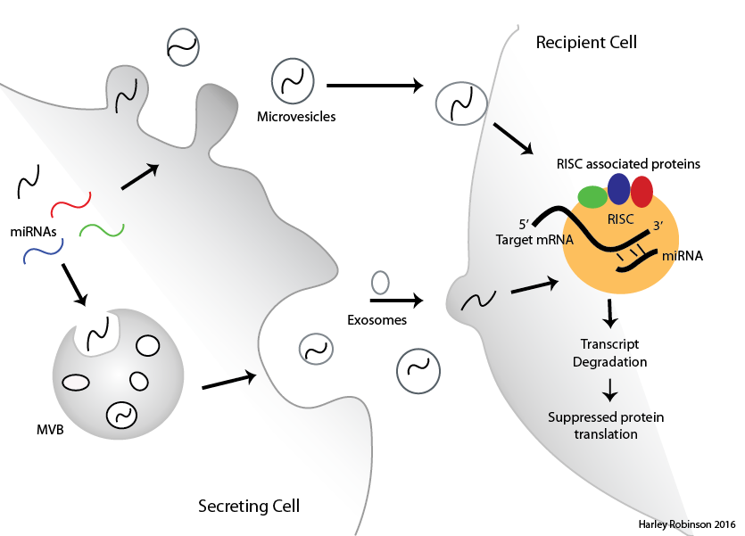
MicroRNAs in Extracellular Vesicles

Slide 3
PC3 cell line.

Slide 4
Aims:
Identify the selectively exported miRNAs
Identify RNA-binding proteins correlated to the miRNA export
Verify candidate miRNA escort proteins ability to bind to miRNAs and transport to extracellular vesicles.

Slide 5
Selective Exported miRs.
Methods and data.

Slide 6
Selectively Exported MiRs.
Correlation graph and table.

Slide 7
Selectively Exported MiRs.
qPCR results.

Slide 8
Aims:
Identify the selectively exported miRNAs
Identify RNA-binding proteins correlated to the miRNA export
Verify candidate miRNA escort proteins ability to bind to miRNAs and transport to extracellular vesicles.

Slide 9
RNA-binding proteins and Motifs.
Methods

Slide 10
Shared motifs found Differentially exported Mir
Sequence logos and networks.
Info about proteins that appear to correlate to these proteins.

Slide 11
Proteins correlate to differential export.

Slide 12
Aims:
Identify the selectively exported miRNAs
Identify RNA-binding proteins correlated to the miRNA export
Verify candidate miRNA escort proteins ability to bind to miRNAs and transport to extracellular vesicles.

Slide 13
Westerns and Immunofluorescence:

Slide 14
To Do:
Confirm miRNA-Protein interaction via pull down/Western/MS
Determine importance of Sumoylation on the proteins.
In vitro colocalization between protein and miRNA (using Cy5-oglio)
Figure out how cavin-1 is enduing its effects?

