Slide 1
Exosomes Secreted Under Hypoxia Enhance Invasiveness and Stemness of Prostate Cancer Cells by Targeting Adherens Junction Molecules.
Ramteke, Ting, Agarwal, Mateen, Somasagara, Hussain, Graner, Frederick, Agarwal And Deep. 2015
Notes:
Introduce name etc.
Somewhat related to my project, exosomes in PC3 cells, but I focus on miRNAs and the mechanism of export.

Slide 2
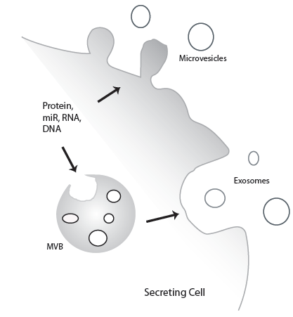
Exosomes.
Subpopulation of extracellular vesicles.
Intercellular communication
(Mulcahy et al 2014)
Limited details surrounding formation, sorting and content.
Strong links to roles in cancer, stress signaling and immunity (Campos et al. 2015; De Toro et al. 2015)

Slide 3
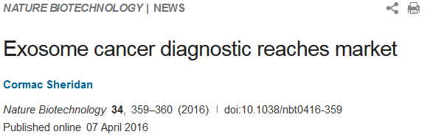
Exosomes in Cancer
Knockdown of exosome biogenesis, via RAB proteins reduced tumour growth and metastasis in Melanoma (Peinado H 2012)
Addition of Colorectal cancer derived exosomes to healthy cells induced migration (Chiba et al 2013)
Exact mechanism still investigated
Potential as a target for cancer diagnostics and treatment targets
Notes:
Rab27 allows for the return of the MVB to the plasma membrane.

Slide 4
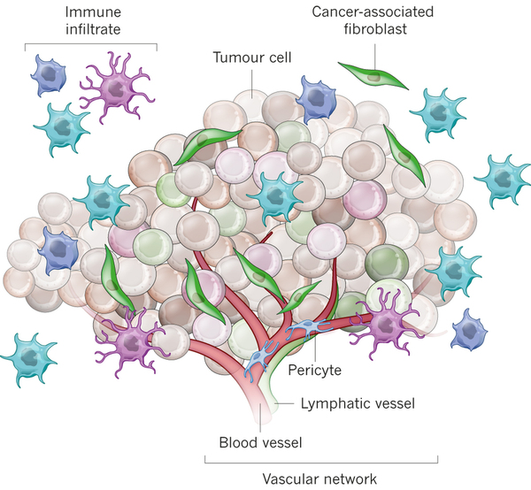
Hypoxia in Cancer
Tumour out grows vasculature = hypoxia.
Aggressive phenotype linked with hypoxia (Vaupel 2008)
Hypoxia mediated metastasis: mechanism unclear.
Link between hypoxia and microenvironment (Kim et al 2009)

Slide 5
Hypotheses and Aims
Hypothesis:
Hypoxic prostate tumour cells secrete exosomes, absorbed by surrounding cells, which enhance cancer cell invasiveness and metastasis.
Aims:
Establish the differences in exosome content between hypoxic and normoxic cells.
Determine the invasiveness, migration and stemness induced by hypoxic exosomes.
Elucidate the causative agent induced by the hypoxic exosomes.

Slide 6
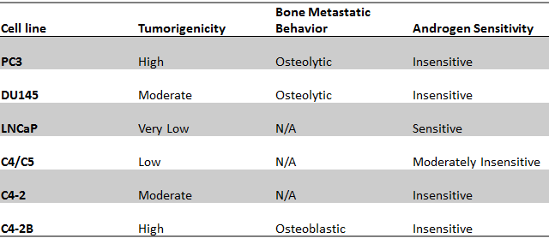
Cell Lines and Conditions
Use of LNCaP and PC3 cells.
Hypoxic conditions set to 1% oxygen.
Exosomes collected using ultracentrifugation or from kits.
Figure 1 assesses exosome distribution.

Slide 7
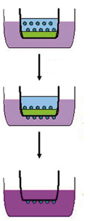
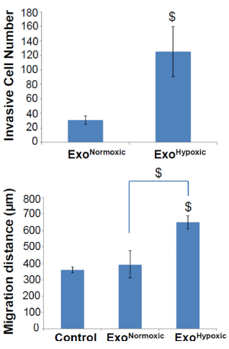
Can EXO^{hyp} induce invasiveness?
Invasion Assay: 24hrs incubation after exposure to hypoxia or normoxia derived exosomes.
Approximately 6 fold increase of invasion when incubated with EXO^{hyp}.
Notes:
LNCaP exo applied to LNCap cells. Invasion assay, 4samples

Slide 8
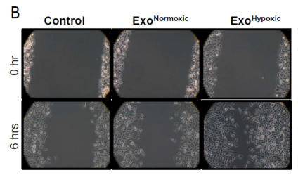
Does EXO^{hyp} induce migration?
Standard stratch assay: images and migration distance measured.
Stemness also assessed g Similar results.
Notes:
LNCaP exo applied to PC3 cells. Never specified control. How was the wound measured accurately?

Slide 9
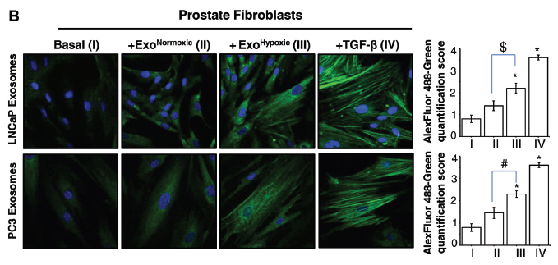
Can EXO^{hyp} induce CAF phenotype?
Fibroblasts can be stimulated: by inflammation or cancer.
Stimulation results in increased alpha-smooth muscle actin (ɑ-SMA).

Slide 10
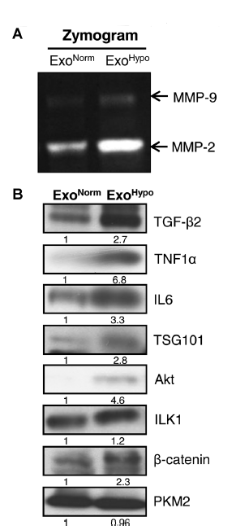
Is there distinct proteomic content?
MMPs implemented in angiogenesis and metastasis and enhanced in hypoxic cells.
Cytokines, growth factors and signalling molecules known to play role in tumour microenvironment.
All of the above increased in EXO^{hyp}, bar PKM2.
Not comprehensive.

Slide 11
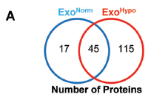
Does this protein content mediate any particular pathways?
Mass spectrometry.
Pathways:
Cell adherence and cytoskeletal
Remodeling of Epithelial adherens junctions
Signalling:
Endocytic
Enrichment in adherens junction pathways.

Slide 12
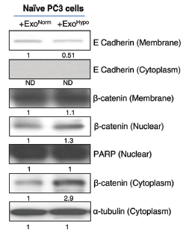
Are adherens being targeted?
Adherens Junction proteins: E-cadherin bound to cytosolic beta-catenin.
PARP (nuclear control)
Alpha-tubulin (cytoplasmic control)
Decrease in membrane E-cad resulted in increased nuclear and cytoplasmic catenin.

Slide 13
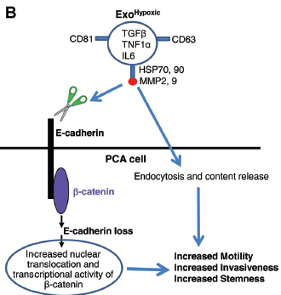
Conclusion and Proposed Mechanism
Hypothesis:
Hypoxic prostate tumour cells secrete exosomes, absorbed by surrounding cells, which enhance cancer cell invasiveness and metastasis.…..
SUPPORTED!
PLUS: suggested how this occurs.

Slide 14
Limitation and strengths, future directions.
Strengths:
Supported the hypothesis.
Use of several cell lines.
Great starting point
Limitations:
Lacking control
Not stating controls
Non-innovative
Future directions:
Further assess the proposed mechanism
Additional pathways
Explore other avenues; eg RNA.

Slide 15
Questions?

Slide 16
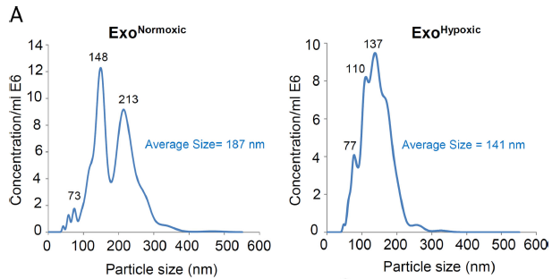
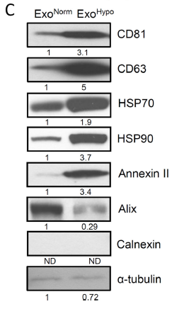
Is there a difference in exosome population?
Lysed Exosomes analyzed for typical vesicular markers via Western Blot.
Nanoparticle tracker analysis: size ∝ motion ∝ subpopulation
Important to determine subpopulation due to differing biochemisty, biogenesis etc..
Notes:
Lncap exosomes

Slide 17
Prostate Cancer (PCA)
High incidence, low mortality UNLESS.. Metastatic.
Advanced PCA results in survival of 12-15months.
Tends to spread to bone or lymph nodes.
Necessity to understand metastasis and progression
(GLOBOCAN 2012)

