Slide 1
Control of extracellular vesicle microRNA export in prostate cancer.
Harley Robinson. Alex Cristino. Michelle Hill
Hill And Cristino Group.

Slide 2
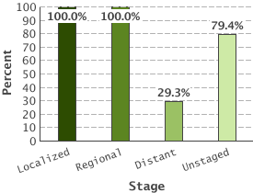
Prostate Cancer
5 Year Relative Survival:
Prostate cancer by stage
2nd highest diagnosed cancer in men worldwide
(SEER 2016)
Bone metastasis leads to poor outcome.
(Body et al 2015)
Metastasis reduced 5 year survival to 29.3%
(SEER 2016)
(SEER 2016)
Notes:
Linker.. This highlights the need to identify biomarkers or biological phenomena that are involved with the metastatic phenotype.

Slide 3
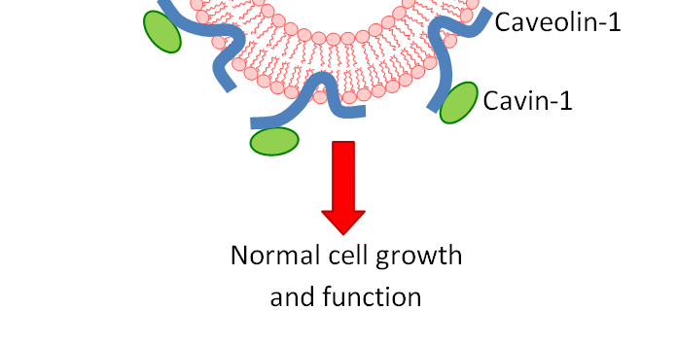
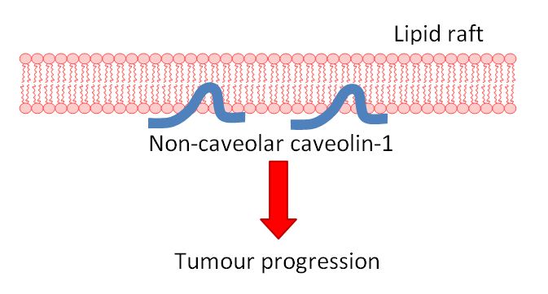
Caveolin-1 and Cavin-1 in Cancer;
Healthy Tissue
Caveolin-1 biomarker for cancer progression.
(Freeman 2012)
Co-expression with cavin-1 in healthy cells.
(Inder 2012, Moon 2014)
Cav1 overexpression linked to metastasis.
(Bennett 2009)
Knock down or addition of cavin-1 reduces metastasis. (Sugie 2015, Inder 2014)
Tumour
?
Notes:
An important biomarker in cancer progression is caveolin-1… Linker: kd or addition of cavin-1 was found to reduce this phenotype in prostate cancer cells.

Slide 4
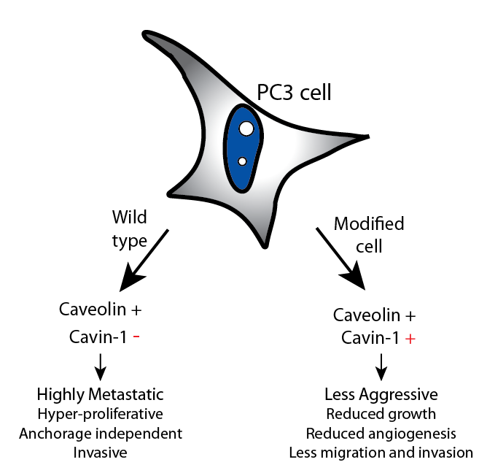
PC3: advanced prostate cancer
Notes:
.. Specifically, cavin-1 added to PC3 cell lines. PC3 cell lines are pro-metastatic prostate cells, derived from a patient with bone metastasis, therefore are suitable cell lines for cancer progression. …. Linker: This establishes

Slide 5
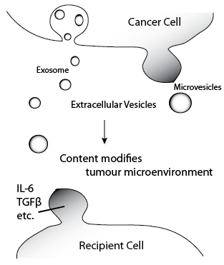
Extracellular Vesicles
Intercellular communication by transfer of cytoplasmic material (Zaborowski 2015)
Cancer derived EVs have roles in tumour microenvironment modifications. (Webber 2015)
Protein content of EVs commonly researched
Cavin-1 modulated EV protein content.
(Inder 2014)
Notes:
We’ve used this system to assess the role of extracellular vesicles in Prostate cancer. …

Slide 6
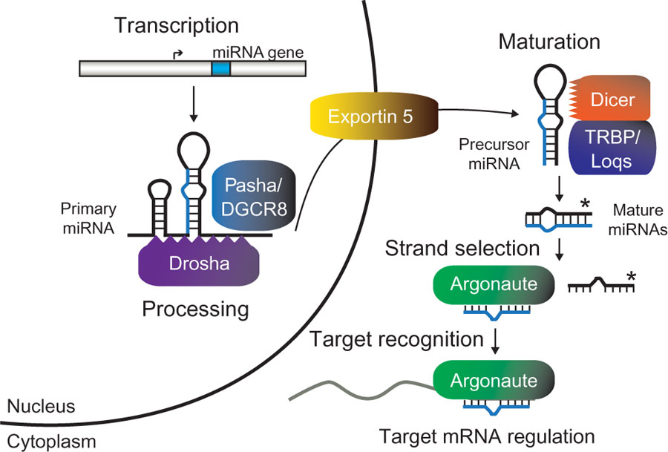
MicroRNAs
Kai et al 2010
Notes:
These small non-coding RNAs get processed into a hairpin, then shuttled out of the nucleus where after further maturation allows complimentary binding to protein transcipts. This results in their degradation. While we know some of these details relating to micrornas, there is much to still be determined. For instance, microRNAs had been found in many cellular compartments, including EVs. Yet, how and why is unknown.

Slide 7
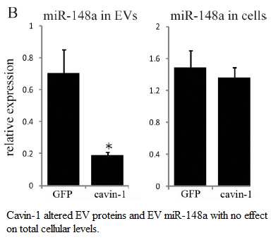
MicroRNAs in EVs
EVs have been proposed as vehicles for microRNAs. (Cheng 2014)
MiR-148a exported from PC3 cell line.
No change to cellular expression
Indicates some form of export mechanism
rather than sampling.
(Inder 2014)

Slide 8
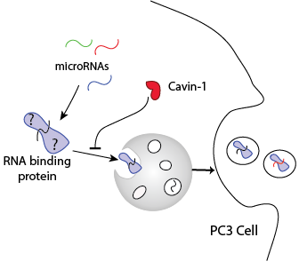
Hypothesis:
RNA binding protein mediates export of microRNAs in PC3 cells where expression of cavin-1 limits protein export and therefore, microRNA export.
Aims:
Identify miRs exported in this system
Identify candidate export protein
Investigate the interaction between export protein and miR
Caveolin+

Slide 9
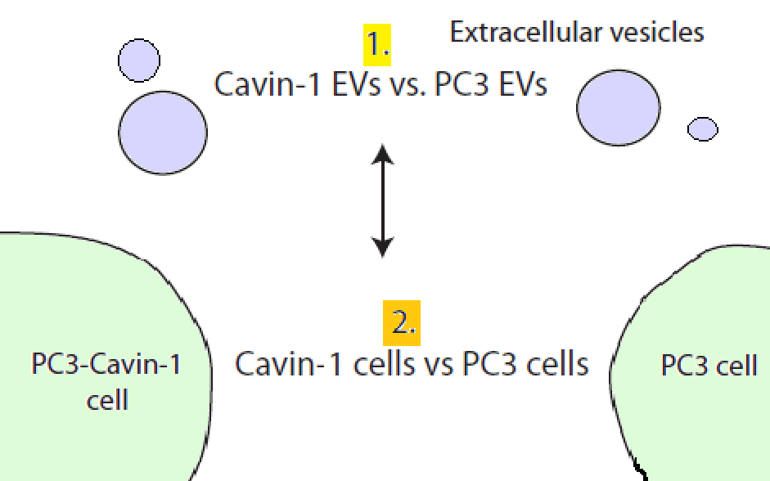
RNA-seq and Differential Expression analysis
3 total RNA EV and cognate cell samples for PC3-GFP and PC3-GFP tagged Cavin-1 (PC3-cavin-1) cell lines.
RNA-seq for small RNAs, via Illumina sequencing. I received the resulting raw counts for miR species.
DESeq2 analysis for R.

Slide 10
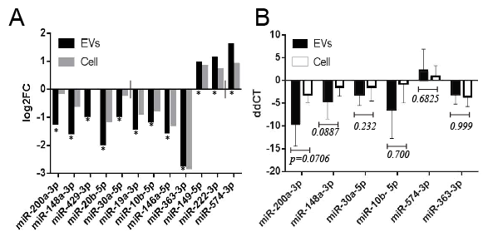
MicroRNAs are selectively exported
95 miRs detected in EVs.
12 miRs significantly modified by cavin-1 in EVs.
Presence in EVs due to sampling or selective export: predict by comparing to cell

Slide 11
RT-qPCR validation
EV and cell collection
RNA extraction
cDNA and poly-A tailing
RT-qPCR
Delta delta CT analysis

Slide 12
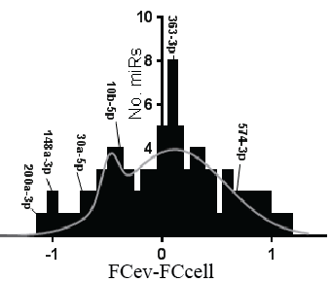
Distribution of miR export
19 miRs selectively exported

Slide 13
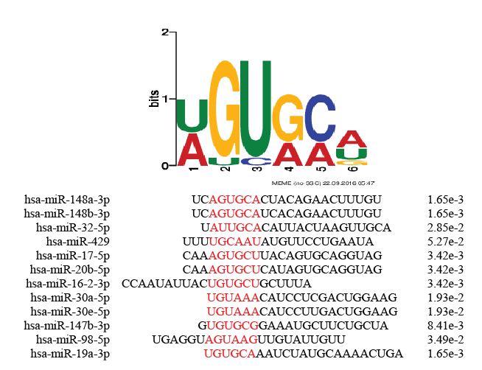
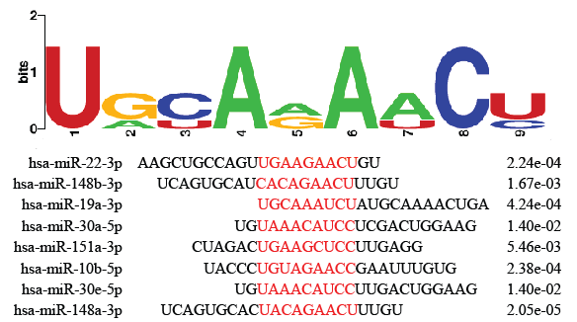
Motifs enriched in exported miRs
Hypothesis: Exported microRNAs share sub-sequences that RNA-binding export proteins bind to.
8/19
12/19
Together, match 14/19 exported miRs

Slide 14
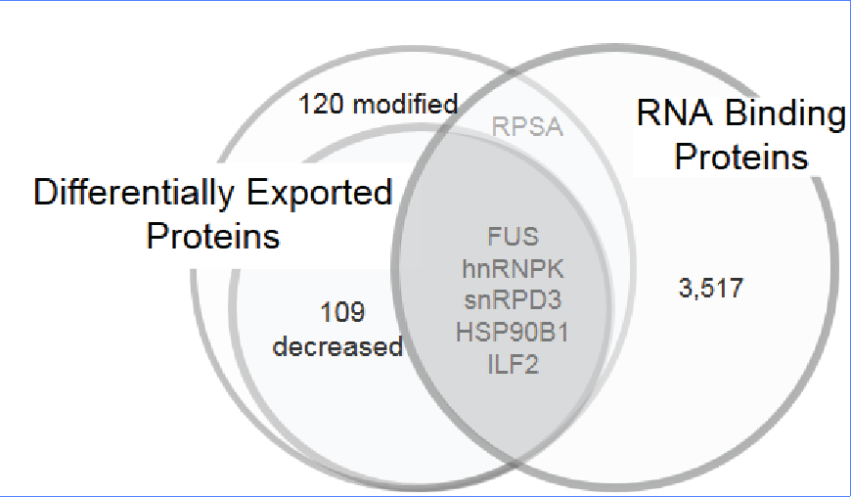
RNA-binding proteins differentially exported
Hypothesis:
Export proteins:
Possess differential export due to cavin-1
Possess RNA binding ability
Predicted to bind the exported miRs.
MS/MS compared proteomic content of EVs from PC3 and PC3-cavin-1 cells. (Inder 2012)
Gene Ontology analysis for RNA binding.

Slide 15
hnRNPK: viable export protein
hnRNPA2B1 mediates export of miRs in T-lymphocytes
(Villarroya-Beltri 2013)
hnRNPK commonly exported in cancer derived EVs
(Zhang 2015, Ji 2013, Welton 2010, Remteke 2015)
hnRNPK binds to miR-122 at AGUGUG region. (Fan 2015)
FIMO prediction matches motif to this region (p=0.0435)
hnRNPK fulfils all criteria for the candidate export protein

Slide 16
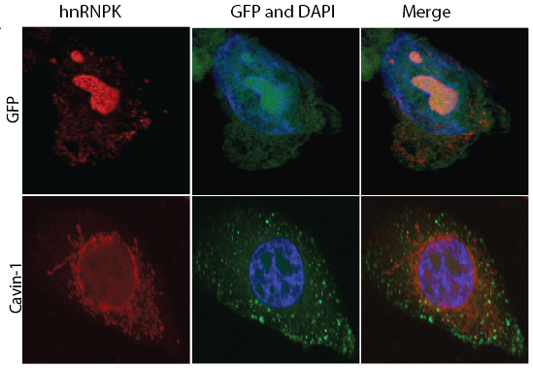
Subcellular localization of hnRNPK modified
Compare PC3 to PC3-cavin-1 cell line to assess difference in activity.

Slide 17
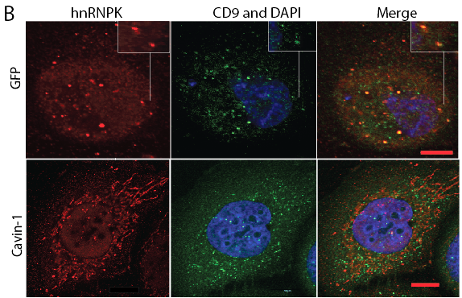
hnRNPK changes between MVB and ER
CD9 is a MVB and
exosome marker

Slide 18
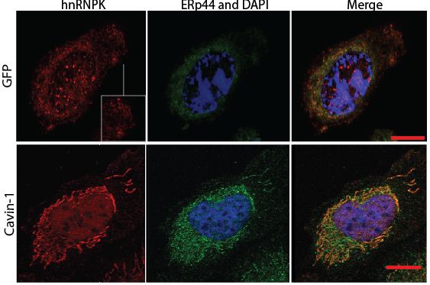
hnRNPK in ER in cavin-1 cells
ERp44 is a resident
ER protein

Slide 19
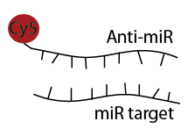
microRNA in situ hybridization
Similar concept to FISH
Fluorophore tagged complimentary RNA hybridizes to target
In addition with IF for hnRNPK localization

Slide 20
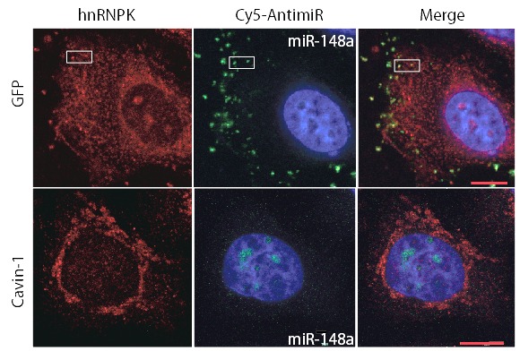
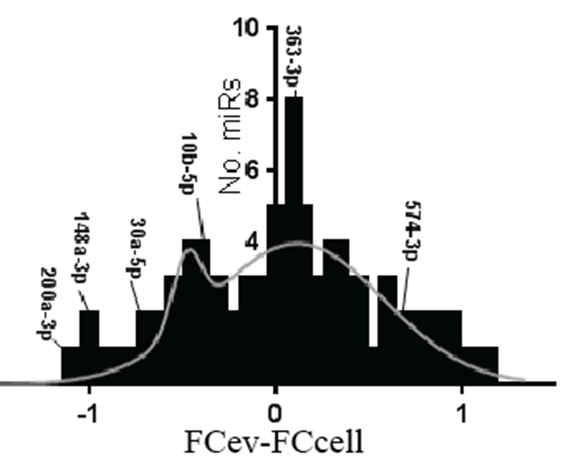
hnRNPK co-localizes with miR-148a
Mir-148a

Slide 21
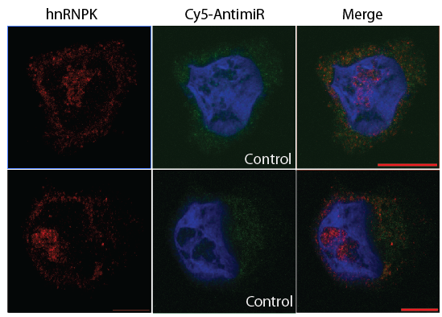
Scrambled 148a as control. Won’t bind hnRNPK or localize to nucleolus

Slide 22
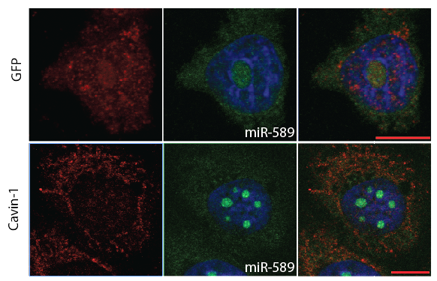
miR-589 is believed to be exported due to sampling

Slide 23
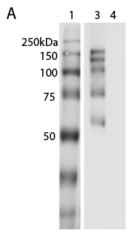
hnRNPK binds RNA
hnRNPK co-localizes with miR-148a, but does it bind?
RNA immunoprecipitation: pull down hnRNPK and its binders, including RNA.
1- ladder
3 – hnRNPK IP
4 – Control; rabbit IgG
 | RNA eluted (ng/µL)
 | hnRNPK IP | IgG Control
1 | 11.78 | 1.40
2 | 4.20 | 0.20
3 | 14.7 | 0.80

Slide 24
Acknowledgements
Hill Lab
Alex Cristino
Amanda Oliver

