Slide 1
Control of extracellular vesicle microRNA export in prostate cancer.
Harley Robinson.
Supervisor: Assoc.Prof Michelle Hill
Co-supervisor: Dr. Alexandre Cristino

Slide 2
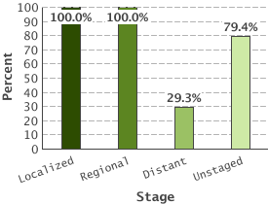
Prostate Cancer
5 Year Relative Survival:
Prostate cancer by stage
2nd highest diagnosed cancer in men worldwide
(SEER 2016)
Bone metastasis leads to poor outcome.
(Body et al 2015)
Metastasis reduced 5 year survival to 29.3%
(SEER 2016)
(SEER 2016)
Notes:
Diagnostics, advanced= increased mortalities due to additional comorbidities. Need to identify biomarkers and processes that contribute to metastatic progression.

Slide 3
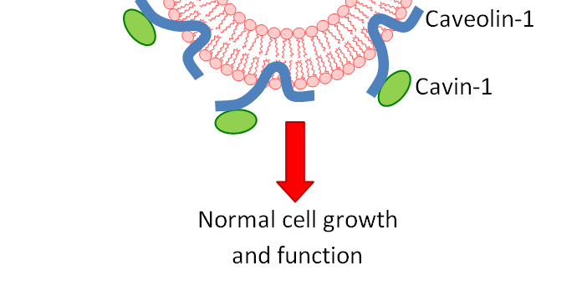
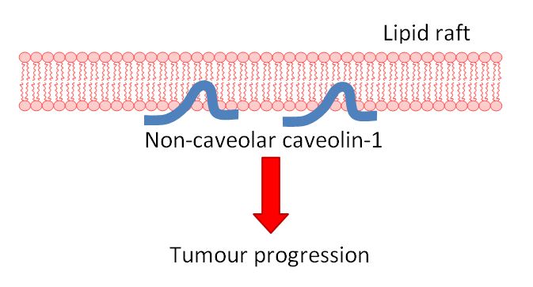
Caveolin-1 and Cavin-1 in Cancer;
Healthy Tissue
Caveolin-1 biomarker for cancer progression.
(Freeman 2012)
Co-expressed with cavin-1 in healthy cells.
(Inder 2012, Moon 2014)
Cav1 overexpression in advanced prostate cancer, PC3, cells linked to metastasis.
(Bennett 2009)
Knockdown or addition of cavin-1 in PC3 reduces aggressiveness. (Sugie 2015, Inder 2014)
Tumour
?
Notes:
An important biomarker in cancer progression is caveolin-1… Linker: kd or addition of cavin-1 was found to reduce this phenotype in prostate cancer cells.

Slide 4
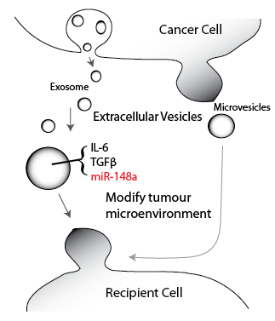
Extracellular Vesicles in Cancer
Cancer derived EVs have roles in tumour microenvironment modifications. (Webber 2015, Neviani et al 2015)
Intercellular communication by transfer of cytoplasmic material (Zaborowski 2015)
Cavin-1 modulated EV protein and microRNA content. (Inder 2014)
Notes:
One novel mechanism revealed in recent years is the role of extracellular vesicles in cancer progression.
While we predominately investigated proteomic content, another interesting finding that indicated microRNAs may also be used in this role.

Slide 5
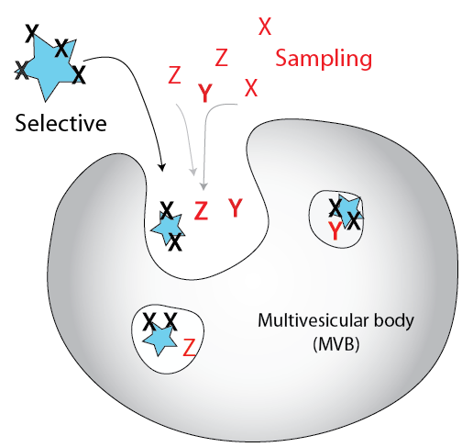
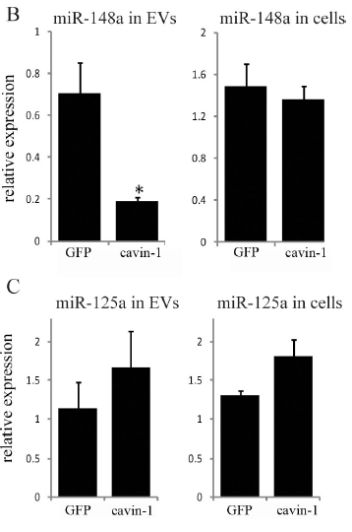
Cargo loading by sampling or export
Put smapled microrna in.
Put in diagram
(Inder 2014)
Notes:
Recently, vesicle contained microRNAs had been implemented in cancer progression. Alike protein, the EV transported microRNAs have been reported to modulate microenvironments and pre-metastatic niche formation, but through their canonical function. MicroRNAs are small non-coding RNAs that mediate post-transcriptional gene silencing through complementary base pairing to target protein transcripts or messenger RNA for degradation. This is particularly important when you consider that a single microRNA can target hundreds of protein transcripts and therefore modulates many vital cellular pathways. Hereby, being transported between cells could be viable from of intercellular communication, or a major source of disarray in disease states. Previous work using the PC3-cavin-1 cell model found that the prostate cancer cells did secrete oncogenic material, namely mir-148a, whereas the less tumorigenic cell did not. Interesting, this modification was not reflected by a change in cellular expression. This indicates that there is some form of export mechanism that populates the microRNA content of the EVs in prostate cancer. However what this is is unknwn.

Slide 6
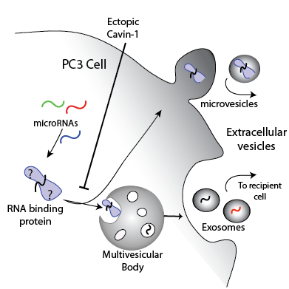
Hypothesis:
Cavin-1 expression in PC3 cell limits the extracellular vesicle export of a subset of microRNAs by modulating the export of their RNA-binding proteins
Aims:
Identify miRs exported in this system
Identify candidate export protein
Investigate the interaction between export protein and miR
Caveolin +ve

Slide 7
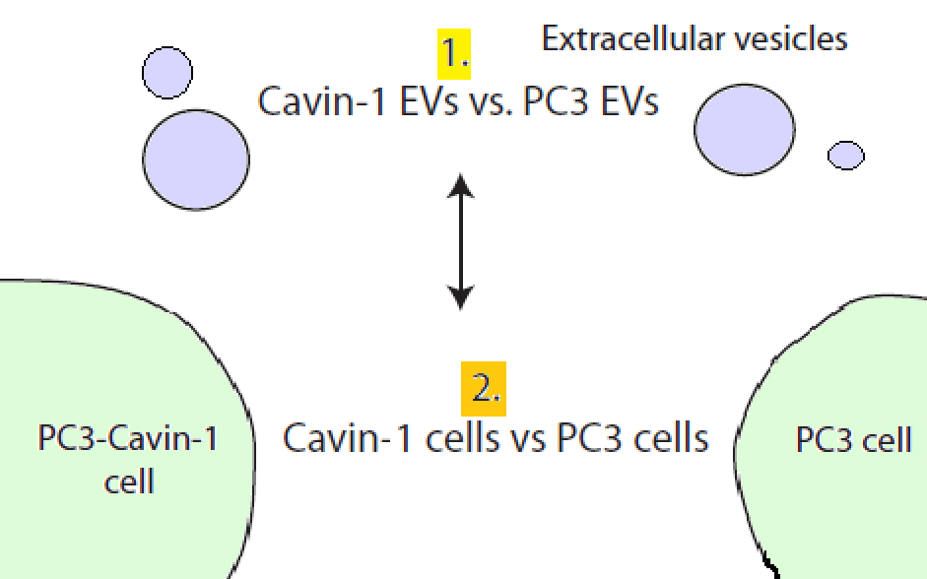
Aim 1. Identify miRNAs exported in this system
Selective vs sampling export.
3 replicates prepared by Jayde Ruelcke
RNA-seq by Nicole Cloonan
DESeq2 analysis for R.
Analyses differences in export
Analyses differences in expression

Slide 8
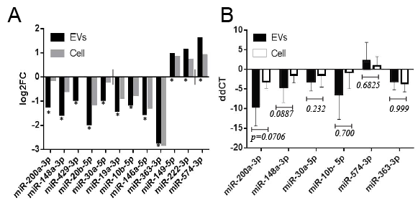
MicroRNAs are selectively exported
95 miRs detected in EVs.
12 miRs significantly modified in EVs by cavin-1 expression.
Both sampling and selective export occurring.
* p ≤ 0.05 from Wald p-value test
Used to compare between cell lines

Slide 9
RT-qPCR validation
EV and cell collection
RNA extraction
cDNA synthesis and poly-A tailing
RT-qPCR
Delta delta CT analysis
Normalized to miR-125a-3p
Mann-Whitney U test

Slide 10
Aim 2. Identify candidate export protein
Hypothesis:
Cavin-1 expression in PC3 cell limits the extracellular vesicle export of a subset of microRNAs by modulating the export of their RNA-binding proteins
RNA-binding proteins bind to conserved RNA regions.
Caveolin+

Slide 11
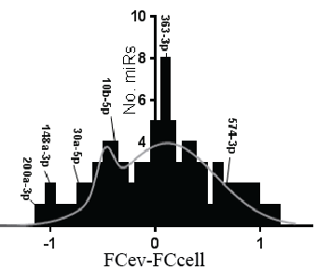
Expanding the sample set
19 miRNAs selectively exported, most with links to cancer.
Notes:
… We now know which micrornas are being selectively exported from this system, some of which are validated, that can be used to understand mechanism overall. Next we wanted to understand whether these microRNAs possess similarities to explain their export.

Slide 12
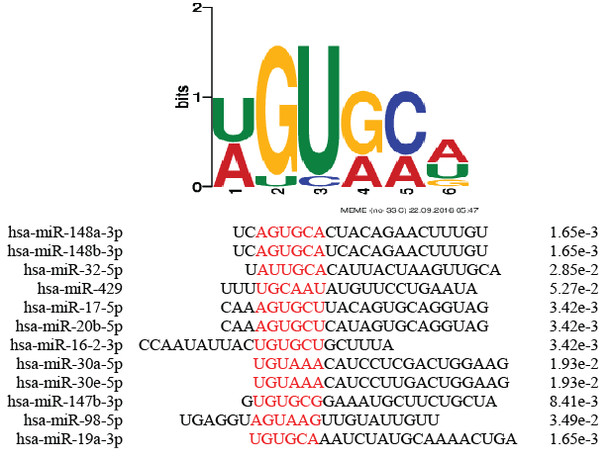
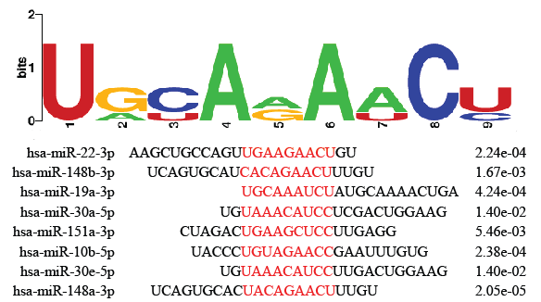
Motifs enriched in exported microRNAs
Exported microRNAs share sub-sequences that RNA-binding export proteins bind to.
8/19
12/19
Together, match 14/19 exported miRNAs.
No matches to sampled microRNAs.
Notes:
Used the 19 micrornas that were selectively exported, from last analysis.
MEME: 4-10 nucleotides in length.
x/19 is how many of the miRs contained that motif.

Slide 13
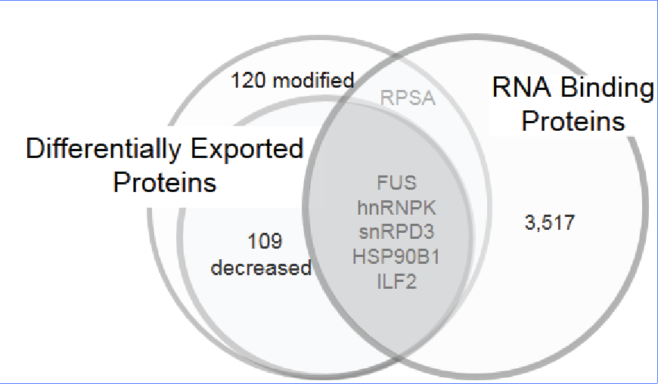
Quantitative proteomics of EVs
Export proteins should:
Possess differential export due to cavin-1
Possess RNA binding ability
Predicted to bind the exported miRs.
MS/MS compared proteomic content of EVs from PC3 and PC3-cavin-1 cells. (Inder 2012)
Gene Ontology analysis for RNA binding.
Notes:
Next we looked at potential proteins that could be interacting with those selectively exported micrornas… Based on this criteria… From this analysis we found 5 proteins that could be potential export proteins. We then assessed these further by looking into the literature to determine if any of these proteins are more suited for the position.

Slide 14
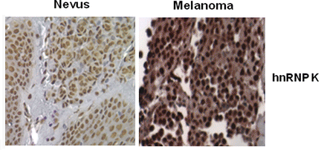
Heterogeneous Nuclear RiboNucleoProtein K as a viable export protein
hnRNPK predicted to match to the selective exported motif (p=0.0435, via FIMO prediction).
hnRNPK usually complex with hnRNP members for regulation of mRNA metabolism and transport in/from the nucleus.
Overexpressed in cancer with aberrant cytoplasmic localization
hnRNPK commonly exported in cancer derived EVs
(Zhang 2015, Ji 2013, Welton 2010, Remteke 2015)
Notes:
Memebers of the hnRNP family appear to be involved with the export of mirs in other cell lines, which indicates that FUS or hnrnpk may be better suited for this role… Linker: together, this indicates that hnRNPK fulfills the criteria for export protein.

Slide 15
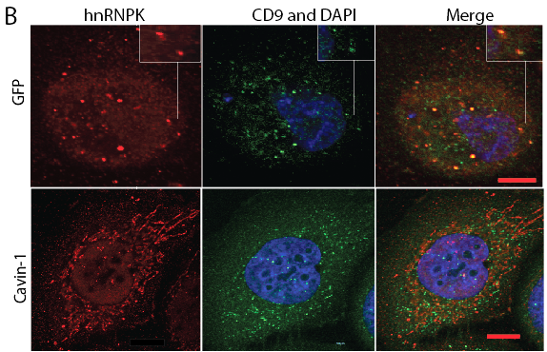
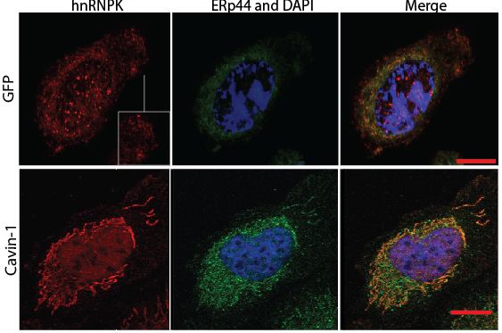
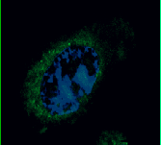
hnRNPK translocate between MVB and ER
Scale bar= 10µm
hnRNPK ERp44 and DAPI Merge
PC3
PC3-Cavin-1
CD9 is a MVB and exosome marker
ERp44 is a endoplasmic reticulum marker
Notes:
Next, we wanted to know what those punctate structures were… CD9 is a common marker used to determine…. Here we found that hnRNPK is found somewhat in forming exosomes, the smaller of the EVs suppopulations, that is not occurring in the cavin-1 cell lines, consistent with what the mass spectrometry data indicated.

Slide 16
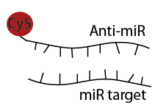
Aim 3. Investigate the interaction between export protein and microRNA. microRNA in situ hybridization
Similar concept to FISH
Fluorophore tagged complimentary RNA hybridizes to target
In addition with IF for hnRNPK localization
Notes:
Next, we wanted to know and confirm that hnRNPK actually interacts with its predicated targets. We attempted to do this in two separate ways: by looking at in situ colocalization, and binding interaction. So first we used a methology similar in concept to FISH, but slightly modified.

Slide 17
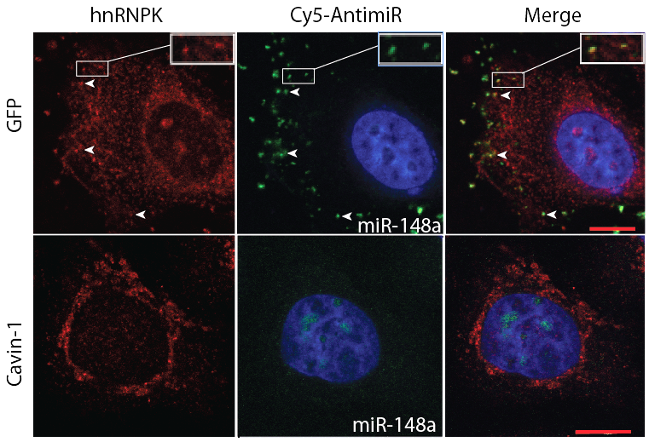
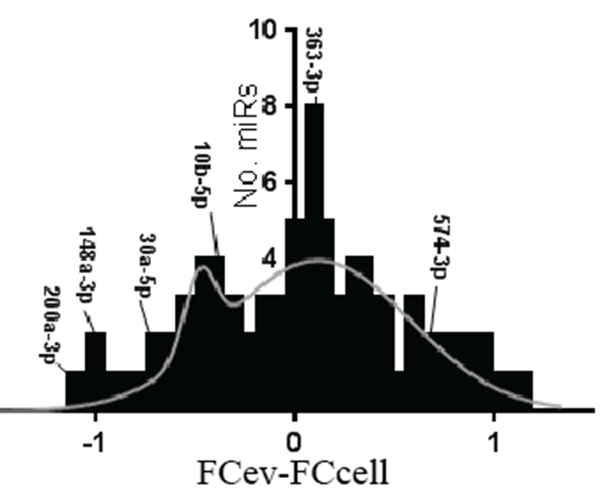
hnRNPK co-localizes with miR-148a
miR-148a
PC3
+ miR-148a contains
binding motif
PC3-Cavin-1

Slide 18
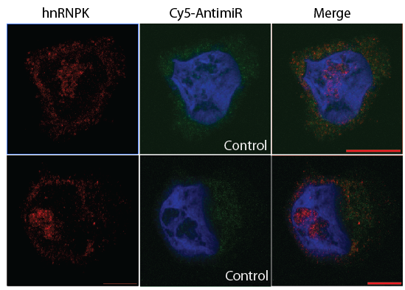
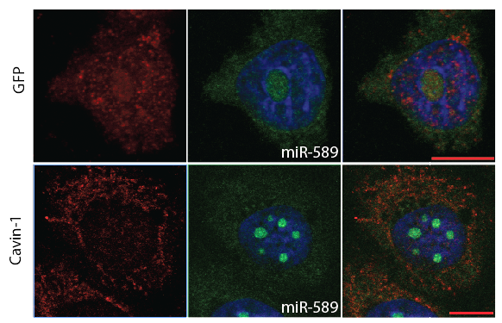
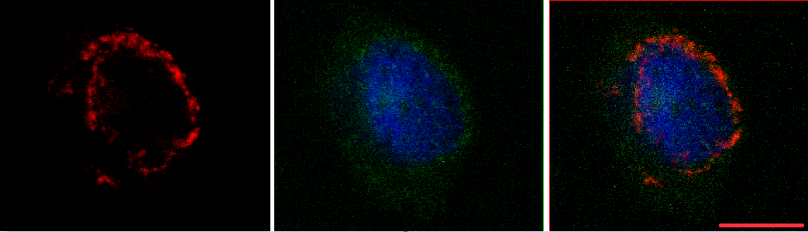
Scrambled-148a as control. Won’t bind hnRNPK or localize to nucleolus
hnRNPK Cy5-antimiR Merge
hnRNPK Cy5-antimiR Merge
PC3
PC3
PC3-Cavin-1
PC3-Cavin-1
miR-589: ‘sampling’.
No co-localization with hnRNPK or be found in puncta.

Slide 19
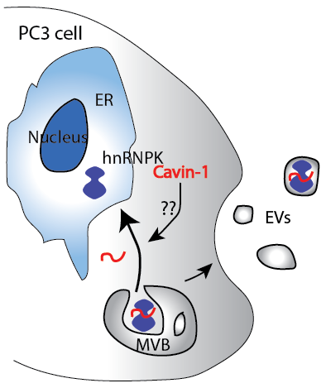
Conclusion:
Mechanism:
hnRNPK translocate to MVB/exosomes
Presence and absence of hnRNPK in MVB correlates to miRNA change.
Addition of cavin-1 limits hnRNPK in EVs potentially by sequestering to ER
Therefore reduces miRNA export

Slide 20
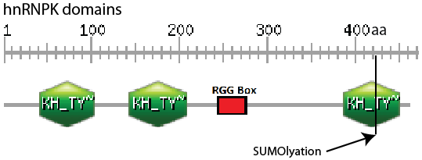
Future directions and significance:
Confirm hnRNPK- miRNA interaction: optimized pull-down assays and further validations.
Assess the link between cavin-1 and hnRNPK activity: several hypotheses for this.
Significance:
Extracellular vesicle cargo regulation
microRNA regulation
Identification of underlying processes mediating advanced prostate cancer progression.
SUMO a Change in subcellular localization and binding of RNA.
(Lee et al. 2012, Paziewska et al 2004)
(Adapted from ScanProsite 2016)

Slide 21



Acknowledgements
Supervisors: Assoc. Prof Michelle Hill and Dr. Alex Cristino
Hill Lab:
Jayde Ruelcke
Amanda Oliver (Former)
UQDI microscopy facility
Nicole Cloonan and Kerry Inder for RNA-seq and MS results.

Slide 22
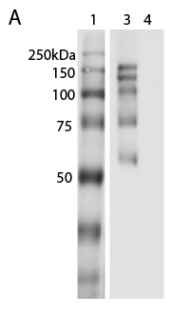
hnRNPK co-localizes with miR-148a, but does it bind?
Crosslinked immunoprecipitation: pull down hnRNPK and its binders, including RNA.
 | RNA eluted (ng/µL)
replicate | hnRNPK IP | IgG Control
1 | 11.78 | 1.40
2 | 4.20 | 0.20
3 | 14.7 | 0.80
hnRNPK
immunoblot
hnRNPK IP
rabbit IgG

