Slide 1
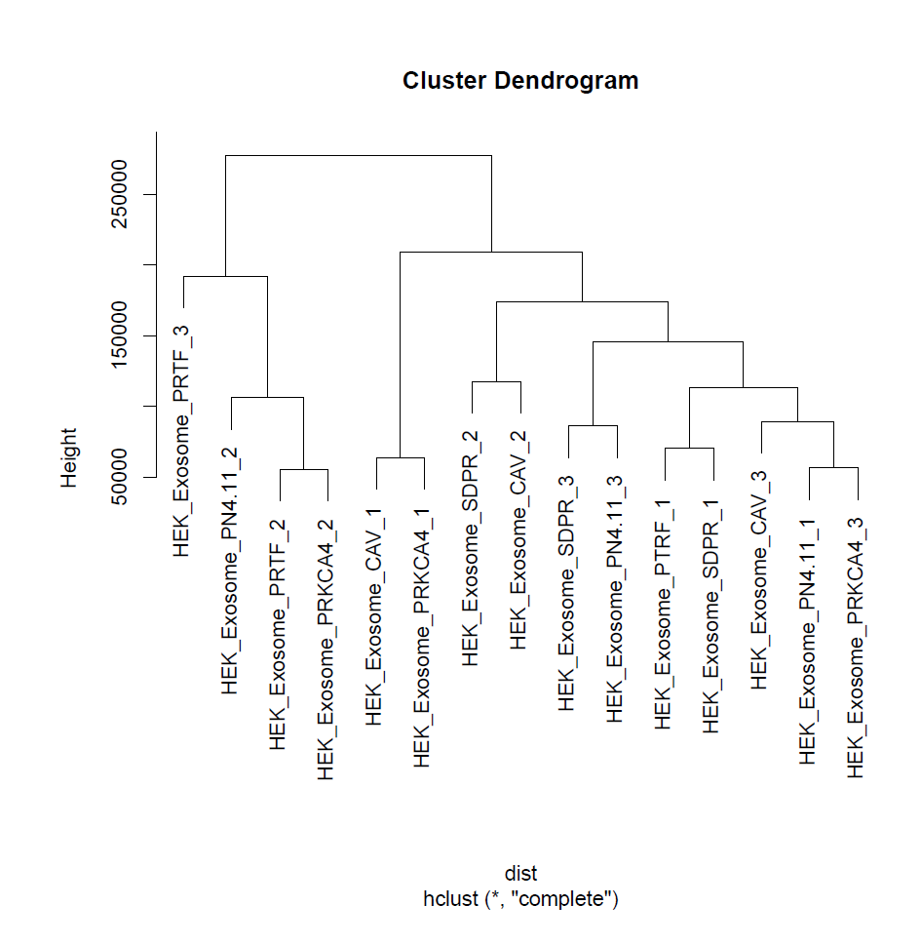
Notes:
HEK exo QC:
HEK exo dendrogram(left), HEK exo MDS (right)

Slide 2
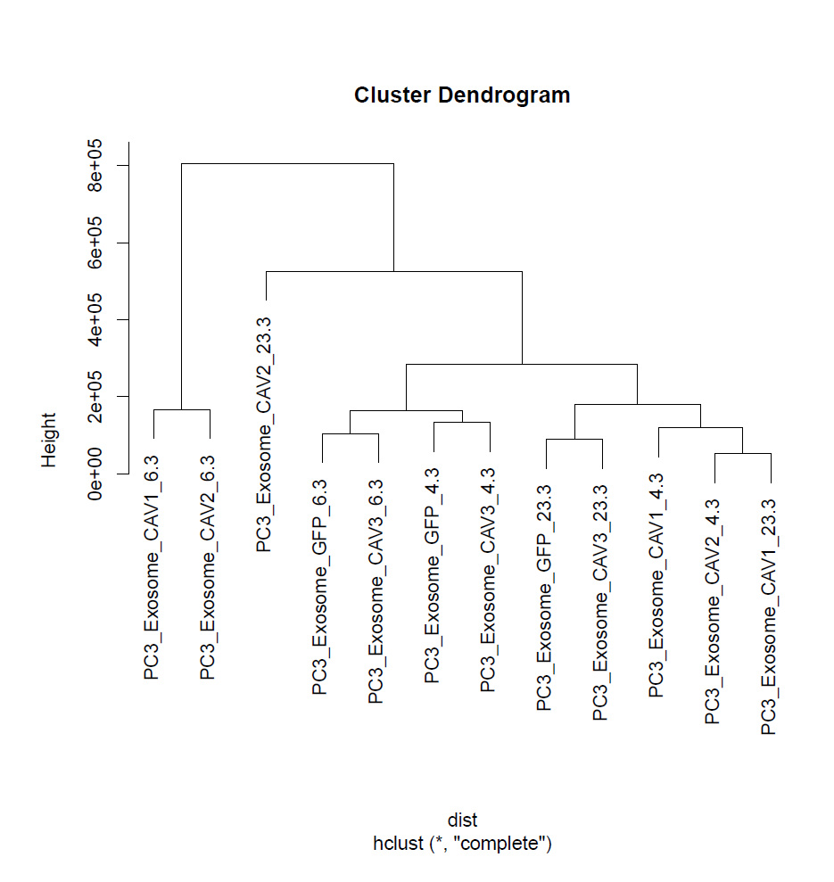
Notes:
PC3 QC
PC3 dendrogram (left), MDS(right)

