Slide 1
Control of extracellular vesicle microRNA export in prostate cancer.
Harley Robinson. Alex Cristino
Hill and Cristino Group.

Slide 2
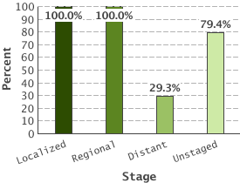
Prostate Cancer
5 Year Relative Survival:
Prostate cancer by stage
Highest diagnosed cancer in men worldwide
(SEER 2016)
Bone metastasis leads to poor outcome.
(Body et al 2015)
Metastasis reduced 5 year survival to 29.3%
(SEER 2016)
(SEER 2016)

Slide 3
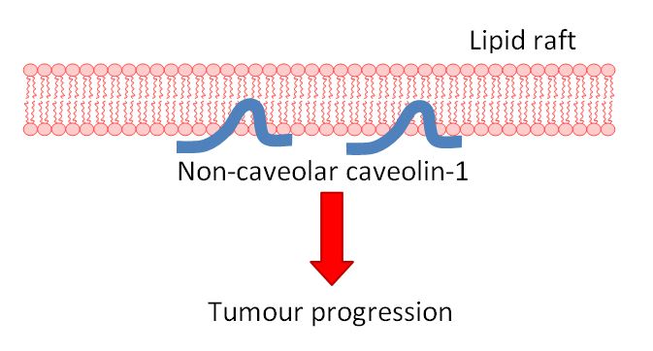
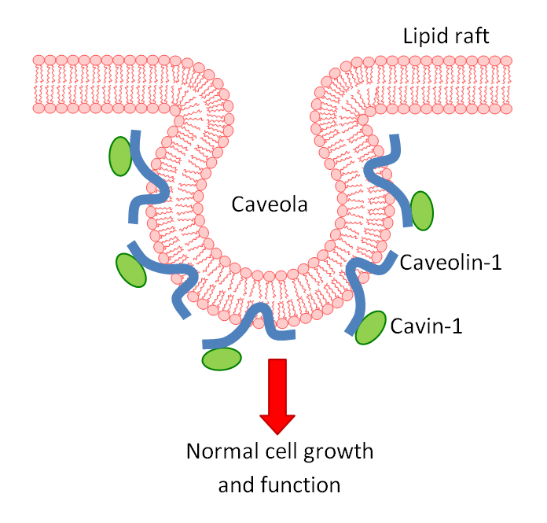
Caveolin-1 and Cavin-1 in PCa;
Caveolin-1 biomarker for cancer progression.
(Freeman 2012)
Co-expression with cavin-1 in healthy cells.
(Inder 2012, Moon 2014)
Overexpression linked to PCa metastasis.
(Bennett 2009)
Knock down or addition of cavin-1 reduces metastasis. (Sugie 2015, Inder 2014)

Slide 4
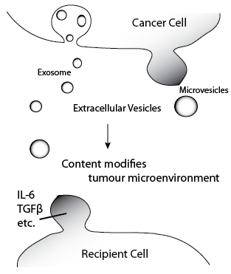
Extracellular Vesicles
Secreted vesicles containing cytoplasmic or sorted material. (Zaborowski 2015)
Transfer to other cells induces modifications
Cancer derived EVs have roles in tumour microenvironment modifications. (Webber 2015)
Protein content of EVs commonly researched

Slide 5
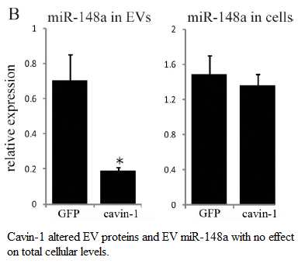
MicroRNAs in EVs
EVs have been proposed as vehicles for microRNAs.
MiR-148a exported from PC3 cell line.
No change to cellular expression
Indicates some form of export mechanism
rather than sampling.

Slide 6
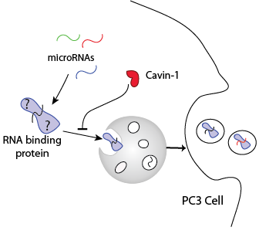
Hypothesis and Aims:
Aims:
Identify miRs manipulated by this system
Identify candidate export protein
Investigate the interaction between candidate and microRNAs
Caveolin+

Slide 7
RNA-seq and Differential Expression analysis

Slide 8
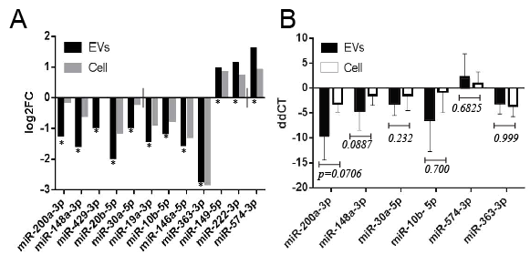
MicroRNAs are selectively exported
12 miRs significantly modified by cavin-1 in EVs.
Presence in EVs due to sampling or selective export

Slide 9
RT-qPCR validation
EV and cell collection
RNA extraction
cDNA and poly-A tailing
RT-qPCR
Delta delta CT analysis

Slide 10
Investigating similarities of miRs
EXAPLAINATION OF MOTIF ANALYSIS AND EXPANSION OF MIR SET

Slide 11
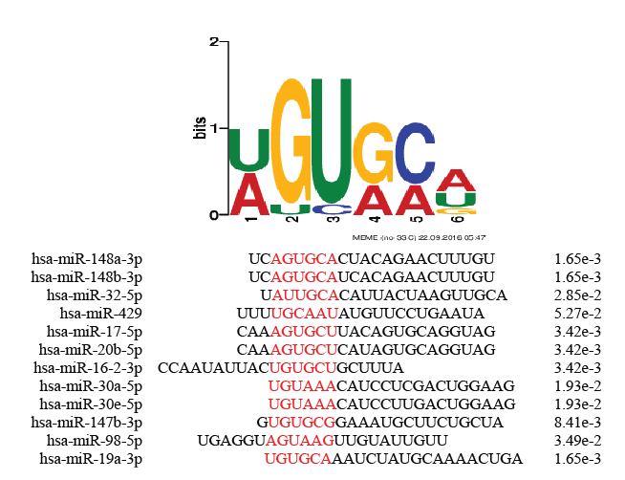
Motifs detected

Slide 12
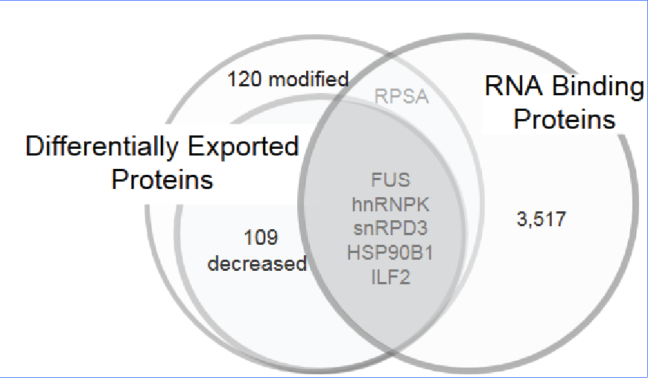
RNA-binding proteins exported
Candidate checklist:
Needs to be differentially exported
Must bind RNA
Predicted to bind the exported miRs.
MS/MS compared proteomic content of EVs from PC3 and PC3-cavin-1 cells.
Gene Ontology analysis for RNA binding.

Slide 13
hnRNPK: viable export protein
hnRNPK commonly exported in cancer derived EVs
hnRNPA2B1 mediates export of miRs in T-lymphocytes
hnRNPK binds to miR-122 at AGUGUG region.
FIMO prediction matches motif to this region (p=0.0435)
hnRNPK fulfils all criteria for the candidate export protein

Slide 14
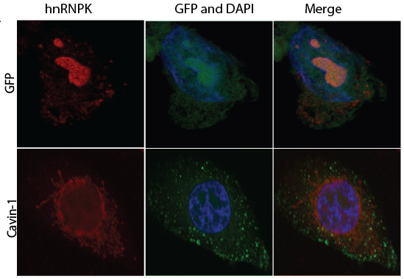
hnRNPK changes subcellular localization
Compare PC3 to PC3-cavin-1 cell line to assess difference in activity.

Slide 15
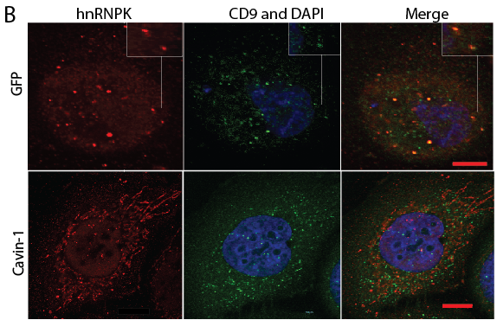
hnRNPK changes between MVB and ER
CD9 is a MVB and
exosome marker

Slide 16
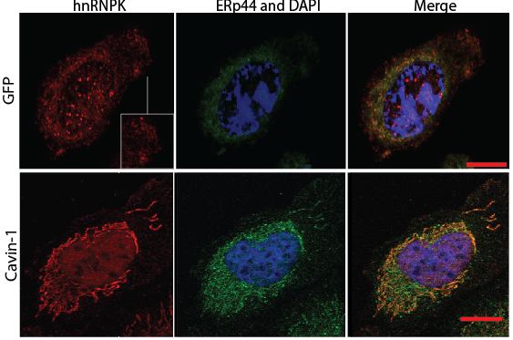
hnRNPK in ER in cavin-1 cells
ERp44 is a resident
ER protein

Slide 17
miR-ISH
Similar method to FISH
Fluorophore tagged complimentary RNA hybridizes to target

Slide 18
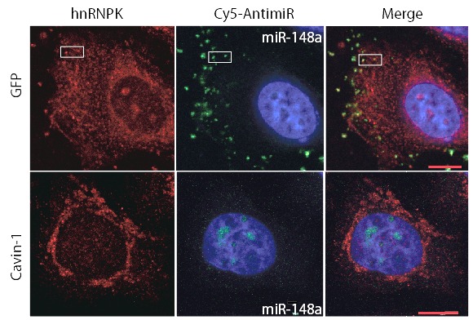
hnRNPK co-localizes with miR-148a

Slide 19
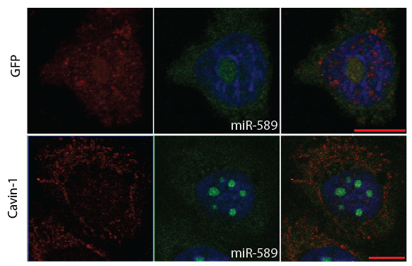
miR-589 is believed to be exported due to sampling

Slide 20
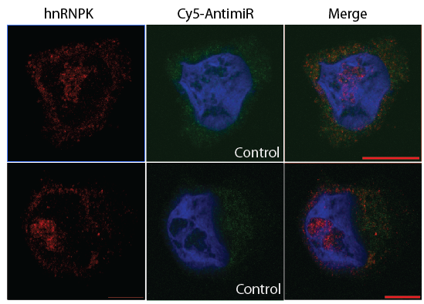
Scrambled 148a as control. Won’t bind hnRNPK or localize to nucleolus

Slide 21
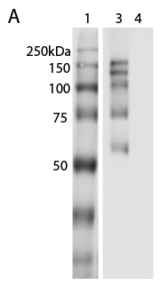
hnRNPK binds RNA
hnRNPK co-localizes with miR-148a, but does it bind?
RNA immunoprecipitation: pull down hnRNPK and its binders, including RNA.
1- ladder
3 – hnRNPK IP
4 – Control; rabbit IgG

Slide 22
hnRNPK binds RNA
 | RNA eluted (ng/µL)
Replicate | hnRNPK IP | IgG Control
1 | 11.78 | 1.40
2 | 4.20 | 0.20
3 | 14.7 | 0.80
Purified RNA bound to hnRNPK
Confirms hnRNPK-RNA interaction,
but not microRNA

Slide 23
Future:
Look into RNAs binding to see if micrornas are binding

