Slide 1
CMN260 Novel Ideas
Week 6 Tutorial: The Post-modern Novel

Slide 2
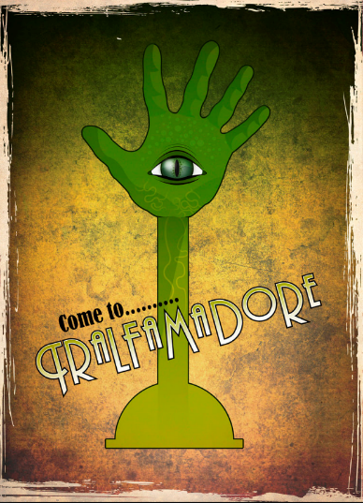
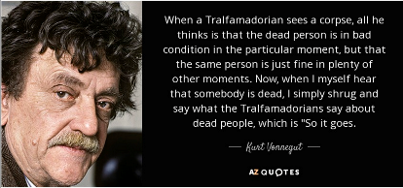
‘There is nothing intelligent to say about a massacre.’
‘And so it goes.’

Slide 3
‘And so it goes.’
Postmodernism
Reaction to/against modernism
Cultural condition of late 20th century
‘Reality’ is always in quotes
Parody, appropriation, irony, play
Self-consciously populist
Metafiction/intertextuality/
language
Deconstruction

Slide 4
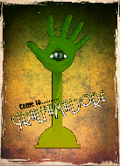
creative response
Write a postmodern piece, using some of the devices of pomo, such as irony, playfulness, black humour, parody of older forms, pastiche, intertextuality/referentiality, juxtaposition of clashing genres/images, exposure of mechanisms of production. Or try experimenting / playing with one of these:
Write backwards
Use experimental forms
Play with voice
Be ergodic (literature that requires a ‘non-trivial effort to traverse’)
Be polyphonic (includes a diversity of points of view and voices)

Slide 5
creative response
Write a postmodern piece, using some of the devices of pomo, such as irony, playfulness, black humour, parody of older forms, pastiche, intertextuality/referentiality, juxtaposition of clashing genres/images, exposure of mechanisms of production. Or try experimenting / playing with one of these:
Suggested prompts for structuring a creative response :
Write a journal entry or straight first person narrative in which the text speaks back to the writer. Play around with formatting, fonts and/or voices.
Try narrating either ‘a day in a life’ of a character who experiences an unexpected or traumatic event on the day in question backwards, starting from getting into/out of bed.
Choose a well known legend or fairy tale. Retell the tale from the POV of a minor character. The POV character could be non-human or an inanimate object. Be self-reflexive and have the character comment on the process or construction of writing. Don’t worry about anachronisms.

Slide 6
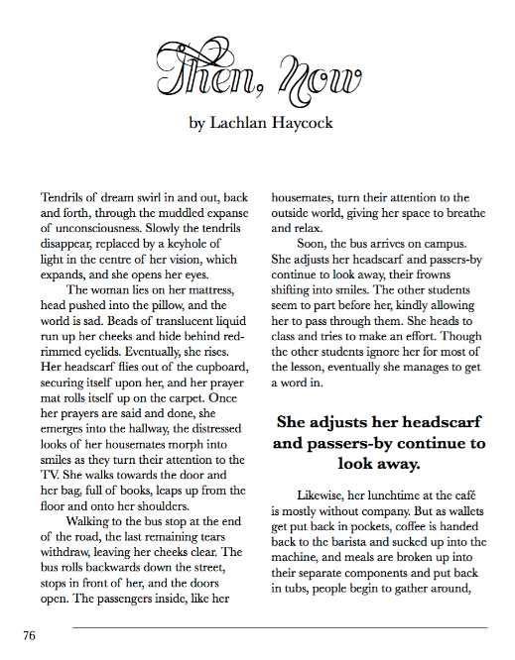
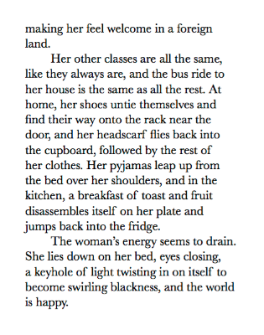
Within Without 2015 USC Creative Writing Anthology

Slide 7

critical response
What is postmodernist writing? Answer this question with reference to postmodern narrative techniques used in Slaughterhouse 5. Your answer must be supported with textual evidence from the reading, and it must include at least one academic reference.
Postmodern Narrative Techniques in Slaughterhouse 5 include:
Narrator regressus in infinitum*.
‘All this happened, more or less’
Postmodern metafiction (irony, playfulness, pastiche, parody, self-reflexivity)
Antinomacy: Reverse chronology
Refrains/repetitions : ‘so it goes’
Fragmentation
Time travel as a narrative technique (non-linear structure
* The process of going back endlessly, i.e., tracing each happening to a proceeding step

Slide 8
critical response
What is postmodernist writing? Answer this question with reference to postmodern narrative techniques used in Slaughterhouse 5. Your answer must be supported with textual evidence from the reading, and it must include at least one academic reference.
Suggested prompts for structuring your response:
‘Realism isn’t enough anymore [...].Realism presents
history as linear chronology, presents characters in the
terms of liberal humanism, allows for the possibility of
free will and responsible moral choice. But the novel
[Slaughterhouse Five] implies that events like Dresden
invalidate such liberal assumptions. They are revealed to
be inadequate fictions...’ (Waugh 1984: 128).
1.) Considering this statement by Waugh, choose one
or two postmodern narrative techniques Vonnegut
uses in the novel and discuss how these devices expose or
reveal realism to be ‘an inadequate means of portraying a
experiences like Dresden.’ (Waugh 1984: 129)
Waugh, P. 1984 Metafiction: The Theory and Practice of Self-Conscious Fiction, Methuen, New York

Slide 9
critical response
What is postmodernist writing? Answer this question with reference to postmodern narrative techniques used in Slaughterhouse 5. Your answer must be supported with textual evidence from the reading, and it must include at least one academic reference.
Suggested prompts for structuring your response:
In his prelude to Slaughterhouse Five, Kurt Vonnegut describes the novel ‘as somewhat in the telegraphic schizophrenic manner of tales of the planet Tralfamadore, where the flying saucers came from.’
2.) Considering this statement how does Vonnegut’s use
of time – ‘cyclic’ ‘historical’ and ‘personal’ – affect the
reader’s understanding of the novel as a trauma narrative?

Slide 10
critical response
What is postmodernist writing? Answer this question with reference to postmodern narrative techniques used in Slaughterhouse 5. Your answer must be supported with textual evidence from the reading, and it must include at least one academic reference.
Suggested prompts for structuring your response:
3.) Vonnegut uses black humour and irony throughout Slaughterhouse Five. What do these literary devices achieve? Do they enhance or undermine the seriousness of the subject matter Vonnegut is trying to address in the novel?
4.) What does Vonnegut achieve by placing himself as a character in the story?

Slide 11
Suggested links/readings for your critical response
Moody, J. ‘Mixing Fantasy with Fact: Kurt Vonnegut’s Use of Structure in
Slaughterhouse-Five’ in Theocrit: The Online Journal of Undergraduate
Literary Criticism and Theory 1.1 (Spring 2009): pp. 74 - 81
The Trauma of Memory and Shattering of Time in Kurt Vonnegut’s Slaughterhouse-Five and Christ Marker’s La Jetée
Personal Memory, Writing, and Mental Disorders: The Kurt Vonnegut
Syndrome
Caciedo, A. ‘“You must remember this": Trauma and Memory in Catch-22 and Slaughterhouse-Five’ in Critique: Studies in Contemporary Fiction, 46:4, pp. 357-368.

Slide 12
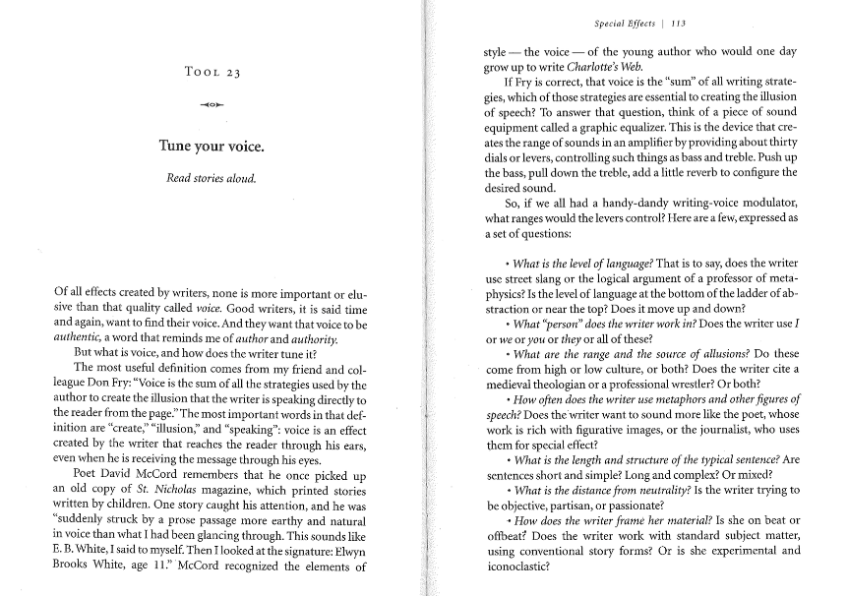
Something extra (and hopefully instructional)...
Clark, R.P (2006) Writing Tools: 50 Essential Strategies for Every Writer, Little, Brown & Co., New York

